Slide 1
MQTT
GMES workshop 22/09/21
Corentin Dupont
Waziup e.V.
Technical director
corentin.dupont@waziup.org

Slide 2
MQTT?
MQTT (Message Queue Telemetry Transport) is a publish-subscribe messaging protocol designed for lightweight M2M communications.

Slide 3
HTTP vs MQTT
MQTT Operation
Connect
Publish
Subscribe
Unsubscribe
Unconnect
HTTP Method
POST
PUT
GET
DELETE
Client/Server
Publish/Subscribe

Slide 4
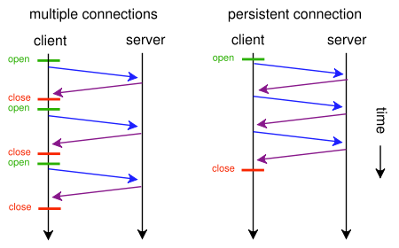
HTTP vs MQTT
HTTP
MQTT

Slide 5
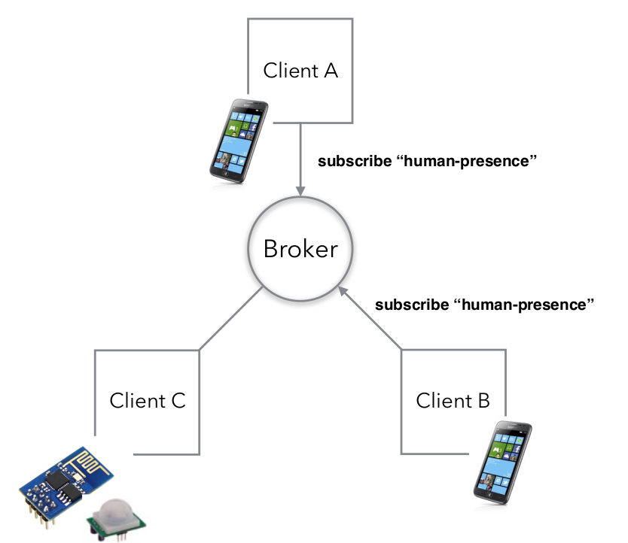
Architecture

Slide 6
Topics
myhome/livingroom/temperature
Topic level
Topic level
Topic level

Slide 7
Topics wildcards
myhome/+/temperature
Topic level
Select all rooms
myhome/#
Topic level
Select all subtopics

Slide 8
Quality of service
Fire and forget (0): Client sends message to broker. Doesn’t care what happens to it.
Deliver at least once (1): Client only destroys copy of message when acknowledgement is received from broker.
Deliver exactly once (2): Multiple levels of checks and balances until it is established that message has been sent exactly once.

Slide 9
Last Will Testament
Configure a connection to send message to a specified client in case the connecting client’s connection closes in an ungraceful manner.

Slide 10
Persistent Sessions
In the event that the client goes offline, the broker stores all messages that the client has subscribed to and notifies the client of all such messages once it comes back online.

