Slide 1
What was the rental share of family-friendly movies at Sakila?
Family friendly movies were a 37% of Sakila’s total rental orders during the period considered.
Still, non-family oriented movies took the largest share of movie rentals at Sakila.

Slide 2
How did monthly rental sales grow per store (2017)
Total rental sales were very similar at both stores. Initially sales tripled from February to March and then doubled by April. There was no grow from April to May.

Slide 3
What is the average rental time for family friendly movies in the US and International markets?
4.5 days is the average rental time for a family or non-family oriented movie regardless of where it is rented.

Slide 4
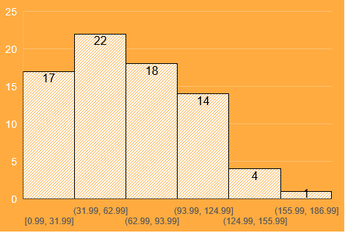
How does rental sales per customer look like in the US?
Number of customers
Most of Sakila’s US customers spent between 30 and 125 dollars at its stores. The average rental payment is approximately 50 dollars and very few customers spent more than 125 dollars.
Rental payments (US dollars, Feb-May/2017)

