Slide 1
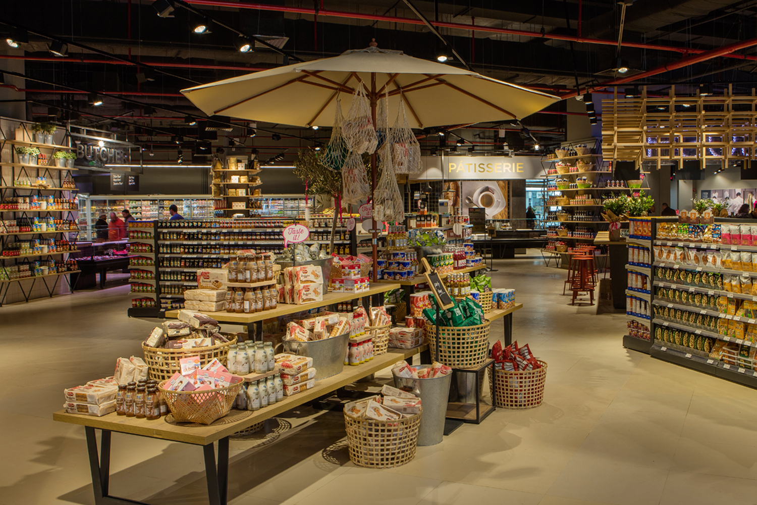
CUSTOMER SEGMENTATION
Author: Guillermo Ruiz
8th of October 2020

Slide 2
Motivation
Poor region (Burma)
Loss making company
Solid trend of economic growth
Availability of data
Overview (Otober 2019):
GDP per capita ($US): 1,299.7
GDP growth(%): 6.8
Fiscal balance (% of GDP) : -2.6
Annual inflation rate (%) : 5.9
Motivation
Data
Shiny app
Going forward

Slide 3
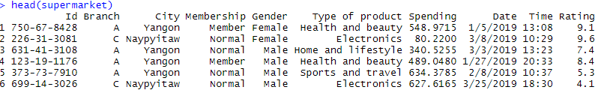
Data
1. Supermarket data
2. 1,000 observations
3. 10 variables
Motivation
Data
Shiny app
Going forward

Slide 4
Shiny app
Let´s have a close look at our customer segmentation analysis in Shiny
Motivation
Data
Shiny app
Going forward

Slide 5
Going forward
Disposable income
Age
Granular sales for products
Special offers and discounts
Bundling
Data collection
Cost analysis
Suppliers
Profits by product
Similar supermarkets (location, size, business model)
Competition
Benchmarking
Market analysis
Fastest growing cities in the country
Most profitable neightbourhoods (business model)
Motivation
Data
Shiny app
Going forward

Slide 6
THANK YOU FOR YOUR ATTENTION
Customer segmentation
8th of October, 2020
Author: Guillermo Ruiz

