Slide 1

Navigating the labor market during covid
Guillermo Ruiz
11 December 2020

Slide 2
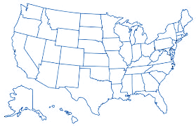
Motivation
The objective of this project:
is not providing an explanation of the general impact of COVID in the labor market
is to provide a snapshot of the job market to identify opportunities during the pandemic
GDP per capita ($US): 1,299.7
GDP growth(%): 6.8
Fiscal balance (% of GDP) : -2.6
Annual inflation rate (%) : 5.9
COVID pandemic
Economic slowdown
Effects on the labor market
Motivation
Data
Figures
Conclusions

Slide 3
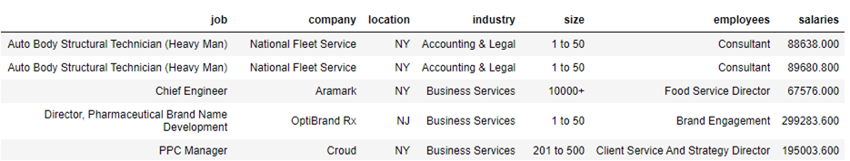
Data
1. Web Scraping Glassdoor
2. 563 observations
3. 7 variables
Motivation
Data
Figures
Conclusions

Slide 4
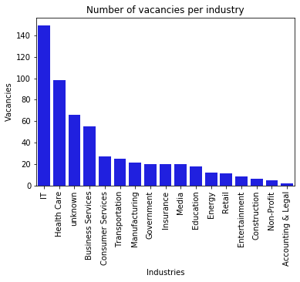
Number of vacancies per industry
Motivation
Data
Figures
Conclusions

Slide 5
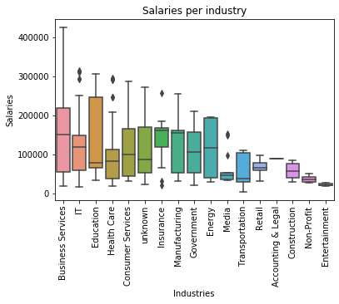
Salaries per industry
Motivation
Data
Figures
Conclusions

Slide 6
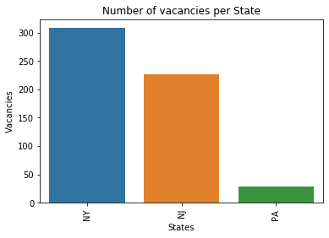
Number of vacancies per State
Motivation
Data
Figures
Conclusions

Slide 7
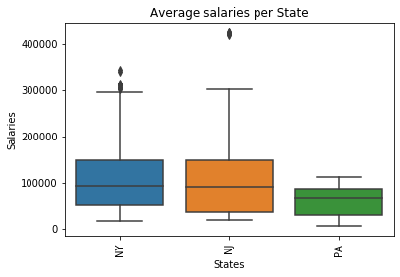
Average salaries per State
Motivation
Data
Figures
Conclusions

Slide 8
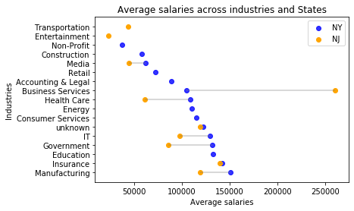
Average salaries across industries and States
Motivation
Data
Figures
Conclusions

Slide 9
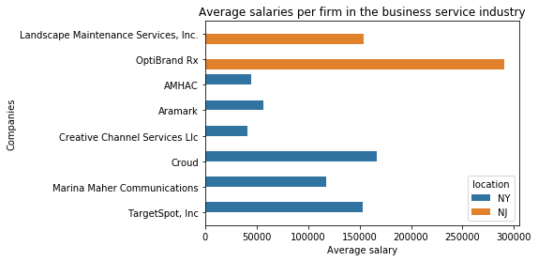
Average salaries per firm in business service industry
Motivation
Data
Figures
Conclusions

Slide 10
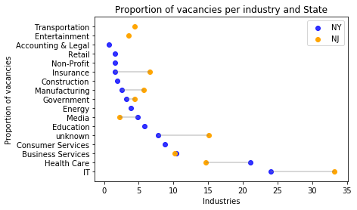
Proportion of vacancies per industry and State
Motivation
Data
Figures
Conclusions

Slide 11
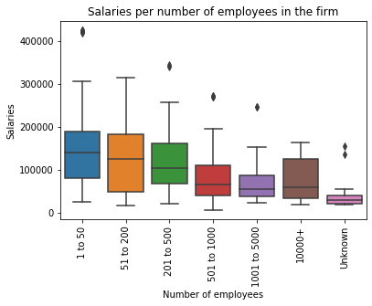
Salaries per number of employees in the firm
Motivation
Data
Figures
Conclusions

Slide 12
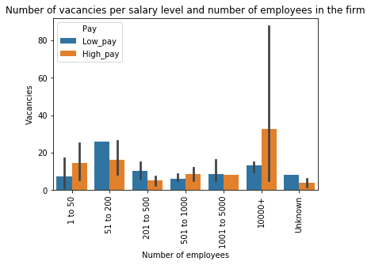
Number of vacancies per salary level and nº of employees
Motivation
Data
Figures
Conclusions

Slide 13
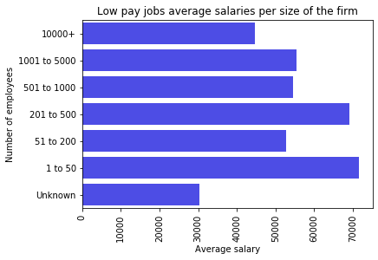
Low pay jobs average salaries per nº of employees
Motivation
Data
Figures
Conclusions

Slide 14
Conclusions
There are big differences in average wages and number of vacancies across industries.
IT and healthcare offer the best economic opportunities in the pandemic.
Industries
States
The state of New York offers higher average salaries than the other states. This can partly be a consequence of higher health risk as a function of population density.
For high skilled workers, companies with a high number of employees stand as a better choice than smaller ones.
For low skilled workers, smaller companies are a better choice.
Firm size
Data collection
Increase number of observations by web scraping several job portals (LinkedIn).
Repeatedly web scrape Glassdoor
Motivation
Data
Figures
Conclusions

Slide 15
THANK YOU FOR YOUR ATTENTION
Navigating the labor market during COVID:
a snapshot from three states
Guillermo Ruiz
11 December 2020

