Slide 1

DjangoHomeStation
Google Drive
WebPhotoFrame
GoogleService
AlexaClient
AlexaService
Alexa
BluetoothService

Slide 2
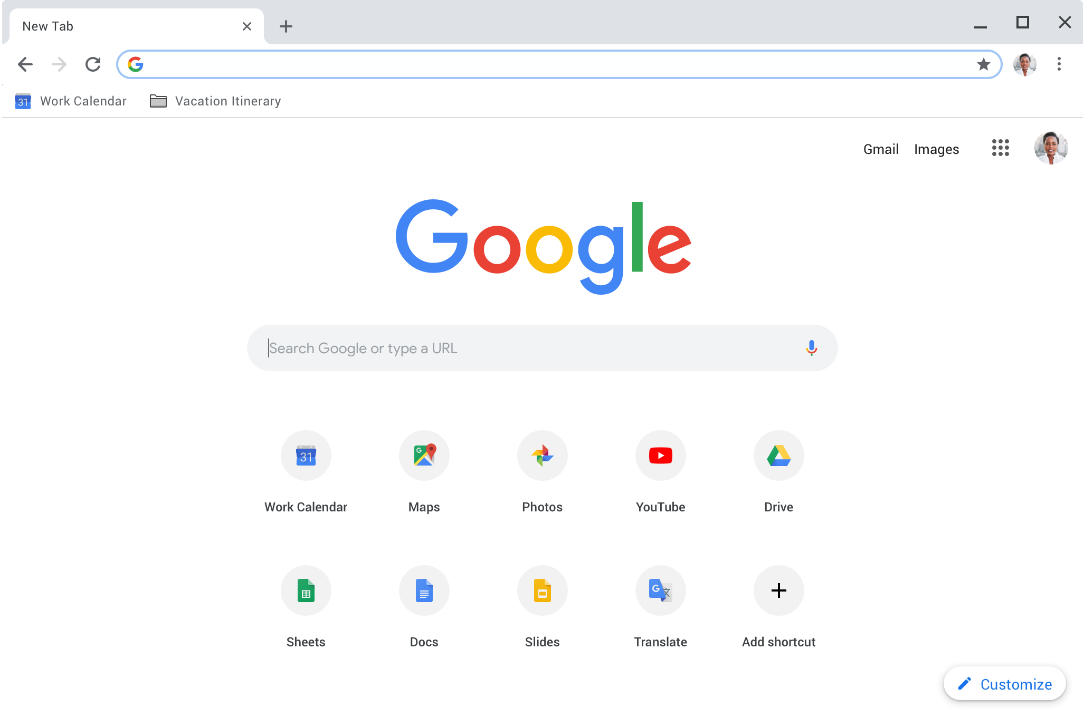



DjangoHomeStation
WebPhotoFrame
Description of photo
Guille, Felix, Alberto
GoogleService
AlexaClient
Available People:
+ Add
Person 1
…
AlexaService
Description: bla bla
How is here: Guille
Date:
Location: Asturias
Points:
Group:
BluetoothService

