Slide 1
DIS-Translation
french translation experience
February 2020

Slide 2
Concepts
Installation and Usage

Slide 3
concepts

Slide 4


How it works
Translator “tr_fr.cmd”
Translation
“input” directory with the messages files in English
“output_fr” directory with the messages files translated to French
English to French database
“db_fr” directory
“jar” directory with JAR files in French
Deployment
“output_fr” directory with the messages files translated to French
JAR file generator “crea_jars_fr.cmd”

Slide 5
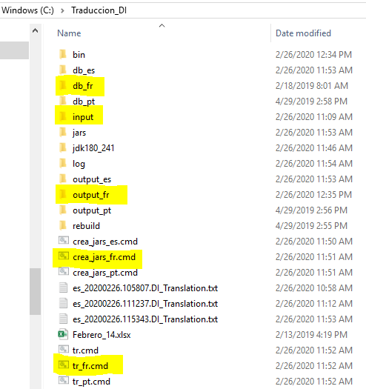
How it Works – directories & tools

Slide 6
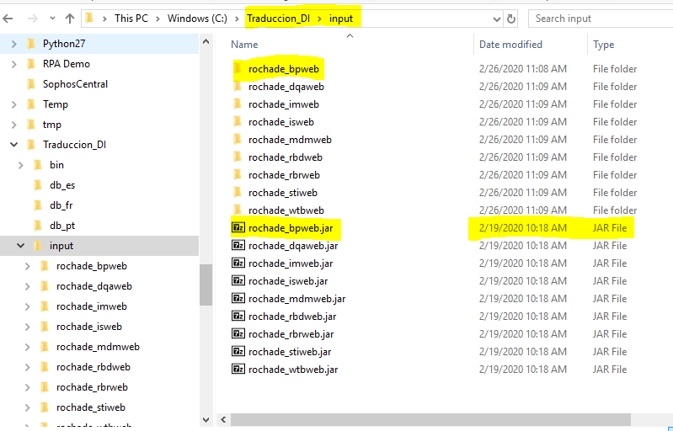
How it works
The program takes as input all the subdirectories in “input” directory.
The files *.jar have been copied from the current 9.9 installation and they contain the original files with the messages in English.
Each jar file have been decompressed in their corresponding subdirectory under “input”.
When a new versión is available, this directory should be updated.

Slide 7
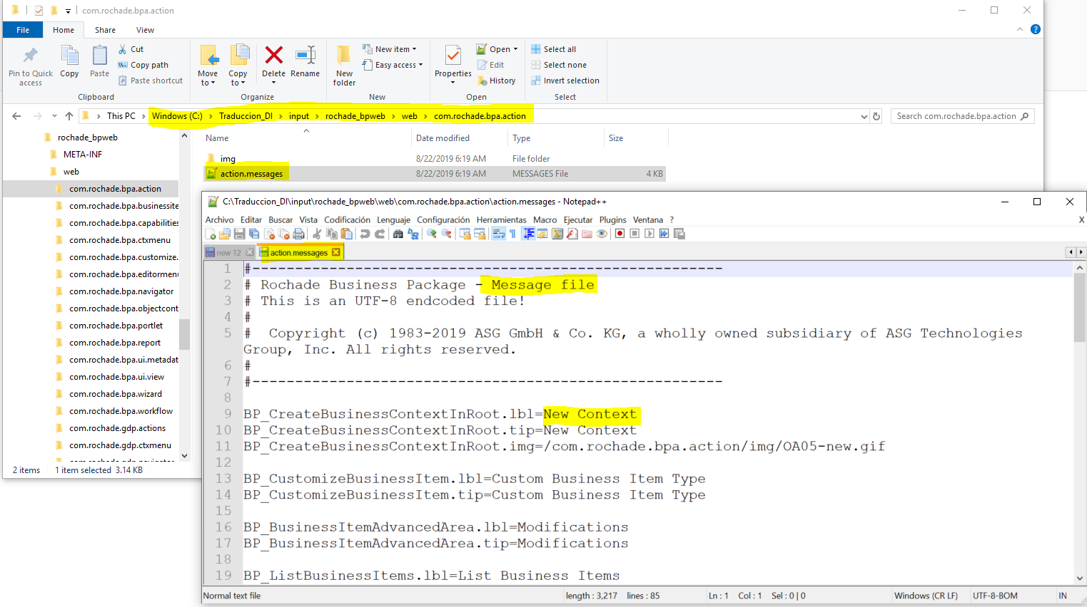
How it Works- input directory

Slide 8
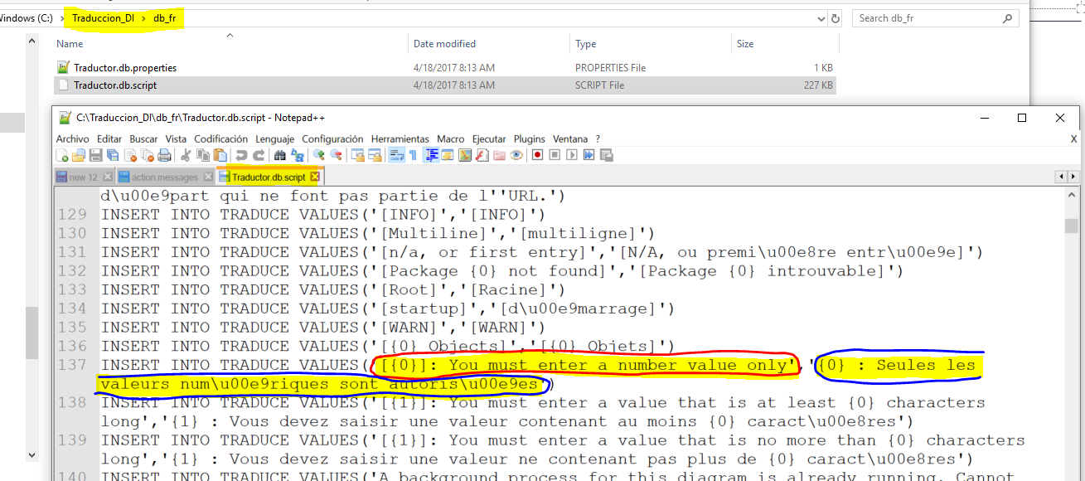
How it Works- db_fr directory

Slide 9
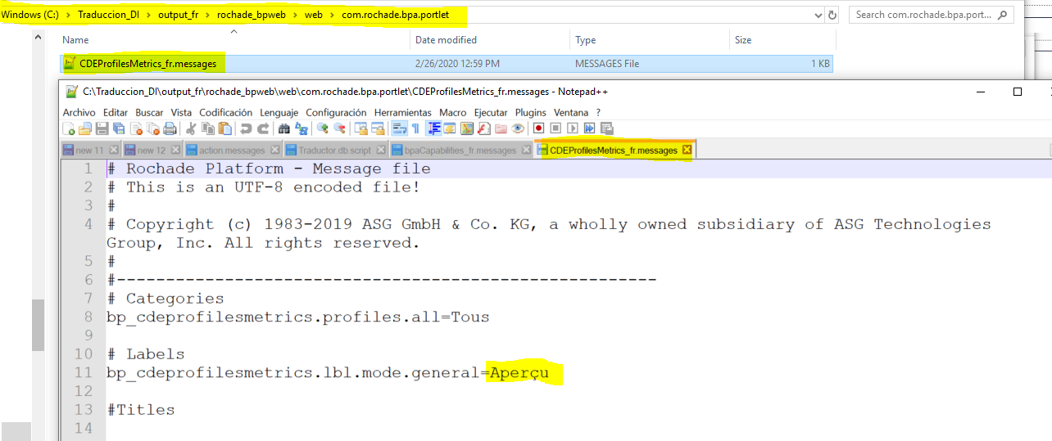
How it Works- output_fr directory
After the execution of “tr_fr.cmd -t”

Slide 10
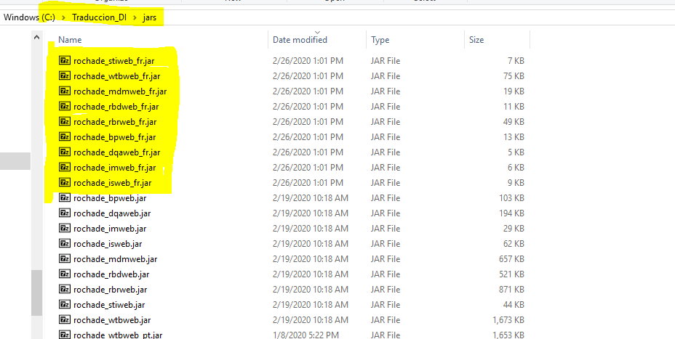
How it Works- JARS directory
After the execution of crea_jars_fr.cmd

Slide 11
installation

Slide 12
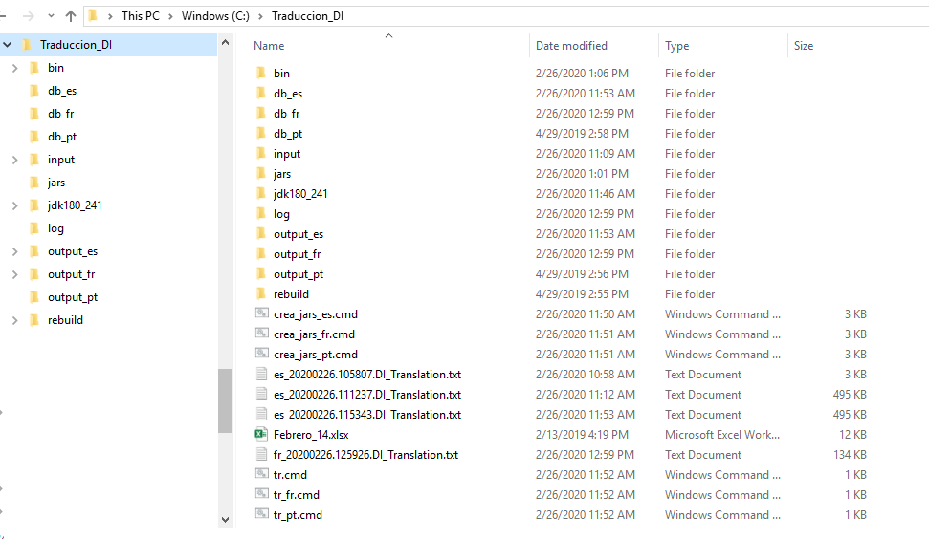
installation
Uncompress Traduccion_DI.zip

Slide 13
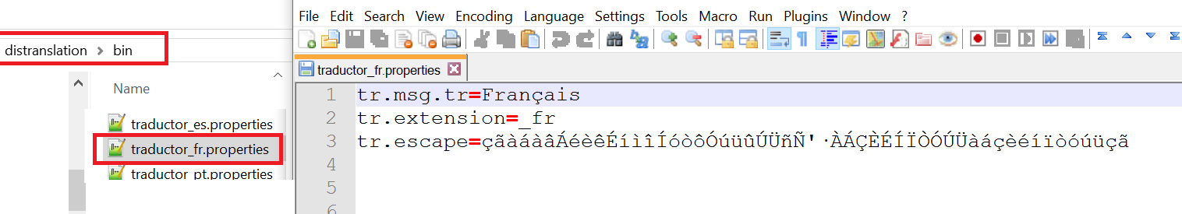
installation
BIN directory
It contains the runtime. Traductor.jar (it includes the java source), and traductor_##.properties, where ## is the language
tr.msg.tr =It contains the label that will be included in the translated files
tr.extension=The suffix that will be added to the messages file(translated)
tr.escape=list of characters to be escaped

Slide 14
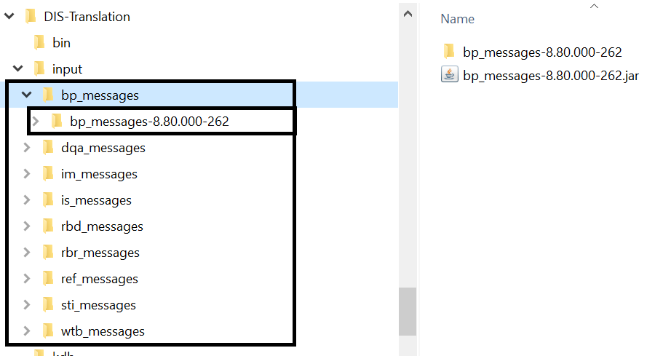
Installation
input directory
It contains the original messajes files in English
Download and update the messages files from the URLs below, and keeping the directory structure with xxx_messages, and uncompress the original JARs (in English) within the corresponding xxx_messages directory
bin/Readme.txt
• bp_messages: http://gechemmu10.asg.com:8080/hudson/view/metaRDM/job/iMetaBusinessPackage-gradle/
• dqa_messages http://gechemmu10.asg.com:8080/hudson/job/Rochade_DQA_gradle/
• im_messages: http://gechemmu10.asg.com:8080/hudson/view/metaRDM/job/iMetaIssueMan-gradle/
• is_messages: http://gechemmu10.asg.com:8080/hudson/job/Index_Search/
• rbd_messages: http://gechemmu10.asg.com:8080/hudson/view/Ro.Browser+iMetaGlossary/job/RoBrowser/
• rbr_messages: http://gechemmu10.asg.com:8080/hudson/view/Ro.Browser+iMetaGlossary/job/RoBrowser/
• ref_messages: http://gechemmu10.asg.com:8080/hudson/view/metaRDM/job/iMetaRDM-gradle/
• sti_messages: http://gechemmu10.asg.com:8080/hudson/view/Ro.Browser+iMetaGlossary/job/RoBrowser/
• wtb_messages: http://gechemmu10.asg.com:8080/hudson/view/Ro.Platform/job/Rochade_Platform/

Slide 15
Usage - options

Slide 16
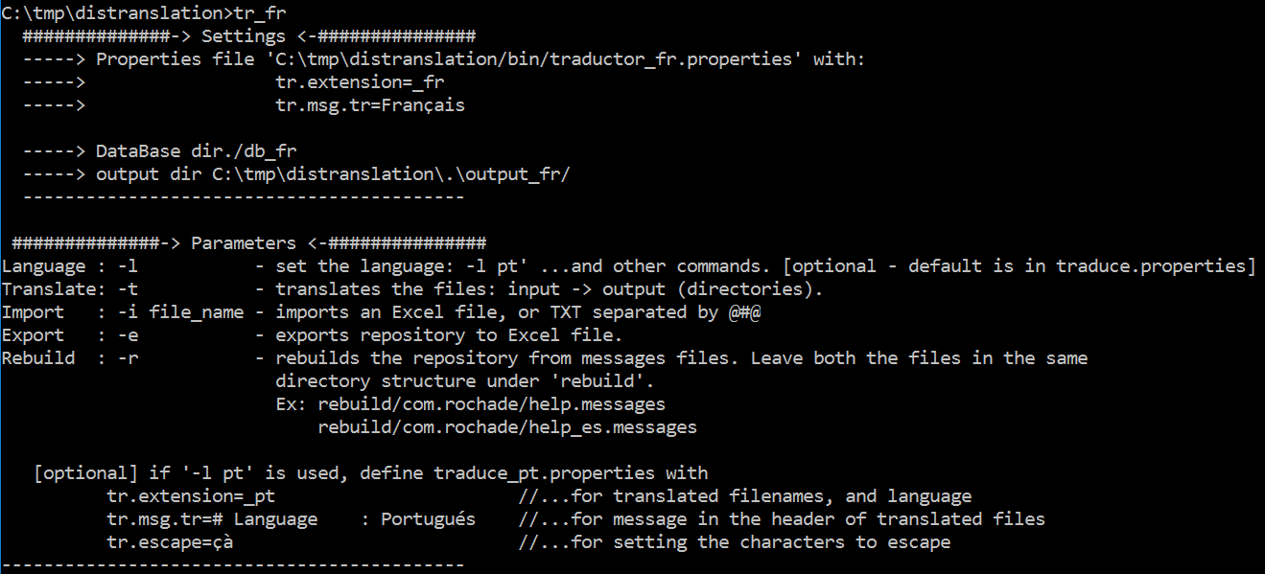
usage
Options
Current settings
Options

Slide 17
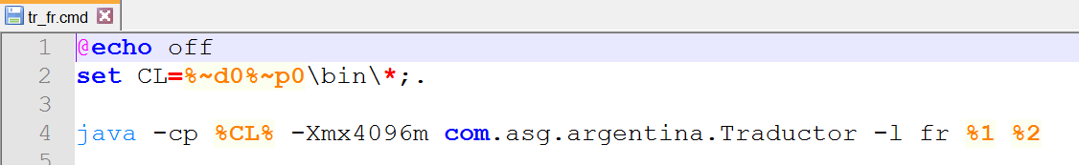
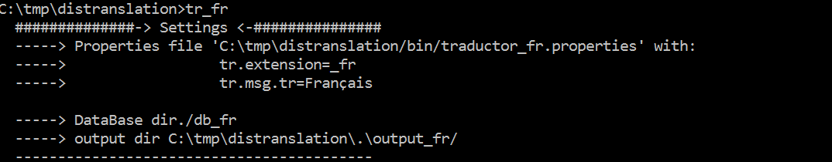
usage
tr_fr.cmd
tr_fr.cmd has the language fr by default
When tr_fr.cmd is executed output_fr, and db_fr directories are created
Language setting

Slide 18
rebuild

Slide 19
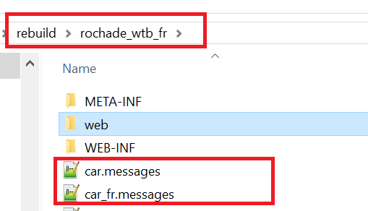
Usage -rebuild
This option allows to reuse previous translations

Slide 20
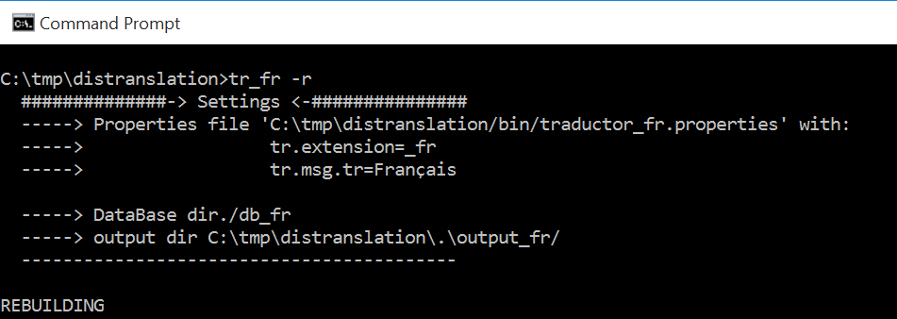
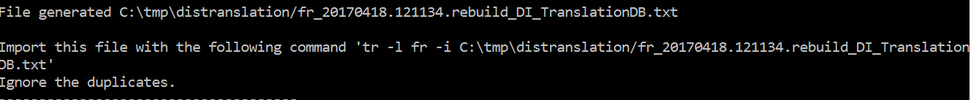
Usage -rebuild
command
output
“tr_fr –r” takes the pairs of files: english and french into “rebuild” directory, and it generates the file:
fr_%TM%.rebuild_DI_TrasnlationDB.txt, each line of this file, it contains the english-french phases taken from each individual file in rebuild directory
The next step is to import the generated file in the repository.

Slide 21
import

Slide 22
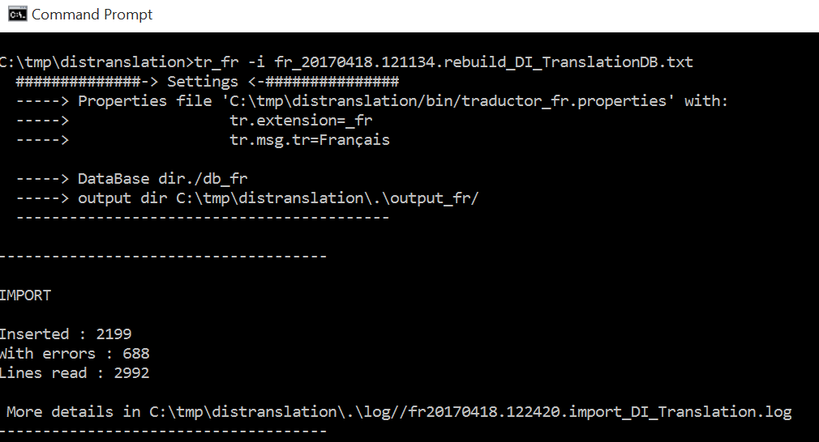
Usage - import
Import the translations from the previous “rebuild”
command
The database is updated/created
Errors by rows duplicated
Log with details of errors

Slide 23
translation

Slide 24
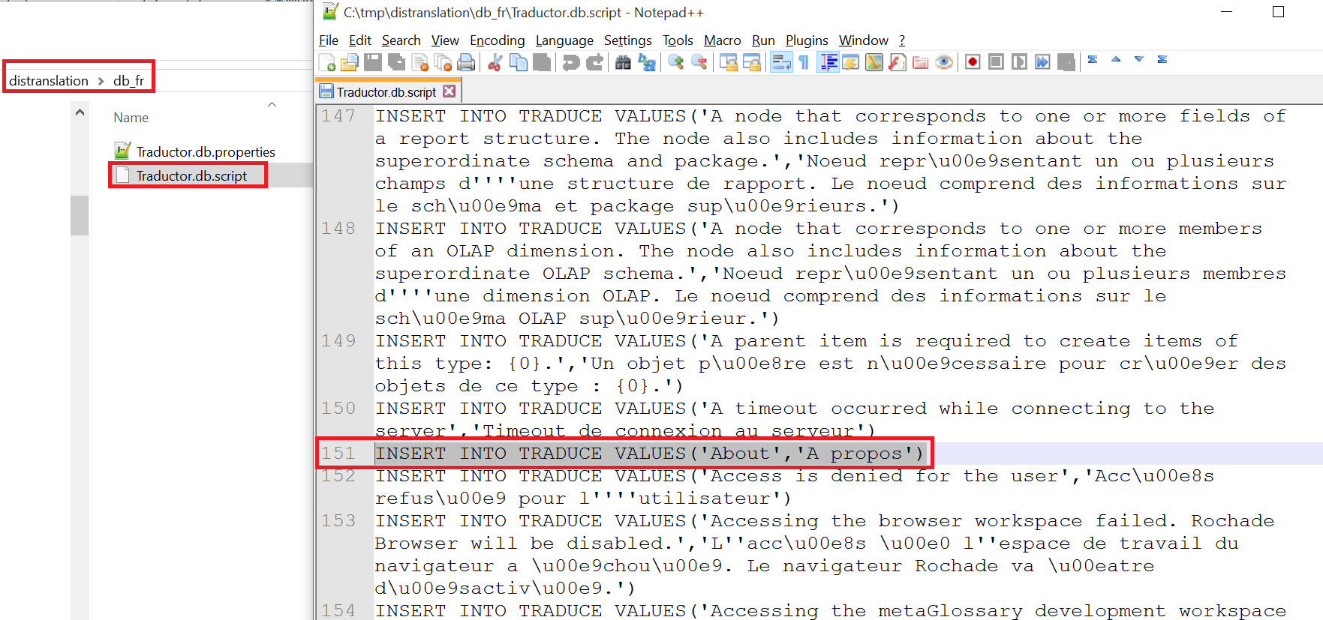
Usage - translation
Pre-requisite
Before executing the translation, verify if the database in db_fr has at least one translated term

Slide 25
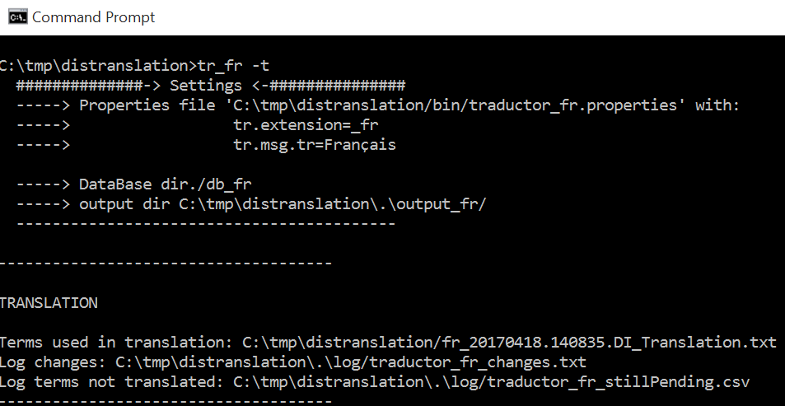
Usage - translation
command
tr_fr.cmd command takes the files in English from input directory, and using db_fr database, it generates the translation in output_fr
Import the translations from the previous “rebuild”
Translated files are generated under output_fr
Verify the translation
To continue with the translation

Slide 26
Translation – adding/updating

Slide 27
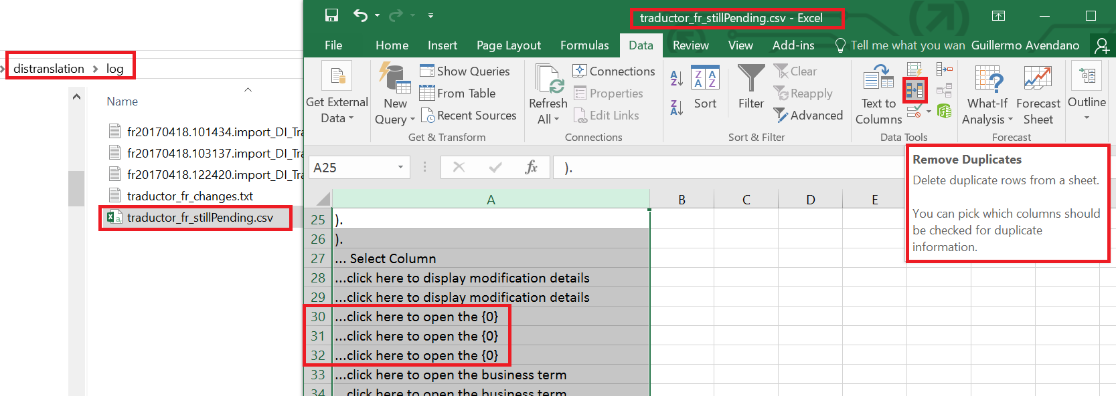
Translation – adding/updating
traductor_fr_stillPending.csv
traductor_fr_stillPending.csv contains the messages still not translated.
Open this file with excel, and SORT AND REMOVE DUPLICATES

Slide 28
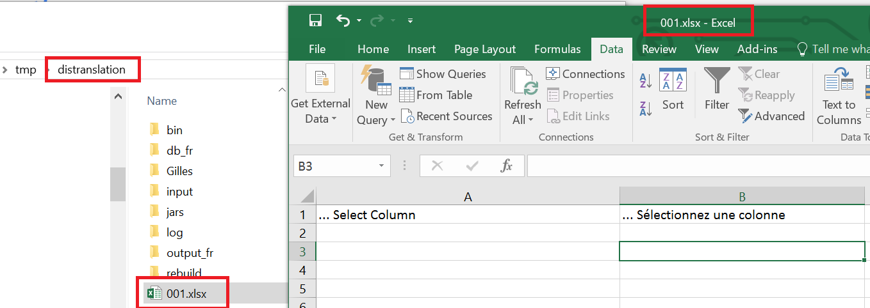
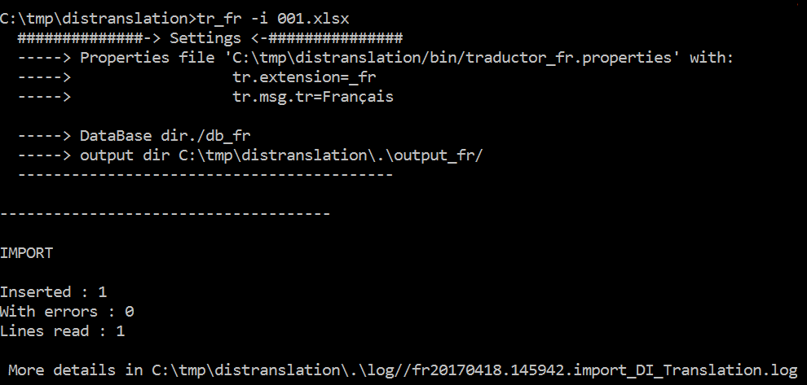
Translation – adding/updating
Save the file as XLSX in the root directory, and add the new translations.
Import the new translated phrases
command

Slide 29
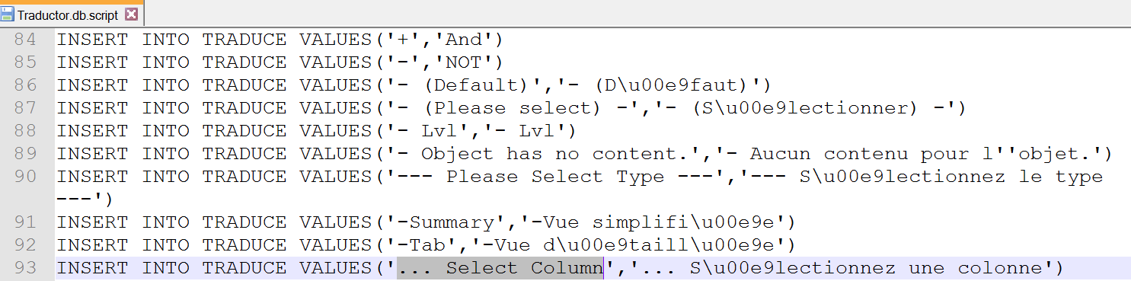
Translation – adding/updating
Optionally – verify if the ítems have been loaded into the database “db_fr”

Slide 30
export

Slide 31
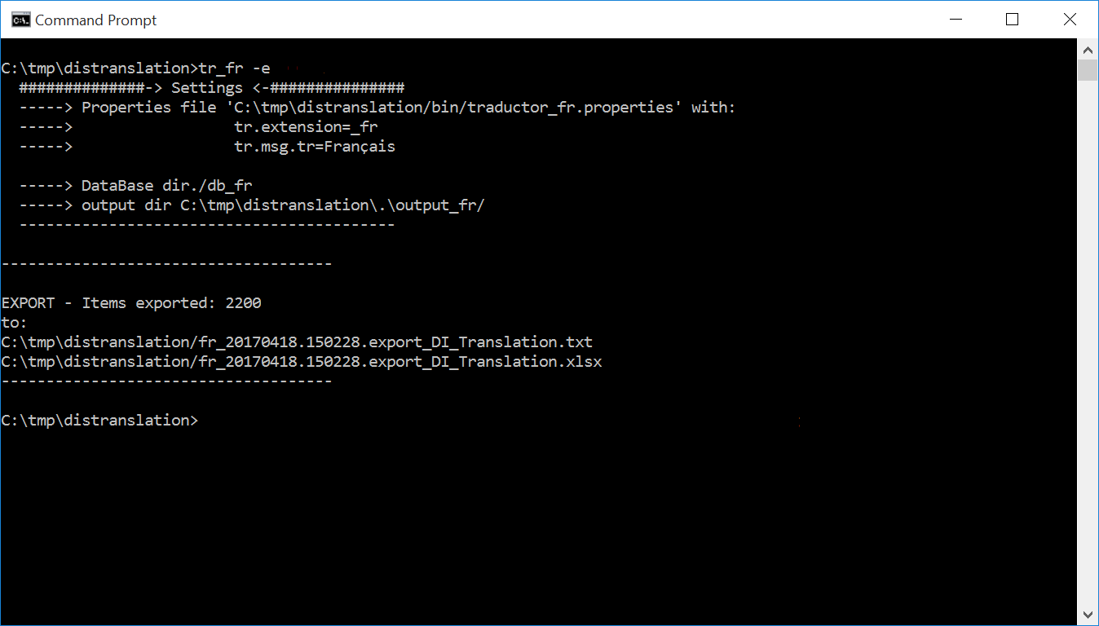
Usage - export
Use export for doing a backup and/or recreate the database if needed
command
Save this file

Slide 32
Create jars with translated files

Slide 33
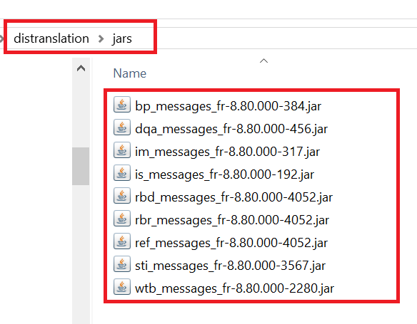
Create translated jar files
Crea_jars_fr.cmd
crea_jars_fr.cmd, it creates the jar files, with the translated files into jars directory.
This script uses the translated files into output_fr directory (generated by “tr_fr.cmd –t”)

Slide 34
THANK YOU

