Slide 1
DIS-Translation
french translation experience
April 2017

Slide 2
Agenda
Installation and Usage

Slide 3
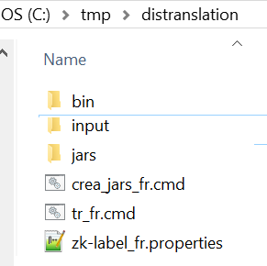
installation
Uncompress distranslation.zip file and create a directory structure like this

Slide 4
installation

Slide 5
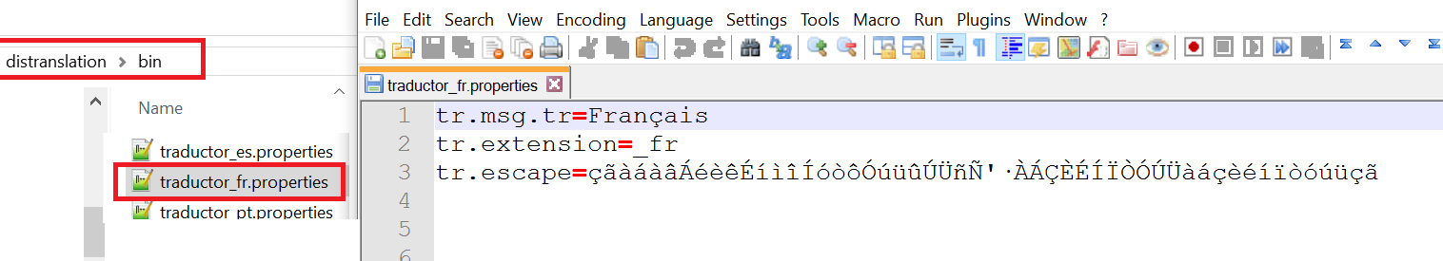
installation
BIN directory
It contains the runtime. Traductor.jar (it includes the java source), and traductor_##.properties, where ## is the language
tr.msg.tr =It contains the label that will be included in the translated files
tr.extension=The suffix that will be added to the messages file(translated)
tr.escape=list of characters to be escaped

Slide 6
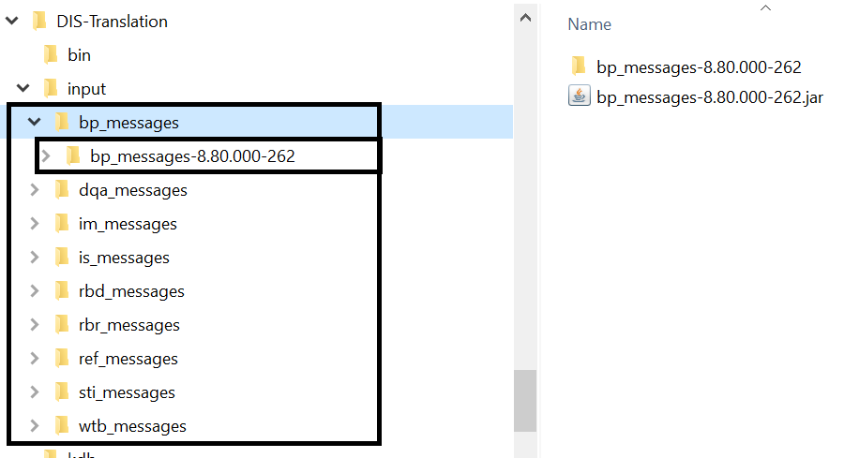
Installation
input directory
It contains the original messajes files in English
Download and update the messages files from the URLs below, and keeping the directory structure with xxx_messages, and uncompress the original JARs (in English) within the corresponding xxx_messages directory
bin/Readme.txt
• bp_messages: http://gechemmu10.asg.com:8080/hudson/view/metaRDM/job/iMetaBusinessPackage-gradle/
• dqa_messages http://gechemmu10.asg.com:8080/hudson/job/Rochade_DQA_gradle/
• im_messages: http://gechemmu10.asg.com:8080/hudson/view/metaRDM/job/iMetaIssueMan-gradle/
• is_messages: http://gechemmu10.asg.com:8080/hudson/job/Index_Search/
• rbd_messages: http://gechemmu10.asg.com:8080/hudson/view/Ro.Browser+iMetaGlossary/job/RoBrowser/
• rbr_messages: http://gechemmu10.asg.com:8080/hudson/view/Ro.Browser+iMetaGlossary/job/RoBrowser/
• ref_messages: http://gechemmu10.asg.com:8080/hudson/view/metaRDM/job/iMetaRDM-gradle/
• sti_messages: http://gechemmu10.asg.com:8080/hudson/view/Ro.Browser+iMetaGlossary/job/RoBrowser/
• wtb_messages: http://gechemmu10.asg.com:8080/hudson/view/Ro.Platform/job/Rochade_Platform/

Slide 7
Usage - options

Slide 8
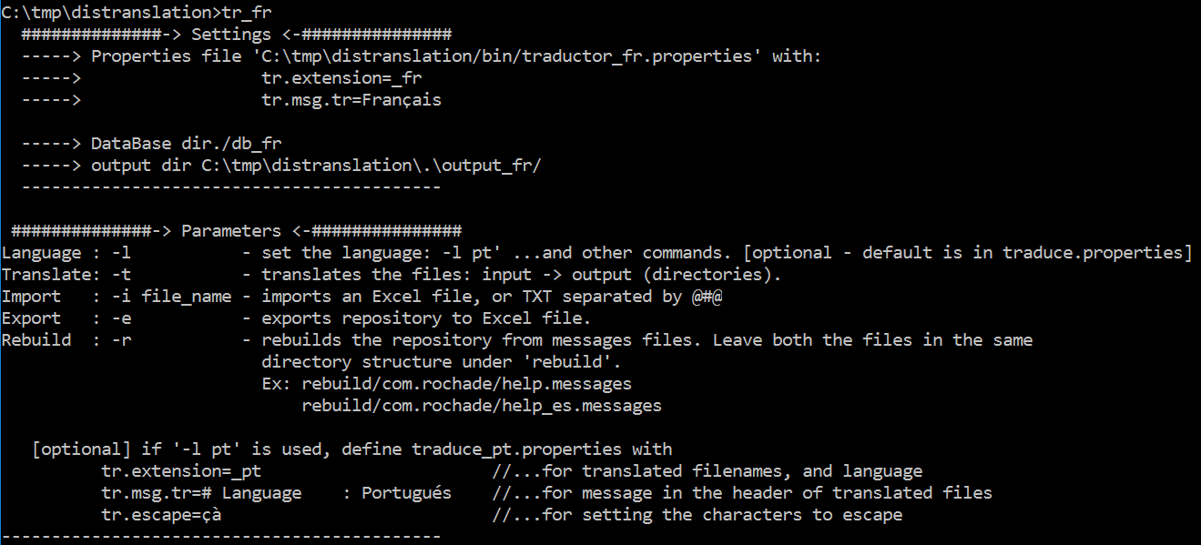
usage
Options
Current settings
Options

Slide 9
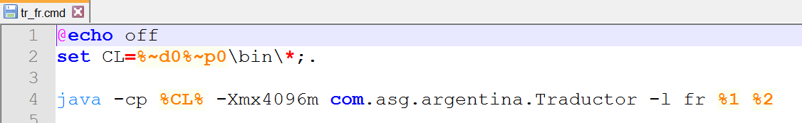
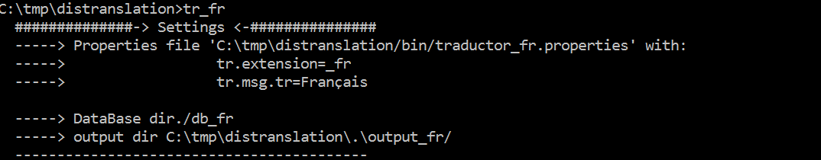
usage
tr_fr.cmd
tr_fr.cmd has the language fr by default
When tr_fr.cmd is executed output_fr, and db_fr directories are created
Language setting

Slide 10
rebuild

Slide 11
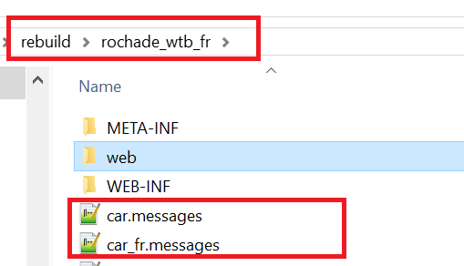
Usage -rebuild
This option allows to reuse previous translations

Slide 12
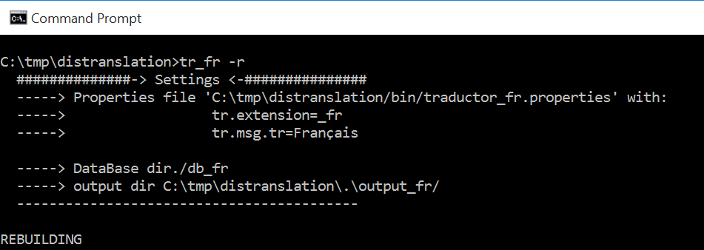
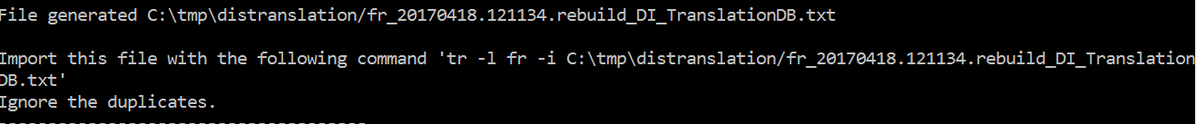
Usage -rebuild
command
output
“tr_fr –r” takes the pairs of files: english and french into “rebuild” directory, and it generates the file:
fr_%TM%.rebuild_DI_TrasnlationDB.txt, each line of this file, it contains the english-french phases taken from each individual file in rebuild directory
The next step is to import the generated file in the repository.

Slide 13
import

Slide 14
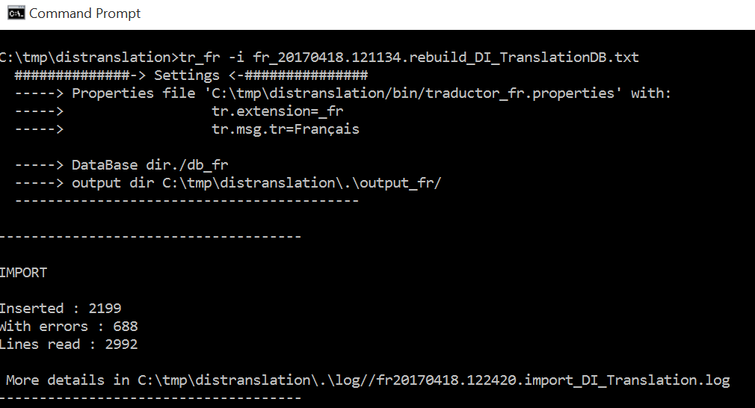
Usage - import
Import the translations from the previous “rebuild”
command
The database is updated/created
Errors by rows duplicated
Log with details of errors

Slide 15
translation

Slide 16
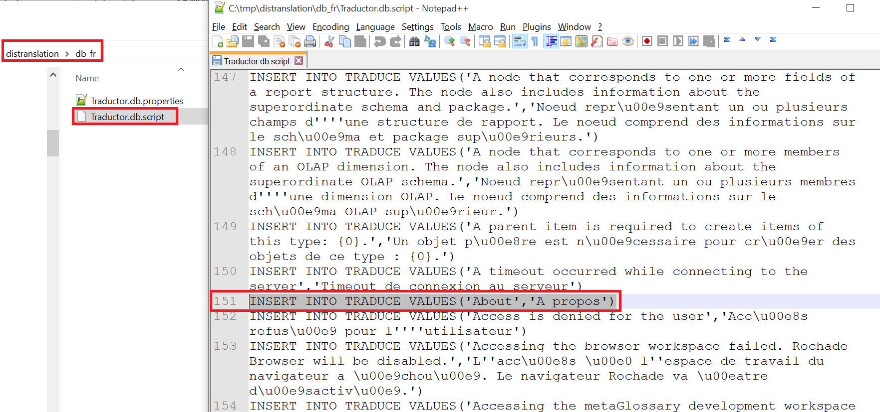
Usage - translation
Pre-requisite
Before executing the translation, verify if the database in db_fr has at least one translated term

Slide 17
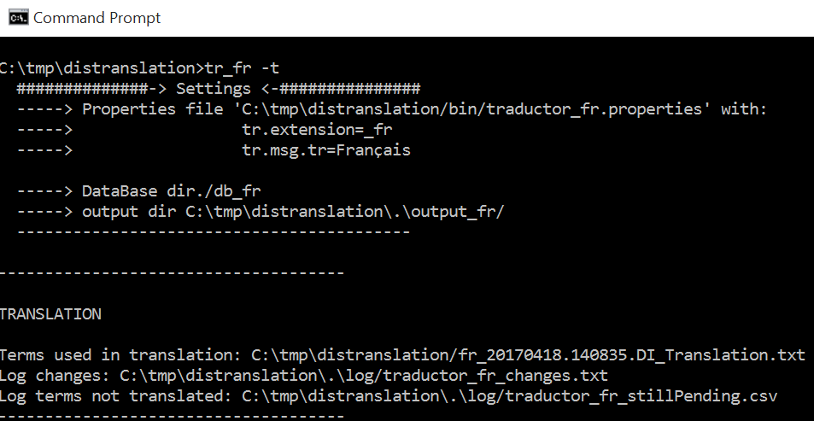
Usage - translation
Import the translations from the previous “rebuild”
command
tr_fr.cmd command takes the files in English from input directory, and using db_fr database, it generates the translation in output_fr
Translated files are generated under output_fr
Verify the translation
To continue with the translation

Slide 18
Translation – adding/updating

Slide 19
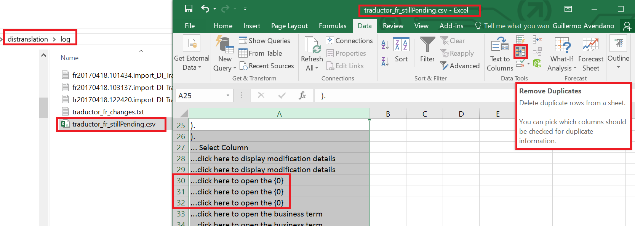
Translation – adding/updating
traductor_fr_stillPending.csv
traductor_fr_stillPending.csv contains the messages still not translated.
Open this file with excel, and SORT AND REMOVE DUPLICATES

Slide 20
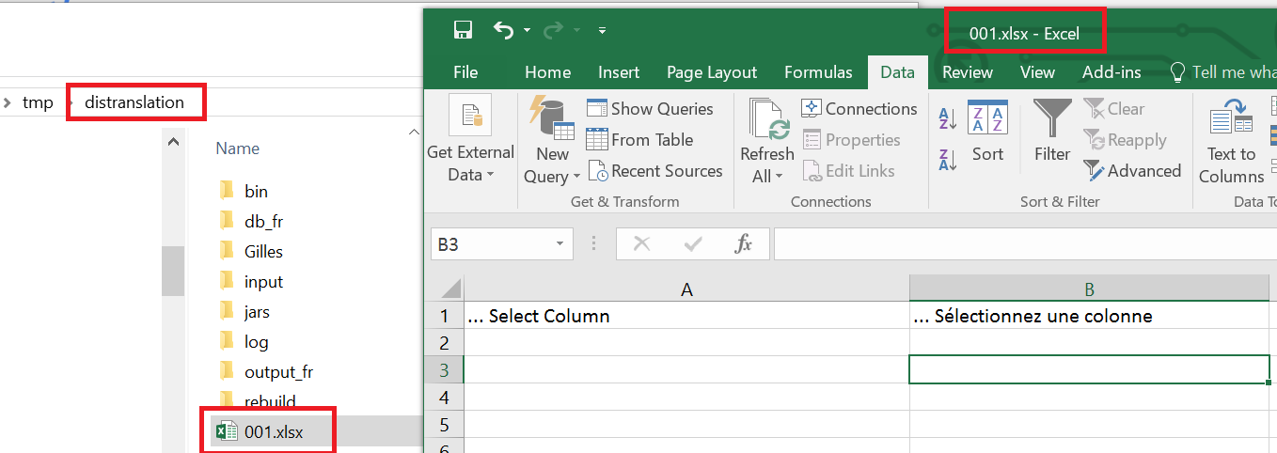
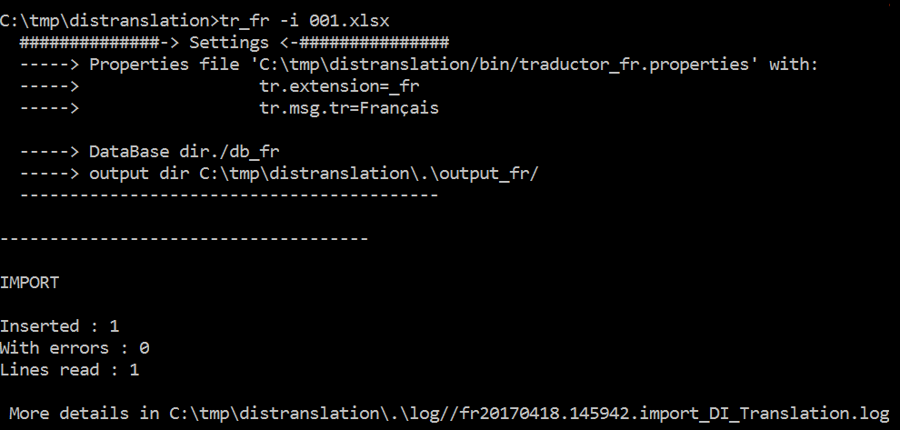
Translation – adding/updating
Save the file as XLSX in the root directory, and add the new translations.
Import the new translated phrases
command

Slide 21
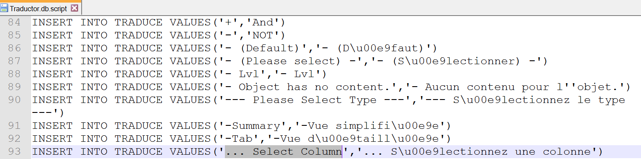
Translation – adding/updating
Optionally – verify if the ítems have been loaded into the database “db_fr”

Slide 22
export

Slide 23
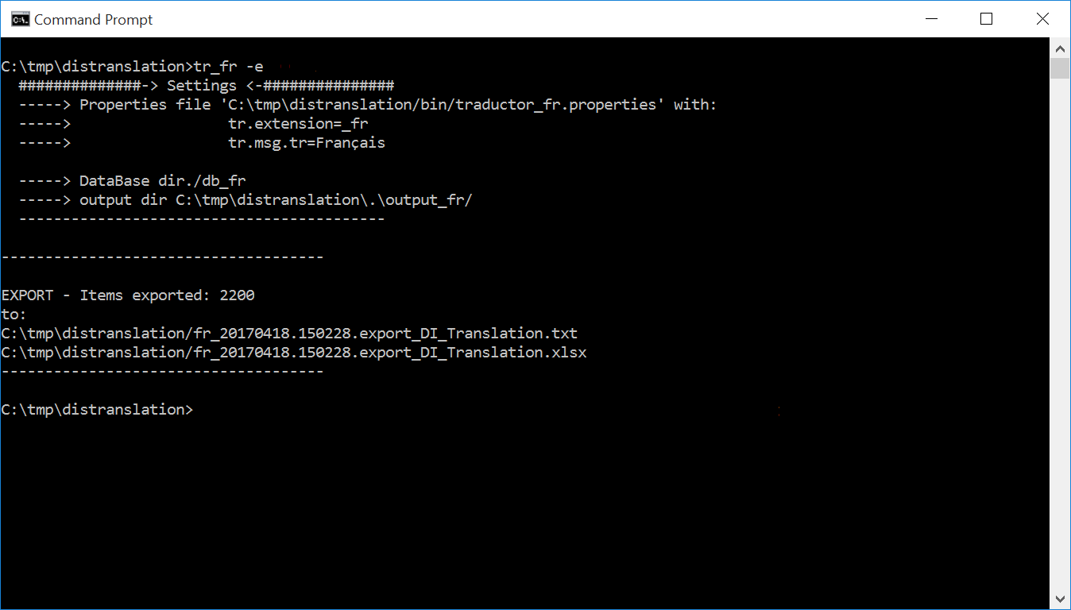
Usage - export
Use export for doing a backup and/or recreate the database if needed
command
Save this file

Slide 24
Create jars with translated files

Slide 25
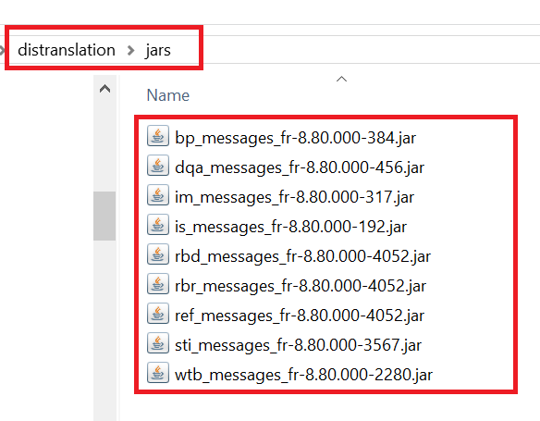
Create translated jar files
Crea_jars_fr.cmd
crea_jars_fr.cmd, it creates the jar files, with the translated files into jars directory.
This script uses the translated files into output_fr directory (generated by “tr_fr.cmd –t”)

Slide 26
THANK YOU

