Slide 1


Slide 2
TEAM
Guillermo Blasco
Adriana Freitas
Francesc Roca

Slide 3
MARKET OVERVIEW
Conservative garbage collection disadvantages:
High cost of administration and operation
Low efficiency and few quality of service
Bad citizens experience,
Garbage out of the containers
- Few visibility of incidences

Slide 4
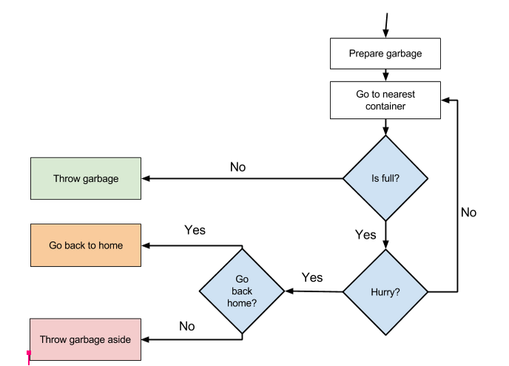
CONSERVATIVE GARBAGE COLLECTION

Slide 5
SOLUTION OVERVIEW PHASE I
What happened?
- Notify users when the nearest container is full and empty
- Notify administration when the containers are full
Benefits :
Users knows when is the best moment to throw garbage
Administrators knows when garbage has to be collected
Administrators have full visibility of incidences, containers and vehicles
Required data:
User input when containers are full or have incidences
Information when containers are full / empty

Slide 6
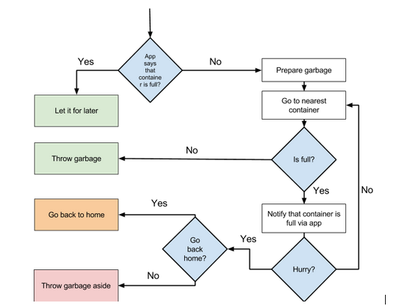
SOLUTION OVERVIEW PHASE I

Slide 7
SOLUTION OVERVIEW PHASE II
Why happened that?
Issues in the garbage collection plan → notify users
Change of user’s behaviour → modify collection plan
Benefits:
- Users knows the status of the service and have better experience
- Administration have enough information to review collection plans
Required data:
- Geospatial data of garbage collectors to detect incidences
- Traffic and weather data
- Data of incidences in garbage collection system

Slide 8
SOLUTION OVERVIEW PHASE III
What shall happen?
Forecast the fill rate of containers → fill rate prediction for users
Inform administration of the fill rate of all containers at future hours
Benefits:
- Users can plan its actions → save time
- Administrators can prepare plans with forecast
Required data:
- Time series data of garbage mass of containers from sensors

Slide 9
SOLUTION OVERVIEW PHASE IV
What we should do to maximize success?
- Suggest users best moment for throw the garbage
- Automatic collection plan update
Benefits :
Users knows in real time the status of the containers
Administrators can offer the best service at the lowest cost

Slide 10
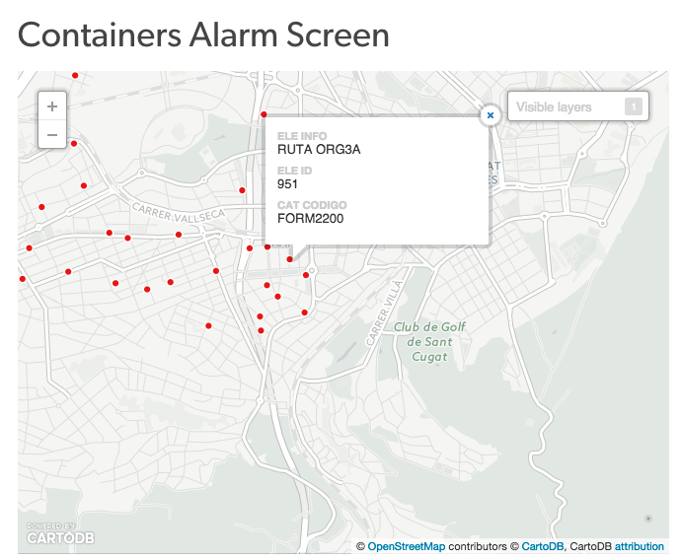
PROTOTYPE
Analysing Data

Slide 11
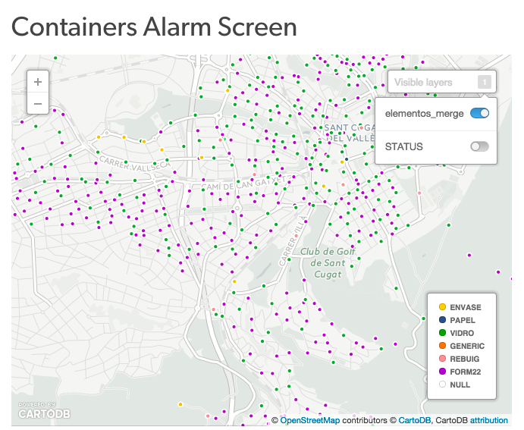
PROTOTYPE
Analysing Data

Slide 12
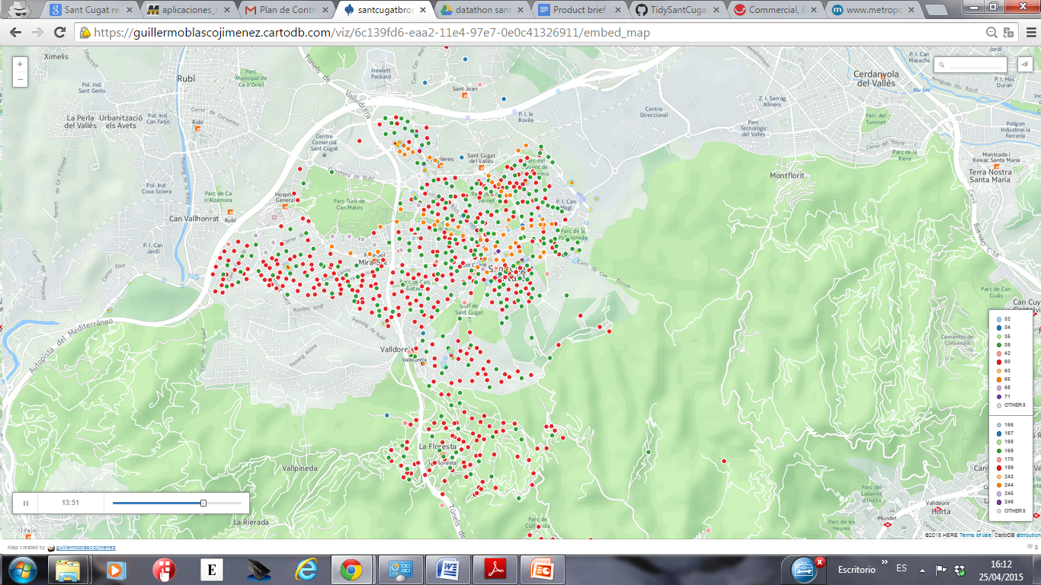
PROTOTYPE
Visualizing container types and vehicle tracking

Slide 13
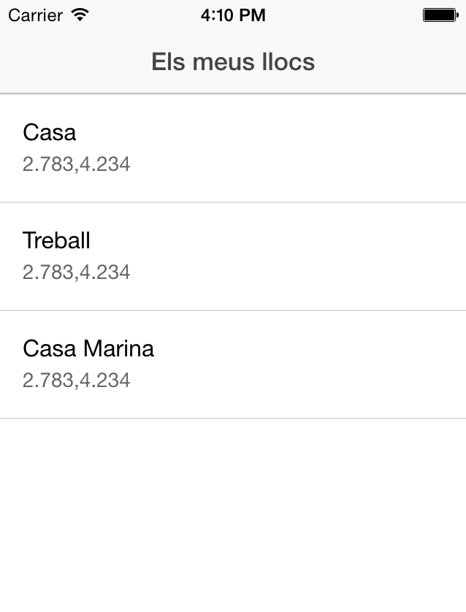
PROTOTYPE
App

Slide 14
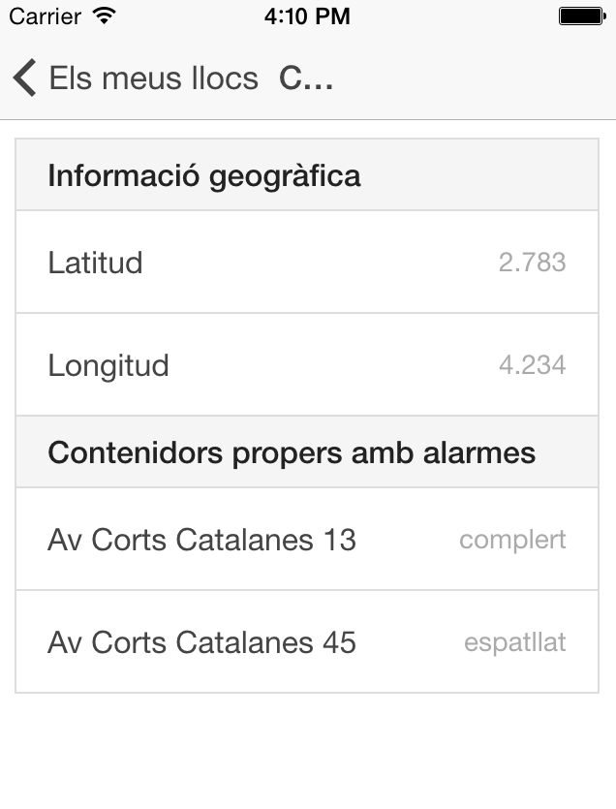
PROTOTYPE
App

Slide 15
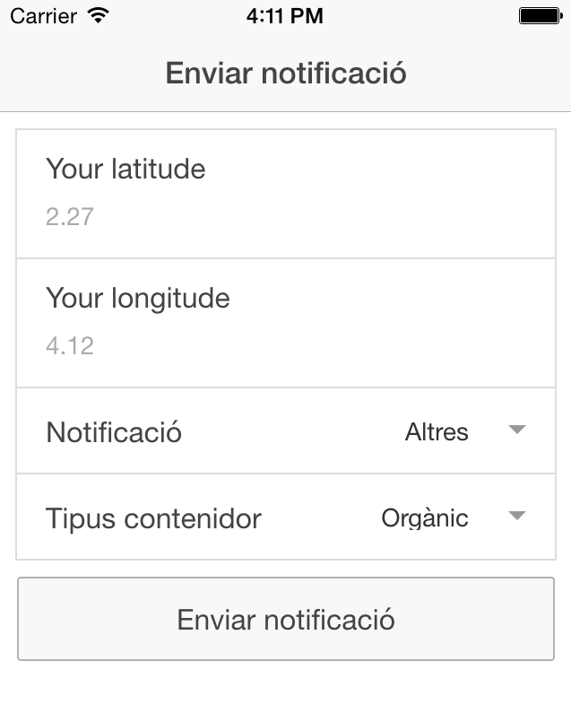
PROTOTYPE
App

Slide 16
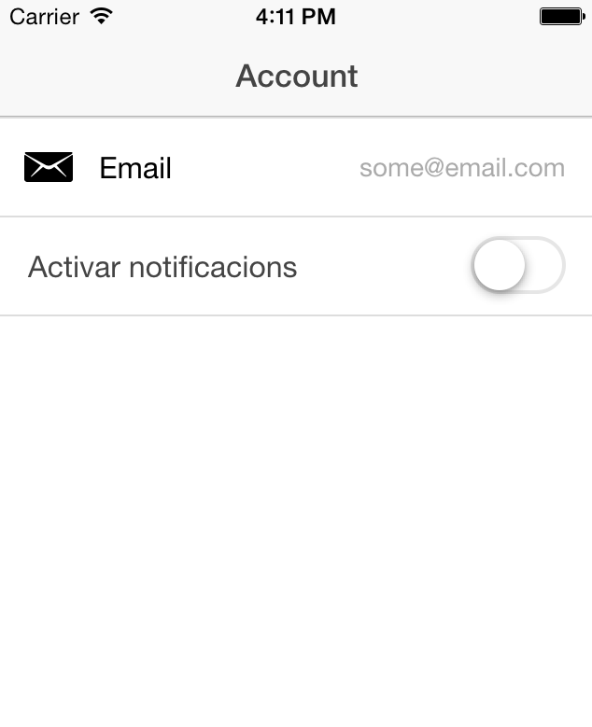
PROTOTYPE
App

