Slide 1
Can I help our Union Reps predict turnout to Worksite Meetings?
Guillermo Schneider

Slide 2
Introduction
I work as a Data Analyst at SEIU 32BJ, a labor union. We represent ~80,000 Janitors, Cleaners, Doormen, Security Guards, Window Cleaners, and other building workers in NYC.
Our Union Representatives often organize group meetings with our members at their worksite (called Worksite Meetings).
By using our new app to scan member IDs, they’ve been gathering more accurate meeting attendance data for the past year.
We’re curious if we can use this to can help predict expected turnout to Worksite Meetings.

Slide 3
Research Question
Do buildings’ division, member count, and ADF (political) contributions influence turnout to worksite meetings?
Turnout ~ Division + Members + ADF
Notes:
dependent variable: turnout, number of members in the building that showed up to the meeting
Building internal Division: whether it’s a commercial building, residential building, a school building
Roster size: number of workers in the building
ADF:( American Dream Fund) We aren’t allowed to spend member dues on political lobby so we ADF which members can contribute to separately from their dues. Number of the building that is contributing to ADF. Often this is referenced as members that are more likely to come to events and be involved, so I was interested in including it

Slide 4
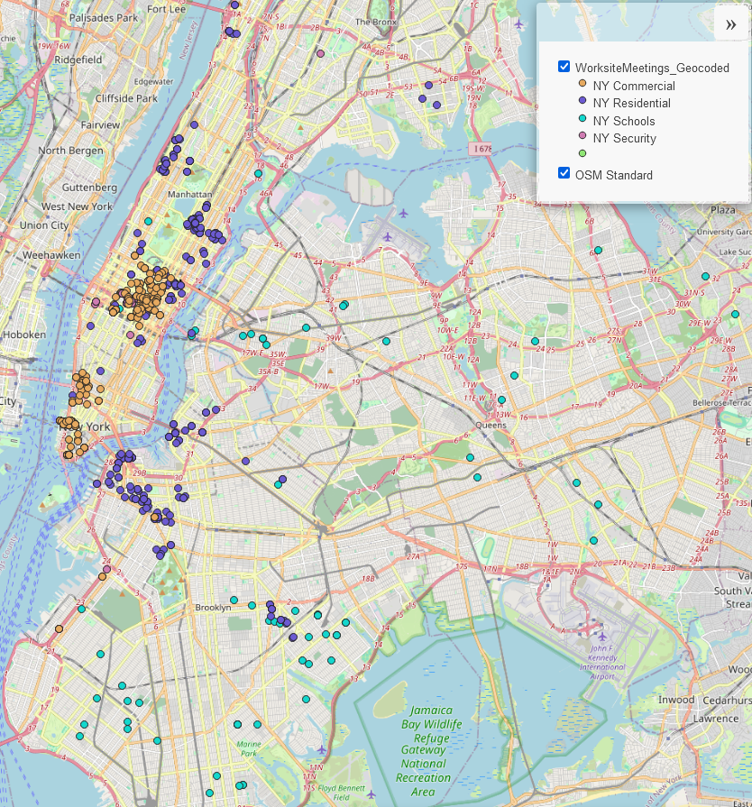
Building Division Map
228 Commercial Worksite Meetings
249 Residential Worksite Meetings
72 Schools Worksite Meetings
Notable Commercial Buildings:
Empire State Building
World Trade Center
Madison Square Garden
Penn Station
Barclays Center
The MoMA
Broadway Theatre(s)

Slide 5

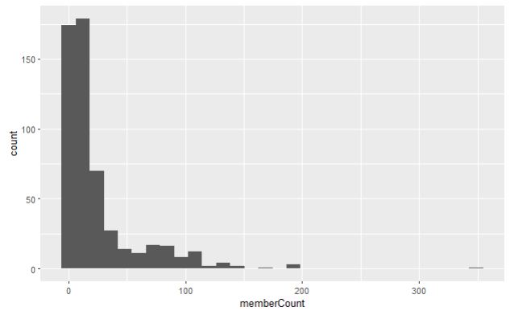
Member Count
Notes:
Median: half the buildings under 10 members,

Slide 6
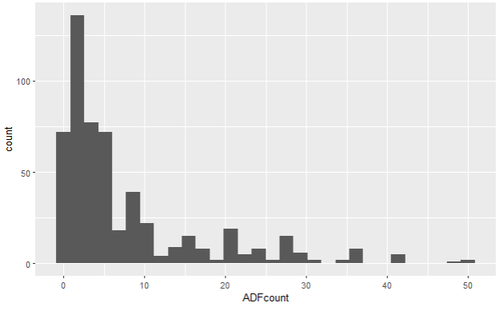
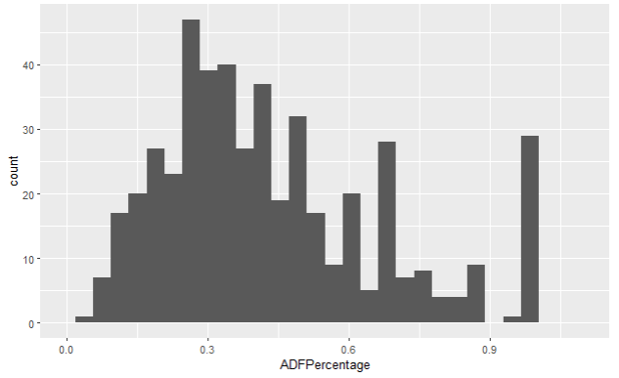

ADF (American Dream Fund)
Notes:
I was struggling with ways to combat the small counts and right skewness of all my data. I felt creating ADFPercentage (dividing ADF count by roster size) was a more honest view of the proportion of contributions. Vaguely normally distributed, center on the lower end at around 1/3 of the site is contributing into the political fund

Slide 7
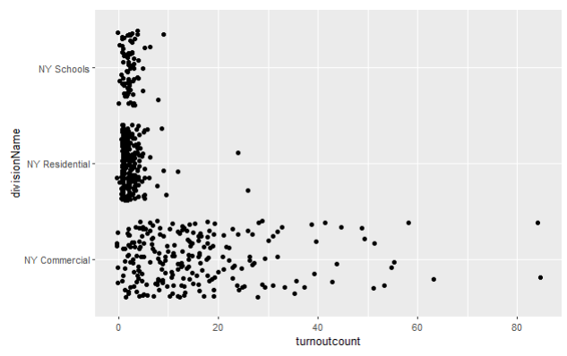
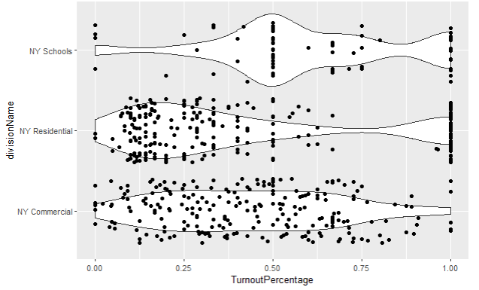
Turnout by Building Division
Notes:
Schools: smaller member count, buildings are farther apart, this bump at 50% if confusing to me, im thinking it could a day/night shift thing where only half the shift can come to a meeting at a time?
Residential: the grouped 100% are mostly 1 doorman buildings, but surprised to see lower turnout for the other buildings
Commercial: incredibly broad spread, glad to see higher turnout. A lot of our union reps come from the jobs, so I know the commercial reps pride themselves on their good relationship w members and getting good turnout often from buildings they used to work at. they have the highest turnout numbers, allowing for broaders percentages when dealing with full human as numbers?

Slide 8
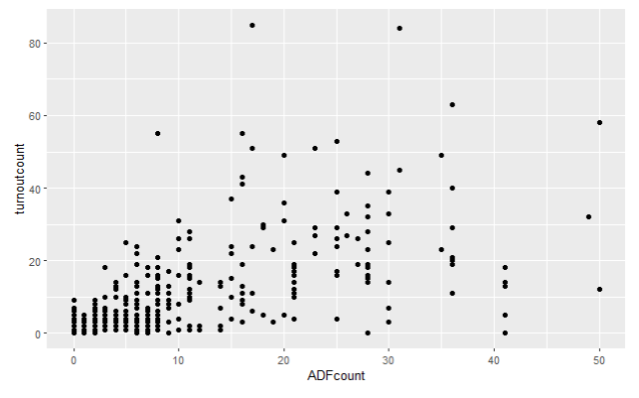
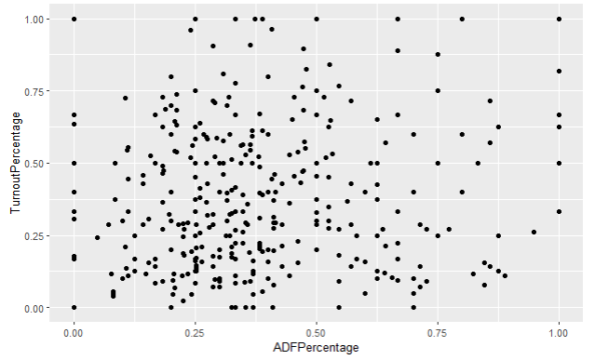
Turnout Percentage vs ADF Percentage
Notes:
Our field reps often talk about ADF being a good metric for member union activity: “if they’re paying into political fund, they're more likely to be politically and union engaged, and more likely to go to events, including worksite meetings”.
I was surprised that to methis isn’t really showing that, im not sure theres a clear pattern here for worksite meetings that we were hoping for

Slide 9
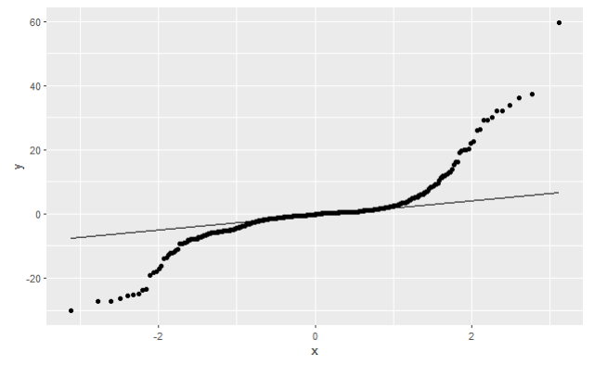
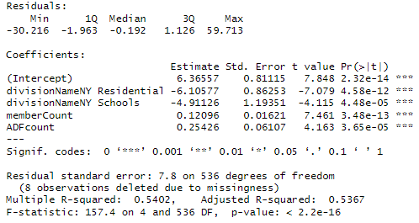
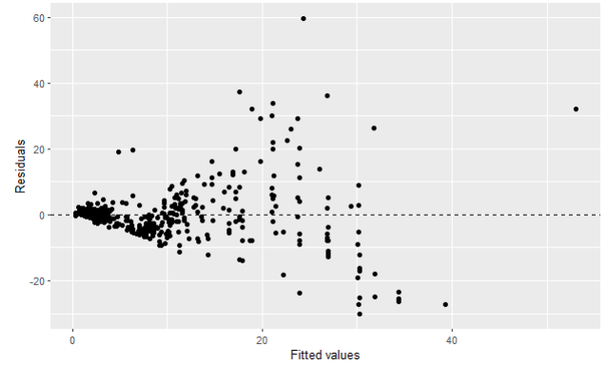
Failed Linear Regression Model
Notes:
I tried a linear model using the turnout counts and ADF counts. It had heavy tails, distribution is not normal, very skewed. Also My residuals seems to be increasing and are not constant. Unfortunately, we learned this is probably not a good fit for linear models?

Slide 10
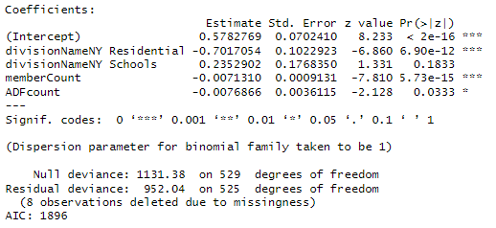
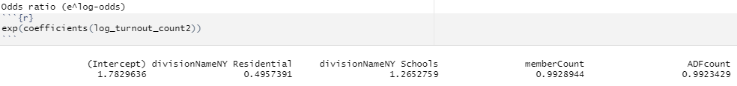
Weighted Logistic Regression Model
Notes:
Using percentage of turnout, turnout count divided by member count at the building, to get a proportion, bounded within 0 to 1. I also found it needed to include the turnout count as a weight in the model, bc my data is a bit unbalanced.
I found the logistic regression interpretation a bit confusing, Im taking the exponential of the log odds to turn them into the odds ratio:
but these are my interpretation (while holding all other variables constant):
im not sure interpreting the intercept is that useful, but assuming hypothetical membercount is 0 and adf count is 0 and a ny commercial building, we’re expecting the probability of turnout is around 78%
NY Residential buildings odds ratio of 0.49, suggests a 51% lower odds of turnout than a NY Commercial buildings
with the membercount odds ratio with 0.99, a increase of 1 more member at the buildings, would suggests a 1% lower odds of turnout
similarly with ADFCount odds ratio being 0.99, a increase of 1 more person signing up for ADF at the buildings, would suggests a 1% lower odds of turnout

Slide 11

Chi-square statistic (χ²)
Null hypothesis (H0): there is no association between our variables
Alternative hypothesis (H1): there is an association between our variables
Chi-squared to p-value:
X² = Null deviance – Residual deviance
X² = 1131.38 – 952.04
X² = 179.34
df = 529 – 525 = 4
p-value is less than.05 so we reject the null hypothesis. There is a statistically significant relationship between the buildings’ division, member count, and ADF contributions to turnout
Notes:
chi-square statistic (χ²), which is used to assess the significance of the model, to get a chi squared from log, you use the null deviance – the residual deviance. df of freedom 4.

Slide 12
Conclusions
Our turnout seems to be more polarized than we thought, with extremes (both very high and very low turnout %) seeming to be more common than expected
Our Union Reps may be putting to much weight on whether a building contributes to ADF means they’ll be more likely to come to Worksite Meetings
Commercial Building members are much more likely to turnout
Targeting smaller buildings may be key for better turnout

Slide 13
Limitations and Future Analysis
Limitations: I’m calculating turnout % using past turnout divided by current roster. Usually, rosters stay similar sizes through the year (especially due to union contract protections on unlawful reduction in forces), but they do change, introducing possible inaccuracy.
Improved dataset: I think its possible but tedious to have my SQL queries roster and ADF data for each day, to more accurately calculate the turnout % for the exact day of the worksite meeting
Future Analysis: With that dataset, I could compare data before and after worksite meetings to see the potential impact of the visit
Notes:
If I knew I was going to end up with log regression, its possible I should’ve made my analysis around peoples metrics rather than grouped buildings metrics. It makes more sense to me have attend/didn’t attend for a single person, than the proportion of attendance I have set up atm.

Slide 14
Thank you!
Unions for All!

