Slide 1


CSV for R
RBesT Pilot
Sebastian Weber, Francis LeMonnier, Jo Valentine
July 2016

Slide 2
Discussion Topics
The Key to a Successful Validation
Quality-first driven Software Development
Why RBesT is a Quality Success Story
R Validation Model
A Modern R Package to Facilitate the Use of Historical Data
Writing A Modern R Package
Summary

Slide 3
The Key to a Successful Validation
Getting the balance right, putting the weight where it is needed.
Validation means ensuring that we have done something according to process
Validation does not mean writing lots of documents ...
With RBesT, Business, IT and QA have come up with a simple, balanced recipe for validating this type of code:
The coder codes and documents the code – the coder does the really hard work. ONCE!
IT have a standard protocol (written ONCE) to deploy the code to the platform
QA have created a streamlined, standard, check list approach (ONCE) to ensuring that the process has been followed and that all deliverables are in place.

Slide 4
Quality-first driven Software Development
What is the Key Driver? Why is this important?
Pure and Simple: Inspection!
We can be inspected at any time, for a multitude of reasons
Software Development results in program code that does things on our behalf: analyses, listings etc.
We need to ensure that we are compliant everywhere
Having a Quality-first driven Software Development strategy means we are transparent in what we do and inspection-ready
It does not mean it has to be difficult or burdensome ...

Slide 5
Why RBesT is a Quality Success Story
Exploiting the R language itself
RBesT is self-documenting:
one of the strong points of the R language is that coders document as they write the code, within the code and the documents generated
This can be exploited:
to provide the traditional user requirements (‘Vignette’ – how to use the code, what it does)
to provide a functional specification (‘Package Specification’)
Verification testing of RBesT is performed by code written in R and is all within the same deployed package, making the specification and testing, one discrete validation package, simplifying the required documentation
RBestT developed according to CRAN standards means the coder has prepared requirements and tests in one package

Slide 6
Why RBesT is a Quality Success Story (2)
Successful co-operation between IT, QA and Business
For any validation project, it is quite an enviable place to be when coding is complete to have everything in ONE place:
✓ URS – User Requirments Specification
✓ FS – Functional Specification
✓ UAT – User Acceptance Testing (Functional Testing in this case)
RBesT needs to be deployed to Modesim
and uses a standard protocol, executed by IT
RBesT needs a validation wrapper and that is provided by SOP-7017983 and its associated deliverables:
Validation Assessment Document (VAD)
Validation Evidence Document (VALED)
Both are easy to prepare and have no need for further documentation about RBesT

Slide 7
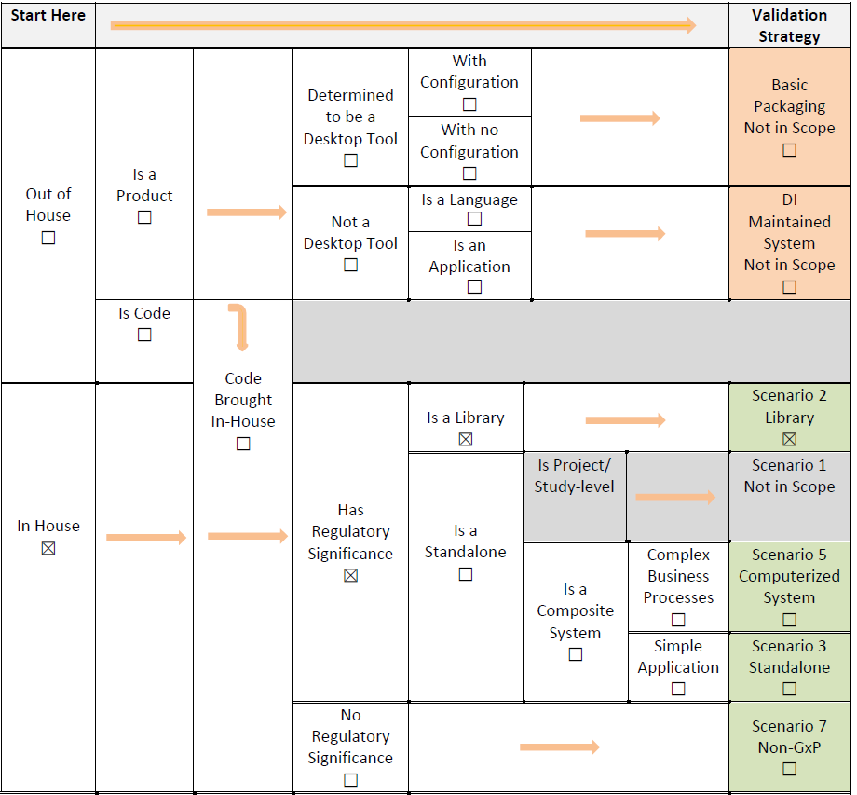
R Validation Model
Validation Assessment Document (RBest)
Replaces eHLCCD
Easy and Efficient
Authored and Managed by OQM

Slide 8
R Validation Model
VALED (Validation Evidence Document)
Checklist Type of Document
Eliminates Redundancy (Points to PROTON Rather Than Recreating Documents in DiARy)
The Vignette (URS) and the Reference Guide (FS) Produced by R Code Eliminated Creation of Separate URS/FS/DS Documents
References PROTON Test Cases
References PROTON Test Evidence
Includes “Canned” Verbiage
Approval of Version 1.0 = Approval of Val Plan, URS, FS, DS
Approval of Version 2.0 = Approval of Val Summary Report

Slide 9
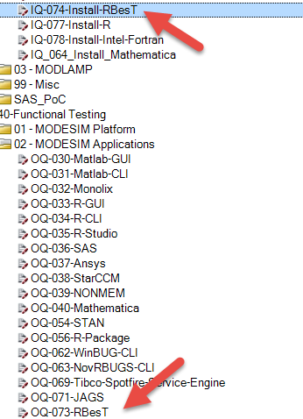
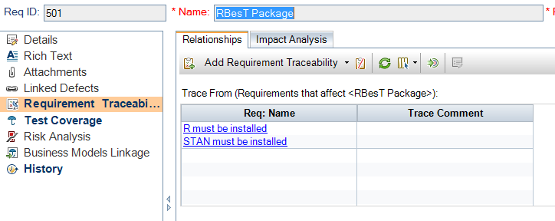
R Validation Model
PROTON (PROfessional Testing Online)
A Project Was Created Under the MODESIM Domain
Requirements Were Added
Test Cases Were Added
Evidence Was Stored in PROTON

Slide 10
Best Practices
Testing and Documentation
This method brings us closer to an Agile, Test Driven Development
Work with your OQM for document creation and approval
Coordinate with MODESIM Team for R Code inclusion
Create Code to produce the Vignette and Reference Guide
Create code that will test your new code
Produce results to be attached in PROTON

Slide 11
RBesT: R Bayesian evidence synthesis Tools
A Modern R Package to facilitate the use of historical data
Key elements for RBesT (validation) success
Well documented methodology (publications) => clear use-case
Historical data workstream => scientific feedback and repeated testing
Great Quality team => recognized quality of RBesT code and helped to map elements of modern R software development to Novartis Quality terms
Key elements for Novartis Validation mapping to R
User specifications (USR) ⬄ R vignette
Functional specifications (FS) ⬄ R reference manual
User Acceptance Testing (UAT) ⬄ R tests

Slide 12
Writing A Modern R Package
Modern software development for R
Helpful guidance documents
"R Packages", H. Wickham: http://r-pkgs.had.co.nz/
"Advanced R", H. Wichham: http://adv-r.had.co.nz/
Principles of modern software development
Version control
Consistency
Clear design
Document functions with examples
Automated testing tedious to write, but crucial; can be based on the examples
Requires training, above references are a start

Slide 13
Summary
Collaboration is key in scientific and quality matters
RBesT has been written as modern R package
Carefully designed
Well documented
Fully tested
A new model for validating R packages is born
Elimination of double documentation
DiAry documents (VAL + VALED) classify package and document the process for installation, qualification and testing
Direct deployment from subversion to MODESIM
Buisness relevant documentation and test evidence generated from the source code

Slide 14
Backup

Slide 15
Developing a Modern R Package
Utilities matter as these facilitate best practices
Code management (loading, building, ...) devtools
In-code documentation via special comments roxygen2
Automated testing testthat
Automatic deployment bash scripts
RBesT source http://chbslx0132.eu.novartis.net/svn/BesT/trunk/

