Slide 1

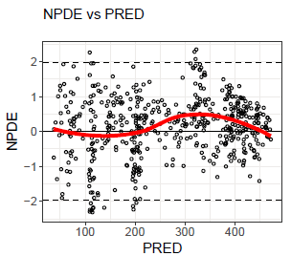
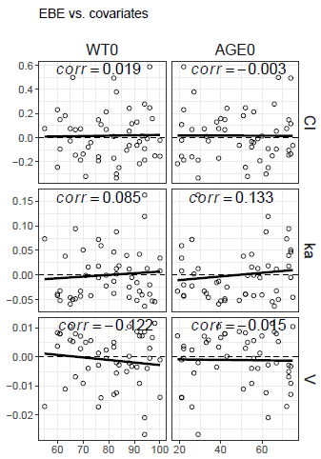
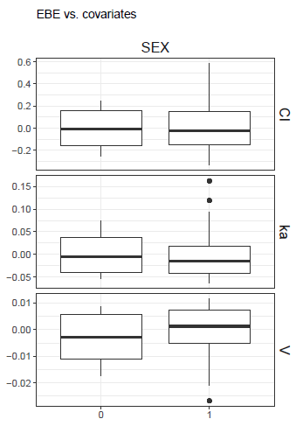
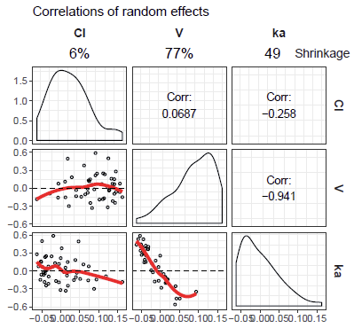
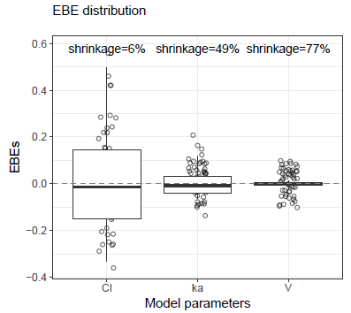
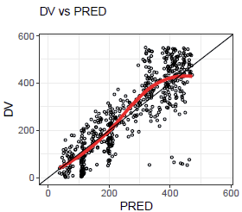
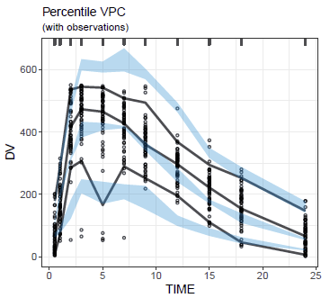
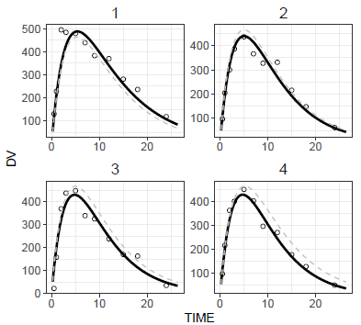
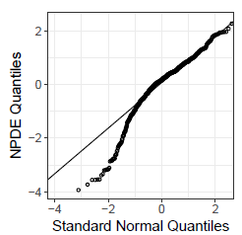
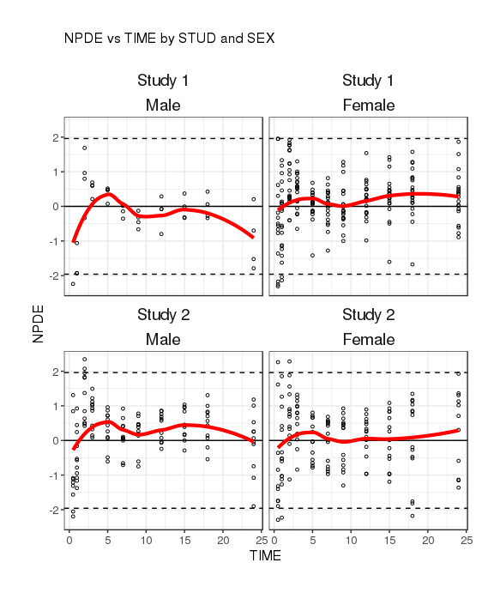
Cheat Sheet v0.9.4
Default Plots
Default plots visualized using the functions pmx_plot_xx(), where xx is a placeholder for the plot name
Use of %>% operator on controller to generate diagnostics plot ctr %>% pmx_plot_npde_pred()
List of plot names xx available by printing the controller
Key Features
Scatter plots
Covariate plots
EBE-based plots¹
Library of diagnostic plots for nonlinear mixed-effects model building and evaluation:
Consistent, reproducible and efficient workflow
High quality graphics, ready-to-use in submission documents and publications
Advanced Features for customization and stratification
Automated generation of PDF, Word or PNG outputs for reporting purpose
pmx_plot_eta_conts()
pmx_plot_eta_cats()
¹EBE: Empirical Bayes estimate
pmx_plot_npde_pred()
pmx_plot_npde_time()
pmx_plot_iwres_ipred()
pmx_plot_iwres_time()
pmx_plot_abs_iwres_ipred()
pmx_plot_abs_iwres_ipred()
pmx_plot_dv_pred()
pmx_plot_dv_ipred()
pmx_plot_eta_matrix()
pmx_plot_eta_box()
Monolix Requirements
Monolix versions 2016 and later
Requiring to run the following Monolix tasks: POPULATION PARAMETERS, EBEs, STANDARD ERRORS and PLOTS
Make sure to export charts data (in Monolix: Settings -> Preferences -> Export -> switch on the Export charts data button)
Select at least the following plots to be displayed and saved: individual fits and scatter plot of the residuals
VPC
Individual plots
QQ-plots and density plots²
pmx_plot_vpc()
[Arguments]
ctr, type, idv, obs, pi, ci, rug, bin, is.legend, dname
Several pages of plots are generated:
pmx_plot_individual(
npage = 1,
facets=list(
nrow=3, ncol=2))
pmx_plot_eta_hist()
pmx_plot_eta_qq()
pmx_plot_npde_qq()
pmx_plot_iwres_qq()
pmx_plot_iwres_dens()
² QQ plot: quantile-quantile plot
Controller Creation
Automated Diagnostics Report
Plot Customization
Controller is the user interface object of ggPMX:
containing all underlying information to generate diagnostics plot
key argument to most of the ggPMX functions (use of %>% operator)
1. Define the location of your working directory
theophylline_path = file.path(system.file(
package = 'ggPMX'), 'testdata', 'theophylline')
work_dir = file.path(theophylline_path, 'Monolix')
2. Define the location of your modeling dataset
input_data = file.path(theophylline_path, 'data_pk.csv')
3. Create controller using function pmx()
ctr = pmx(sys = 'mlx', config = 'standing', directory = work_dir, input = input_data, dv = 'Y', dvid = 'DVID', cats=c('SEX'),conts=c('AGE0','WT0'))
[mandatory] sys, config, directory, input, dv [optional] id, time, dvid (mandatory in case of multiple endpoints), cats, conts, strats, occ, settings, endpoint, sim, bloq
pmx_report() - [Arguments]: ctr, name, save_dir, format, template, footnote, edit, title,...
Three types of format (format argument) :
“report”: produces name.pdf and name.docx reports, located in save_dir with default diagnostic plots
“plots”: produces a folder named ggpmx_GOF located in save_dir containing all default diagnostic plots (pdf and .png format)
“both”: is a combination of both options above
1. Start from a generated R Markdown (.Rmd):
ctr %>% pmx_report(name = "DiagnosticPlots1", save_dir = work_dir, format = "both")
2. Modify resulting R Markdown (Diagnostic_plots1.Rmd) as desired (e.g. change the size, settings of some figures) into new template
3. Create a report using the customized template:
ctr %>% pmx_report(name = "DiagnosticPlots2", save_dir = work_dir, format = "report", template = file.path(work_dir, "DiagnosticPlots2.Rmd"))
Any plot can be customized in two ways:
Individually, by specifying options:
pmx_plot_npde_time(ctr, smooth = list(color = "blue"),
point = list(shape = 4), is.draft = TRUE,
labels = list(x = "TIME after first dose (days)",
y = "Normalized PDE"))
Globally, at the level of Controller creation, using pmx_settings, e.g. adding a DRAFT label to all plots, modify labels using cats.labels:
mySet = pmx_settings(is.draft=TRUE, use.labels=TRUE,
cats.labels=list(SEX=c("0"="Male","1"="Female")))
ctr = pmx_mlx(config = "standing",...,settings = mySet)
Report Customization: Create Custom Template
Stratification and Filtering
Simplified Controller Creation
Two ways of stratifying a plot:
1. using the stratification function by categorical covariates and providing the plot name in argument:
pmx_plot_cats(ctr, "npde_time")
2. using arguments strat.facet (discrete) or strat.color (continuous) in pmx_plot_xx().
Allows two-dimentional stratification:
pmx_plot_npde_time(ctr,
strat.facet = STUD~SEX)
Models fitted with Monolix, i.e., sys = 'mlx':
pmx_mlx(config, directory, input, dv, dvid, cats, conts, strats, occ, settings, endpoint, sim, bloq)
Automatic parsing of .mlxtran files:
pmx_mlxtran(file_name, config, call, endpoint)
file_name: path to .mlxtran file (Monolix project)
Visual Predictive Check (VPC)
To produce the VPC, a simulation file is required (e.g. sim.csv), with (at least) the following columns: ID (individual identifiers), REP (simulation replicate number), TIME, DV (dependent variable)
Create a simulation object to use as argument in Controller creation:
sim = pmx_sim(file = "sim.csv", irun ="rep", idv="TIME")
Change bins:
pmx_plot_vpc(bin = pmx_vpc_bin(style="equal", n=10))
Change prediction and confidence intervals, data points properties:
pmx_plot_vpc(type = "percentile",
pi = pmx_vpc_pi(interval = c(0.1,0.9),
ci = pmx_vpc_ci(interval = c(0.1,0.9),
obs = pmx_vpc_obs(color="blue", shape=18, size=2))
Multiple-endpoint models (PKPD models)
ggPMX produces one set of diagnostics plots per endpoint
Select the endpoint (if more than one) at the level of the Controller -> create endpoint object with pmx_endpoint() and pass it to Controller.
Endpoint index (code) in modeling dataset (usually dvid) should be mapped to Monolix output index X (file.code), i.e. predictionsX.txt and finegridX.txt, where X=1,2,...
ep = pmx_endpoint( code = "4", label = "some_label",
unit = "some_unit", file.code = "2", trans="log10")
ctr = pmx_mlx(..., dvid = "YTYPE", endpoint = ep)
If code and file.code index match, use simplified syntax (no endpoint object): ctr = pmx_mlx(..., dvid = "YTYPE", endpoint = 1)
Two ways of filtering the data:
1. Locally, at the level of a plot:
ctr %>% pmx_plot_dv_pred(
filter = DV > mean(DV) & PRED < median(PRED))
2. Globally, at the level of the Controller, affecting all subsequent plots:
ctr %>% pmx_filter(
data_set = "prediction",
ID == 5 & TIME < 2)
Resource
https://github.com/ggPMXdevelopment/ggPMX
© 2019 Novartis
Authors
Bruno Bieth, Irina Baltcheva, Christian Bartels, Souvik Bhattacharya, Thomas Dumortier, Didier Renard, Amine Gassem

