Slide 1

SystemC-AMS
Tutorial
Institute of Computer Technology
Vienna University of Technology
Markus Damm

Slide 2
SystemC activities at TU Vienna…
… or, more precicely, at the Embedded Systems group of
Prof. Christoph Grimm:
Member of the SystemC AMS working group
SystemC / SystemC AMS modelling
  ANDRES project (ANalysis and Design of run-time
  REconfigurable heterogeneous Systems)
  SystemC synthesis (project with Frequentis)
  using affine arithmetics with SystemC AMS
  using TLM for WSN simulation
TLM ↔ SystemC AMS interaction
Teaching of SystemC and SystemC AMS

Slide 3
Simulation Environment
We mostly use a very simple simulation environment, which is completely open source & free:
  Linux (Ubuntu)
  Nedit with custom Syntax highlighting
  Makefiles
  GTKWave (waveform viewer)
In SystemC teaching, we encourage the students to install this environment on their own desktop computer / laptop
For this environment, we provide an easy to use SystemC / SystemC AMS installation script
Let’s have a look…
(but any editor will do)

Slide 4
What this talk is about
We walk through a simple communication system example (BASK)
This is a model our students have to build from scratch during a
1 day SystemC AMS hands-on tutorial
Along the way
  we encounter some common pitfalls
  review some SystemC AMS concepts
You should get an idea on how
  to model with SystemC AMS
  SystemC AMS simulation works

Slide 5
Generating a sine-wave in SystemC-AMS
SCA_SDF_MODULE(sine) {
sca_sdf_out<double> out; // output port
void sig_proc(){ // our workhorse method
out.write( sin( sc_time_stamp().to_seconds()*(1000.*2.*M_PI))) ;
}
SCA_CTOR(sine) {} // constructor does nothing here
};
The sig_proc() method specifies the process of the Module
In this case, it generates a 1kHz Sine wave
However, we used the SystemC method sc_time_stamp() to get the current simulation time…
SystemC AMS has its own method for this, sca_get_time(). We will see shortly, what difference this makes…

Slide 6
Instantiating and connecting
#include "systemc-ams.h"
SCA_SDF_MODULE(drain) { // a drain module to connect the signal to
sca_sdf_in<double> in; // input port
SCA_CTOR(drain) {} // constructor does nothing, no sig_proc() specified!
};
int sc_main(int argc, char* argv[]){
sc_set_time_resolution(10.0, SC_NS);
sca_sdf_signal<double> sig_sine ;
sine sin("sin");
sin.out(sig_sine);
sin.out.set_T(100,SC_NS); // The sampling time of the port
drain drn("drn");
drn.in(sig_sine);
sc_trace_file* tr = sc_create_vcd_trace_file("tr"); // Usual SystemC tracing
sc_trace(tr, sig_sine ,"sig_sine");
sc_start(2, SC_MS);
return 0;
}

Slide 7
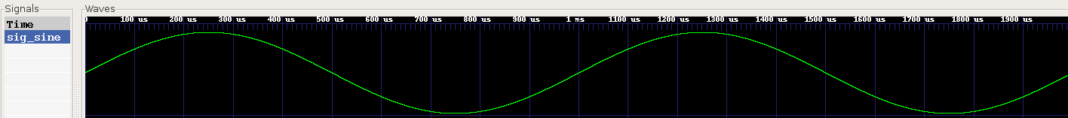
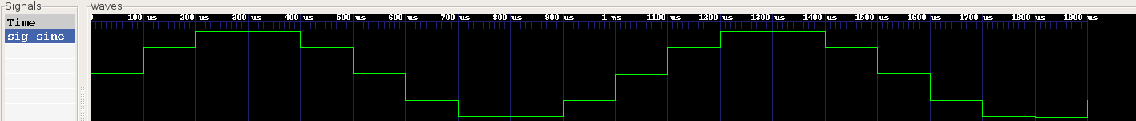

Simulation result
…completely as expected, it also worked with sc_time_stamp()
So what’s the big deal? Consider the following seemingly innocent change in the drain:
SCA_SDF_MODULE(drain) {
sca_sdf_in<double> in;
void attributes(){ in.set_rate(1000); }
SCA_CTOR(drain) {}
};
The simulation result now looks like this:
No changes were made in the sine module. This is a side effect due to the data rate change in the drain!

Slide 8
Data rates and scheduling
The explanation is simple: before this change, the process schedule looked like this: sine, drain, sine, drain,…
Now, the drain reads 1000 token at once, thus, the sine modules’ sig_proc() has to be executed a 1000 times before the drains’ sig_proc() can be executed once. That is, the schedule looks like this: sine, sine,…, sine, drain, sine, sine,…, sine, drain,…
During those successive executions of the sine modules’ sig_proc() , the sc_time_stamp() method returns the same value every time – yielding the same output every time!
The sca_get_time() method takes this into account
⇒ Don’t use sc_time_stamp() in SDF-Modules! You might get errors where you don’t have the slightest clue of the cause.

Slide 9

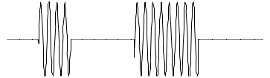
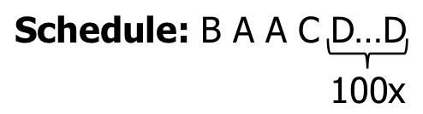
Timed Synchronous Data Flow (TDF)
…implies a samling
period of 20 s here!
Sine-source
“TDF-Cluster“
A
20 s
e.g. sampling
period of 2 ms
here…
50
20 s
20 s
20 s
100
C
20 s
20 s
D
100
1
B
1
1
01001100
2 ms
Environment
2 ms
Modulation
2 ms
Bit-source
data rates
The static schedule is simply determined by the data rates set at the ports with set_rate(). So far, this is usual SDF.
In SystemC AMS, a sampling period is associated to token production/consumption of a port with set_T().
…but it is set only at one port of a cluster!

Slide 10
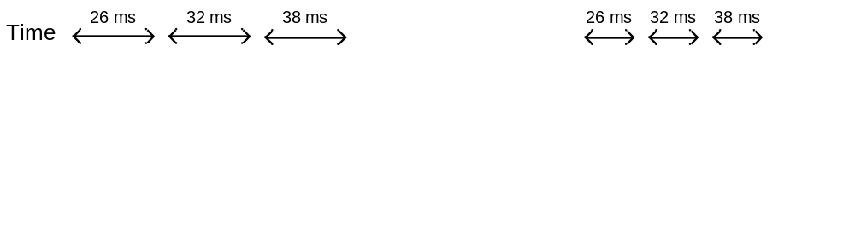
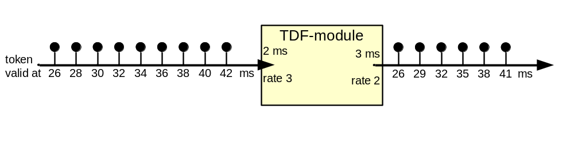
Simulation time and multirate dataflow
Although sca_get_time() works well globally, there is one more pitfall when using data rates > 1.
Consider the following simple example:
Return value of sca_get_time()
Depending on the application, we might have to take into account the difference between the value of sca_get_time() when a token is read / written and the time the respective token is actually valid.
This is especially true for token production.
Let’s see how to apply this knowledge for a bullet-proof sine source with custom data rates…

Slide 11
A sine-wave module with custom data rate
SCA_SDF_MODULE(sine) {
sca_sdf_out<double> out;
int datarate; double freq, stepsize; // some data we need
void attributes(){ out.set_rate(rate); }
void init(){ // This method is called when scheduling is done already…
double sample_time = out.get_T().to_seconds(); // …such that get_T() works.
stepsize = sample_time*freq*2.*M_PI;
}
void sig_proc(){
for(int i=0; i<rate; i++){
out.write(sin( sca_get_time().to_seconds()freq*2*M_PI+(stepsize*i) ),i);
}
}
sine(sc_module_name n, double _freq, int _datarate){ // constructor with
datarate = _datarate; // additional parameters
freq = _freq;
}
};
This module is completely self-contained and makes no assumptions on the rest of the model. It will work no matter what.

Slide 12



A BASK modulator demodulator exploiting multirate dataflow
BASK: Binary Amplitude Shift keying
Principle of BASK modulation:
carrier signal
×
modulated signal
data signal
modulation
( multiplication)
Principle of BASK de-modulation:
modulated signal
rectifier
(absolute value)
lowpass
filter
bit
recovery
data signal

Slide 13
The mixer (modulation)
SCA_SDF_MODULE(mixer) {
sca_sdf_in<bool> in_bit;
sca_sdf_in<double> in_wave;
sca_sdf_out<double> out;
int rate;
void attributes(){
in_wave.set_rate(rate);
out.set_rate(rate);
} // NOTE: data rate 1 is the default for in_bit
void sig_proc(){
if(in_bit.read()){ // Input is true
for(int i=0; i<rate; i++){ // => Copy double input to output
out.write(in_wave.read(i),i);
}
}else{ // write zeros otherwise
for(int i=0; i<rate; i++){out.write(0.,i);}
}
}
mixer(sc_module_name n, int _rate){rate = _rate;}
};

Slide 14
The overall transmitter
SC_MODULE(transmitter) {
sca_sdf_in<bool> in; // The bits modulated onto the carrier
sca_sdf_out<double> out; // the modulated wave
mixer* mix; // a mixer
sine* sn; // The source of the carrier wave
sca_sdf_signal<double> wave;
transmitter(sc_module_name n, double freq, int rate){
mix = new mixer("mix", rate); // Instantiate the mixer with
mix->in_bit(in); // the data rate
mix->in_wave(wave);
mix->out(out);
sn = new sine("sn", freq, rate); // Instantiate the carier source
sn->out(wave); // with frequency and data rate
}
};
Note: This is an ordinary hierarchical SystemC module, where the submodules are SystemC AMS modules!

Slide 15
The rectifier
SCA_SDF_MODULE(rectifier) {
sca_sdf_in<double> in;
sca_sdf_out<double> out;
void sig_proc(){
out.write(abs(in.read()));
}
SCA_CTOR(rectifier){}
};

Slide 16
The lowpass filter
SCA_SDF_MODULE(lowpass) { // a lowpass filter using an ltf module
sca_sdf_in<double> in; // input double (wave)
sca_sdf_out<double> out; // output is the filtered wave
sca_ltf_nd ltf_1; // The Laplace-Transform module
double freq_cutoff; // the cutoff-frequency of the lowpass
sca_vector<double> Nom, Denom; // Vectors for the Laplace-Transform module
void sig_proc(){
out.write(ltf_1(Nom,Denom, in.read()));
}
lowpass(sc_module_name n, double freq_cut){
Nom(0)= 1.0; Denom(0)=1.0; // values for the LTF
Denom(1)= 1.0/(2.0*M_PI*freq_cut); // to describe a lowpass-filter
}
};

Slide 17
Electrical network version of the lowpass filter
SC_MODULE(lp_elec) {
sca_sdf_in<double> in;
sca_sdf_out<double> out;
sca_elec_node n1,n2; // electrical nodes
sca_elec_ref gnd;
sca_c c; sca_r r; // capacitor and resistor
sca_sdf2v vin; // SDF to voltage converter
sca_v2sdf vout; // voltage to SDF converter
lp_elec(sc_module_name n, double freq_cut):c("c"),r("r"),vin("vin"),("vout")
double R = 1000.; // choose fixed R
double C = 1/(2*M_PI*R*freq_cut); // and compute C relative to it
vin.p(n1); vin.n(gnd); vin.ctrl(in);
vout.p(n2); vout.sdf_voltage(out);
c.value = C;
c.p(n2); c.n(gnd);
r.value = R;
r.n(n1); r.p(n2);
}
};

Slide 18
Bit recovery
SCA_SDF_MODULE(bit_recov){
sca_sdf_in<double> in;
sca_sdf_out<bool> out;
int rate, sample_pos;
double thresh;
void attributes(){
in.set_rate(rate);
}
void sig_proc(){
if(in.read(sample_pos) > thresh) out.write(true);
else out.write(false);
}
bit_recov(sc_module_name n, double _thresh, int _rate){
rate = _rate; thresh = _thresh;
sample_pos=static_cast<int>(2.*(double)rate/3.); // compute sample position
}
};
sampling points
Note that we just read the sample point we are interested in
All other values are basically discarded!

Slide 19
The overall receiver
SC_MODULE(receiver) {
sca_sdf_in<double> in;
sca_sdf_out<bool> out;
bandpass* bp;
rectifier* rc;
lowpass* lp;
bit_recov* br;
sca_sdf_signal<double> wave1, wave2;
receiver(sc_module_name n, double freq, int rate, double thresh){
rc = new rectifier("rc");
rc->in(in);
rc->out(wave1);
lp = new lowpass("lp", freq/3.);
lp->in(wave1);
lp->out(wave2);
br = new bit_recov("br", thresh, rate);
br->in(wave2);
br->out(out);
}
};

Slide 20
Instantiating and connecting
#include "systemc-ams.h”
int sc_main(int argc, char* argv[]){
sc_set_time_resolution(10.0, SC_NS);
sca_sdf_signal<bool> bits, rec_bits; // the bits which are transmitted & received
sca_sdf_signal<double> wave; // the modulated wave
bitsource bs("bs"); // The data source
bs.out(bits);
bs.out.set_T(1, SC_MS);
transmitter transmit("transmit", 10000. , 1000);
transmit.in(bits);
transmit.out(wave);
receiver receiv("receiv", 10000., 1000, 0.02);
receiv.in(wave);
receiv.out(rec_bits);
drain drn("drn");
drn.in(rec_bits);
sc_trace_file* tr = sc_create_vcd_trace_file("tr");
…
sc_start(20, SC_MS);
return 0;}

Slide 21
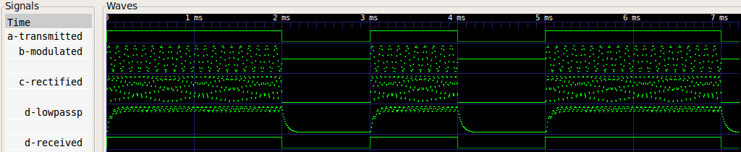
Simulation result BASK
Looks fine! However, something is strange… who knows what it is?
Multirate-dataflow allowed us to overcome causality!
  The bit recovery module reads the sample of interest during
  the same sig_proc() execution when it also writes the result.
  However, the output token is valid the same time as the first
  input token.

Slide 22
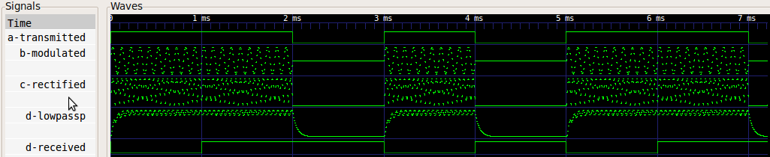
Using delay to regain causality
SCA_SDF_MODULE(bit_recov){
…
void attributes(){
in.set_rate(rate);
out.set_delay(1);
…
}
};
This delays the output of the bit recovery module by one token,
which in this case results in a 1 ms delay.
Delays also have to be used in the presence of feedback loops.
You can also write initial values in the init() method.

Slide 23
A simple environment model
SCA_SDF_MODULE(environment) {
sca_sdf_in<double> in1, in2;
sca_sdf_out<double> out;
double attenuation, variance;
void sig_proc() {
out.write((in1.read()+in2.read())*attenuation+gauss_rand(variance));
}
environment(sc_module_name n, double _attenuation, double _variance){
variance = _variance;
attenuation = _attenuation;
}
};
This module takes two waves, adds them and exposes them to attenuation and Gaussian noise.
We assume the presence of a Gaussian noise function here.

Slide 24
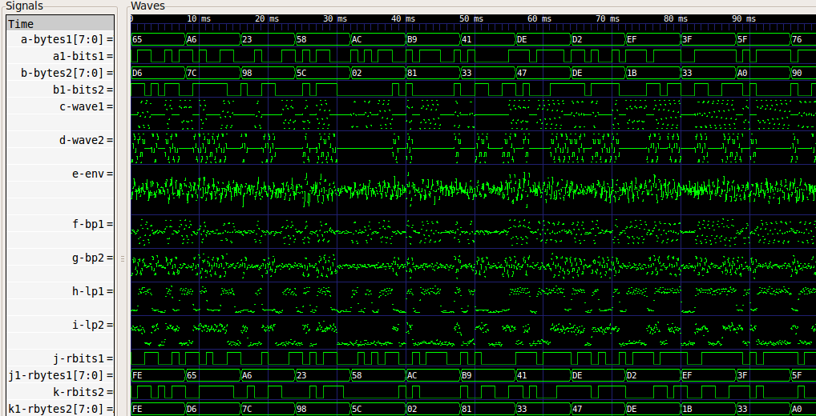
Simulation result with environment model

Slide 25
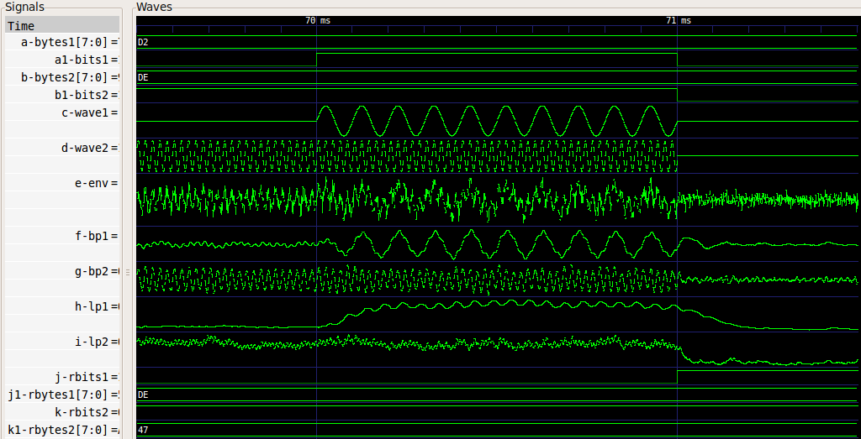
Simulation result with environment model

Slide 26
Thank you
for your
attention!
Your:
questions
comments
ideas
objections

