Slide 1
Project: Accident data of Seattle city
Applied Data Science Capstone

Slide 2
Introduction
Accident data of Seattle city is considered for this project, where labeled data is already available and used for further analysis.
The attributes of the data set show different influence factors on accident probability, which will by analyzed in order to solve the problem to reduce the rate of accidents for the future. Furthermore, causes and circumstances that lead to larger accident probabilities are addressed as there are high correlations on different attributes observable.
Using the outcome of the project, improvements on traffic factors may be done and additional caution may be given to dangerous situation or traffic constellations.

Slide 3
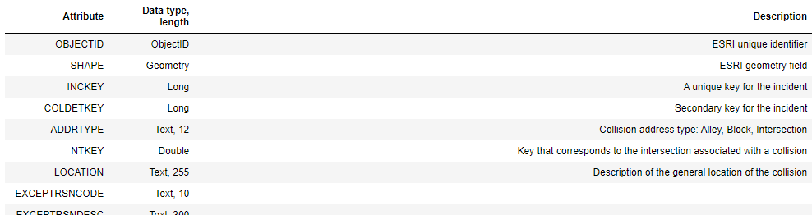
Data
The labeled data in the first column describes the severity of the accidents, where different attributes are found on the remaining columns of the data set.
Data Set Basics
Title: Collisions - All Years
Abstract: All collisions provided by SPD and recorded by Traffic Records.
Description: This includes all types of collisions. Collisions will display at the intersection or mid-block of a segment. Timeframe: 2004 to Present.

Slide 4
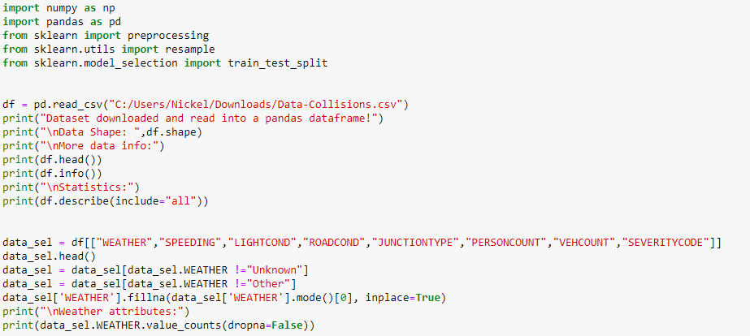
Data Preparation
The data set is loaded from csv and preprocessed in order to replace any mismatching attribute.

Slide 5
Data Selection and Evalutation
Specific data attributes (e.g. weather conditions and speeding) are selected for prediction of severity of accidents.
K Nearest Neighbor(KNN)
First, the value of K is optimized and the accuracy is determined.

Slide 6
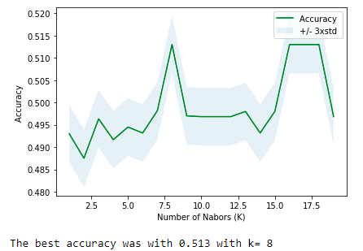
Data Selection and Evalutation
K Nearest Neighbor(KNN)
First, the value of K is optimized and the accuracy is determined.

Slide 7
Conclusion for K Nearest Neighbor (KNN)
It can be observed, that the optimization of K does not lead to significant improvements.
The accuracy is always in the order of 50% (0.48-0.52) - this is NOT a good result w.r.t. using the selected attributes in order to predict the severity.

Slide 8
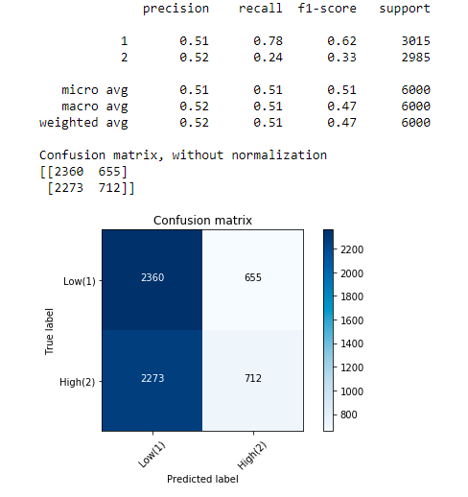
Support Vector Machine (SVN)
In order to achieve better results, the SVN method is applied.

Slide 9
Support Vector Machine (SVN)
Conclusion for SVN
Using SVN for estimation of severity, we observe a similar precision of about 0.51-0.52 for estimation of low-1 or high-2 severity.
Nevertheless, the recall is much higher (0.78) for low-1 severity than for high-2 severity (0.24).
The values show us, that it is NOT very good to predict the severity of an accident only given the state of the weather and the speeding.
Due to the general larger occurany of low severity than high severity, it is right the way clear, that the recall is much larger for low severity.

Slide 10
Conclusions
Using the existing dataset of the course, some remarkable insights have been obtained.
At the beginning it was guessed, that the severity of an accident could be predicted by the weather or speeding conditions.
Using different methods for estimation of the severity based on the existing dataset it could be observed, that only small amount of information can be gained by predictions.

Slide 11
References and Repository
Repository
Link to Github repository: https://github.com/Guinn808/Coursera_Capstone
Notebook: https://github.com/Guinn808/Coursera_Capstone/blob/master/Coursera_Capstone.ipynb
Data: https://github.com/Guinn808/Coursera_Capstone/blob/master/Data-Collisions.rar
Metadata: https://github.com/Guinn808/Coursera_Capstone/blob/master/Metadata.pdf

