Slide 1
MOLECULAR BIOLOGY AT THE QUANTUM LEVEL:
CAN MODERN DENSITY FUNCTIONAL THEORY
FORGE THE PATH?
Brian Kolb and T. Thonhauser, Nano LIFE
Vol. 2, No. 2 (2012) 1–20,

Slide 2
Aims of the presentation
Presenting physical theories to study a system
What is quantum chemistry?
What are theories used to model systems?
What does it allows to do?

Slide 3
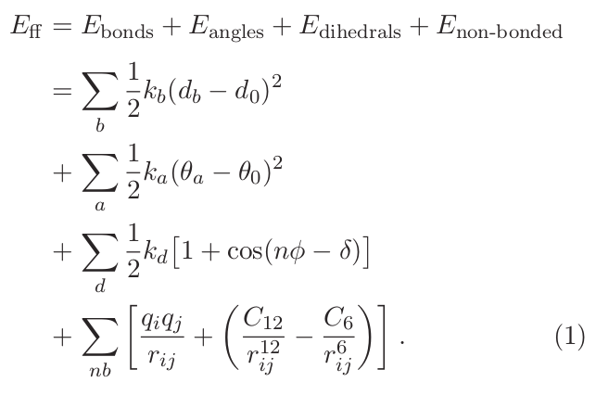
Classical physics and force fields
Straight-forward, physically motivated representation of forces acting on a collection of atoms

Slide 4
Classical physics and force fields
Most commonly used method for macromolecules
Relatively easy to compute
May be adapted by adding more terms
Approximate approach
Not physically relevant

Slide 5

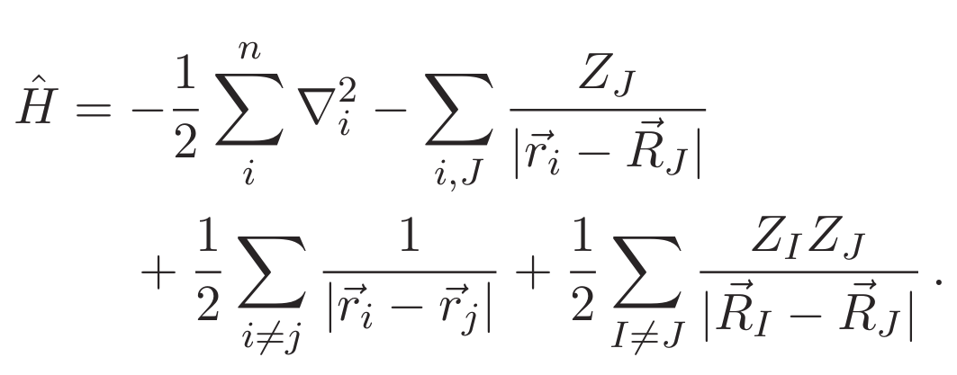
Quantum mechanics
First, intuitive way to get more accurate results:
Solve Schrodinger equation:

Slide 6
Quantum mechanics
Problems:
Impossible to solve it analytically
Possible to solve numerically but:
For a water molecule: 10 electrons
→ 10 positions * 3 dimensions
→ 30 variables, ~ 10¹⁸ TB
Need to approximate this wave-function

Slide 7
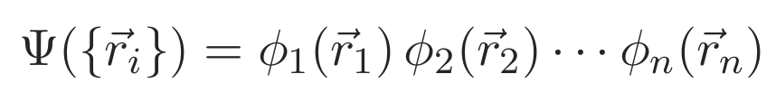
Wave-function approaches
Possible way to solve this problem:
Assume single-electron states and develop a solution from it:
→ kind of mean-field, each electron respond to the average field created by all others electrons in their single-particle orbitals.

Slide 8
Hartree-Fock method
Based on wave function approach:
→ Misses electrons correlation, system energy could be lowered
→Relatively easy to compute, it is thus used as a first step when evaluating systems

Slide 9
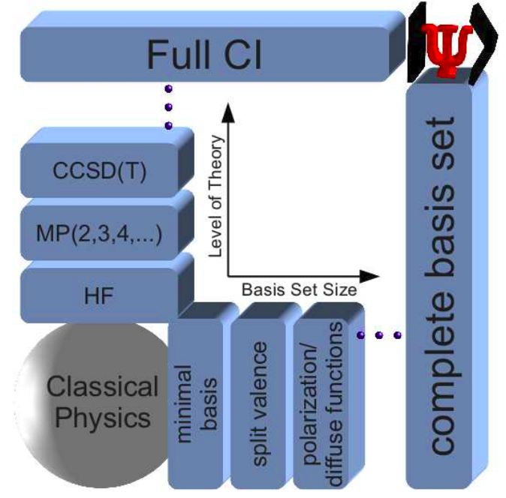
Hartree-Fock method
Post-HF methods:
Hartree-Fock methods are used as a basis to apply explicitly electron correlation correction.
Basis set: set of functions used to describe electron states.
Pople diagram,
Brian Kolb and T. Thonhauser, 2012

Slide 10

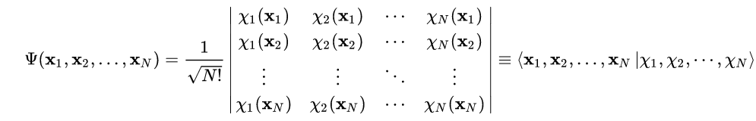
Slater determinant
Need to enforce the Pauli exclusion principle
Use of a determinant
→ When two lines in a determinant are changed, the sign of the determinant changes

Slide 11
Post-HF method: Full CI
Full Configuration Interaction
  Uses a combination of Slater determinants
  Linear combination of determinants gives the wave function
Produce all possible excitations for a given set of orbitals → most exact method
Really heavy, available only for really small systems

Slide 12
Post-HF method: Coupled Cluster Theory
Same principle as Full-CI but using only small number of excitations
CCSD(T) → Cluster Coupled Single Double and perturbative Triple
  Using two perturbation then a third one as a perturbation
  gold-standard

Slide 13
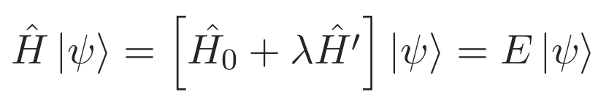
Post-HF method: Moller-Plesset
Knowing solution of the unperturbed problem:
Adding a little perturbation λĤ’, Ĥ’ considering electrons correlation
Use of orders of this theory in regard of powers of λ (MP2, MP3, …)
Higher order doesn’t always give better results!

Slide 14
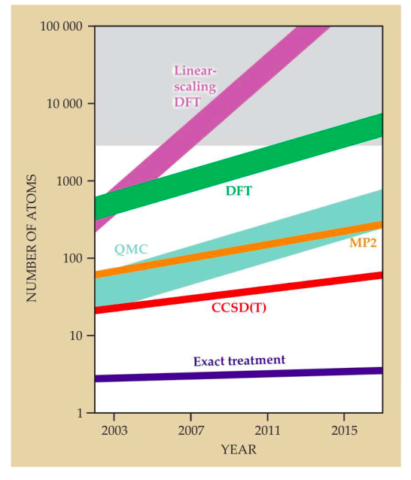
Adapted from Brian Kolb and T. Thonhauser, 2012

Slide 15
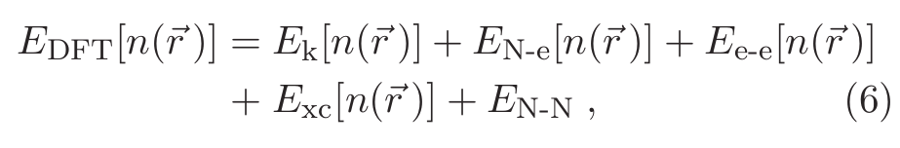
Density Functional Theory
It is possible to write the total energy of a system as a functional of the electron charge density
Can be approximated
(orbital-free methods)
Known: 1-body term
Known: Hatree term
Born-Oppenheimer approximation
→ treated as a constant
Needs to be estimated

Slide 16
Exchange-correlation Term
Main approximation in DFT
Several approaches
  Local density approximation (LDA)
  Semi-local functional = Generalized Gradient Approximation (GGA)
  Hybrid functional
Defines the method accuracy

Slide 17
van der Waals interactions
These density functions give local or semi-local answer to the problem of macromolecules
Problem: vand der Waals interactions, vital in macromolecules, are non-local
Need to find a way to take these interactions into account to model reliable biological systems

Slide 18
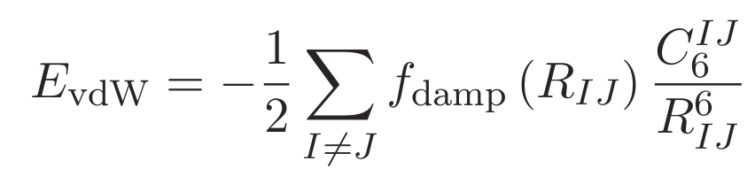
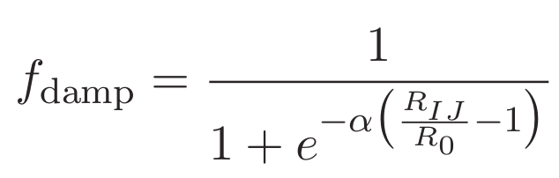
Density Functional Theory with added Dispersion
We can take van der Waals interaction into account by adding a dispersion term
The damping function goes from 0 at at small distance to 1 at long distance
Not a density functional, relies on a set of external data

Slide 19
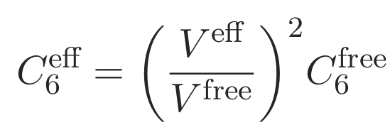
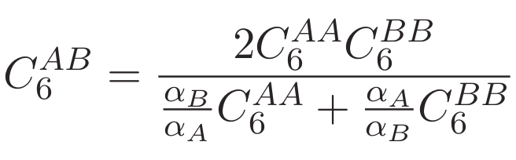
DFT + vdW
Addition of a term to make it a functional of the charge density by:
- Defining a new C₆ coefficient
- Defining a new hetero-nuclear combination
V^{eff} being the volume of the atom in a system and
V^{free} the volume of the free atom
α_{i} being the static polarizability of the atom i

Slide 20
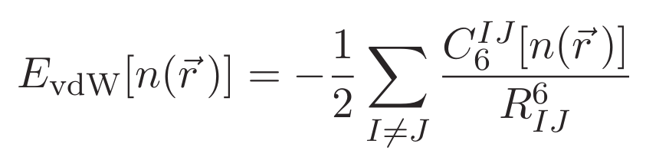
DFT + vdW
We get this new equation that depends on the charge density
It is not really clear if the really affects the energy to use this method but, according to the author, this method is less sensitive to the use of different exchange-correlation functions.

Slide 21
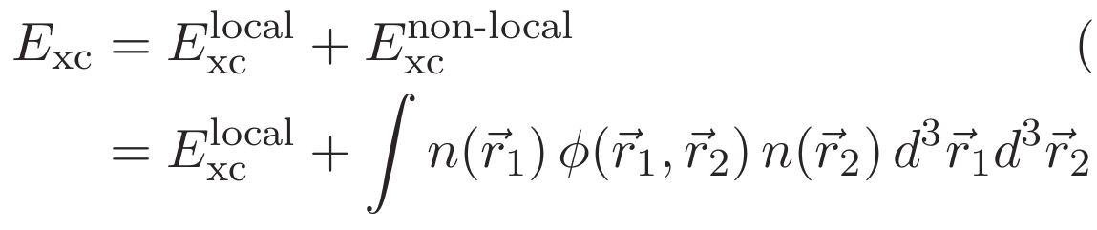
Van der Waals – Density Functional
An –in principle- optimal approach:
Considering the total energy such as a non-local functional of the density
The point of this equation being to compute the kernel function ϕ
→ How charge densities at the two positions correlate

Slide 22
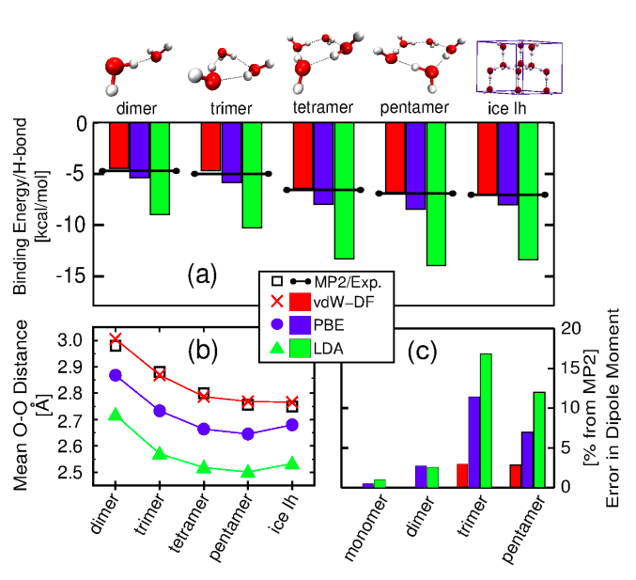
Water behavior
Force fields describe well water bulk behavior but are parameterized to do so
→overfiting
VdW-DF method tends to improve the description of water but:
→ Use of the good basis set and correlation-exchange function
→ Nuclear quantum effects?

Slide 23
Proteins simulation
Way to big to be simulated this way
Simple helical chains composed of alanine:
  Van der Waals interactions are needed to explain experimental stability

