Slide 1
QM/MM Methods for Biomolecular Systems
Hans Martin Senn and Walter Thiel
Introduction :
Thanks to the efforts of theoretical chemists, quantum mechanical methods (QM) can now give reliable geometries, energies, resactivities and electronic properties for molecules
Despite these advances: difficult and time consuming (disk & memory) to calculate accurately the structure and properties of large and complex molecular systems using purely QM methods
Hybrid methods = multiscale methods: a large molecule is divided into multiple fragments. +/- expensive and accurate methods are applied to the different fragments ie expensive QM methods with inexpensive MM methods are combined
keep in mind: with MM methods, impossible to analyse chemical reactions, bond forming/breaking, charge transfert, electronic excitations

Slide 2
QM methods :
For the chemically active regions
Describe - chemical reactions
        - electronic processes : charge
        transfer, electronic excitation
Restricted to system up to few 100 atoms

Slide 3
MM methods (force field based):
For the surrounding (prot and solvent)
Capable of treating > 100 000 atoms
Allowing for simulation over time scales of
tens of nanosec

Slide 4
QM/MM methods :
Modeling of reactive biomolecule system at reasonnable computational effort
Investigation of :
  – inorganic/organometallic systems
  – solid state systems
Studying processes in explicit solvent

Slide 5
History
1976 : beginning of the QM/MM era applied to an enzymatic reaction
1990:
  coupling of semi empirical QM methods to CHARM (Chemistry at Harvard Macromolecular Mechanics) force field, widely used set of force fields for molecular dynamics
  Evaluation of the accurency and effectiveness of the QM/MM treatment against ab initio and experimental data
2000-2010:
  Application of QM/MM approach to biomolecular problems
  QM/MM approach in combination with modern rate theory and techniques for enzymatic reactions (quantum nature of atomic motion, free energy and reaction path method)

Slide 6
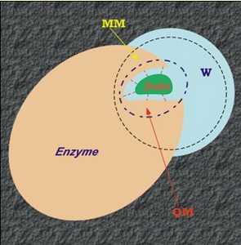
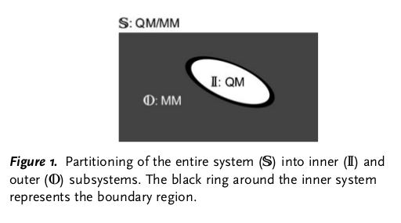
Basic methodological features of the QM/MM approach:
We have to add coupling terms due to QM-MM interactions
I) Partitioning

Slide 7
Boundary regions: QM and MM procedures are modified/augmented
Consists of atoms that appear in both the QM and MM calculation
May contain additional atoms that cap the QM subsystem
When boundary change during the course of simulation ie shifting active region → adaptative partitioning, hot spot methods. For us, boundary region is define once and for all at the start.

Slide 8
2) Choice of suitable QM and MM methods
In practice:
density functional theory (DFT) as QM method due to its favorable computational effort/accuracy ratio
semi empirical QM methods remain important
Post Hartree Fock(HF) ab initio correlation methods → the most accuracy methods based on Moller-Plasset permutation theory
Linear-scaling local correlation methods → extended the size of systems that can be treat
Empirical valence bond method: to model influence of the solvent and protein environment on reactions
Several biomolecular force fields available:
AMBER, CHARMM, GRAMOS...

Slide 9
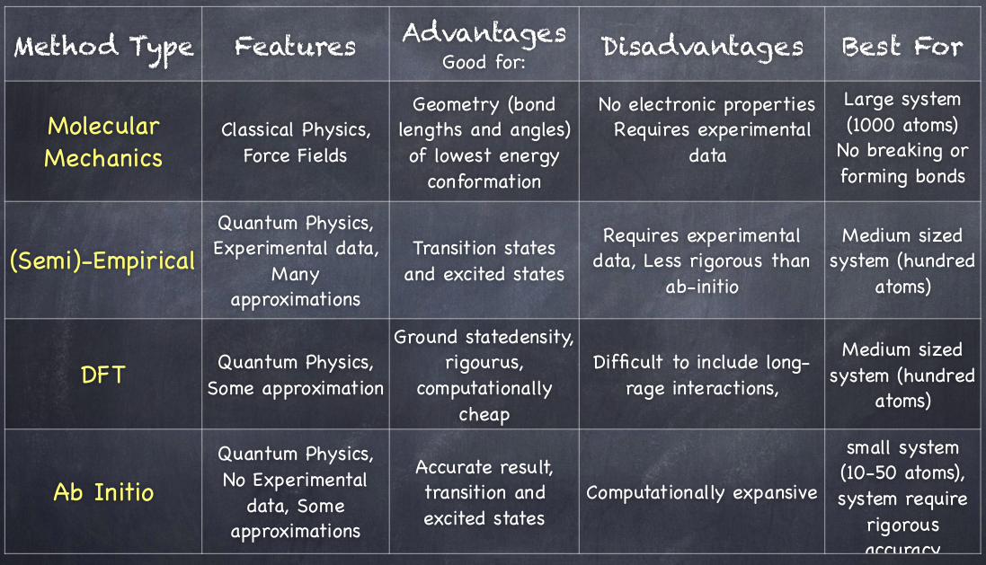
QM/MM methods
AM1,
CNDO/2,
INDO,
NDDO,
MOPAC,
AMPAC,
SPARTAM,
ZINDO
HF, Post HF, Valence bond method

Slide 10
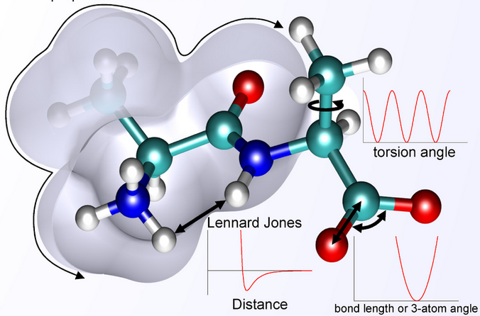
The MM energy expression
MM regions contains bonded terms:
– bond stretching
– angle bending
– torsions
– out of plane
deformations

Slide 11


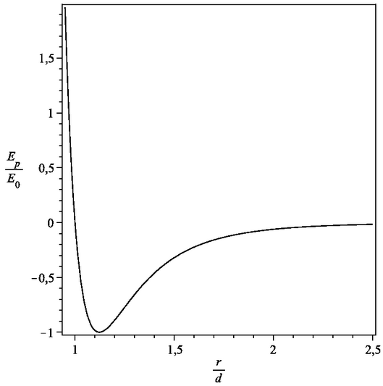
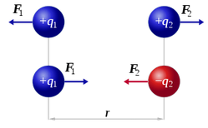
The MM energy expression
Bound lenght
Bound angles
Torsion angle
Lennard Jones potentiel (VdW)
= interaction between 2 atoms in rare gas
Coulomb interaction term

Slide 12
Partitioning: Subtractive vs additive schemes
Subtractive: several layers: QM-MM double counting on the regions is subtracted
Additive: different methods in different regions
+ interaction between the regions

Slide 13
QM/MM Additive scheme
O
L
I
+
QM
MM
Total energy
O+I+L = S
Interactions
Interactions
+
QM
MM
Coupling term

Slide 14
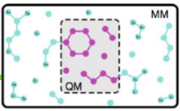
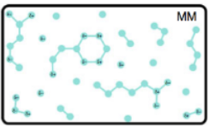


QM/MM Subtractive scheme
O
L
I
MM
+
-
QM
MM
Total energy
O+I+L = S
+
-

Slide 15
Advantages and disadvantages of
QM/MM Subtractive schemes
Advantages:
  – simplicity because no QM-MM coupling term
  – usage of standard MM and QM methods without modification
Disadvantages:
  – require complete set of MM parameters for inner system
  – QM-MM interactions treated at MM level
  – QM doesn’t incorporate charges of MM region

Slide 16
ONIOM approach
( subtractive scheme)
EIMOMM(S)= EMM,real(S) + EQM,model(I+L) - EMM,model(I+L)
EIMOMO(S)= EQM1,model(S) + EQM2,real(I+L) - EQM2,model(I+L)
IMOMM = ONIOM2(QM:MM):
IMOMO = ONIOM2(QM1:QM2):

Slide 17
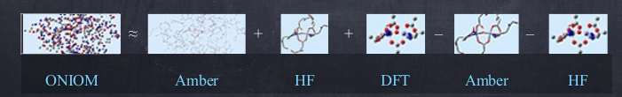
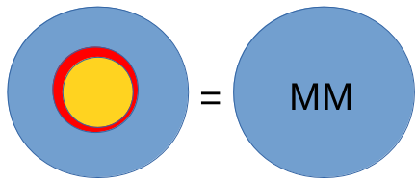




Exemple of ONIOM application
EONIOM(S)= EAMBER(S) + EHF(I) + EDFT(L) – EAMBER(I) – EHF(L)
EONIOM(S)= EMM(S) + EQM(I) + EQM(L) – EMM(I) – EQM(L)
+
+
-
-
EIMOMM(S)= EMM,real(S) + EQM,model(I+L) – EMM,model(I+L)

Slide 18

Additive QM/MM
We have to treat the different interactions:
  – bonding interactions
  – Van der Waals interactions
  – Electrostatic interactions (mechanical/electrostatic/polarized embedding)

Slide 19
  Electrostatic interactions (mechanical/electrostatic/polarized embedding)
  Mechanical embedding
QM-MM interaction are treated at the MM level.
Rigid atomic point charges are applied to the QM region
Advantage: computationally efficient
Disadvantages:
– Outer region charges don’t interact with QM density
– when charge distribution in QM region change (reaction), it could cause discontinuities in the potential energy surface
– the derivation of the MM point charges for Inner region isn’t trivial
– these MM charges don’t reproduce the true charge distribution in the Inner region faithfully

Slide 20
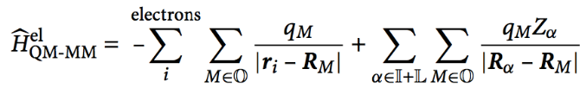
Mechanical embedding
The solution is to perform QM calculation in presence of the MM charge model
Incorporation of the MM point charges as one electron terms in the QM Hamiltonian

Slide 21
  Electrostatic interactions (mechanical/electrostatic/polarized embedding)
Electrostatic embedding:
Inner region can adapt to changes in the charge distribution of the environment and can be polarized by the Outer region MM charges
advantages:
– no charge model needs to be derived for the Inner region
– QM-MM electrostatic interaction is treated at the QM level → more accurate
disadvantages:
– QM treatment increase the computational demands (especially for the calculation of the Coulonb forces→ QM density acting on the many MM point charges)
General issue of compatibility between MM charge model and QM electron density:
the electrostatic MM parameters don’t represent faithfully the real charge distribution.
Common practice: from QM calculation, apply a true charge distribution into the MM model, results are reasonable when used with widely MM set force field

Slide 22
  Electrostatic interactions (mechanical/electrostatic/polarized embedding)
Polarized embedding:
One consider the polarization of the MM regions due to the charge density in the inner one
a polarized charge model in MM region is polarized by the QM electric field but doesn’t itself act back on the density
a fully self consistent formulation that include the polarizable MM model into QM Hamiltonian and so allow for mutual polarization

Slide 23
  Van der Waals interactions
Treated at the MM level
Non depending of the additive or subtractive scheme
Described by Lennard Jones potential
Appropriate parameters requested for QM atom in Inner region
Configuration change of QM atoms during reaction involve the following question: switch or not of parameters from reactant description to product description →short range nature of the VdW interactions decrease these complications and only QM region atoms closest to the boundary contribute significantly

Slide 24
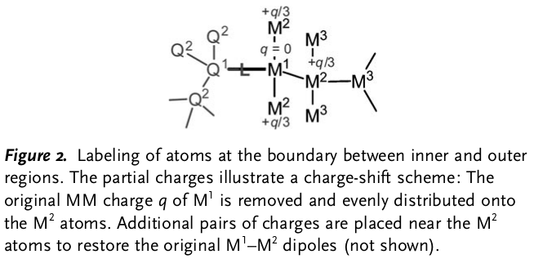
  Covalent bonds crossing the QM/MM boundary
Q1 & M1
= junction/boundary atoms
Simplest solution:
define subsystems such that the boundary doesn’t pass throught a covalent bond (explicit solvation studies: solute at QM level and surrounding at MM level)
For enzymatic reaction involving partners not covalently bonded to the enzyme

Slide 25
  Covalent bonds crossing the QM/MM boundary
But in many cases, QM-MM boundary cuts through a covalent bond → 3 issues:
1- The dangling bond ( which stay in the void) of the QM atom Q1 must be capped
2- for electrostatic or polarized embedding, overpolarization of the QM density by the MM charges close to the cut has to be prevented
3- bonded MM terms → atoms from both subsystems have to be selected such that double counting of interactions is avoided
main goal: achieve a well-balanced description of QM-MM interactions

Slide 26
3 different classes of boundary schemes
Link-atom schemes → additional atomic center L, not part of the real system, covalently bound to Q1 and saturates its free valence.
This new center creates somes issues:
– each link atom generates 3 artificial structural degrees of freedom not present in real system
– the link atom and the QM electron density is spatially very close to the MM frontier atom M1 so that the point charge of M1 will tend to overpolarize the QM density in the case of electrostatic or polarized embedding
– The link atom is generally chemically and electronically different from the group which it replaces.
Approach to reduce overpolarization:
- deletion of the one electron integrals associated with the link atom
- Deletion of MM point charges in the link region from the Hamiltonian
- Shifting of the point charges in the link region
- Stack the charges close to the QM region by replacing them by charge distribution

Slide 27
3 different classes of boundary schemes
Boundary-atom schemes: the MM atom M1 is replaced by a special boundary atom that appear in both QM and MM calculation. This boundary atom mimics the cut bond and its electronic characters of the MM moiety attached to Q1 on the QM side and in the MM calculation, it behaves as a normal MM atom.
This scheme is based on a type of monovalent pseudopotential that is parametrized to repoduce certain desired properties.
Ex: at a cut C-C single bond, methyl group is mimiced

Slide 28
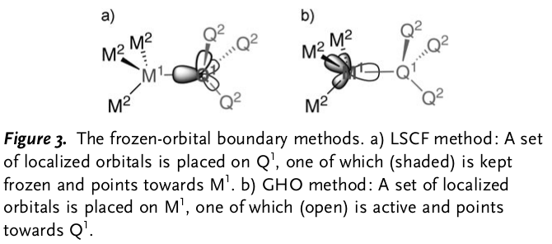
3 different classes of boundary schemes
Localized-orbital schemes place hybrid orbitals at the boundary and keep some of them frozen. They serve to cap the QM region, replacing the cut bond
– LSCF (local Self Consistent Field): QM calculation on a model system that contains the frontier bond. A strictly localized bond orbital for this bond is constructed and contains contributions from the frontier atoms only.
– GHO (Generalized Hybrid Orbitals) constructs localized hybrid orbitals and freezes some of them. It places the set of localized hybrid orbitals on M1 rather than Q1

Slide 29
QM/MM applications
3 strategies:
  – add QM functionality to an MM package
  – add MM functionality to an QM package
  – coupling existing QM and MM programs in
  a modular manner
Advantage of the first 2 strategies: inherent strengths brought with the basic package
Advantage of the last strategy: more flexible, common user interface
For a long time: biomolecular QM/MM application dominated by enzymatic reaction
More recently:
  – QM/MM calculation of spectroscopic and excited-states properties
  – QM/MM structure refinement (combination with experimental data: NMR, X-ray diffraction)

Slide 30
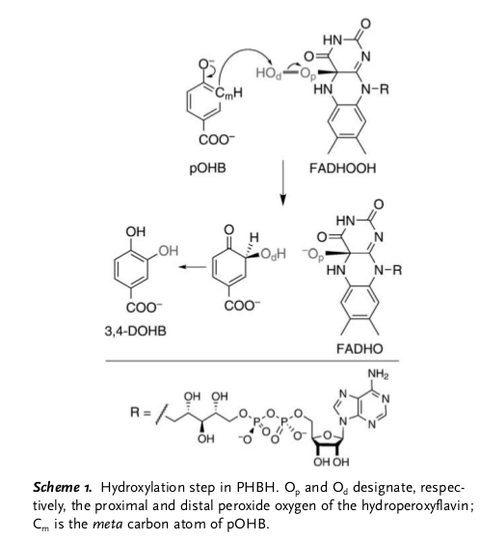
Enzymatic reaction
Monooxygenase:
Para-HydroxyBenzoate Hydroxylase (PHBH)
Active in soil bacteria: role in oxidative degradation of aromatic compounds such as lignin
FADHOOH
=
“OH” donor
Cofacteur: flavin-adenine dinucleotide
= FAD
Substrate =
p-hydroxybenzoate
Isoalloxazine
PHBH:
- activate Substrate by deprotonation
-prepare the ‘OH’ donor
-protect it from reaction with water
- keep the 2 reactants in favorable position for reacting
3,4-dihydroxybenzoate

Slide 31
Enzymatic reaction
Hydroxylation step of the PHBH catalytic cycle = prototype systems for computational studies on enzyme reactions
Provide evidence for the dianionic state of the active substrate
AM1(Austin Model 1 = semi-empirical QM method) applied to the substrate and the isoalloxazine part of FADHOOH
CHARMM force field applied to the remaining part of the cofactor and to the whole protein including crystal water

Slide 32
Enzymatic reaction
Conclusion:
the activation barriers obtained correlated well :
– with the experimental turnover rates of pOHB
– with experimental rate constants for the hydroxylation step
Corroborate the SEAr mechanism and the dianionic state of the substrate
Global effect of the surrounding protein on the energetic of the reaction found to be relatively small

Slide 33
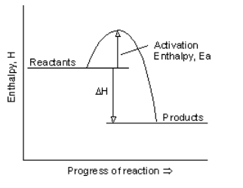
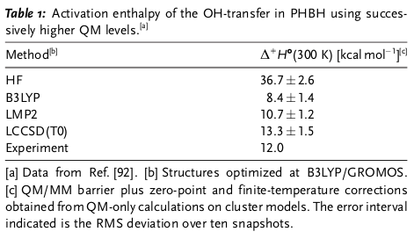
Aromatic electrophilic substitution
=12 kcal/mol
-55 kcal/mol
Enlarged model with a fully hydrated protein and a shell of water molecules around it
GROMOS force field (MM) combined with different QM methods: Hartree Fock, DFT (B3LYP), LMP2 and LCCSD, optimization started from 10 snapshots taken from MD simulations
ccl: – HF drastically overestimates the barrier height
  – B3LYP underestimates it

Slide 34
  QM/MM methods to calculate spectroscopic properties and investigate electronically excited-states
Obtain vertical electronic excitation energies
Obtain magnetic resonance spectroscopic properties
Mössbaur spectroscopic parameters:
to elucidate the high oxidation state intermediates of iron-dependant enzyme (cyt P450)
Excited state reactivity:
– photoactivate trans-to-cis isomerization of the p-coumaric acid chromophore in the photoactive yellow protein
– photoactivate C-G base pair in DNA

Slide 35
Thank you for your attention

