Slide 1
Project Presentation
CCP6214 Algorithm Design and Analysis
TC3L | T10L & T11L
241EC240NH | Morin Thomas
1211103146 | Cheryl Gwee En Xin
1191202880 | Abdullah Muawia Mustafa Hummeida
1211104262 | Julian Vijay

Slide 2
Table of contents
Question 1
Data Set 1 & 2
Question 2
Heap Sort &
Selection Sort
Question 3
Kruskal &
Dijkstra
Question 4
Knapsack

Slide 3
01
DataSet

Slide 4
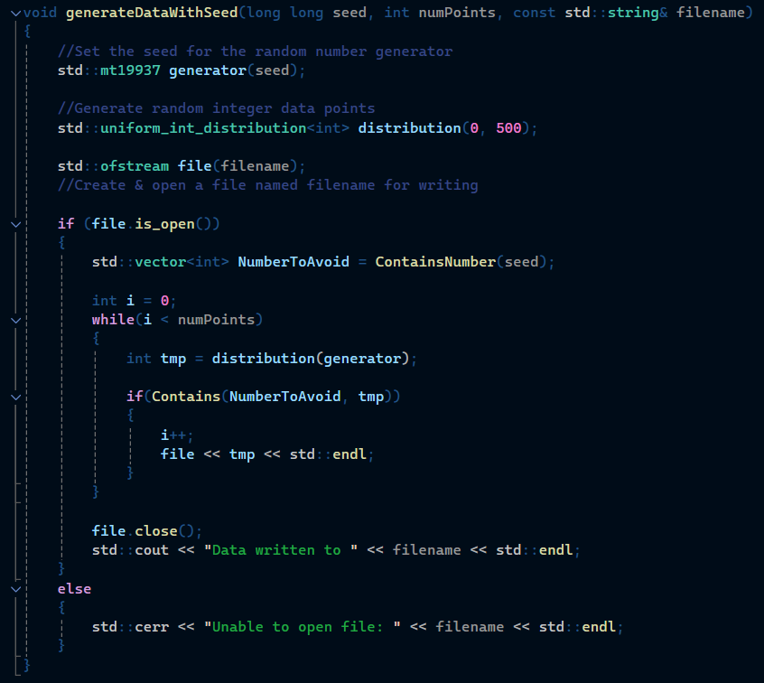
DataSet 1
mt19937 generator(seed)
Pseudo-random number generator class based on the Mersenne Twister.
uniform_int_ditribution<int>
Generate uniformly distributed integers in a specific range.
ContainsNumber(seed)
Find which number should be present from the seed
Contains(NumberToAvoid, tmp)
Determine if a digit present in tmp should be avoided

Slide 5

DataSet 2

Slide 6
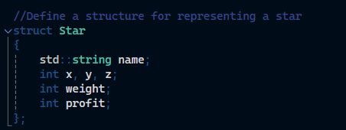
Creation of a struct for our Stars
Name
Coordinates
Example: A, B, ..., T
Its position in a 3D space
Weight
Profit
The weight of the star
The profit of the star

Slide 7
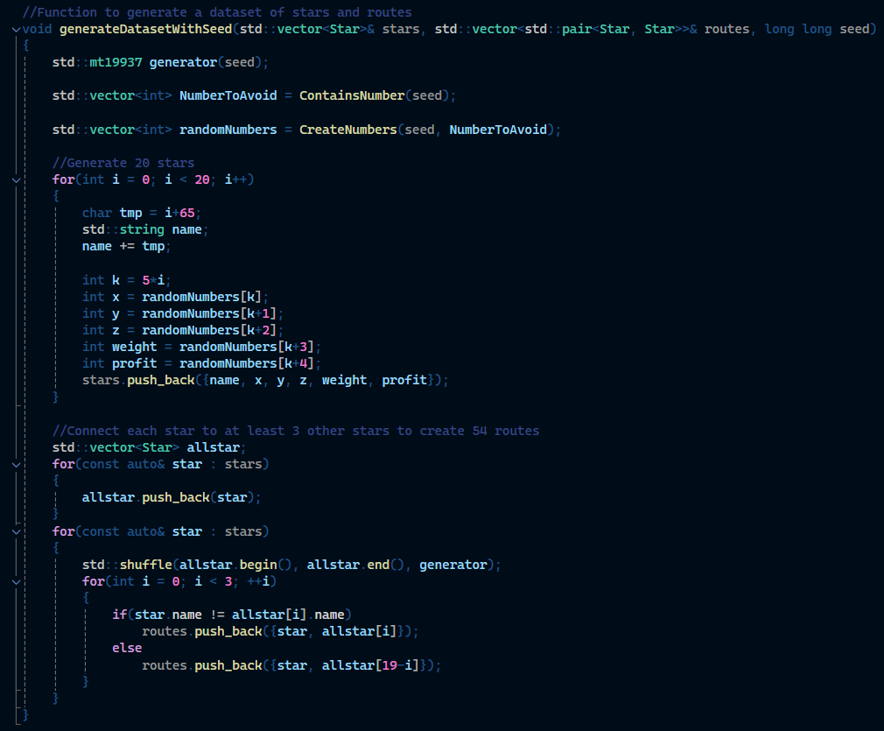
Creation of the second DataSet
100
Generate all random numbers
Create a array of 100 random numbers from the seed
20
Creation of 20 Stars
Iterate over this array to create our stars
54
Add routes
Create routes between stars, at least 3 for each of them

Slide 8
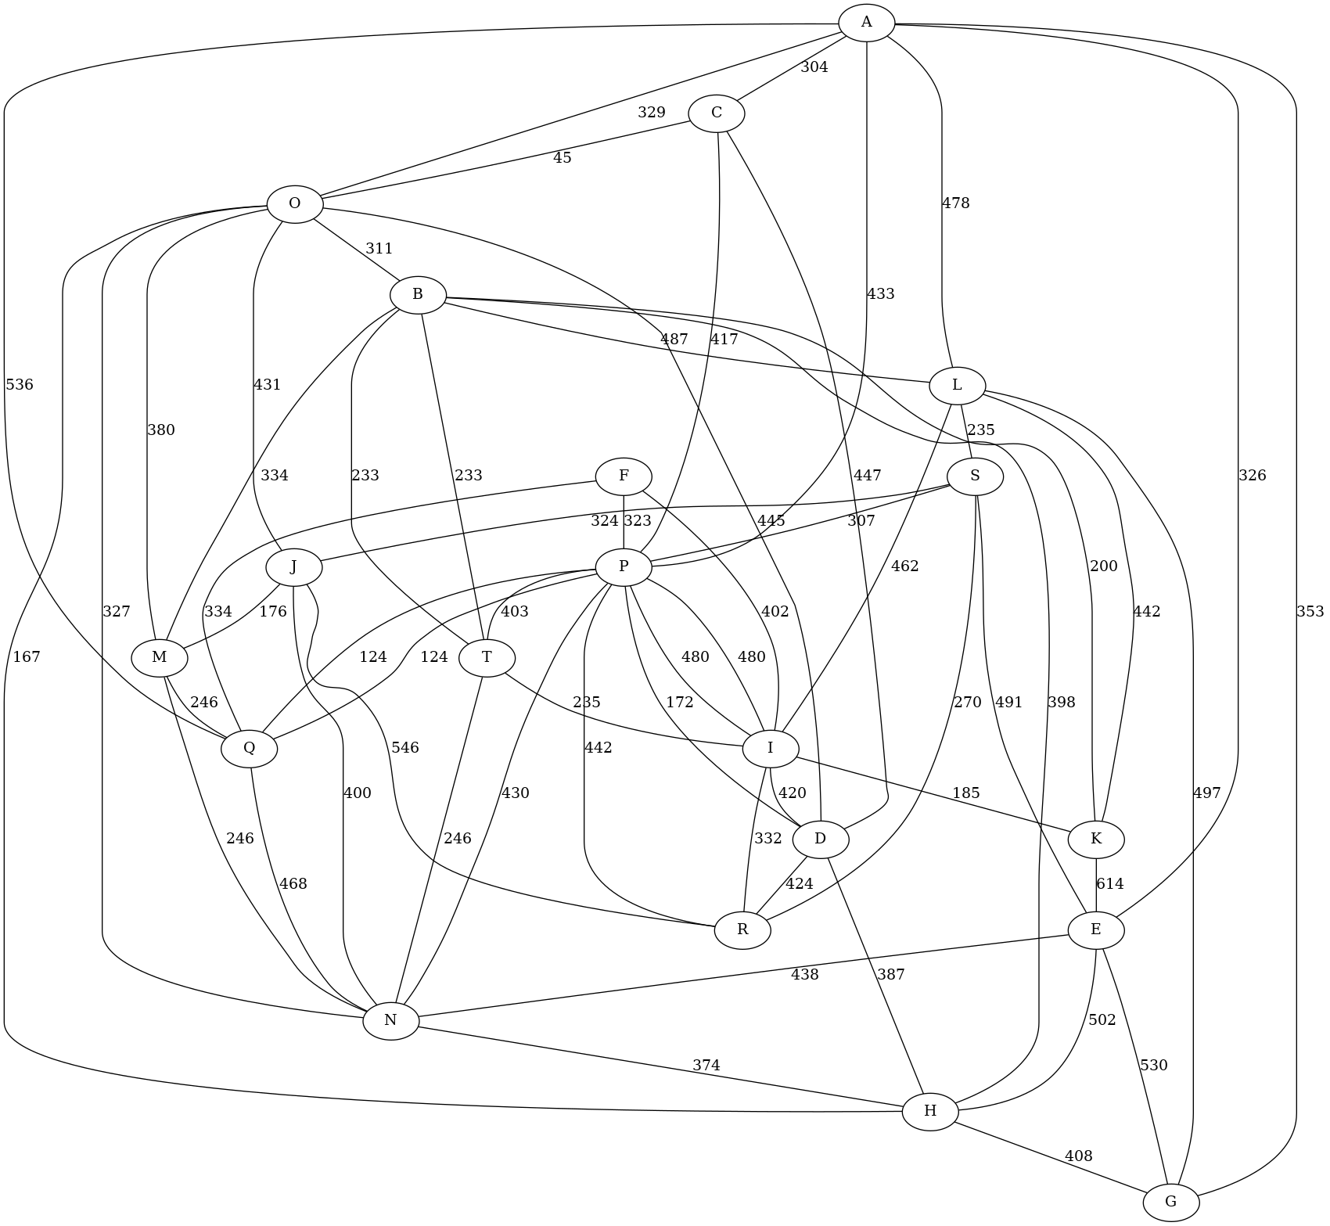
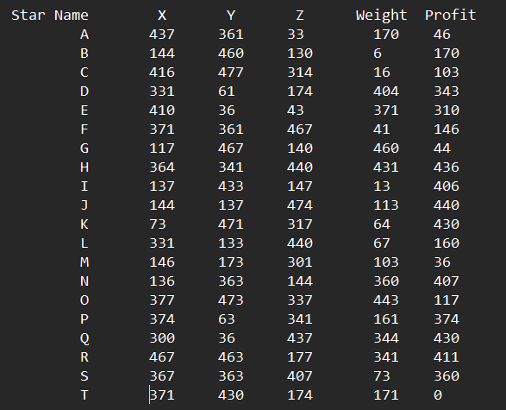
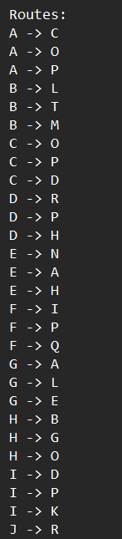
Universe :

Slide 9
02
Sorting Algorithms

Slide 10
Heapsort
Types of heaps
Max heap: The root node is the largest element.
Min heap: the root is the smallest element.
Definition
Heapsort is a comparison-based sorting algorithm that uses binary heap data structure
Efficiency
Heapsort has a time complexity of O(n log n) and is suitable for large datasets.

Slide 11
Heapsort Algorithm steps
2. Extract the maximum element
1. Build a Max heap
3. Heapify the root
4. Repeat
Start from the last non-leaf node and heapify each node.
-Swap the root with the last element of the heap.
-Reduce the heap size by one.
Heapify the root of the tree to maintain the heap property.
The extraction and heapification process until the heap size is greater than 1

Slide 12
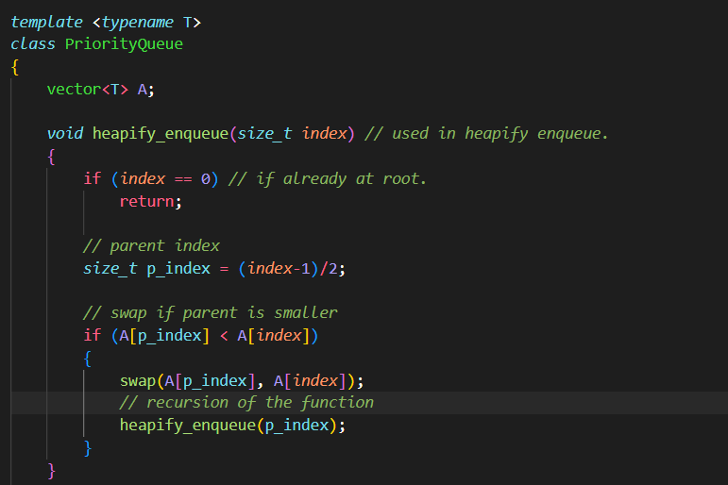
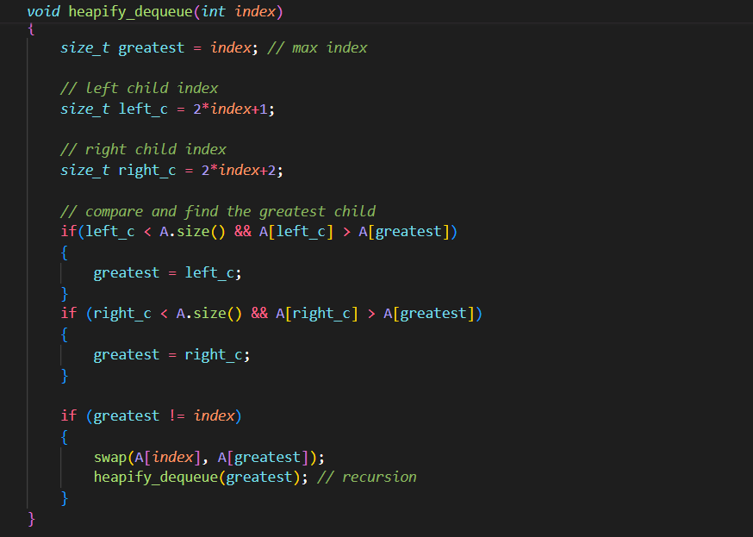
Coding Example of Heapsort

Slide 13
Selection Sort
Definition
Selection Sort is a simple comparison-based sorting algorithm.
Efficiency
Process
Selection sort has a time complexity of O(n^2), making it inefficient for large datasets but easy to understand and implement.
Repeatedly finds the minimum element and moves it to the sorted part of the array.

Slide 14
Steps of Selection Sort
Find the minimum element in the unsorted part of the array
Swap the minimum element with the first element of the unsorted part
Move the boundary of the sorted part one element to the right.
Repeat until the entire array is sorted.

Slide 15
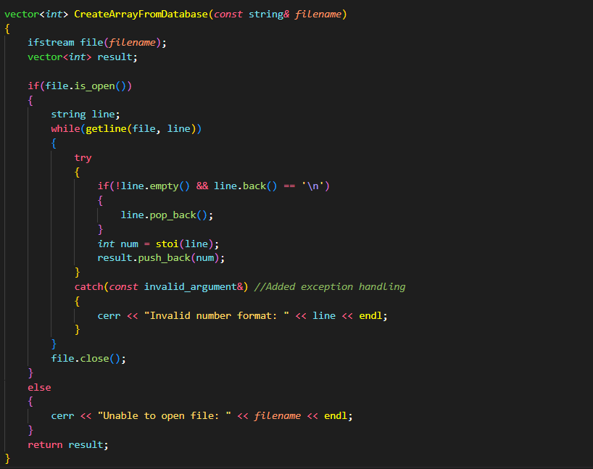
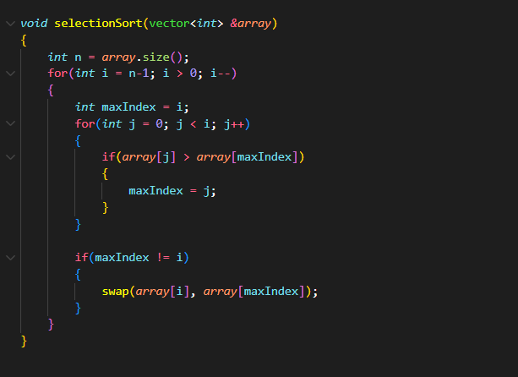
Coding Examples of Selection Sort

Slide 16
Comparison Between Heap and Selection Sort
Efficiency
Heapsort: O(n log n)
Selection Sort: O(n^2)
Memory Usage
Heapsort: O(1) auxiliary space.
Selection Sort: O(1) auxiliary space.
Stability
Heapsort: Not stable
Selection Sort: Not stable
Use Case
Heapsort: Large datasets, when stability is not required.
Selection Sort: Small datasets, educational purposes.

Slide 17
Conclusion of Heapsort and Selection Sort
Heapsort: Analysis: Its time complexity is O(n log n), which makes it efficient in large data sets; however, it is not stable.
Selection Sort: Just, helpful for small data sets, for teaching purposes, the complexity of processing is O(n^2).
Choosing an Algorithm: This is highly depended on data size, if the data set is huge then how stable the tree should be, and application of the trees etc.

Slide 18
03
Shortest Path & Minimum Spanning Tree

Slide 19
Dijkstra's Algorithm
Objective: To discover the shortest routes from a beginning node (star) to all other nodes in a network that has weight using the algorithm known as Dijkstra.

Slide 20
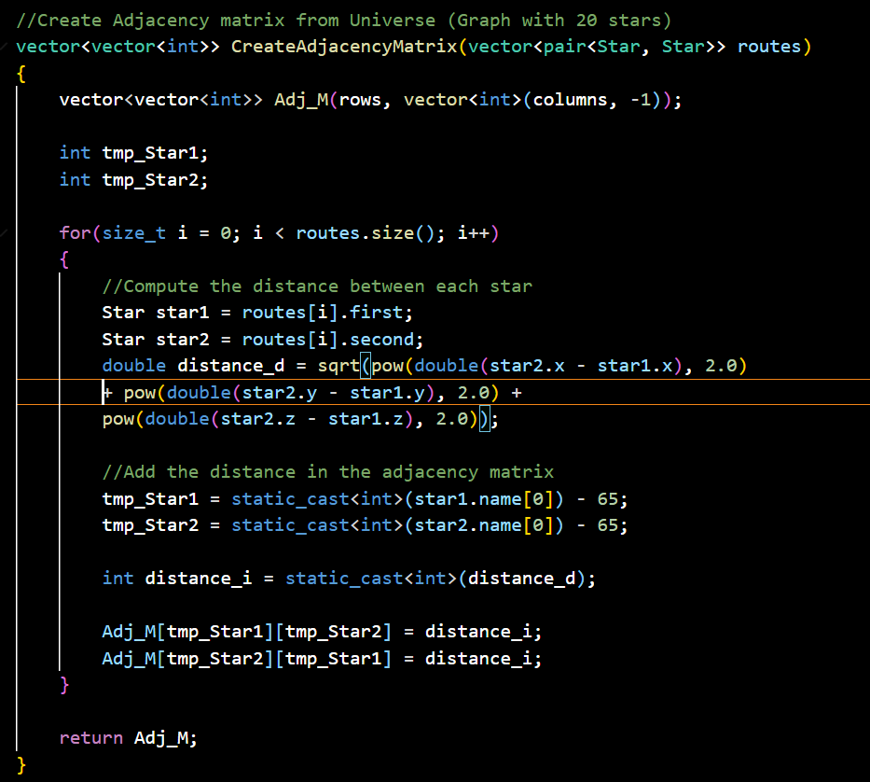
Adjacency Matrix Creation
01
This function takes in a list of routes(pairs of stars) and creates an adjacency matrix where each cell [i][j] has got the distance from star i to j.
02
Create a 20x20 matrix with -1.
03
Calculate the Euclidean distances between the stars and populate the matrix symmetrically.

Slide 21
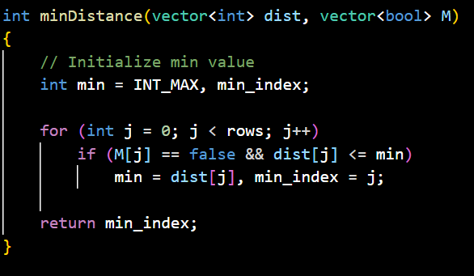
Utility Function for Minimum Distance
1
Search for the vertex having the lowest distance value and that is not yet part of the shortest path tree.
2
Goes over all vertices to identify an unprocessed vertex of least distance.

Slide 22
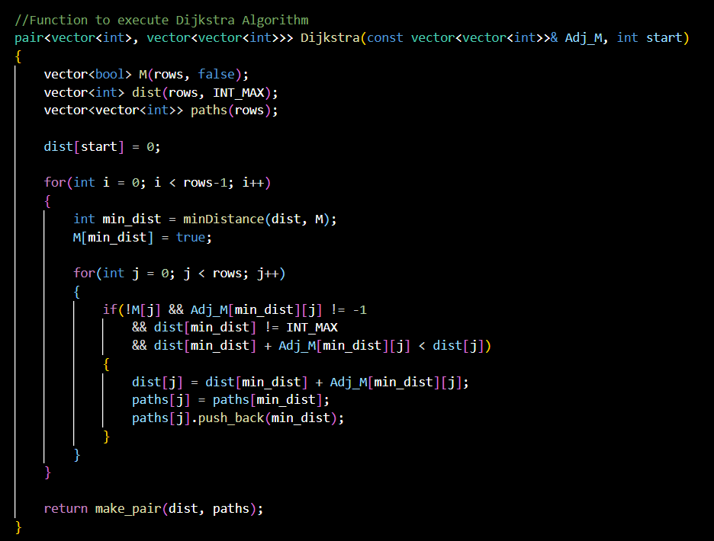
Dijkstra's Algorithm Implementation
The code demonstrates how we use Dijkstra's algorithm in finding shortest path from source node to all other nodes.
The distance and path vectors are initialized.
A boolean array is employed in marking vertices that have been pro
Updates the distance values of the vertices adjacent to the picked vertex.
Records path to reconstruct the shortest path.

Slide 23
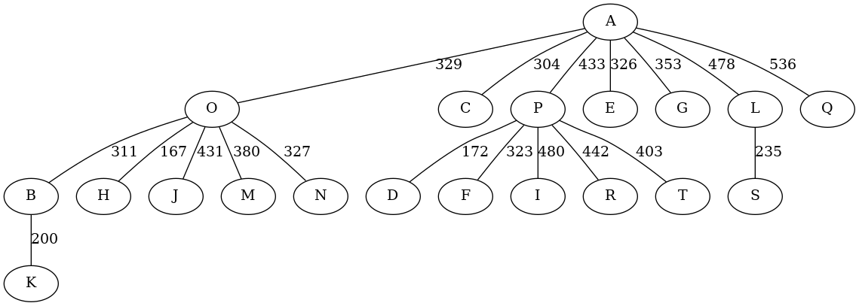
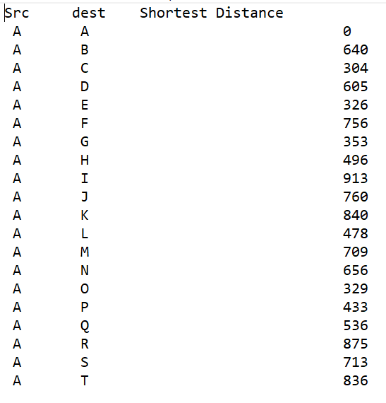
Generating Output Files
1
2
Generates a .dot file for the shortest paths visualization with Graphviz.
This program writes the edge connectivity data and put down the numerical values of the weights into a file in Graphviz format.
Saves a text file with a list of minimum distances from source vertex to every other vertex.
A human-readable form is used for formatting and displaying the results.

Slide 24
Dijkstra Conclusion
Offers a fast way to calculate the shortest paths on a graph.
This algorithm is applicable in different areas like routing of networks, navigation systems, and analysis based on spatial data.

Slide 25
Kruskal's Algorithm
The code shows how Kruskal’s Minimal Spanning tree algorithm is applied in finding the shortest path linking all vertices of a graph.

Slide 26
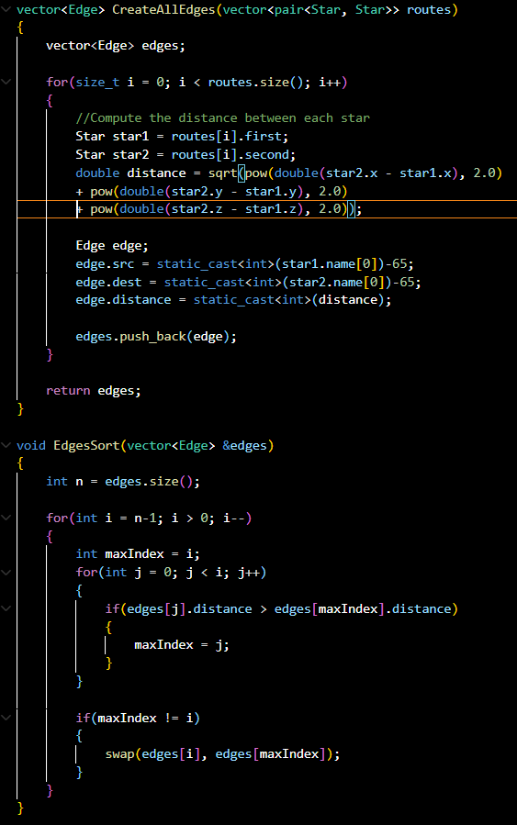
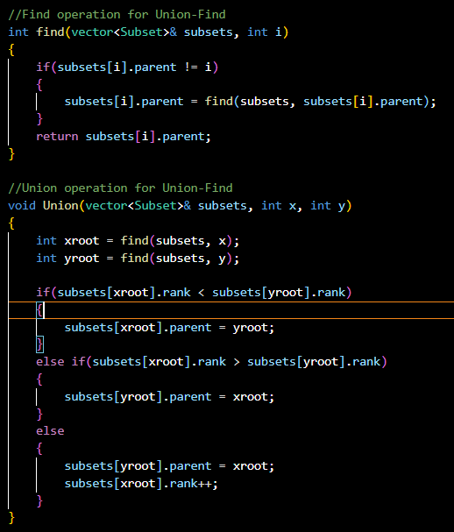
Functions Explanation
01
CreateAllEdges: Take a collection of star routes and transform that into a list that contains the edges with their corresponding Euclidean distances.
02
EdgesSort: Edges are classified based on how far apart they are from each other using a basic algorithm that arranges them in an orderly fashion known as a selection sort.
03
find: Executes the find operation using the Union-Find algorithm along with path compression.
Union: Includes the union operation of the Union-Find algorithm which has union by rank

Slide 27
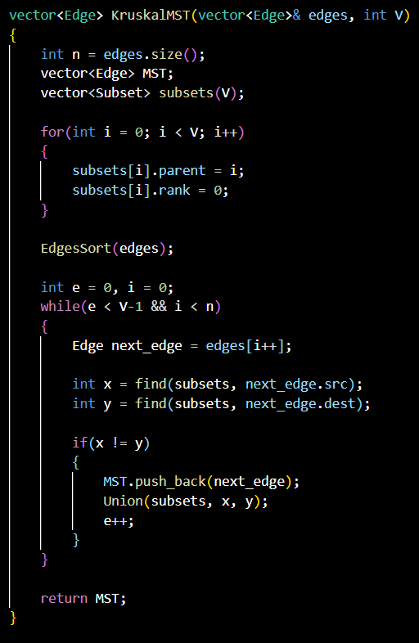
Kruskal's Algorithm Implementation
Arrange all the edges using EdgesSort by their weight in non-decreasing order.
Set up subsets for each vertex
Choose the smallest edge and see if it creates a cycle with the current spanning tree by using Union-Find
When a cycle is not formed, add the edge to the MST and union the sets
Repeat this until the total number of edges is reduced to (V-1) in the MST.

Slide 28
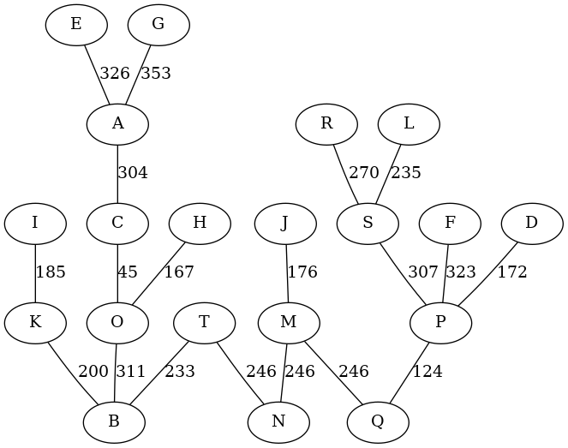
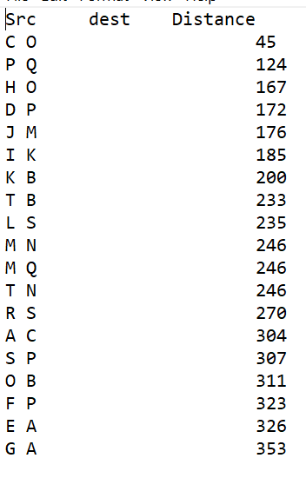
Visualization and Output
1
2
convertToDot: Creates a .dot file that can be used to visualize the MST with the aid of graph visualization tools such as Graphviz.
CreateTxtFileMST: It’s a clear and concise text file summary that stores the MST details.

Slide 29
Efficiency Considerations
The algorithm uses Union-Find with path compression, enabling efficient cycle detection and union operations.
For this particular problem, selection sort is used to sort the edges. This is largely because its simplicity is just perfect for such a small dataset without much performance difference being made at all.

Slide 30
04
Knapsack
Problem: Identify the set of star(s) to visit using the 0/1 Knapsack Algorithm with a capacity of 800kg to achieve the best profit while minimizing weight

Slide 31

Reference
For this problem, we have studied and referenced existing codebases to improve our existing understanding of the 0/1 Knapsack Algorithm implementation.
https://github.com/williamfiset/Algorithms/commit/267df20

Slide 32
Approach Taken
Recursion
Bottom-up Approach
For each item, there is two choices: either include it in the knapsack or exclude it from the knapsack. By considering the ------, this approach leads to inefficient calculation as redudancy occurs.
The issue of recursion is addressed by storing the results of expensive function calls and reusing them when the same input occurs again. This ensures each subproblem is only solved once, making it a more efficient algorithm.

Slide 33
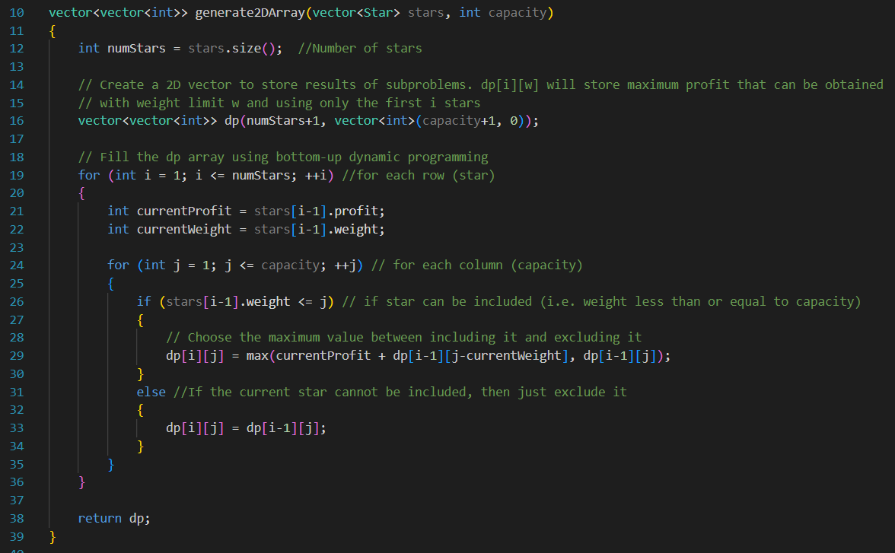
Functions Explained: Part I
generate2DArray
This function takes the number of stars and the capacity for the initialization of the 2D vector. Then for each cell, it checks whether or not to include the star. The star has to pass through two checks to be included—the star weighs less than the capacity, and the profit for including the star is higher than not including it.

Slide 34
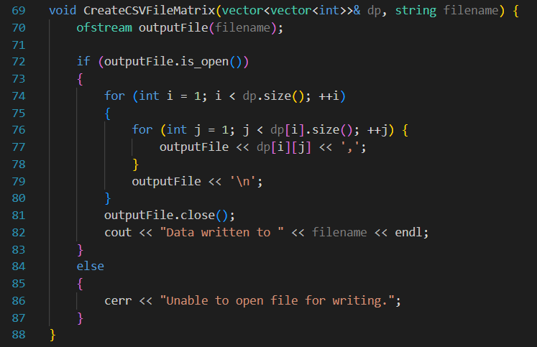
Functions Explained: Part I
CreateCSVFileMatrix
This function will create a CSV file that lists out all the cell values for the 2D array with a comma and a space in between each value to differentiate from the cells.

Slide 35
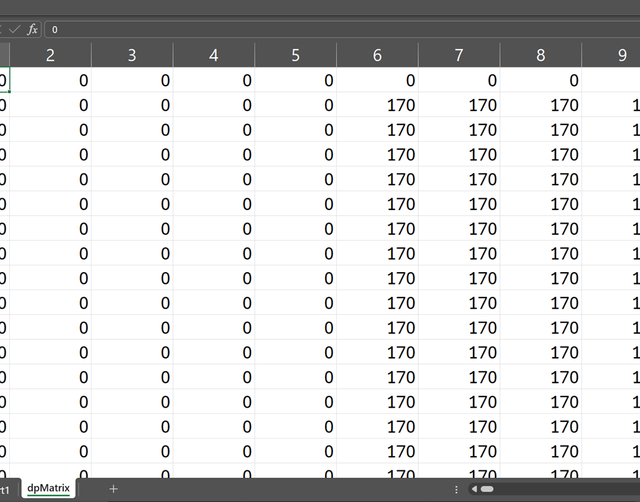
Screenshot of
Resulting Matrix
We have chosen the .csv file format for exporting to better represent the results of the 2D array

Slide 36
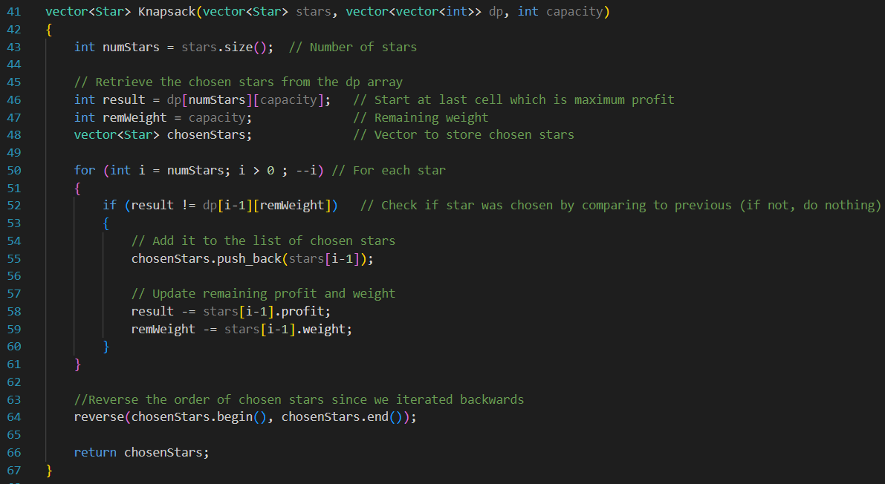
Functions Explained: Part II
Knapsack
This function obtains the list of selected/chosen stars by iterating through the rows from the previously generated 2D array. It starts from the very last cell which is also the value of the maximum obtainable profit. If the value in the cell is not equal to the value of the cell above it (the previous star), it means that it was chosen. It will thus be listed down in the chosenStars vector.

Slide 37
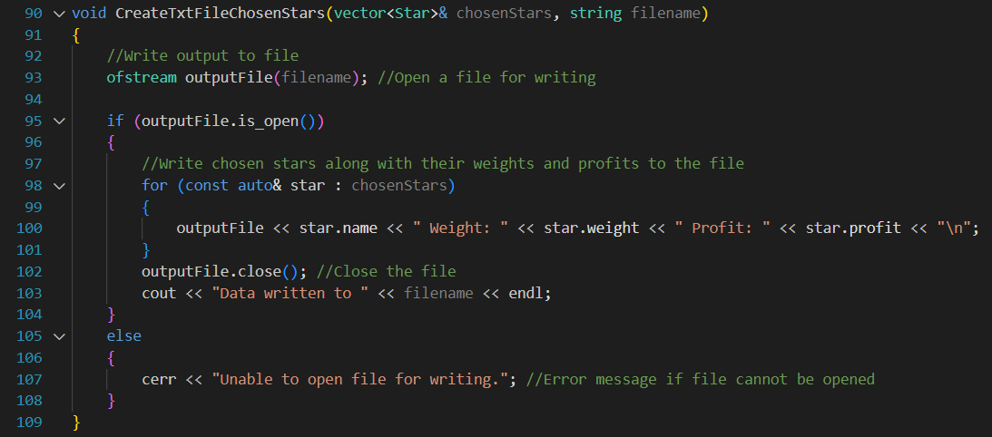
Functions Explained: Part II
CreateTxtFileChosenStars
This function creates a file for writing, and writes down the chosen star names along with their weight and profit to the file. The file will then be closed.

Slide 38
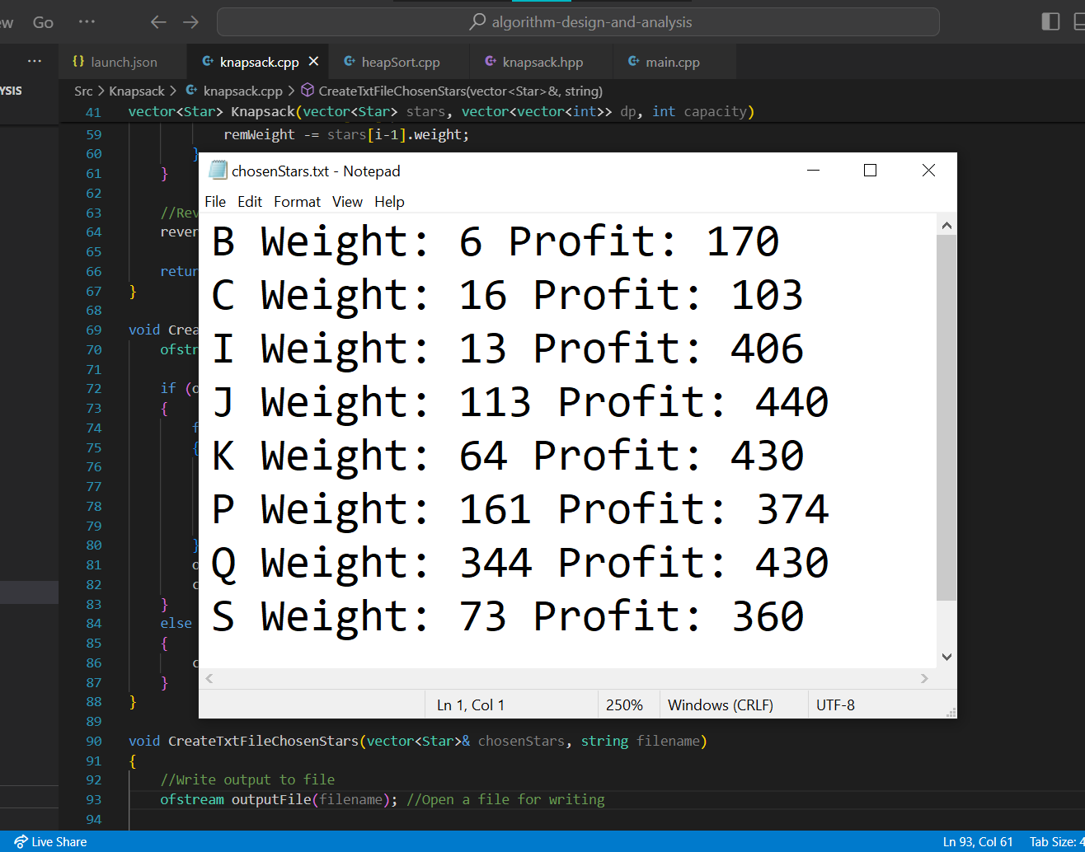
Screenshot of
Chosen Stars
The resulting stars that have been chosen will have their name, weight and profit recorded down in a human-readable text file.

Slide 39
Time & Space Complexity
 | Complexity | Item | Reasoning
Time | O(N*W) | N: the number of items W: the capacity | Computes each entry in the 2D array
Space | O(N*W) | N: the number of items W: the capacity | The 2D array that stores solutions to subproblems

