Slide 1
Driving Behavior Analysis (Under the guidance of R.B.V. Subramaanyam Sir)
Introduction
Type of Dataset (Spatio-Temporal)
Why GPS data is suitable
Framework Used
Relevance of the framework

Slide 2
Attribute Definitions
Driving Operation
Driving State : <direction, speed>
Driving State Transition Graph

Slide 3
Problem Statement
Driving Behavior Analysis can be abstractly seen as “capturing driving behavior profiling with GPS traces”. Formally, given a driver (a vehicle) and corresponding GPS trajectories, it is aimed to find a mapping function that takes the GPS trajectories as inputs, and outputs a sequence of time-varying yet relational vectorized representations in order to quantify the dynamics of the driver’s driving behavior. The said problem is formulated as a task of spatio-temporal representation learning. As per their proposal, first it is necessary to construct a sequence of driving state transition graphs from GPS trajectories, and then learn the latent representations of driving behavior from the graphs.

Slide 4
Challenges
• As the raw GPS data might not be suitable for classical or advanced mining algorithms, so it highly necessitates a novel method to transform GPS traces into an appropriate structure that can effectively characterize driving activities and corresponding spatiotemporal dynamics.
• The optimising strategy should be such that it minimizes the overall loss incorporated in the whole process of converting GPS data to mining ready form and mining itself.

Slide 5
Challenges
• The proposal of a new framework becomes essential which should take two major things into account. Peer-Dependencies, i.e., the similarity between two trajectories should convey similar behaviors of respective drivers. Temporal-Dependencies, i.e., the behavioral patterns of a driver from his past to present.

Slide 6
What is peer and temporal dependencies?
Peer Dependency: If two drivers exhibit similar driving habits, and the vehicle operation patterns of two corresponding trajectories are similar, then the driving state transition graphs of these two trajectories share a lot in terms of structures and characteristics. As a result, the learned representations of driving behavior should be close to each other. Consequently, the method should be able to model the graph-graph peer dependency in representation learning.

Slide 7
Temporal Dependency: The driving operations of the current time slot have autocorrelation with previous driving states. For example, if a driver decelerates while straightforward at t, and if ∆(t, t+1) is small enough, then he is likely to accelerate at t + 1. Consequently, the method should be able to model the current-past temporal dependency in representation learning.

Slide 8
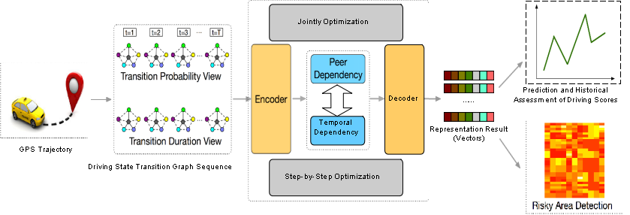
Overview of the framework

Slide 9
Major Steps to be followed
Construction of Multi-View Driving State Transition Graphs
Detection of speed-related operations
Detection of direction-related operations
Extraction of Driving State Sequences
Peer and Temporal-Aware Representation Learning
Base Model

Slide 10
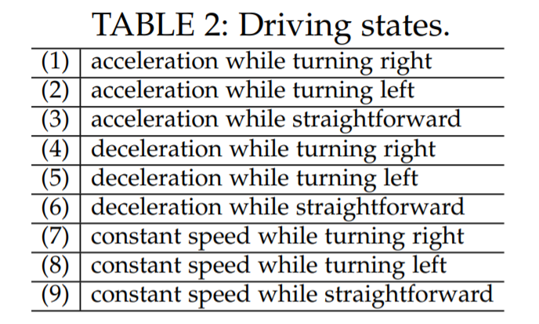
Driving States

Slide 11
Optimization
There are two types of the loss:
Representation learning loss
Regression loss
There are two options to solve the optimization problem of representation learning:
Jointly Optimization
Step-by-step Optimization

Slide 12
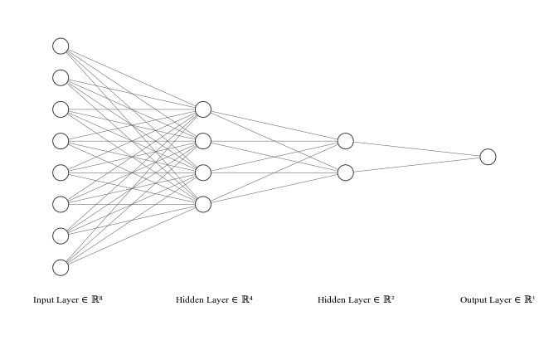
Auto-Encoder Encoding

Slide 13
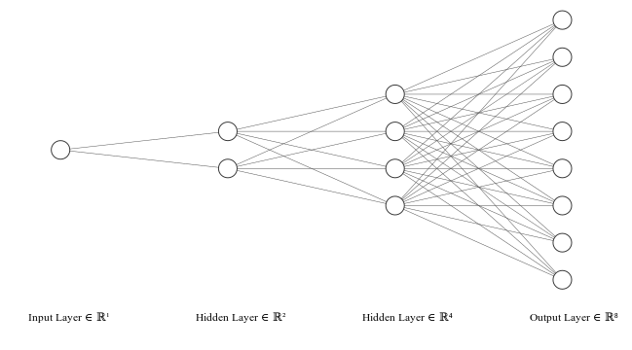
Auto-Encoder Decoding

Slide 14
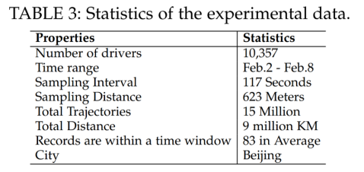
Data Description

Slide 15
Implementation
Data preprocessing
Construction of driving-state transition graphs
Transformation of these graphs to lower dimension vectorized representation using Auto-Encoder
Using classical machine learning algorithms to gain driver’s behavioral patterns.

Slide 16
Applications
Prediction and Historical Assessment of Driving Scores
If driving score of a driver is available for his data upto now, then, using regression, his past score can be deduced and his future score can be predicted.
Risky Area Detection
If for a particular region, most of the drivers obtain score less than a threshold value, then that region can be said as risky area.

Slide 17
Conclusion
Driving behavior analysis can be very useful in assessing driver performances, improving traffic safety, and development of an intelligent and resilient transportation systems. To improve the performance of automated behavior profiling, we used an analytic framework that jointly modelled the peer and temporal dependencies. Specifically, we used the idea to first construct multi-view driving state transition graphs from GPS traces to characterize driving behavior. The empirical experiments on real-world data demonstrated the effectiveness of spatio-temporal representation learning for profiling driving behavior.

