Slide 1
ModuleStudio 0.5.2
News and showcases
Axel Guckelsberger [guite.de]

Slide 2
Events since last camp
2010-09 MOST 0.5.1 release
2011-02 Git migration
2011-08 MOST 0.5.2 beta stage
2011-09 MOST 0.5.2 release

Slide 3
Some numbers
Commits since git migration
  1300 Generator
  2000 Other components
Migrations
  4 smaller applications updated within 2 days.
  More and more things can be achieved only by template overriding or simple extensions.

Slide 4
New features in 0.5.2
Full support for Zikula 1.3
Full support for Doctrine 2.1 and all extensions
Reporting generator creating metrics for the project management and other artifacts
Some editor improvements
  Categories and descriptions for properties
  A generic documentation field for all elements
  Addition of missing label edit possibilities

Slide 5
Zikula 1.3 support
Object-oriented module structure
Includes recent core enhancements
  Core event listeners
  New hook system
  Thumbnail creation with Imagine

Slide 6
Doctrine 2.1 support
Entity and column mappings
  Locking strategies combined with PageLock
Association mappings
  Unidirectional and bidirectional
  Fetch types
  Cascade options on application and database level
  Ordered and indexed associations
Supported but not stable yet in created controllers
  Inheritance hierarchies
  Aggregate fields
  Composite keys

Slide 7
Generator – Field types
Boolean
Integer, Decimal, Float, User
String, Text, Email, Url
Datetime, Date, Time (past / future validation)
Upload (naming schemes, allowed file types)
Array, Object
Many settings possible, explore the field properties.

Slide 8
Generator – More field types
Enabled by String field validation properties
Country fields
Colour fields (form plugin for colour picker)
Language fields (dropdown list with available locales)
Regular expression (e.g. for ip addresses)

Slide 9
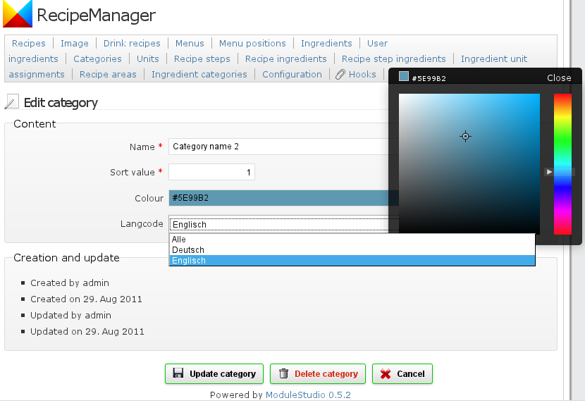
Generator – More field types

Slide 10
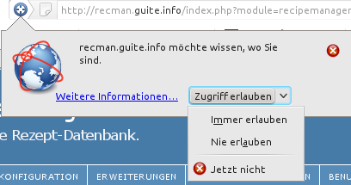
Extensions – Geographical
Adds coordinate fields to an entity
html5 geolocation support during creation for determination of default coordinates

Slide 11
Doctrine Extensions
Loggable – revision management with version fields
Sluggable – permalink handling
  Different configuration options in the model
Sortable – define fields as sortable position / group
Timestampable - automatic date assignments
  Triggers on creation, update or property changes

Slide 12
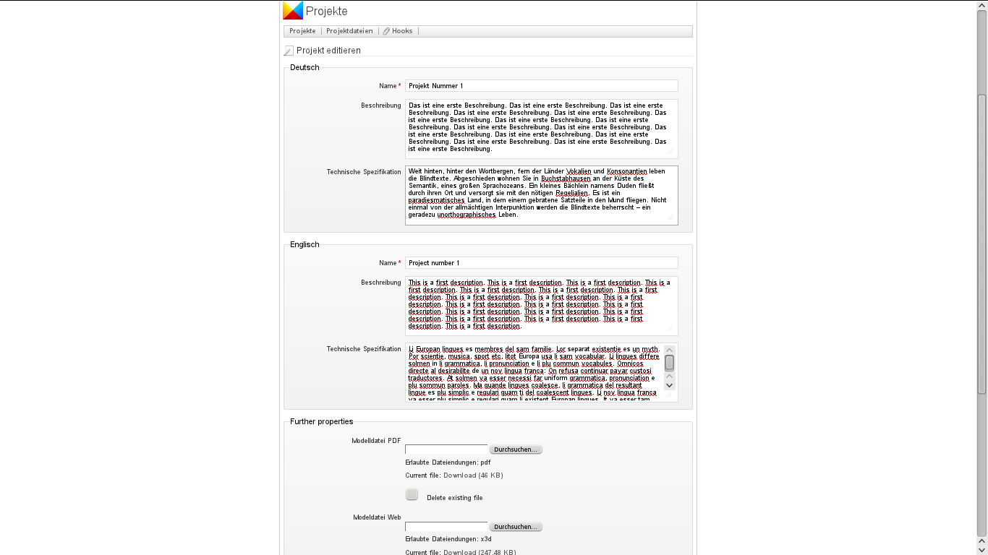
Extensions – Translatable
Automatic translation
handling
  During selection
  During editing

Slide 13
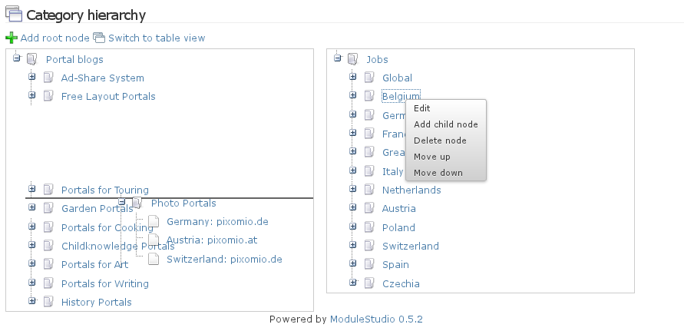
Doctrine Extensions – Tree
Two kinds: Nested set vs. Closure

Slide 14
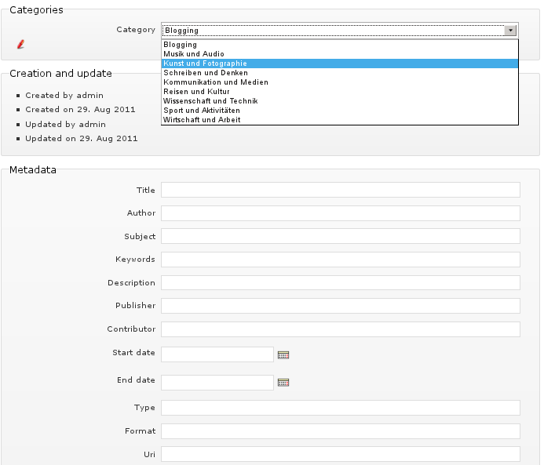
Zikula Extensions
Additional extensions contributed by Zikula core
  Attributes
  Categories
  Meta data
  Standard fields
Zikula 1.3.1-dev
required

Slide 15
Extensions – Combinations
Example: Sluggable and Translatable
  If a translatable field is defined as part of the slug then also the slug will be translatable.
Example: Translatable and Tree
  The translation table does not need to care about the tree-related fields as those are not defined as translatable.

Slide 16
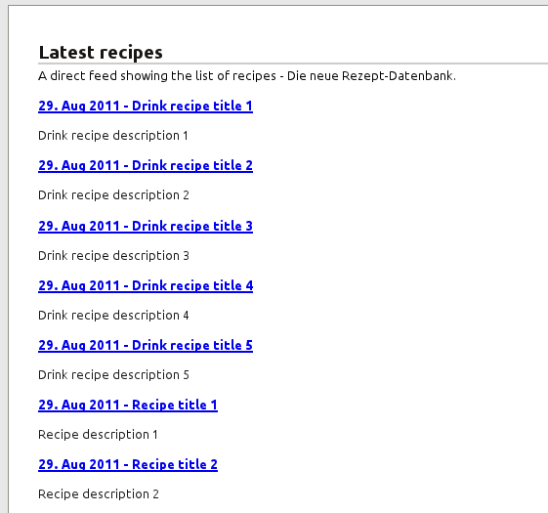
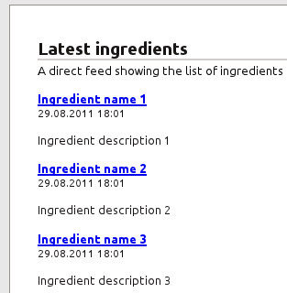
Template output formats
Normal templates
Feeds
  RSS
  Atom

Slide 17
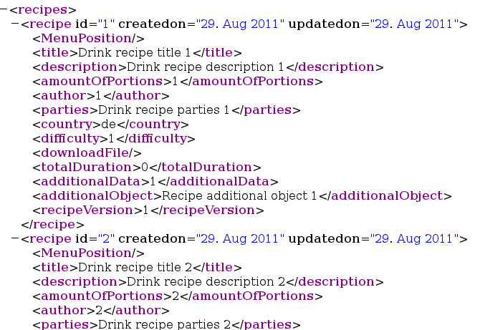
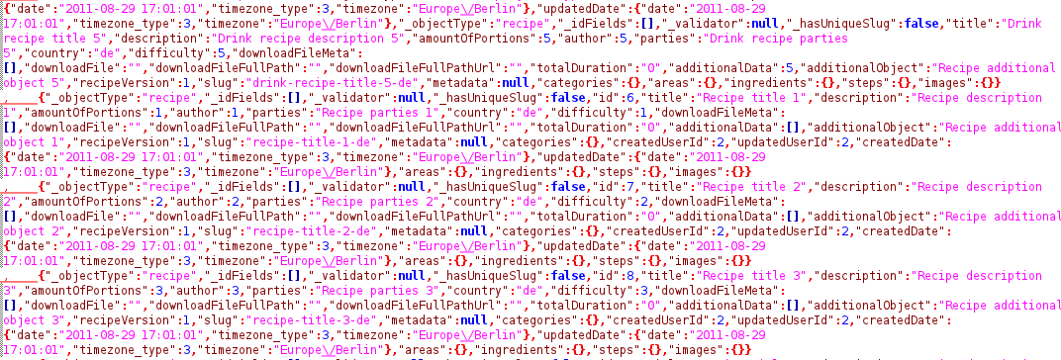
Template output formats
CSV
XML
JSON

Slide 18
Generator – other features
Overhauled validator framework
Url parameter for redirects after editing
  Example: link to edit form for a customer's address
    &returnTo=userDisplay – redirect to address display page
    &returnTo=adminView – redirect to admin list of addresses
    &returnTo=userCustomerDisplay – customer display page
Flexible routing-based short url support

Slide 19
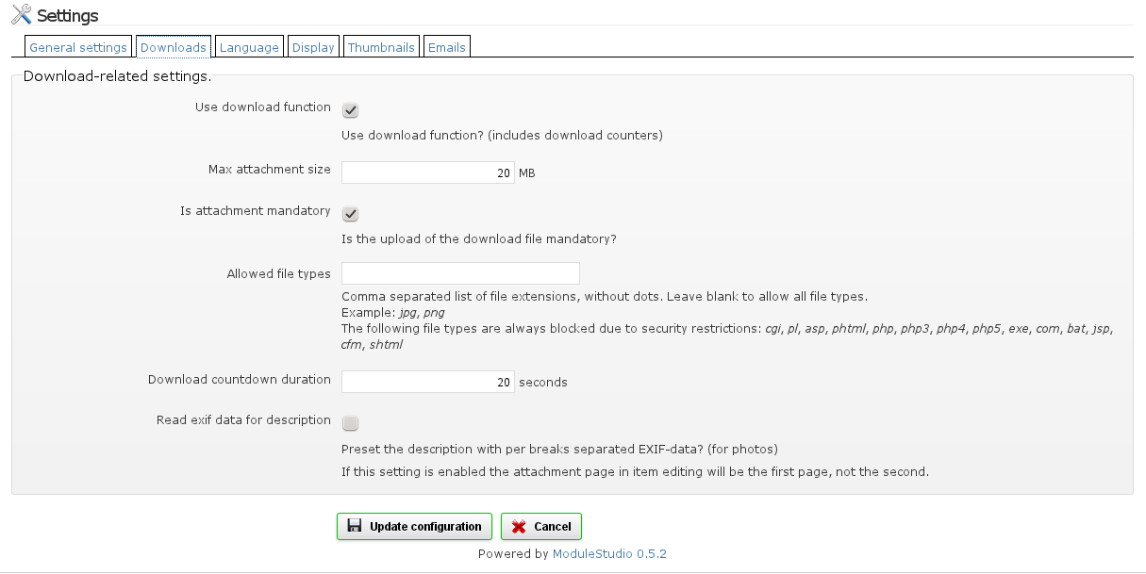
Generator – config page
Modvars can now be modeled in sorted groups
The generator creates a tabbed panel from that

Slide 20
Documentation
First draft for a user manual
Includes validation and generator references
Available in several versions
  Help system in the application
  HTML version (not published yet)
  PDF document

Slide 21
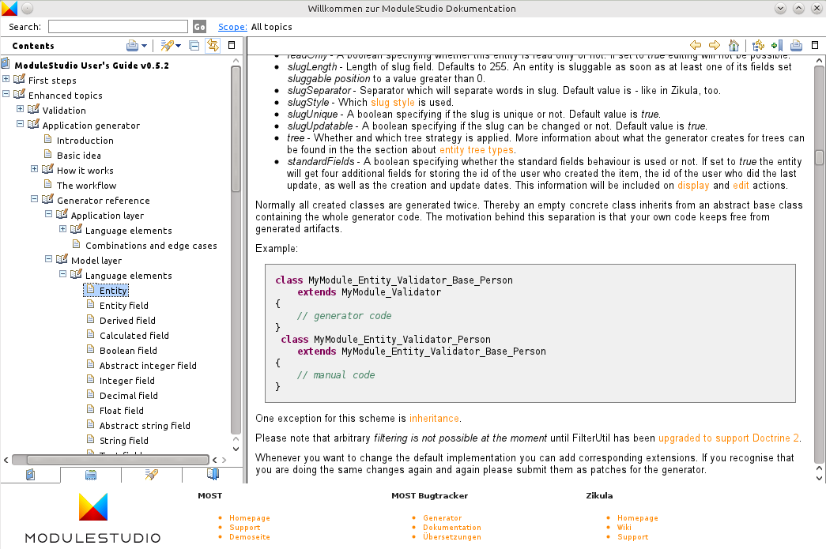
Documentation

Slide 22
Outlook to 0.5.3
Bugfixing for tooling and generator
Some minor generator additions
  Add map inclusion to Geographical support
  Create a basic workflow
Documentation
  Maybe some help interaction improvements (like active help and context-sensitive help).

Slide 23
Questions?
Homepage
  http://modulestudio.de
Github
  https://github.com/Guite/MostGenerator
  https://github.com/Guite/MostHelp
  https://github.com/Guite/MostExamples
Google Group
  http://groups.google.com/group/most-dev/

