Slide 1


A light-weight CNN for Bird species classification
Sarvjeet
Shubham Arun Gujar Mentor
Panchal Kruti Babubhai Tejalal Choudhary
Kommana Madhusri

Slide 2
Introduction
Bird species classification is purely based on image classification as classification is one of the most important and fast growing fields and the reason can be narrowed down to the fact that everything is based on classification everywhere we uses this.
We consider people to be experts in a field if they have mastered classification. Such applications of classification are musicians can classify that what sounds good, doctors can classify diseases blood samples etc.
The ability to classify well takes many hours of training but with the quality datasets deep learning can classify just as well, if not better than we can.

Slide 3
Dataset Used
200 Bird Species:
Dataset contains 200 bird species with 27503 training images, 1000 testing images(5 per species) and 1000 validation images(5 per species).
Dataset also includes consolidated image set that combines all three training ,testing and validation images into a single dataset.
All images are in jpg format with dimensions 224 X 224 X 3.
The training set is imbalanced having varying number of images. Images for each species are contained in separate sub-directory.

Slide 4
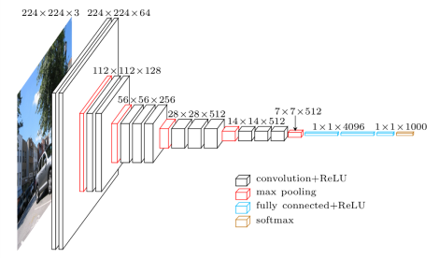
Methodology / Model Used
VGG16 Model - It is a CNN architecture, consists of 16 weight layers including 13 convolutional layers with filter size of 3 X 3, and fully-connected layers of same filter size and 2x2 pooling layers also used. All the convolutional layers are divided into 5 groups and each group is followed by a max-pooling layers. For this model accuracy increases as we increase the depth of the convolutional neural networks.
Fig: Architecture of VGG16 Model

Slide 5
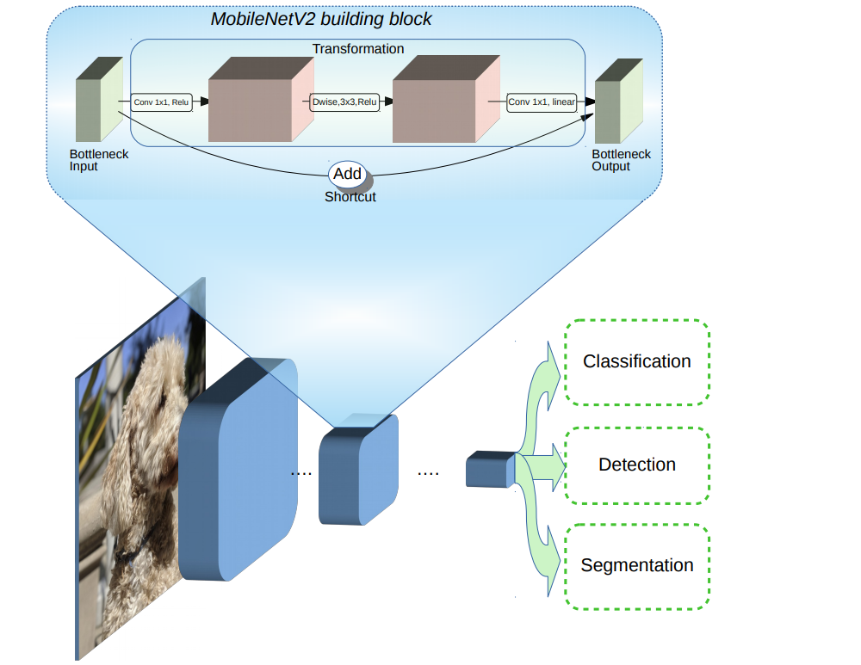
Methodology / Model Used
MobileNetV2 Model - The basic building block is a bottleneck depth-separable convolution with residuals. The architecture of MobileNetV2 contains the initial fully convolution layer with 32 filters, followed by 19 residual bottleneck layers. It uses 3.4 million parameters and the mode size varies between 1.7M to 6.9M. It is suitable for mobile applications and allows very memory-efficient inference and utilizes standard operations present in all neural frameworks. For the ImageNet dataset, MobileNet-V2 improves the state of the art for a wide range of performance points.
Fig: Architecture of MobileNetV2.

Slide 6
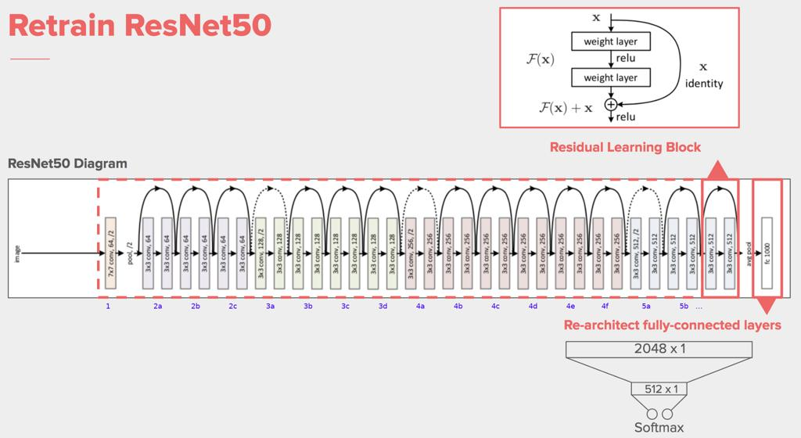
Methodology / Model Used
ResNet50 - Model has 50 layers 48 are Convolution layers, 1 Maxpooling layer and 1 Average pool layer. ResNet-50 model consists of 5 stages each with a residual block. Each residual block has 3 layers with both 1*1 and 3*3 convolutions. The concept of residual blocks is quite simple. In traditional neural networks, each layer feeds into the next layer. In a network with residual blocks, each layer feeds into the next layer and directly into the layers about 2–3 hops away, called identity connections.
Fig: Architecture of ResNet50.

Slide 7
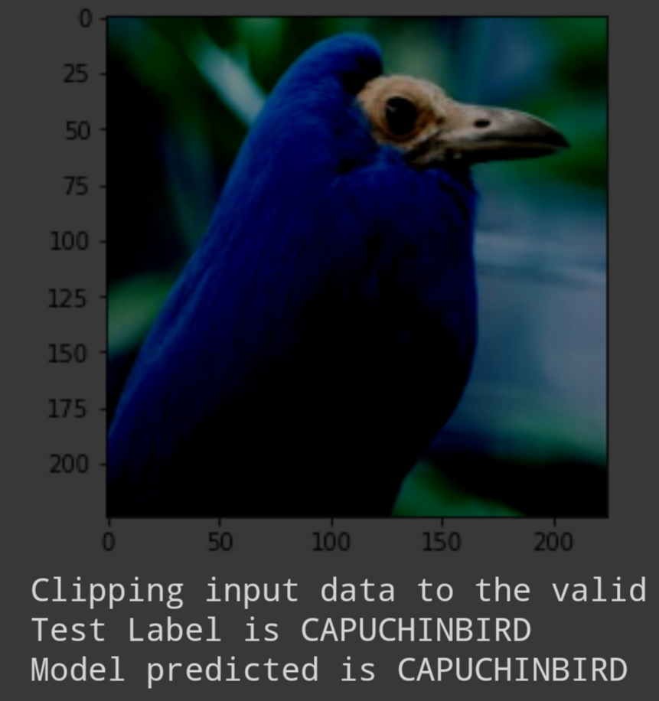
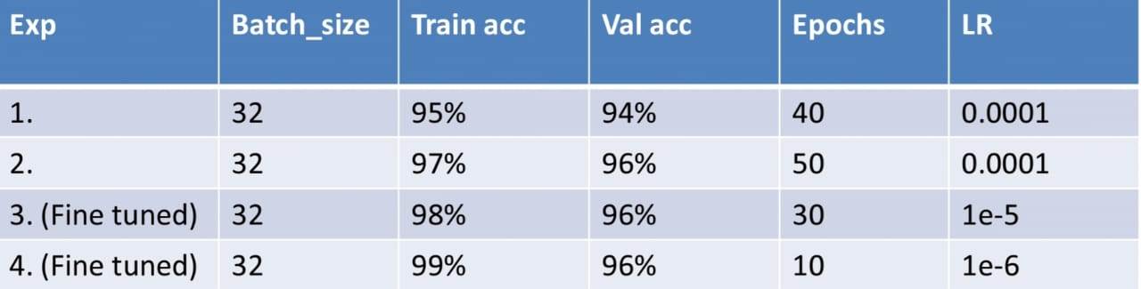
Results Achieved
VGG16 Model:- Model has given 99% accuracy in prediction of finding birds species.
Fig(b): Model accuracy 1,2 are base model and 3,4 are fine tuned model.
Fig(a): Model output image after prediction.

Slide 8
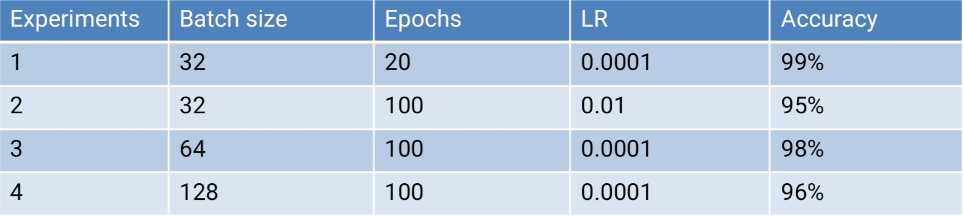
Results from MobileNet Model
Model has given 99% test accuracy and for the different batch size and learning rate accuracy is given below.

Slide 9
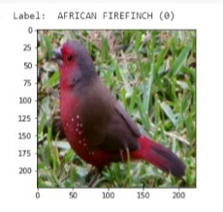
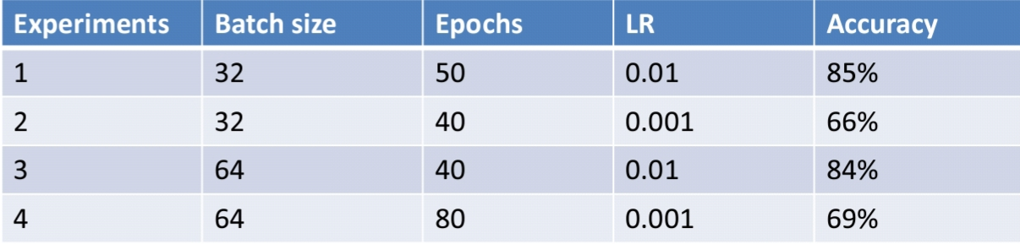
Results from ResNet50 Model
Fig(a): Model Model output image after prediction.
Fig(b): Hyperparameters

Slide 10
Conclusion
Our model works on the principle based on the detection of parts and extracting CNN features from multiple convolutional layers.
These features are given to the classifier for the classification purpose.
On the basis of the results obtained, our model has provided 99% accuracy in prediction of finding bird species.
Future Scope:
Model can be implemented using the cloud that can store huge amount of data for comparison and provide high computing power for processing the images.

Slide 11
References
https://www.analyticsvidhya.com/blog/2020/04/how-to-deploy-machine-learning-model-flask/
https://towardsdatascience.com/step-by-step-vgg16-implementation-in-keras-for-beginners-a833c686ae6c
http://alibabacloud.com/blog/part-1-image-classification-using-features-extracted-by-transfer-learning-in-keras
https://flask.palletsprojects.com/en/1.1.x/
https://towardsdatascience.com/how-to-fine-tune-your-neural-network-for-your-data-image-classification-d0f01c92300b

Slide 12
Thank You

