Slide 1


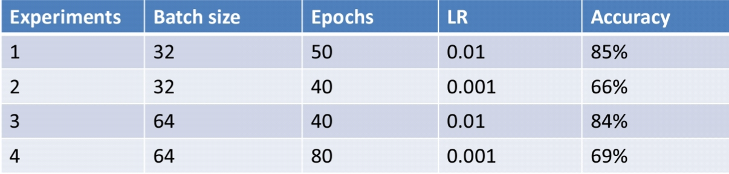
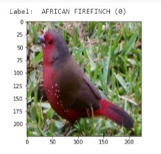
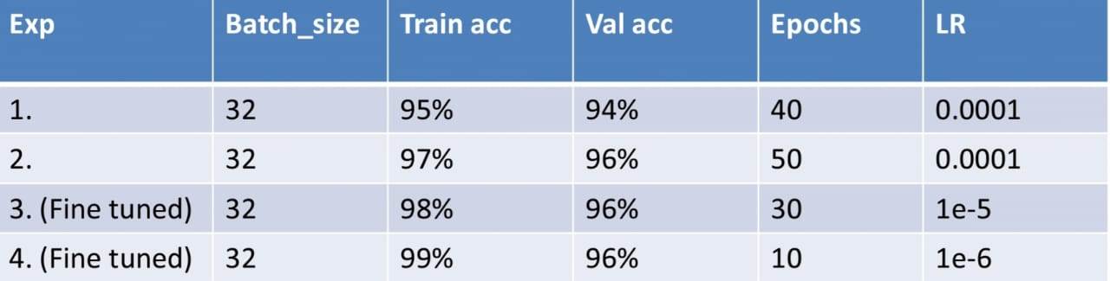
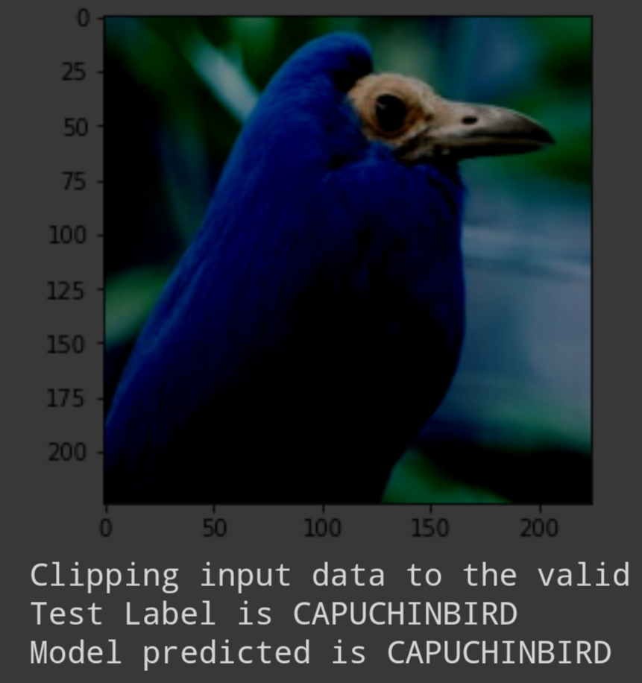
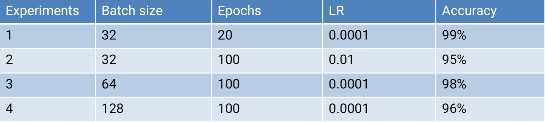
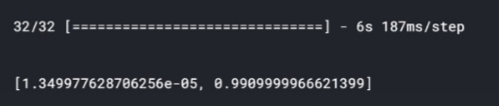

A light-weight CNN for Bird species classification
1.Sarvjeet, 2.Shubham Arun Gujar, 3.Panchal Kruti Babubhai, 4.Kommana Madhusri
Mentor: TEJALAL CHOUDHARY
Abstract
ResNet50 Model- Hyperparameters
Now a day birds are present in various scenarios appear in different shapes, sizes, colors etc. from human perspective.
Human ability to recognize the birds through images is not a tough task but machines can’t.
We have used dataset of 200 bird species with training, testing and validation images.
By using CNN an image is converted to gray scale format passing through neural networks compared with testing images and generate accuracy, predicts classes.
Introduction
Bird species classification is purely based on image classification and is one of the fast growing fields and the reason can be narrowed down to the fact that everything is based on classification everywhere we uses this.
We consider people to be experts in a field if they have mastered classification.
Such applications of classification are musicians can classify that what sounds good, doctors can classify diseases blood samples etc.
The ability to classify will takes many hours of training but with the quality datasets deep learning can classify just as well, if not better than we can.
Fig: ResNet Model output image after prediction.
VGG16 Model- Hyperparameters
Proposed Method
Fig: VGG16 Model output image after prediction.
RESNET50- The ResNet-50 model consists of 48 Convolution layers and 1 Max-pool and 1 Average pool layer. This model has around 23 million parameters.
MOBILENETV2- Hyperparameters
VGG16- A model consists of 16 weight layers including 13 convolutional layers with filter size of 3 X 3, and fully-connected layers of same filter size and 2x2 pooling layers. It has around 138M parameters.
Conclusions
Our model works on the principle based on the detection of parts and extracting CNN features from multiple convolutional layers.
On the basis of the results obtained, our model has provided 94% accuracy in prediction of finding bird species and after fine tuning 99%.
MOBILENETV2-The MobileNetV2 consists of
initial fully convoluted layer with 32 filters
which are followed by 19 residual bottleneck
layers. It uses 3.4 million parameters and the
mode size varies between 1.7M to 6.9M.
References
Experimental Results and Discussion
https://towardsdatascience.com/step-by-step-vgg16-implementation-in-keras-for-beginners-a833c686ae6c
https://reshamas.github.io/deploying-deep-learning-models-on-web-and-mobile/
http://alibabacloud.com/blog/part-1-image-classification-using-features-extracted-by-transfer-learning-in-keras_
Model has given 99% accuracy in prediction of finding birds species.
Team No. - 14

