Slide 1

What will be the next
Disney Blockbuster?
Matt Weiper / Hema Vyas

Slide 2

What we want to Accomplish
Looking into data, which factors contribute to making a Disney movie better than the rest. Using our findings, can we predict which kind of Disney movies are going to be highly successful moving forward? (*Note – dataset is through 2016)
Questions we asked Ourselves
Does genre and rating factor into how the movies perform?
Does the month in which movie was released matter in terms of how much it grosses?
How have things changed over the years? Is this data meaningful?
Drilling down data to last 10 years, does it represent the same answer we got for entire dataset?

Slide 3
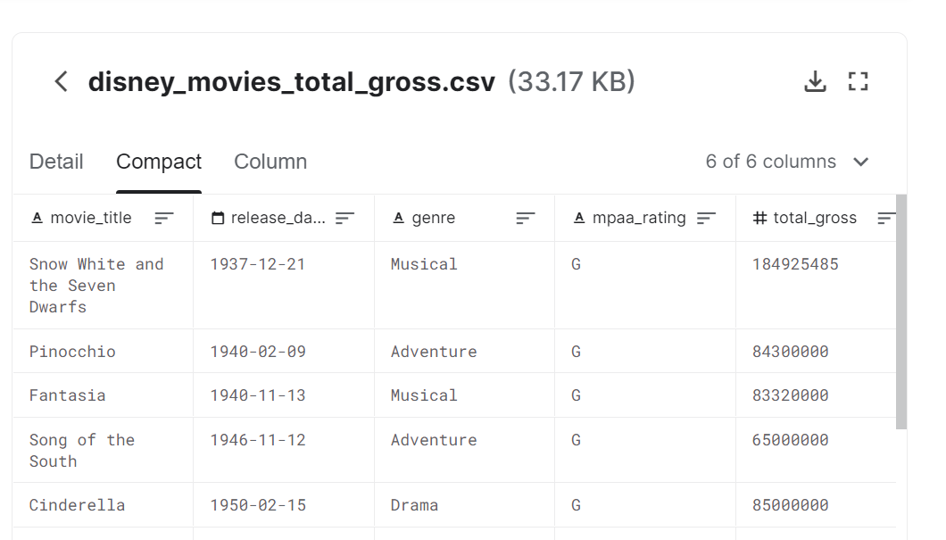

Getting Started
In order to get answers for our questions we wanted to find a good reliable dataset, which had columns for release data, genre, rating, and gross.
We believed with that data we could create new dataframes comparing specific columns, as well as creating plots to really give us answers in finding what makes a Disney blockbuster!
Dataset URL - https://www.kaggle.com/rashikrahmanpritom/disney-movies-19372016-total-gross

