Slide 1
Image Restoration Web-App
Anish Pandita - 90688024
Mayank Chandak - 86041404
Gurkanwal Singh Kang - 93887116
Neelendu Wadhwa - 92966132
CS 295P, Lecture A, Professor Harris
Winter Quarter 2022

Slide 2
Introduction
Have any of these thoughts crossed your mind:
I wish I had better quality photos of my grandparents as memories.
What if there could be a way to make my blurry vacation photos clearer and less pixelated.
If yes, then our Image Restoration Web-App is the go-to solution.

Slide 3
Why use our product?
From being able to bring fresh life to old, bad quality images to applying style transfers to make the images more creative with a sense of modern style and aesthetics, our application has a plethora of use cases.
We are delivering a one stop solution to perform image restoration, style transfer, and storage altogether.
Our product is an open-source implementation and is completely ad-free with no “hidden cost” assigned.

Slide 4
Features
Image Restoration
Style Transfer
Black and white to a colored image
Storage
Authentication (Privacy)
Dashboard
Download images

Slide 5
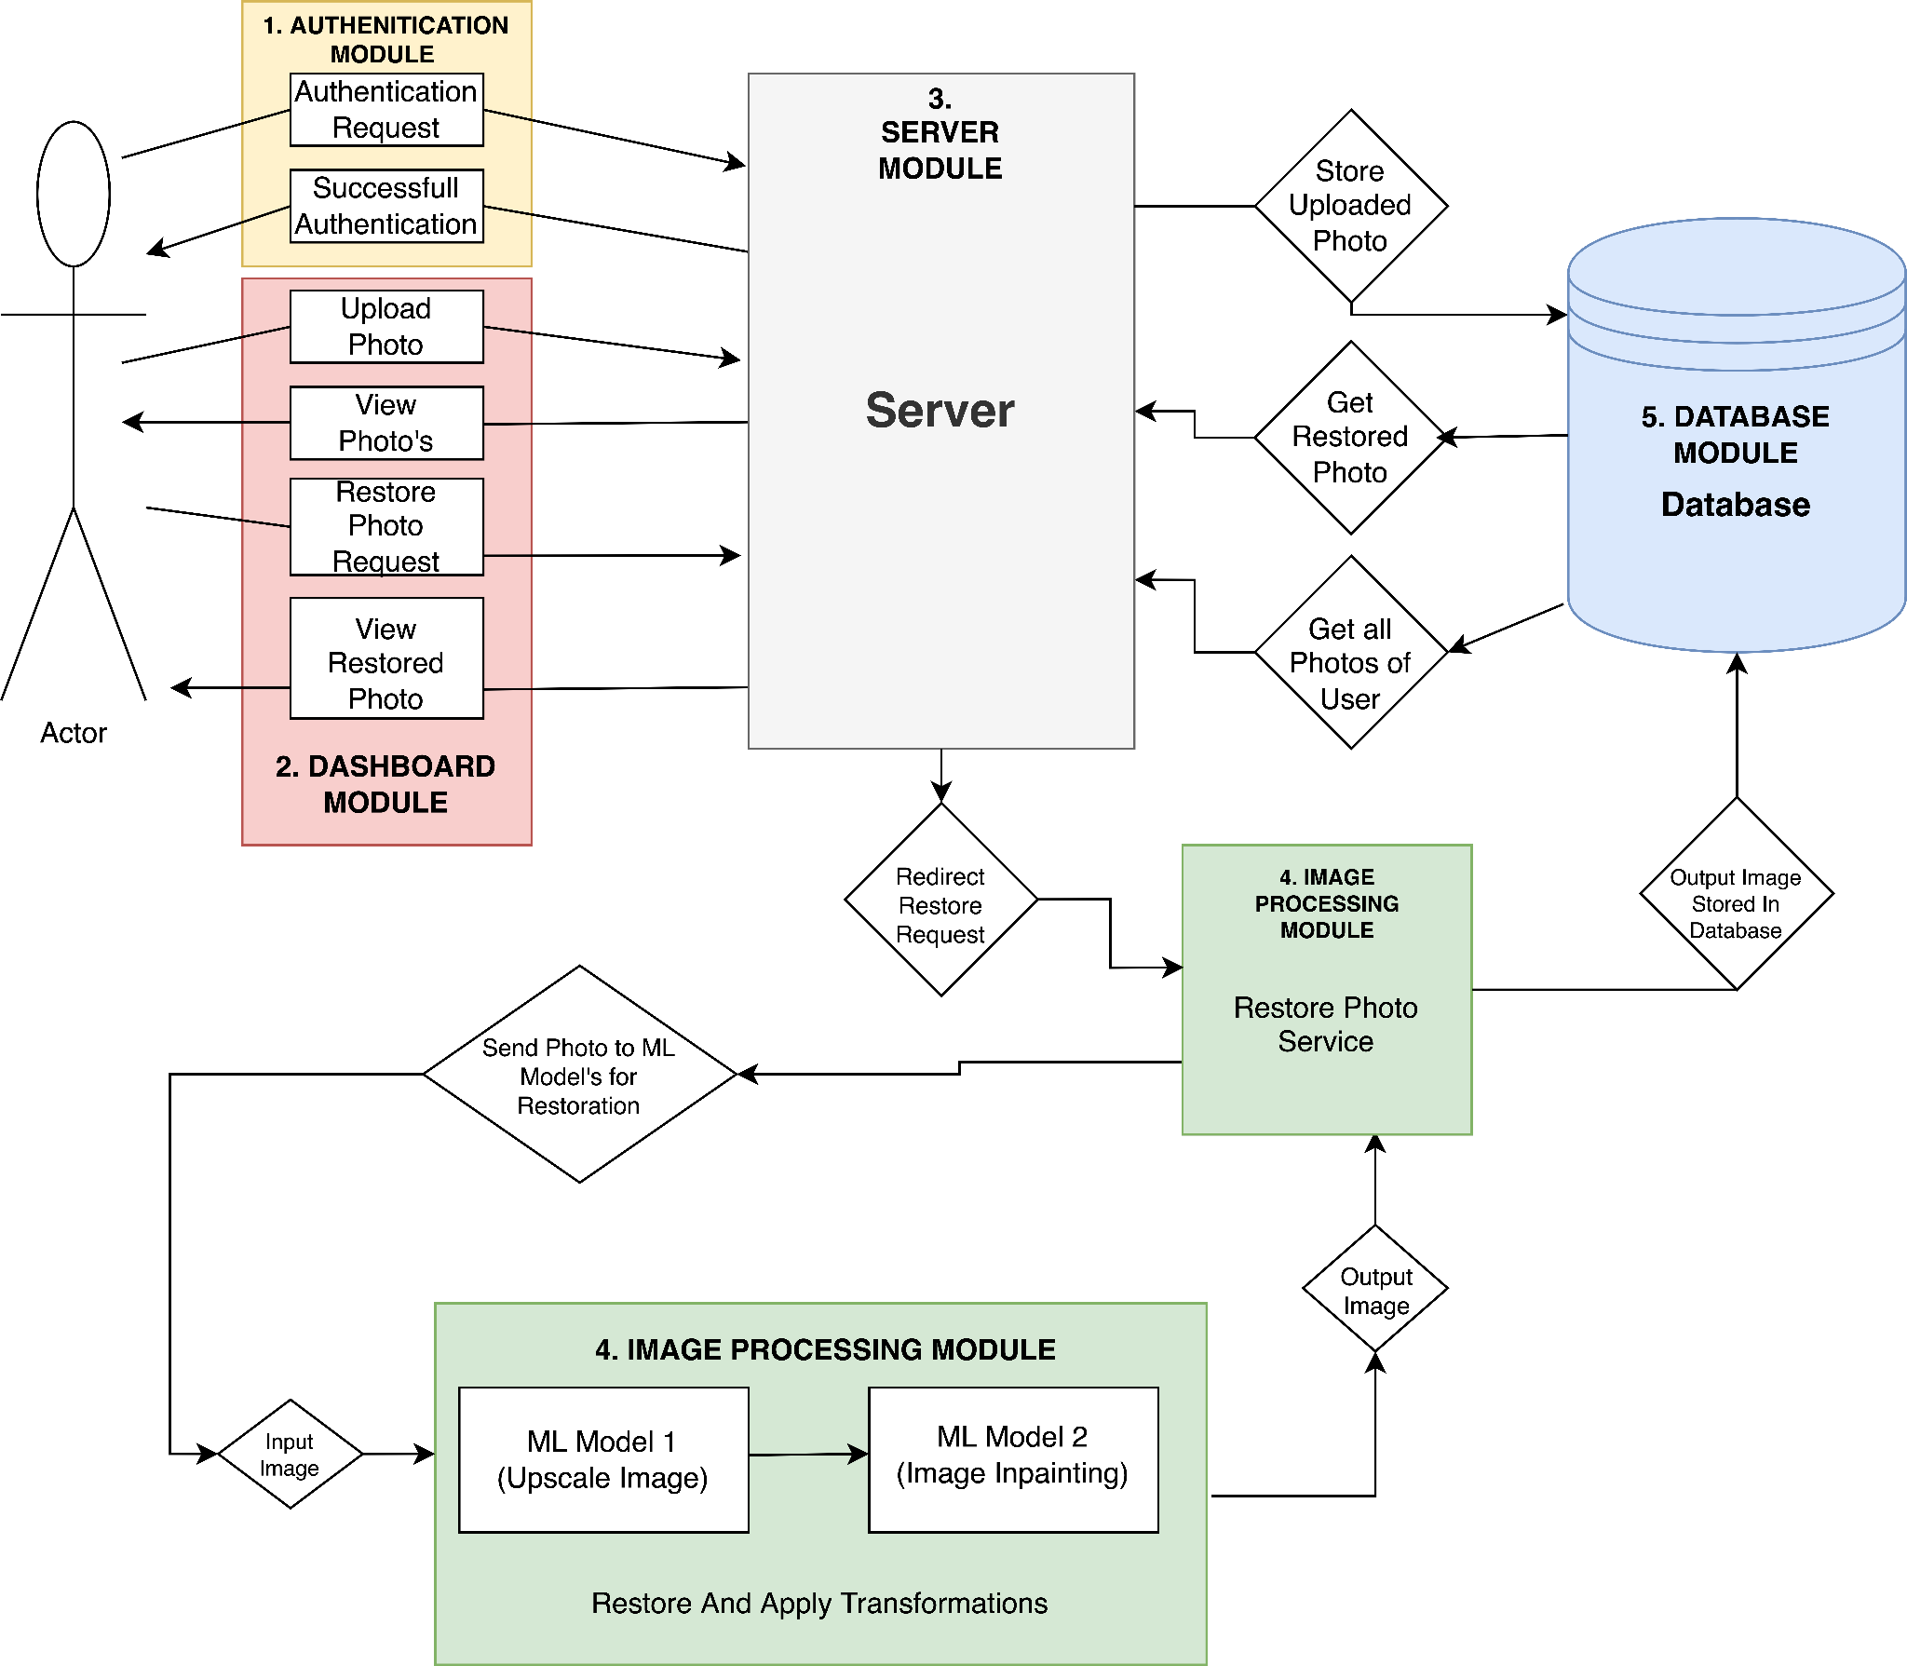
Architecture
Authentication Module
Dashboard Module
Server Module (Controller)
Image Processing Module
Database Module

Slide 6
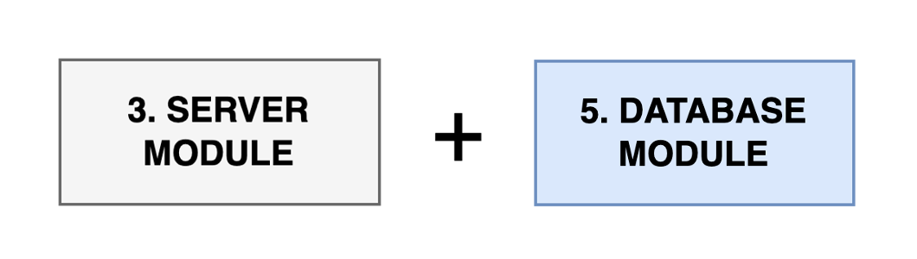
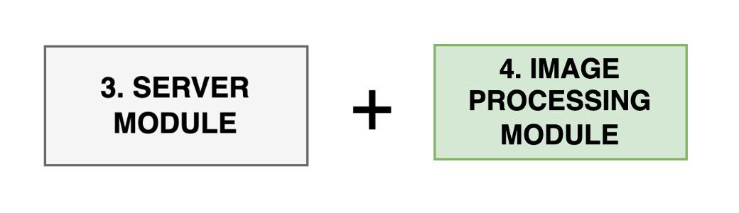
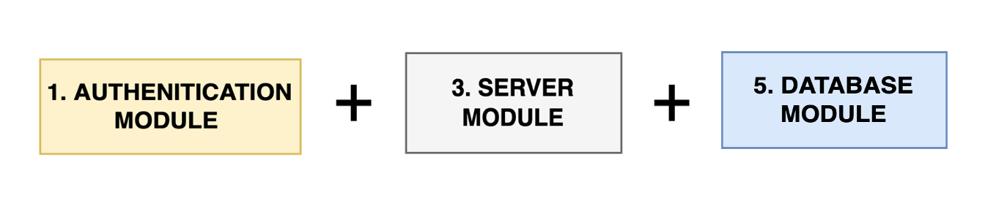
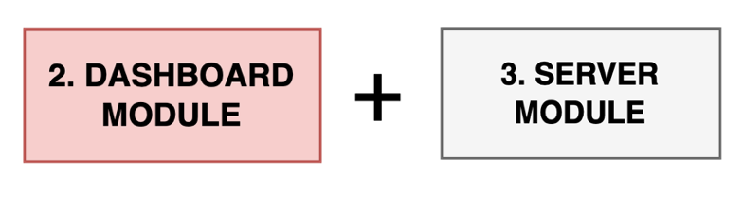
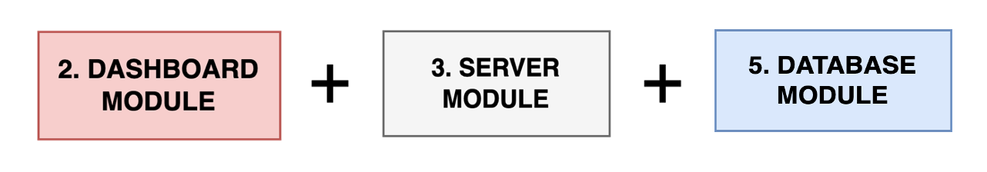
Feature Map
Image Restoration
Style Transfer
Black and white to a colored image
Storage
Authentication (Privacy)
Dashboard
Download images

Slide 7


Demo
Before
After

