Slide 1
Graphical Combinatorics.

Slide 2
Purpose: To left one element.
It is allowed to cross any objects amount in row or column.

Slide 3
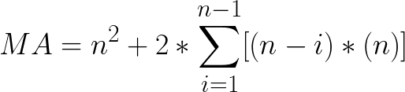

Moves Amount Formula
for nxn matrix
Amount_Of_SingleBall_Moves = n*n
Amount_Of_DoubleBall_Moves = 2*(n-1)*n
Amount_Of_TripleBall_Moves = 2*(n-2)*n
ALL_3x3_Moves = n*n + 2*(n-1)*n + 2*(n-2)*n
MA = n^{2} + 2*\sum_{i=1}^{n-1}[(n-i)*(n)]

Slide 4
2x2

Slide 5
3x3

Slide 13
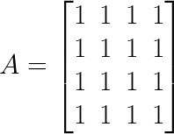
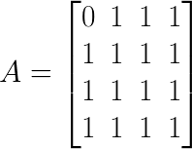
Mathematical Representation of GameBoard
Mathematical Representation of One_BallMove

Slide 14
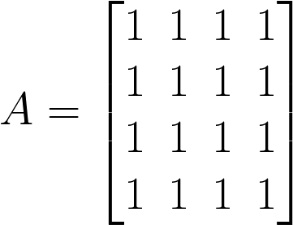
Algorithm

Slide 15
Sets
Amount_of_elements = amount_of_ones_in_row + amount_of_ones_in_columns
Counting from Position to Right End and Down End
(0,0).Position_Moves_Possibilities = [
[(0,0)]
[(0,0),(0,1)]
[(0,0),(0,1),(0,2)]
[(0,0),(0,1),(0,2),(0,3)]
[(0,0),(1,0)]
[(0,0),(1,0),(2,0)]
[(0,0),(1,0),(2,0),(3,0)]
]
POS,

