Slide 1

TABLE OF CONTENT
Introduction
Objectives
Project Overview
Data Set
Tools
Insights
Recommendations

Slide 2
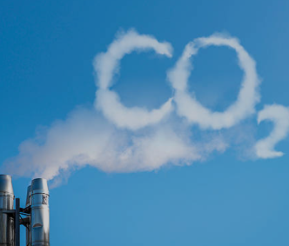
INTRODUCTION
In this Tableau Project we are analysing Emission of CO2 in different countries of World and checking trend of its emission with other factors like population , GDP etc. We are checking the factors which are most responsible for emission of CO2 and how from year 1700 till present, its emission is increasing along with other green house gases.

Slide 3
OBJECTIVES
DATA EXPLORATION- Using Tableau to understand the structure , pattern and relationships between measures and dimensions.
STATISTICAL ANALYSIS- Using Tableau Calculated field to do statistical analysis by calculating averages , counts , sum total etc
VISUALISATION- Using Tableau to visualise the data in order to learn the trends and pattern and analyse our future goals

Slide 4

PROJECT OVERVIEW
Project Name:
CO2 Emission Project
Description
Tableau Public Link:
Conducted By:
Gulafsha Ansari

Slide 5

DATA SET
CO2 emission
Tables Name
No. Of Tables
1
Customers
Products
Categories
shippers

Slide 6
TOOLS
Tableau
Data Visualization & Dynamic Dashboard
MS Power Point
Presentation and Insights
MS Excel
Data Cleaning and Preparation
Tableau
Calculated Columns & Measures

Slide 7


INSIGHTS

Slide 8
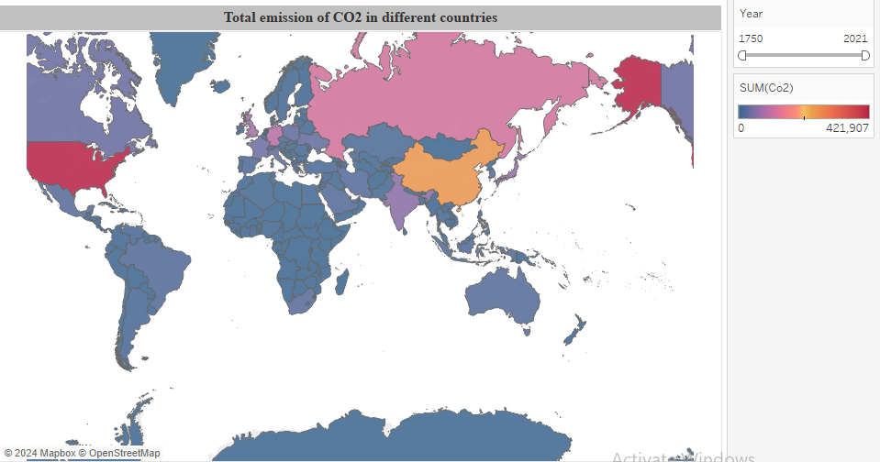
Total Emission of CO2 in different countries
In this visual I am analysing Total Emission of CO2 in every country of world. If we talk about total emission
Of CO2 over years from 1750 to 2021 then we can see that USA comes at no 1 position followed by China, Russia
, Germany, UK and India at 6th position.
But if we check the trend for last 10 years of data then China beats USA for no 1 position due to Industrial Revolution
and India move up to 3rd position from 6th. And according to viz, Emission of CO2 in India started increasing more in
around 1995. Rise in emissions in India has been the increase in the country's per capita income level followed by the
increasing population and changes in the energy.

Slide 9
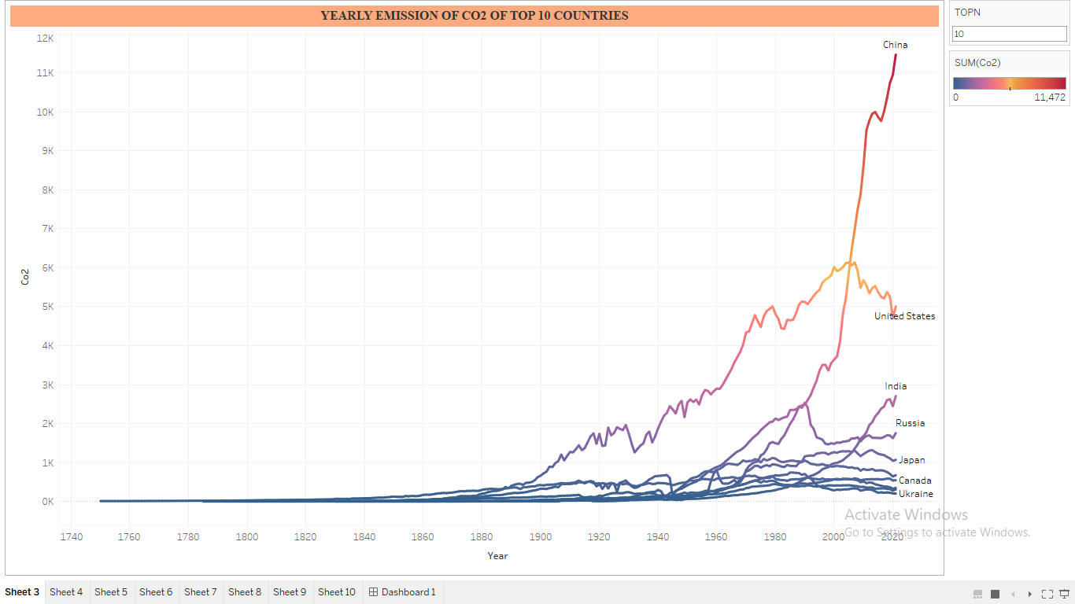
Yearly Emission of CO2 for TOP 10 Countries
In this Visual, I am analysing the trend of emission of CO2 over years starting from 1700’s to 2021 for Top 10 Countries.
From the visual we can conclude that currently China is leading in CO2 emission followed by USA and India. If I talk about China then emission of CO2 wasn’t their till 1900 as industrial revolution came late in China. Up till 2005 USA was the Leading producer of CO2. Sudden increase of CO2 in China can be due to Urbanisation and increased wealth of Households.
Another Analysis is about U.K which is the
only country which has been producing Co2
since 1700’s. Reason can be Industrial
Revolution which started in UK in mid
1700’s making it the oldest country in terms
of CO2 Emission.

Slide 10
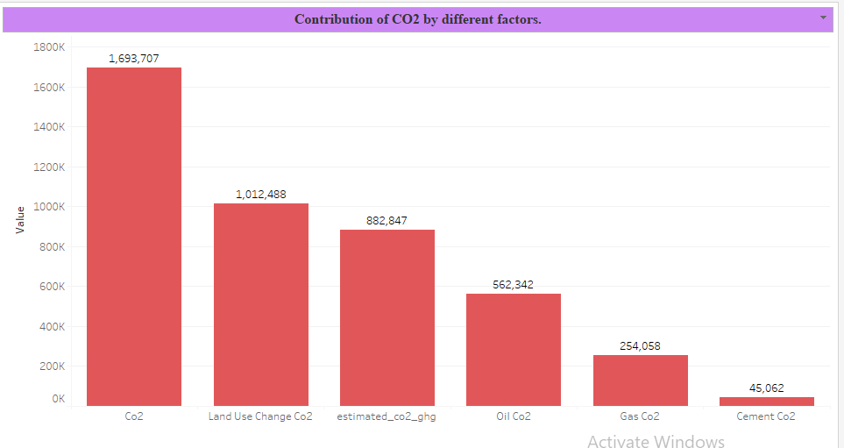
Contribution of CO2 by different factors
In this visual, I am analysing contribution of CO2 due to different factors like land use change ,oil , cement etc.
From the visual we can conclude that out of total CO2 emission of world, maximum contribution which is 1,012,488 is made because of the change in the usage of land which includes mining, deforestation etc. Because of Industrial revolution and growing urbanisation most of the developed countries are removing their forest hence it is the major factor which is contributing in CO2 emission.
And the least contributing factor would be due to cement which is 45,062

Slide 11
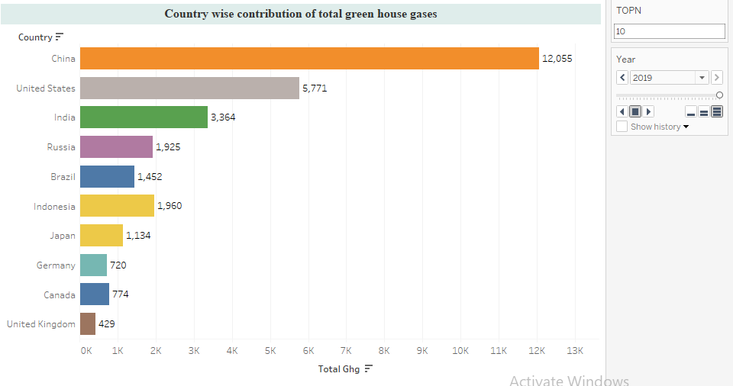
Country wise contribution of total green houses gases over past 10 years
In this visual, I am analysing country wise contribution of total green house gases which includes Nitrous
Oxide, Methane and CO2 with few other gases for Top 10 countries and their trend over last 10 years.
From this visual we can conclude that China has been a leading green house gas producing country
followed By USA and India in last 10 years. Although if I talk about Brazil then in 2010 Brazil was on fourth
Position but after 2010 Brazil made improvements and managed to came down to sixth position as Brazil pledged to cut its emissions by 43% by 2030, compared to 2005 levels by controlling Deforestation and capping the Emission whereas China’s and India’s emission kept on increasing. Though USA still maintained
its emission by being in same range of around 5,700 from past 10 years.

Slide 12
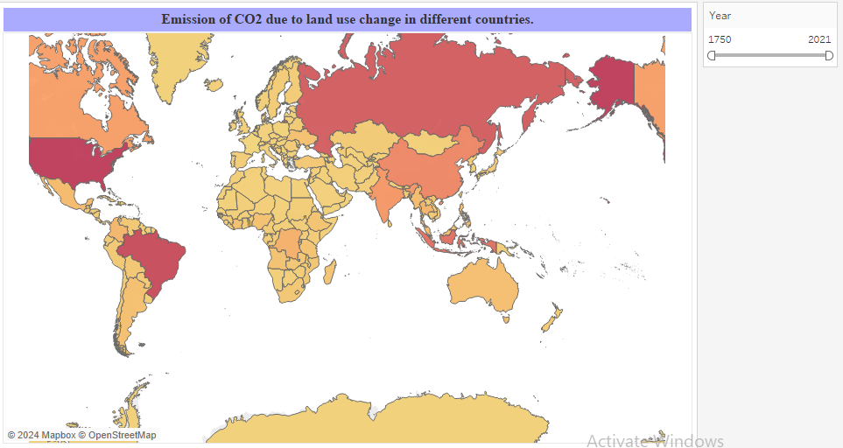
Emission of CO2 due to land use change
In this visual I am analysing emission of CO2 due to Land use change as it is the leading cause of emission
of CO2 as we have seen earlier. If I talk about CO2 Emission from 1700’s till now then USA is the leading
Country followed by Brazil, Russia, Indonesia, China and India. In USA and Brazil, main cause is Deforestation.
In USA, deforestation is happening due to Urbanisation and Infrastructure Development and in Brazil, main
cause of Deforestation is clearing of land for Agriculture and livestock though as we saw earlier both of these
countries are trying to manage their emission of CO2 hence if we talk about last 10 years data, all these
Countries made an impressive improvements but USA is the one which made drastic drop down in deforestation
cases, reason can be net growth of forests, including urban trees, which remove carbon from the atmosphere.

Slide 13
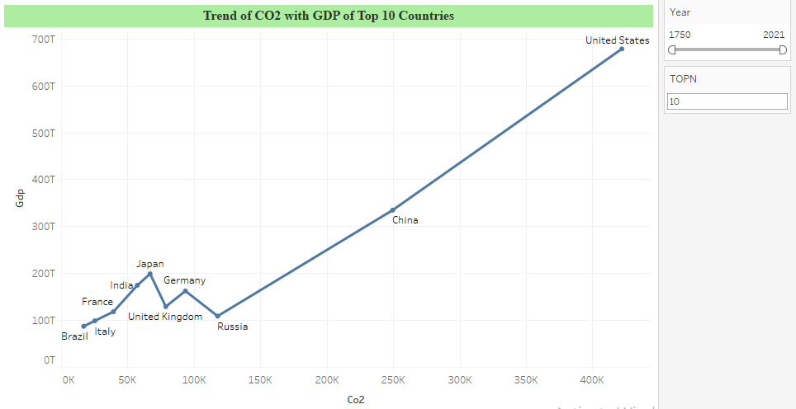
Trend of CO2 with GDP of Top 10 Countries
In this visual, we are analysing trend of CO2 with GDP in top 10 countries. Since the dawn of the industrial age,
fossil fuels have been a key enabler of economic development, providing the fuel that generated most of the
world’s electricity, powering automobiles, ships and aircraft, and fuelling industrial activity. As a result, economic
growth has been closely tied to a rise in greenhouse gas emissions through most of modern economic history.
This is the reason that we can see the linear trend in CO2 emission w.r.t GDP. Hence countries with high GDP i.e
USA, China, Russia has higher CO2 emission though if we talk about data from 2010 onwards then China despite
having lower GDP then USA has way too higher CO2 emission than USA and India came on third position in terms
of both GDP and CO2 emission.

Slide 14
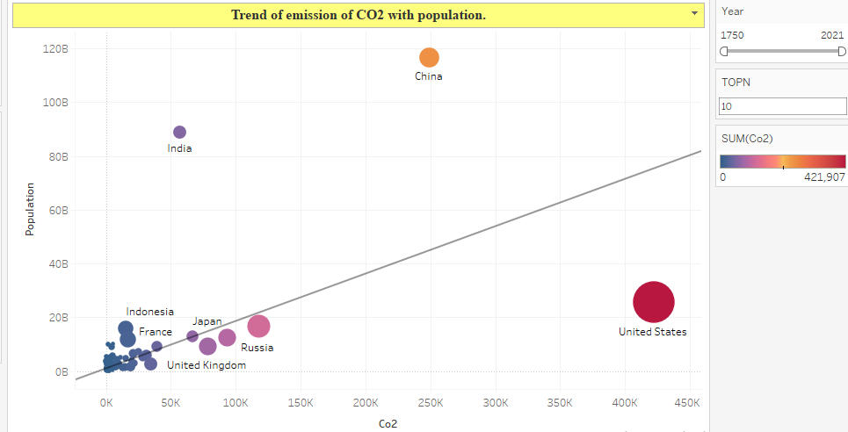
Emission of CO2 with population and temperature change due to CO2
In this visual, I am analysing trend of emission of CO2 with population of Countries and the impact of CO2
on their temperature. If I talk about the linearity then there is a significant linear relationship between population
and CO2 emission as with increase in population demands also increases which can increase the growth of factors
which results in emission of CO2 but If we see Top 3 countries USA, China and India, they do not follow linearity as
USA being less populated out of three has High CO2 emission which is the result of Industrial Revolution. Also here
size of bubbles signifies impact of CO2 emission on temperature where larger the size higher the change in temperature
due to CO2. Here we can see that USA has the higher impact of CO2 on its temperature followed by China. Also we
can see discrepancy as the countries like Russia, UK, Brazil, Indonesia and France which has lower CO2 Emission than
India has high temperature change due to CO2 hence there is no specific relationship between temp change and CO2.

Slide 15
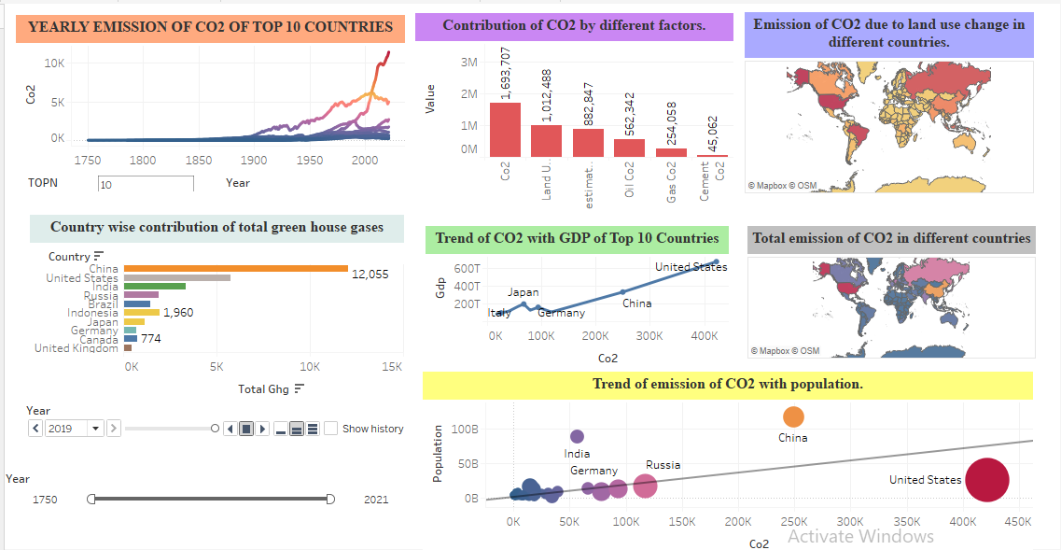
DASHBOARD

Slide 16
Recommendations

Slide 17
Analysis Report
After doing in depth Analysis we came to the following conclusions:
In order to control the world’s CO2 emission, our main focus should be developed countries mainly as these are the countries which are affected mostly by Industrialisation and Urbanisation, with all the modern techniques coming, CO2 emission is increasing day by day and it is high time we take preventive measures mainly in countries like USA, China, Russia, India etc.
Main focus of area should be land use change. As we saw that it is major factor contributing in the growth of CO2 hence we need to control deforestation in all the parts of the world and plant as much trees as we can.
Another factor we need to control is population. As we already saw that there is some linearity seen in population and CO2 emission. More populations, more demands which leads to more land use change, more industries. Hence it is a high time that we control world’s population mainly in countries like China and India.

Slide 18

THANK YOU

