Slide 1

TABLE OF CONTENT
Introduction
Objectives
Project Overview
Data Set
Tools
Insights
Recommendations

Slide 2

INTRODUCTION
In this Project we have done the complete Analysis of Stolen vehicles in different cities of New Zealand on the basis of description of vehicles which are stolen like its type , colour , maker , model etc and whether
it is luxury or standard. We have done the analysis on the basis of locations
where vehicle is stolen.

Slide 3
OBJECTIVES
DATA CLEANING- Cleaning the data by changing fields to appropriate data types , removing duplicates and null values using SQL
DATA RETRIEVEL- Writing SQL queries to retrieve and manipulate the data from different relational tables in database
DATA EXPLORATION- Using SQL queries to understand the structure , pattern and relationships.
DATA INTEGRATION- Using SQL queries to integrate data from multiple sources by combining them using Join Operations.
STATISTICAL ANALYSIS- Using SQL queries to do statistical analysis by calculating averages , counts , sum total etc
VISUALISATION- Using Power BI to visualise the results we got from SQL queries.

Slide 4
PROJECT OVERVIEW
Project Name:
Analysis of Stolen Vehicle in different cities of New Zealand
Description
Conducted By:
Gulafsha Ansari

Slide 5

DATA SET
Make_details
Stolen_vehicles
Locations
Tables Name
No. Of Tables
3
Customers
Products
Categories
shippers

Slide 6
TOOLS
SQL and Power BI
Data Visualization & Dynamic Dashboard
MS Power Point
Presentation and Insights
MS Power Query, SQL
Data Cleaning and Preparation
SQL,DAX
Calculated Columns & Measures

Slide 7


INSIGHTS

Slide 8
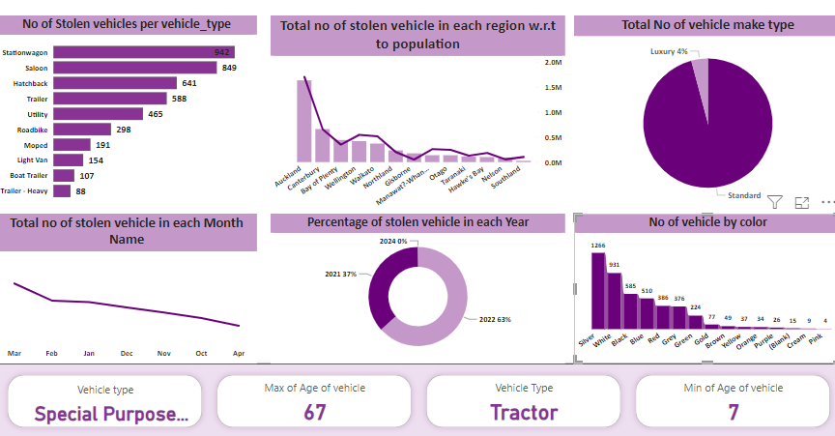
Power BI Analysis

Slide 9
Recommendations

Slide 10
Analysis Report
Special Purpose vehicles are the vehicles which despite being oldest, still get stolen as they are Cash Carrier Vehicles , Concrete carrier Truck sand , Heavy Duty machines carrier trailers etc hence thief don't care about the age of this vehicle , they care about what these vehicle are carrying.
Most of the cars stolen on weekends are station wagon and least stolen are cabs , truck etc. and most of the cars which are stolen most on weekdays are Saloon and station wagon and maximum are stolen on Monday
In Auckland Saloon cars are stolen more followed by station wagon and hatchback coz Auckland is a urban city with business and job opportunities hence people drive these cars more but in bay of plenty Utility is stolen more as bay of plenty is famous for farming hence utility cars are driven more hence we can conclude from this that type of car which is stolen more depends on the region as well.

Slide 11
Vehicles are stolen from Oct to April. There is no data of stolen vehicles in months from May to September. Reason might be because in New Zealand winter season lies from May to Sept, hence season is impacting on rate of no of stolen vehicles. Also maximum number of vehicles which are stolen is in march.
Stolen rate is high in Gisborne , Nelson, Auckland etc which comes under major and large urban areas of New Zealand
96% of stolen vehicles are standard and around 4 percentage of vehicles are luxury
Maximum number of vehicle stolen are of silver colour and least are of pink.

Slide 12

THANK YOU

