Slide 1
3
Legal Assistant
Agents
for SMB Kazakhstan
8
Pipeline Steps
Agentic RAG | Multilingual | Live Government Data
4
Guldana Kassym-Ashim
EPAM Generative AI for Software Development May 2026
Legal Codes
🔄
Agentic RAG
🌐
MCP Integration
📊
RAGAS Evaluation
3
Retry loop, 3 attempts
Live gov data
Quality per response
🌍
Multilingual
👁
LangFuse
📂
Custom KB
Gov Sources
Kazakh / English / Russian
Full observability
Upload your own docs

Slide 2
What Problem Does This Solve?
Legal compliance is expensive and complex for SMBs in Kazakhstan
💸
High Cost
📚
Complexity
🌍
Language Barrier
Legal consultations $50–200 per hour. SMBs can't afford it.
4 legal codes, 2000+ pages. Laws change constantly. Hard to stay updated.
Kazakh, English, Russian. No single accessible source. Errors lead to fines.
💰 Cost Comparison & ROI
👨‍⚖️ Lawyer (1 hour)
📋 PRG / Paragraf (KZ)
🤖 Our AI (1 query)
$20 – $100
$17 – $45/mo
~$0.01
Traditional consultation
Kazakhstan legal DB subscription
incl. RAGAS eval • 1,000 queries ≈ $8
ROI: up to 10,000× cheaper than a lawyer • Unlimited legal access • Answers in seconds, not days

Slide 3
Technology Stack
Production-grade components — all integrated
🧠
LangGraph
🤖
GPT-4.1-mini
🔍
Hybrid Search
🌐
MCP Server
Agentic orchestration 3 agents, 8 pipeline steps TypedDict state management
LLM for all agents Generation, grading & reasoning
ChromaDB vector search + BM25 keyword search RRF Fusion — best of both
Custom FastMCP server adilet.zan.kz + kgd.gov.kz + egov.kz live data
📊
RAGAS
👁
LangFuse
🖥
Gradio UI
📂
Knowledge Base
gpt-4o-mini as judge Faithfulness + Relevancy ~$0.001 per eval
Full pipeline tracing Token cost tracking User feedback logging
Streaming interface Kazakh / English / Russian Real-time agent trace
Upload your own PDFs & DOCX 4 Kazakhstan legal codes Auto-indexed at runtime

Slide 4
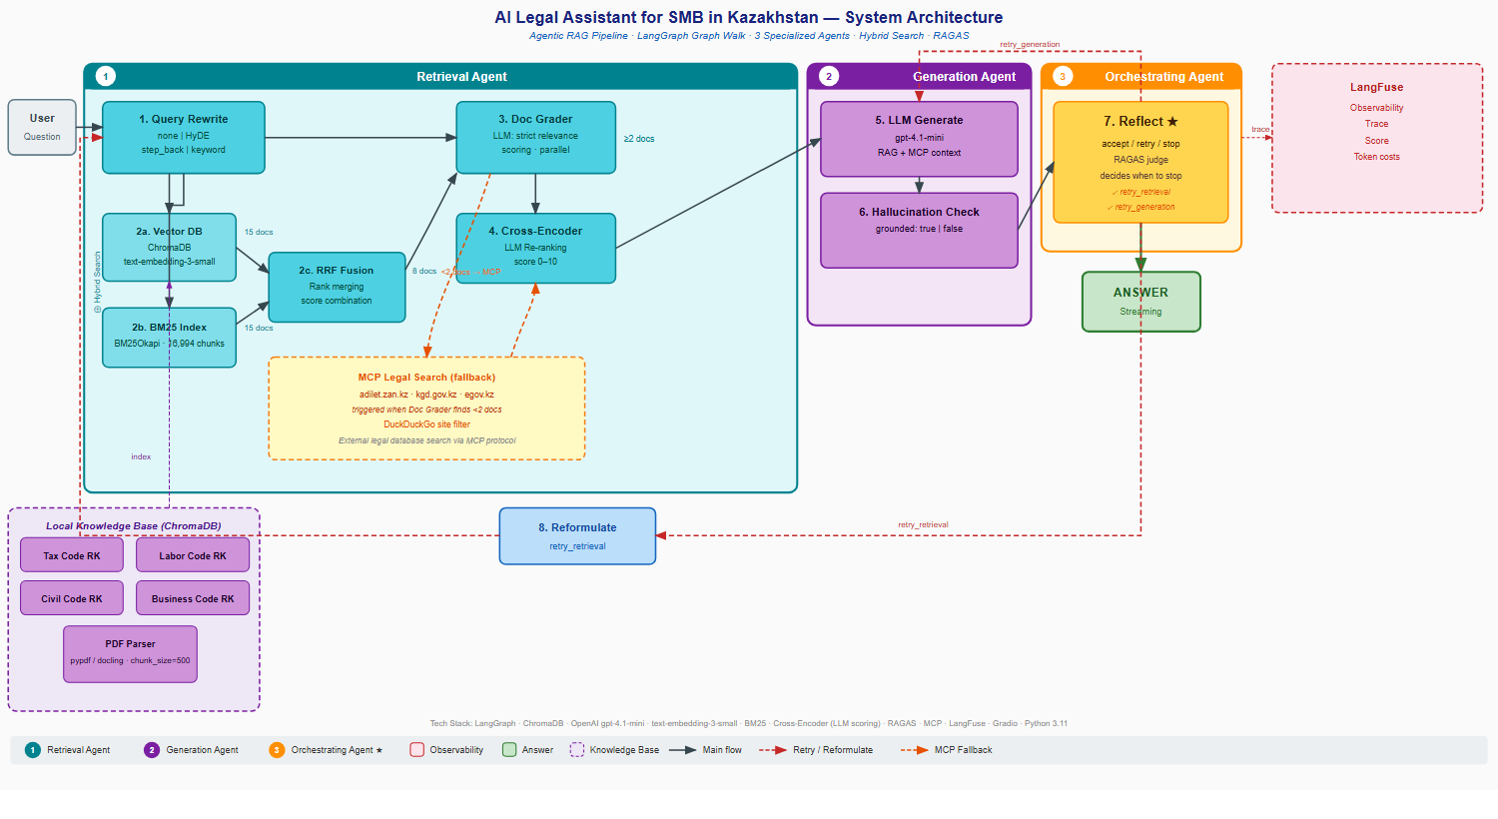
Pipeline Architecture
Agentic RAG with retry loop — 3 specialized agents, 8 pipeline steps

Slide 5
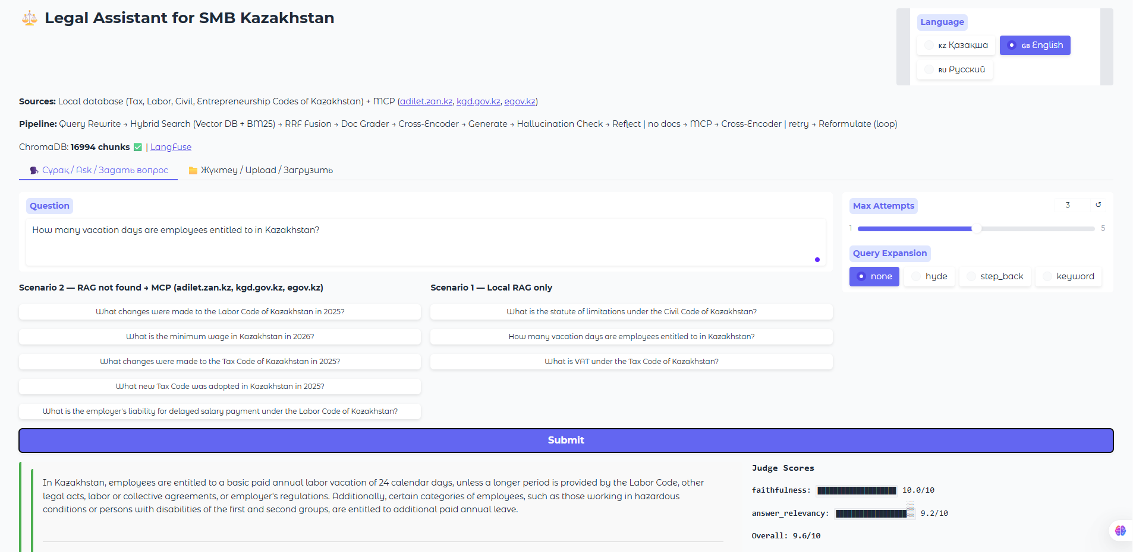
Live Demo

