Slide 1


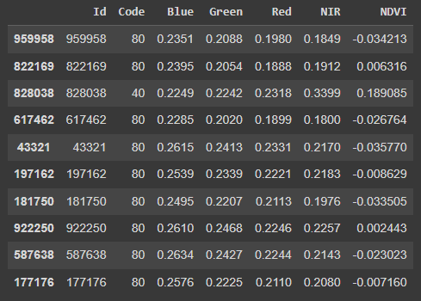
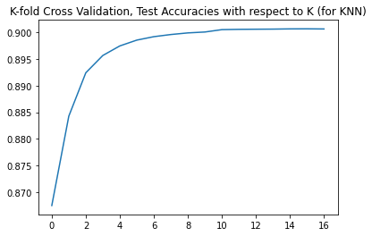
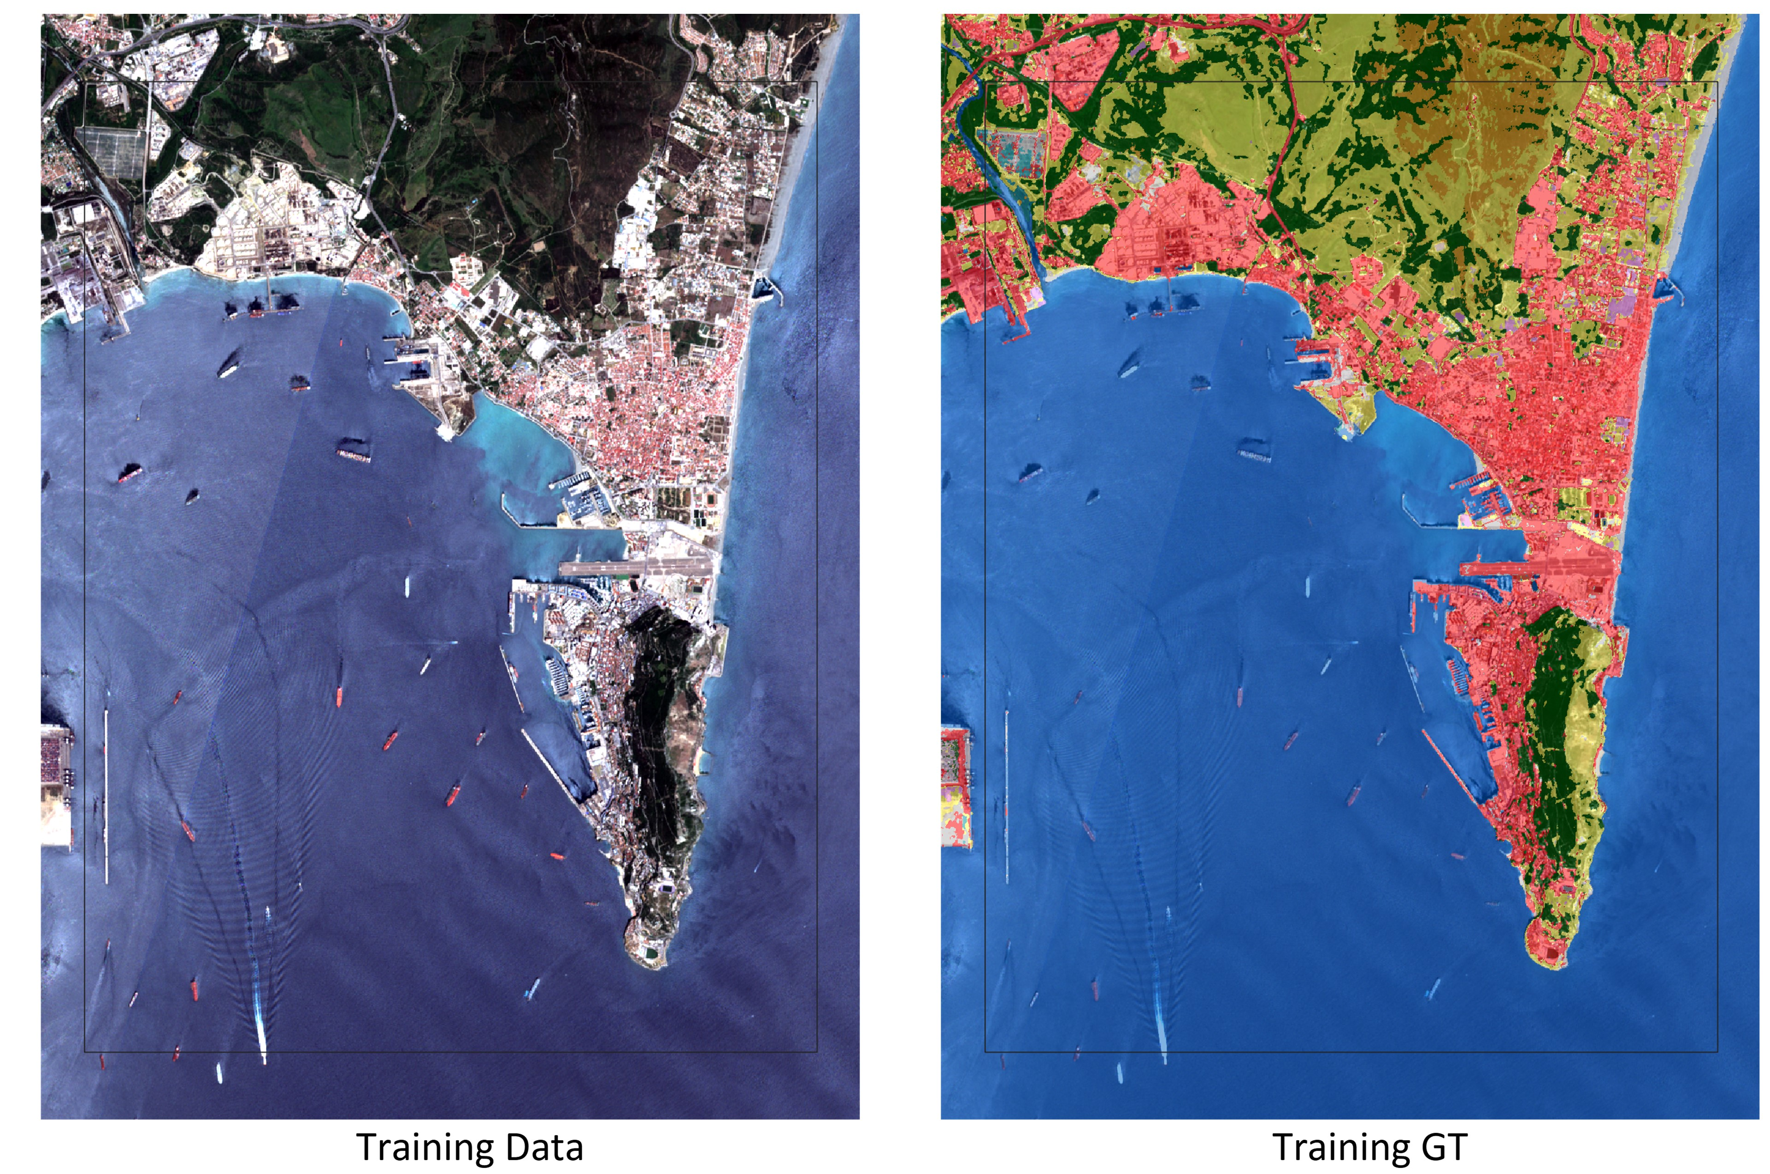
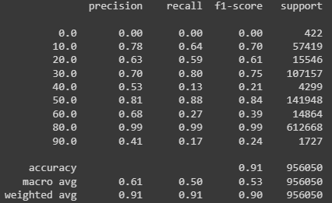
Generate Land Cover Maps For Unseen Data With ML
Eray Ergüleç, Enes Güler
SUMMARY
OVERVIEW OF PROJECT
RESULTS
Climate change has become a serious threat to humanity. Global land cover maps serve as an important means to tackle this problem. ESA has produced a Global Land Cover Map from Sentinel-2 data.
In this study, we generated land cover maps for unseen data by using a limited number of training samples. Gibraltar was chosen as a study area because it has a diverse range of land cover types. FIGURE 2 depicts this area.
We classified land cover using ”Blue," ”Red," ”Green," and "NIR" spectral bands in this project. Also, we created a new band, which is NDVI, to make it more efficient. In Table 1, we showed a small piece of the training data that includes these bands.
First of all, we determined the methods that we thought would be most suitable for the purpose of the project. Then, we recorded the results by using these methods one by one, and in line with these results, we started to classify by choosing the method that would be most suitable for the purpose of the project.
First, we thought that SVM would be the most suitable method for this purpose, and we tried to train and test the system using this method. But during this process, after we saw that the training process took too long and could not give accurate results with large data, we started to try the other methods we chose. Among these methods, we decided that the most suitable one was KNN. KNN is both fast with large data and has more successful test results than other methods; we believe that this method will be the best fit for the project. In FIGURE 1, for KNN optimization, we showed that cross-validation scores against different neighbors' values
As a result, we used 70% of the train.csv, which is 676903 for testing, and then we used all data, which is 967005 for the final train.
First, we tried SVM, and when SVM works with large data, such as the provided data, we need to drop the feature or use a multi-threading approach. We tried this approach, and after we made the test about them, the result shows that KNN is a better algorithm for this specific purpose.
SVM gave us a score of between 0.24-0.26, while KNN gave us a score of 0.33881, which is higher than SVM.
METHODS
A. K-Nearest Neighbors(KNN)
K-NN is a type of classification where the function is only approximated locally and all computation is deferred until function evaluation. Since this algorithm relies on distance for classification, if the features represent different physical units or come in vastly different scales then normalizing the training data can improve its accuracy dramatically. We use this method because it gives us the best scores.
B. Support Vector Machines(SVM)
Support vector machines are supervised learning models with associated learning algorithms that analyze data for classification and regression analysis. We tried SVM to get better results but the training time is too long also the predictions were slow. So we decide to not use SVM.
C. Cross Validation
Cross-validation is any of various similar model validation techniques for assessing how the results of a statistical analysis will generalize to an independent data set. We use cross-validation to calculate accuracy for different parameters to understand the best parameters.
D. Optimization Techniques
While we were working with SVM, to find the best degree and c parameters, we used cross-validation in a for loop and specified them. Also in KNN, we used the same approach to find the N-neighbors parameter.
E. PreProcessing Data
1)Removing Outliers: Our data contains some zero-valued outliers. We cannot calculate NDVI with these outliers. So we deleted them in this part.
2)Normalizing Data: To convert data from 0-1, we divided ‘Blue’, ‘Red’, ‘Green’, ‘NIR’ columns by 10.000.
3)Calculating NDVI: Normalized Difference Vegetation Index (NDVI) quantifies vegetation by measuring the difference between near-infrared (which vegetation strongly reflects) and red light (which vegetation absorbs). We calculated it as (NIR-Red) / (NIR+Red).
TECHNOLOGIES
Matplotlib: To visualization
Numpy: To mathematical operations
Pandas: To anaylze data
SKLearn: To use SVM, KNN and Cross-Validation
Google Colab: To run ipynb
Kaggle: To run ipynb and submit the result
TABLE 1 Example Data For Training
FIGURE 1 cross validation scores against different n_neigbors values
SUCCESS CRITERIA
PRECISION
Precision is defined as the fraction of relevant instances among all retrieved instances
B. RECALL
Recall, sometimes referred to as 'sensitivity, is the fraction of retrieved instances among all relevant instances.
C. F-1 SCORE
F-1 Score is the harmonic mean between precision and recall.
D. ACCURACY
Accuracy is the fraction of predictions our model got right. Formally, accuracy has the following definition: Accuracy = Number of correct predictions Total number of predictions
PROJECT CODES
1] Padwick, Chris, et al. "WorldView-2 pan-sharpening." American Society for Photogrammetry and Remote Sensing. 2010.
FIGURE 2 Gibraltar Area Selected for Study
TABLE 2 Success metrics of model

