Slide 1

MyData2017 Hackathon @ THL
Mangusti
Healthcare Profile
Gunnar Rø, Jyri Soppela, Pauliina Mäkkeli, Severi Niskanen, Jesse Virtanen, Riku Mäki
04/09/2017

Slide 2
1. Introduction
High accessibility web service tool to put your health data in context
  Goal is to motivate and to point towards right sources of information
Can be used on your own but accessibility will also be addressed
  Support in public health care facilities
  UI for mobile and desktop
Choices versus outcomes:
  Our life style choices influence health care outcomes
Initial service or MVP:
  No hard requirements for external data sources
  Doable in months by a small dev team
  Consists of input page and 4 dashboards

Slide 3
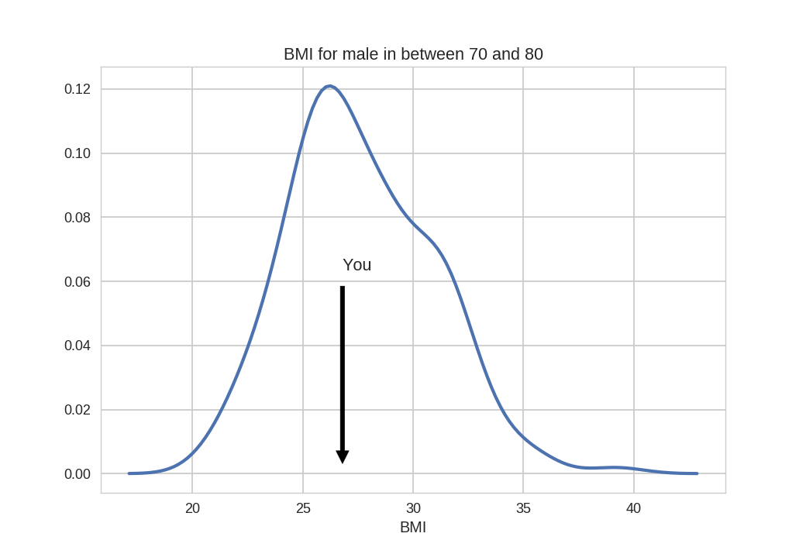
2.1 Dashboards: Compare
Testy McTestface
Help
Logout
Compare
Add filter
Rank by
Browse
Deviation
Goals
Risks

Slide 4
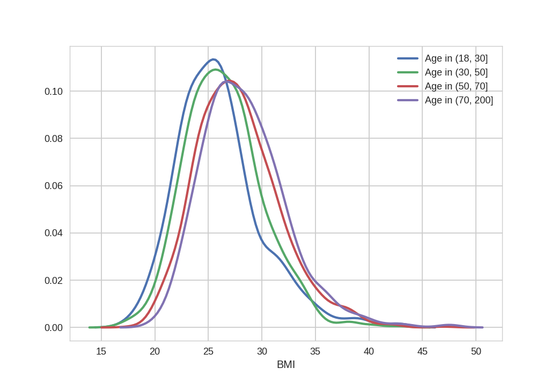
2.2 Dashboards: Browse
Testy McTestface
Help
Logout
Compare
Population 1
Population 2
Population 3
Population 4
Browse
Age Min
Age Max
18
30
Goals
Risks

Slide 5
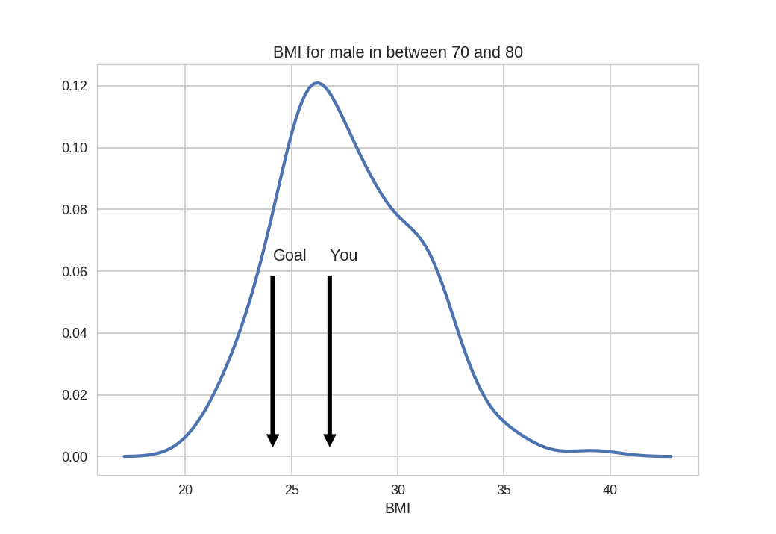
2.3 Dashboards: Goals
Testy McTestface
Help
Logout
Compare
Set goal for
BMI
Browse
Goals
Risks

Slide 6
2.4 Dashboards: Risks
Testy McTestface
Help
Logout
Compare
Population 1
Population 2
Browse
Goals
You have increased risk in:
Heart attack risk increased by 15%
Highest impact would be had by:
- Reduce fat intake
- Reduce smoking
Risks

Slide 7
3. Future possibilites
Data integration:
  User authenticates Kanta to provide data for analysis
  Integrate data from commercial health applications
Life long health path projections
  Use long term health data on population level to project long term effects of current health choices

