Slide 1
EU Retail Analytics
Power BI Portfolio Project
European Retail Sales, Customer, Product & Returns Analysis

Slide 2
Project Overview
Business Context
• European retail business operating across multiple countries
• Sales across products, customers, channels and segments
• Includes returns and monthly sales targets
Business Goal
• Transform messy operational data into a clean analytical model
• Identify revenue, profit, customer and product performance
• Monitor returns and target achievement
Tools
• Excel
• Power Query
• MySQL
• Power BI
• DAX

Slide 3
Data Preparation & Transformation
Data Sources
• Sales
• Customers
• Products
• Returns
• Monthly Targets
• Country Mapping
Power Query Work
• Removed duplicate records
• Cleaned text fields
• Standardized country names
• Handled missing values
• Converted data types
• Resolved mixed date formats
• Prepared analytical tables
Result
A cleaner and more reliable dataset ready for Power BI analysis.

Slide 4
Power BI Data Model
DimDate → FactSales
DimCustomer → FactSales
DimProduct → FactSales
DimCountry → FactSales
FactReturns
FactTargets
Star-schema approach designed for scalable reporting and DAX analysis.

Slide 5
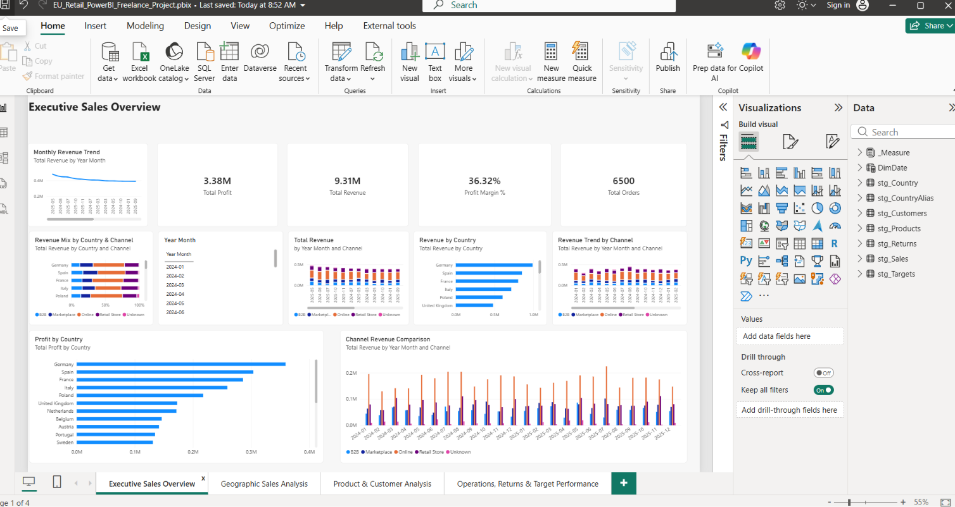
Executive Sales Overview

Slide 6
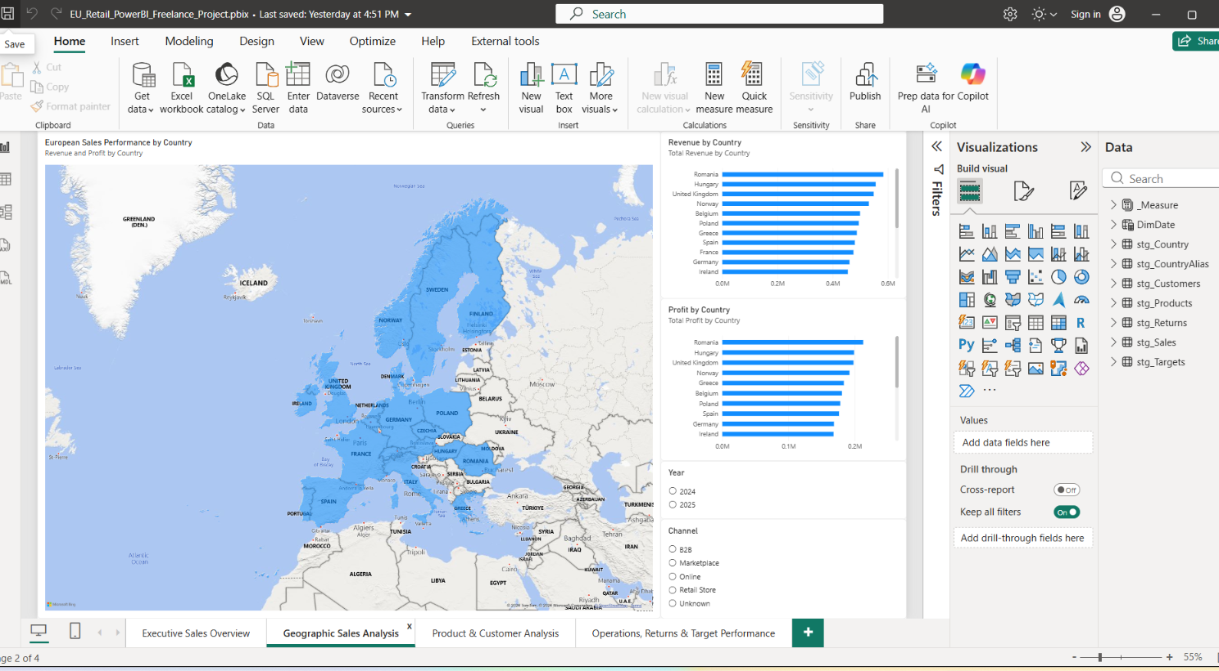
Geographic Sales Analysis

Slide 7
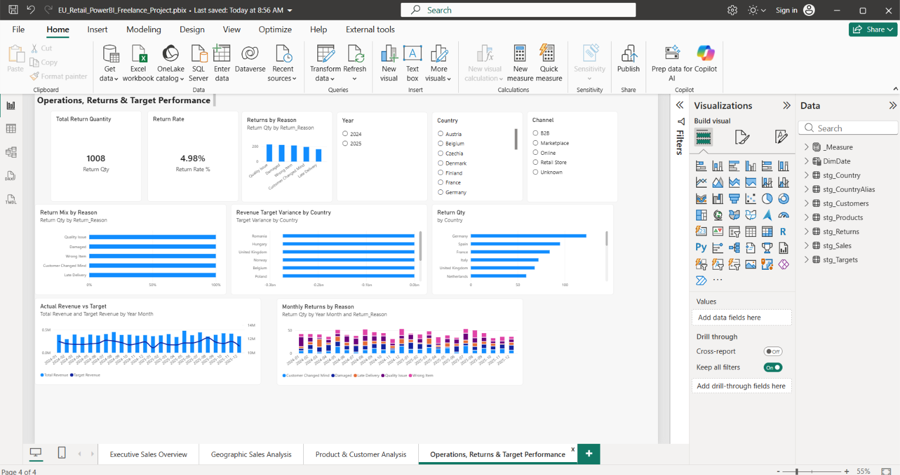
Product & Customer Analysis

Slide 8
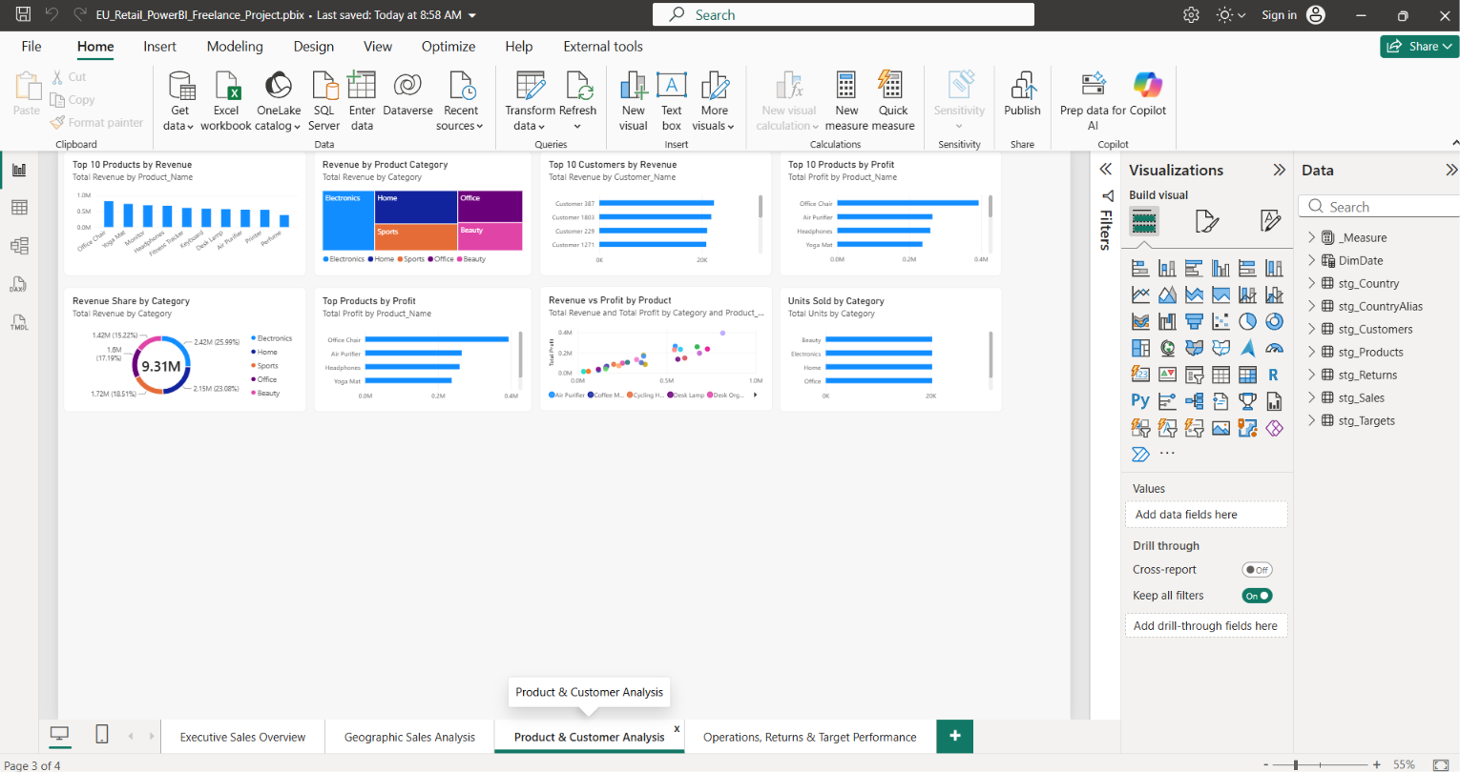
Operations, Returns & Target Performance

Slide 9
Key Business Insights
Revenue: Total revenue reached approximately €9.31M across the analysis period.
Profitability: Profit was approximately €3.38M, with a healthy overall margin.
Geographic Performance: Germany and Spain are among the strongest revenue and profit markets.
Product Performance: A small group of products contributes a significant share of revenue and profit.
Target & Returns: Target performance and return activity provide additional areas for management monitoring.

Slide 10
Tools & Skills
Tools
Excel
Power Query
MySQL
Power BI
DAX
Skills Demonstrated
Data cleaning and transformation
Data modelling and relationships
KPI and DAX development
Dashboard design and visualization
Business-focused analysis
Portfolio documentation
Project Outcome
End-to-end retail analytics solution developed from raw data through transformation, modelling, analysis and interactive Power BI reporting.

