Slide 1
PING Command
Purpose and Connectivity Testing

Slide 2
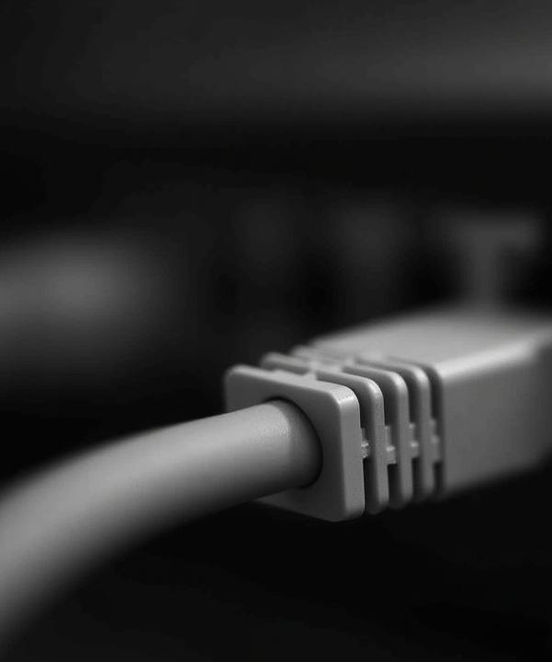
Introduction
The PING command is a critical tool in network management, designed to verify the presence and responsiveness of devices within an Internet Protocol (IP) network. By sending ICMP echo request packets and measuring the time taken for these packets to return, it provides an accurate metric of network latency and device availability.
p
/pThis utility is invaluable for quickly detecting connectivity problems, enabling network professionals to identify and resolve issues before they impact operations. Its simplicity and effectiveness make it a cornerstone for reliable network performance assessment and troubleshooting.

Slide 3
01
Overview of the PING Command

Slide 4

Definition and Purpose
The PING command operates by sending ICMP echo request packets to a specific network device and awaiting a response. This process confirms the device’s availability and determines the round-trip time for communication.
p
/pIts primary purpose is to quickly verify network connectivity and assess latency, which is essential for diagnosing issues and monitoring network performance. This makes the PING command a foundational tool for ensuring efficient and reliable network operations.

Slide 5
How PING Works
PING functions by sending an ICMP echo request packet to the targeted device and awaiting an echo reply. This interaction enables the calculation of round-trip time, which is a key indicator of network latency and responsiveness.
p
/pIf the target device fails to respond, it typically signals connectivity problems such as device unavailability or network interruptions. This process is fundamental for diagnosing network health, helping administrators identify and address issues swiftly to maintain optimal performance.

Slide 6
Common Use Cases
The PING command is an essential tool for network troubleshooting, allowing administrators to verify if a device is active and reachable within the network. It plays a critical role in latency measurement, helping assess the speed and responsiveness of network connections.
p
/pMoreover, PING assists in detecting packet loss, which is vital for evaluating network stability and performance. These capabilities make it indispensable for maintaining reliability both in local and remote network environments.

Slide 7
02
Connectivity Testing with PING

Slide 8
Measuring Network Availability
PING verifies network availability by sending packets to a host and measuring its response time. This process confirms whether a device is reachable and operational within the network.
p
/pAccurate measurement of response times helps ensure network reliability by identifying potential disruptions early. Maintaining uninterrupted communication between systems depends on this timely and efficient verification, making PING an indispensable tool for network administrators.

Slide 9
Diagnosing Network Issues
Analyzing PING responses allows users to pinpoint various network problems such as congestion, packet loss, or unreachable hosts. Variations in response times and failed replies often indicate underlying issues affecting connectivity.
p
/pThis diagnostic tool helps identify hardware malfunctions, misconfigurations, and routing errors that can degrade network performance. By using PING effectively, network administrators can quickly isolate problems and implement targeted solutions to maintain optimal network health.

Slide 10
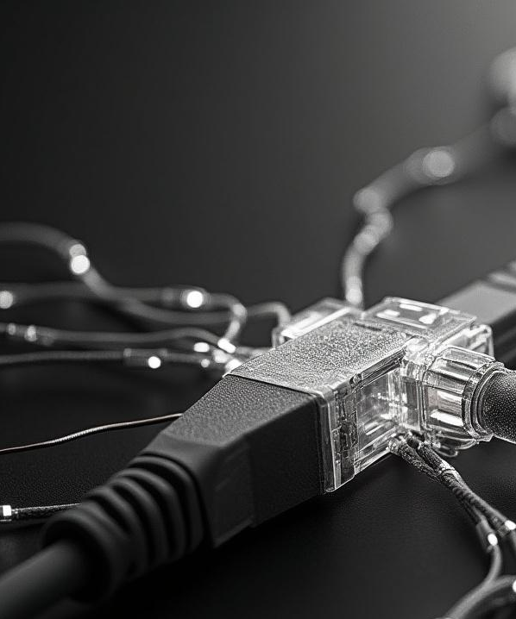
Interpreting PING Results
PING results provide critical insights through round-trip time and packet loss statistics, which reflect network health. A network exhibiting low latency and zero packet loss is considered stable and efficient.
p
/pConversely, high latency, frequent timeouts, or packet loss indicate underlying problems such as congestion, faulty hardware, or configuration errors. Proper interpretation of these metrics enables proactive troubleshooting to ensure continued optimal network performance and reliability.

Slide 11

Conclusions
The PING command remains a fundamental diagnostic tool for quickly assessing network connectivity and performance. Its ability to verify device reachability and measure latency makes it indispensable for network administrators.
p
/pA thorough understanding of how to interpret PING results enhances troubleshooting effectiveness, allowing for swift identification and resolution of network issues. Employing PING as part of routine network monitoring helps maintain consistent and reliable network operations.

Slide 12

THANKS
Do you have any questions?
youremail@freepik.com
+00 000 000 000
yourwebsite.com
Please keep this slide for attribution

