Slide 1
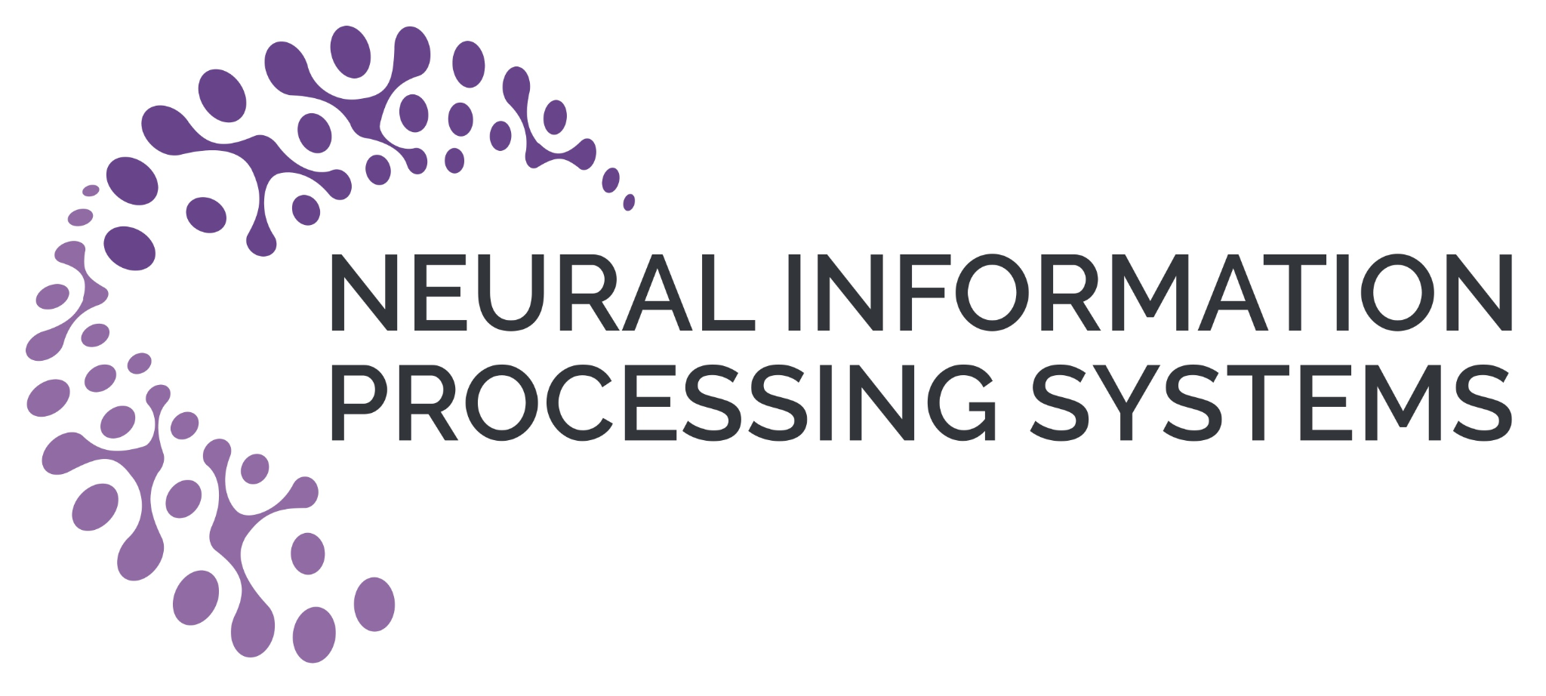
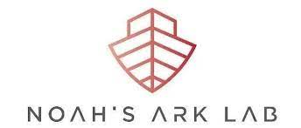


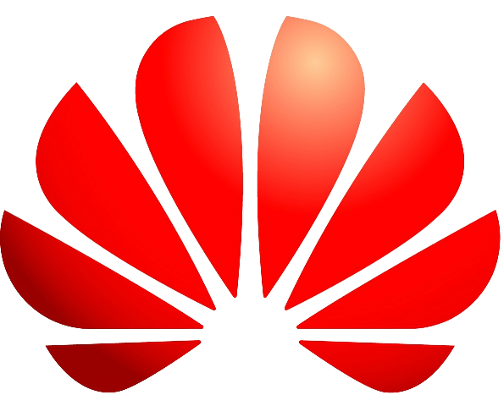
Meta-DMoE:
Adapting to Domain Shift by Meta-Distillation from Mixture-of-Experts
Tao Zhong* , Zhixiang Chi* , Li Gu* , Yang Wang , Yuanhao Yu , Tang Jin
Huawei Noah’s Ark Lab, University of Toronto, Concordia University
Notes:
Hi, My name is Li Gu. Today, I will be presenting our work: Adapting to Domain Shift by Meta-Distillation from Mixture-of-Experts. This is the joint work with collaborators, xxxx

Slide 2
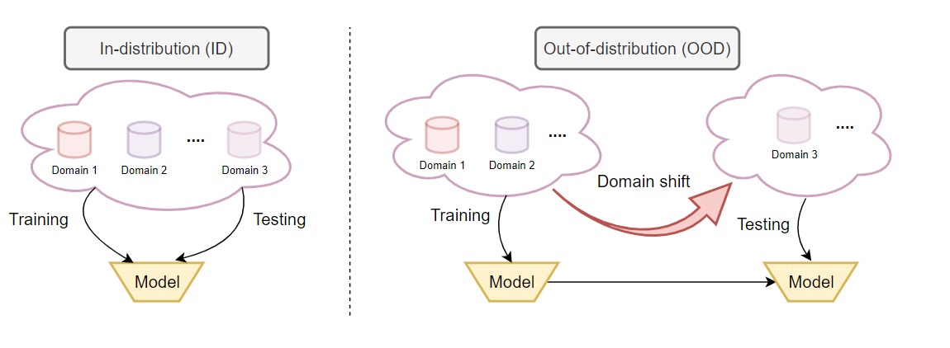
Background: Domain shift in deep learning
Notes:
The problem of domain shift in deep learning is mainly due to the discrepancy of the data distribution between training and testing.

Slide 3
Previous works
Unsupervised Domain Adaptation
Key Idea: Minimize domain discrepancy via collecting target unlabeled data during training
Fernando et al. ICCV 2013
Long et al. NeurIPS 2018
Yang et al. ICCV 2021
- Assume target domains are avalilable in advance during training
Notes:
Previous methods on mitigating the distribution shifts can be classified into three categories. The first is UDA, where both labeled examples from the source domain and the unlabeled examples from a target domain can be collected together to learn an aligned feature space. However, in the real world, collecting the data examples from a target domain in advance might be impractical

Slide 4
Previous works
Unsupervised Domain Adaptation
Key Idea: Minimize domain discrepancy via collecting target unlabeled data during training
Fernando et al. ICCV 2013
Long et al. NeurIPS 2018
Yang et al. ICCV 2021
- Assume target domains are avalilable in advance during training
Domain Generalization (DG)
Key Idea: Learn invariant representations across source and target domains
Ghifary et al. ICCV 2015
Li et al. ECCV 2018
Matsuura et al. AAAI 2020
+ Not rely on prior information of target domains during training
- Fail to exploit domain specific information in target domains
Notes:
An alternative categoryof methods are Domain Generalization. In those methods, a single model is trained on a mix of multiple source domains and learns a domain-invariant feature representation. In testing, the trained model is expected to perform well on all unseen target domains which might be sub-optimal.

Slide 5
Previous works
Unsupervised Domain Adaptation
Key Idea: Minimize domain discrepancy via collecting target unlabeled data during training
Fernando et al. ICCV 2013
Long et al. NeurIPS 2018
Yang et al. ICCV 2021
- Assume target domains are avalilable in advance during training
Domain Generalization (DG)
Key Idea: Learn invariant representations across source and target domains
Ghifary et al. ICCV 2015
Li et al. ECCV 2018
Matsuura et al. AAAI 2020
+ Not rely on prior information of target domains during training
- Fail to exploit domain specific information in target domains
Test-time Adaption in DG
Key Idea: Adapt a single model to target domain with unlabeled data during testing
Zhang et al. NeurIPS 2021
+ Exploit domain specific information in target domains
- Fail to model the correlations among multi-source domains
Notes:
Test-time adaptation in DG allows the model to exploit the unlabeled data during testing to overcome the limitation of using a flawed generic model for all unseen target domains.
But the recent method uses a single model to represent the knowledge from multiple source domains, where their correlations are ignored. So, in order to address issues in previous methods, in this paper, we propose a new test-time adaptation framework that is tailored for multiple sources domain settings.

Slide 6
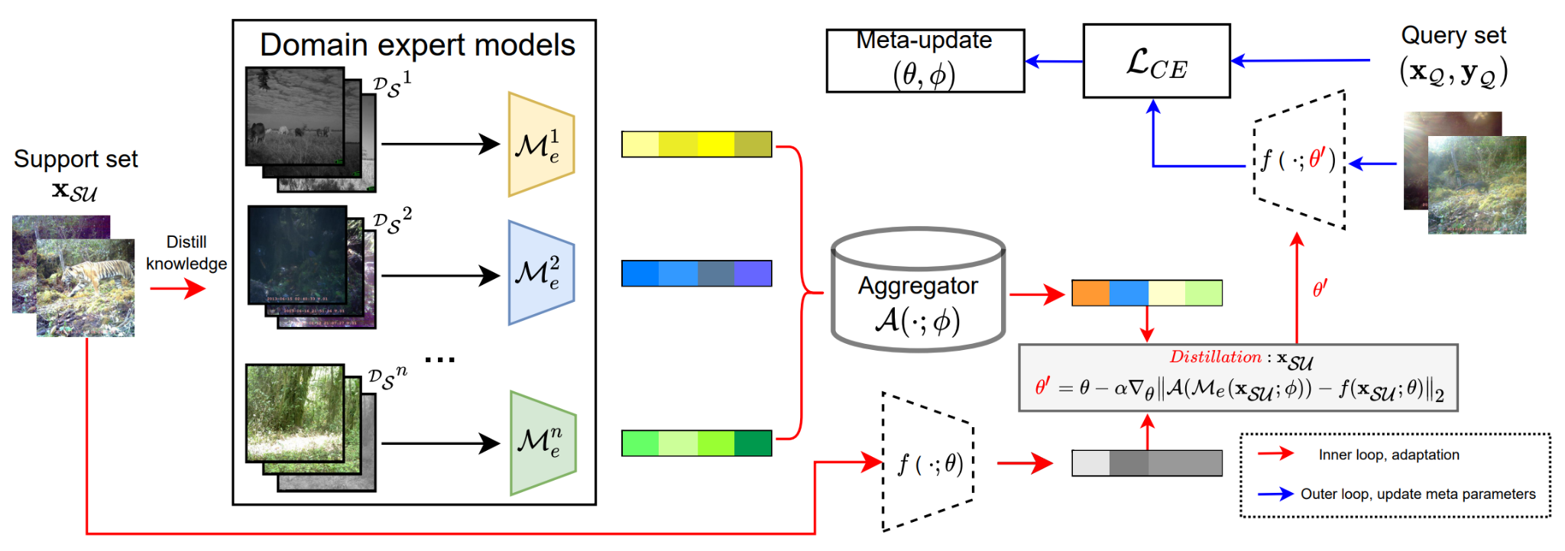
Test-time Adaptation under multi-source domain setting
Notes:
Let’s first take a look at the problem definition. during training, abundant labeled data examples from multiple source domains can be used to model the knowledge.

Slide 7
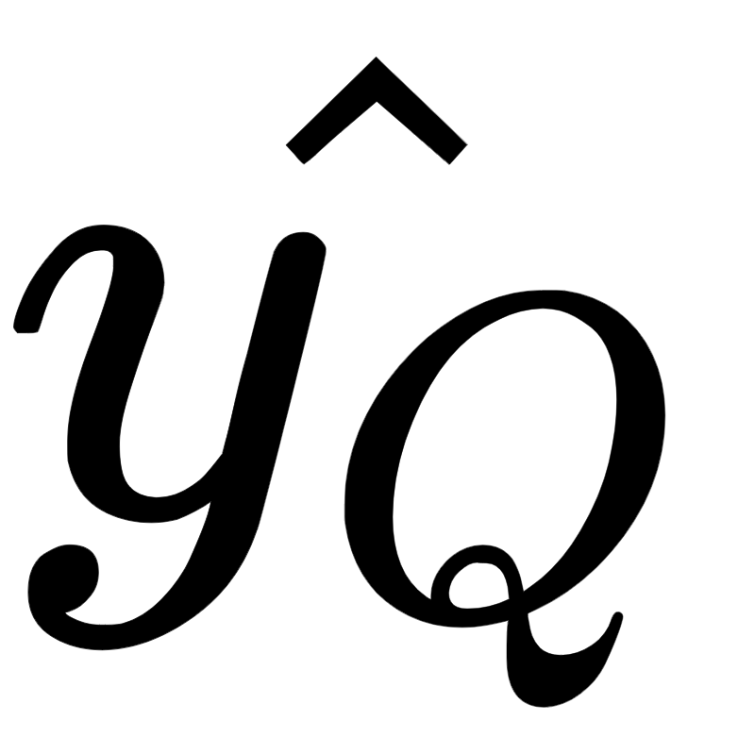
Test-time Adaptation under multi-source domain setting
Notes:
during testing,one or a few of unlabeled data examples from a target domain are collected to adapt the prediction network from theta to theta prime.

Slide 8
Test-time Adaptation under multi-source domain setting
Notes:
After the adaptation, the prediction network is expected to generalize well on unseen examples from the target domain.
To solve this problem, there are three questions to be answered:

Slide 9
Test-time Adaptation under multi-source domain setting
Q1: How to model the knowledge?
Notes:
How to model the knowledge from multi-source domains?

Slide 10
Test-time Adaptation under multi-source domain setting
Q1: How to model the knowledge?
Q2: How to transfer the knowledge?
Notes:
How to transfer the knowledge from multi-source domains to the one target domain?

Slide 11
Test-time Adaptation under multi-source domain setting
Q1: How to model the knowledge?
Q2: How to transfer the knowledge?
Q3: How to guide the adaptation?
Notes:
How to leverage that transferred knowledge to guide the adaptation?

Slide 12
Distillation from Mixture-of-Experts
Q1: How to model the knowledge?
Notes:
First, To model the the knowledge from various source domains, we incorporate the concept of Mixture of Experts, where each model is separately trained using standard supervised learning on its corresponding source domain to learn its discriminative features

Slide 13
Distillation from Mixture-of-Experts
Q2: How to transfer the knowledge?
Notes:
Then, we formulate the test-time adaptation as the process of knowledge distillation from multiple source domains. To be specific, the MoE models are treated as a teacher, and the prediction network as a student. At test time,the target unlabeled data examples are used to query the features from expert models individually. Then, a transformer-based knowledge aggregator is proposed to capture the interconnection among queried knowledge and aggregate the correlated information toward the target domain

Slide 14
Distillation from Mixture-of-Experts
Q2: How to transfer the knowledge?
Q3: How to guide the adaptation?
Notes:
Finally, the output of the knowledge aggragator is treated as supervision signal to update the parameters of the student prediction network to adapt to the target domain.

Slide 15
Distillation from Mixture-of-Experts
Notes:
but, In the proposed knowledge distillation framwork, the paramters of two critical modules are still unknown. The knowledge aggregator

Slide 16
Distillation from Mixture-of-Experts
Notes:
and the initialization of student prediction network.

Slide 17
Meta-Distillation from Mixture-of-Experts
Notes:
So, we follow the meta-learning paradigm with bi-level optimization to train both of them at the meta-level
Specifically, To simulate the test-time out-of-distribution scenarios, we first split the data samples in each source domain into non-overlapped support and query sets.

Slide 18
Meta-Distillation from Mixture-of-Experts
Notes:
The unlabeled support set is used to perform adaptation through knowledge distillation and update the parameter of the student network in the inner loop.

Slide 19
Meta-Distillation from Mixture-of-Experts
Notes:
While, the labeled query set is used to evaluate the adapted parameter to explicitly test the generalization on unseen examples in the outer loop. Finally, the cross entropy loss is backpropagated to calculate the meta gradients and update two set of meta-parameters

Slide 20
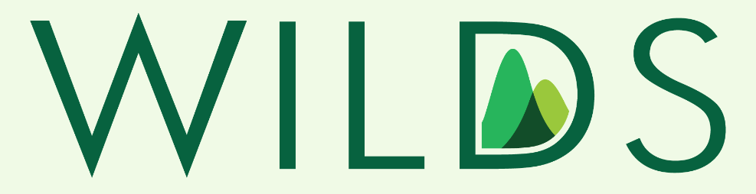
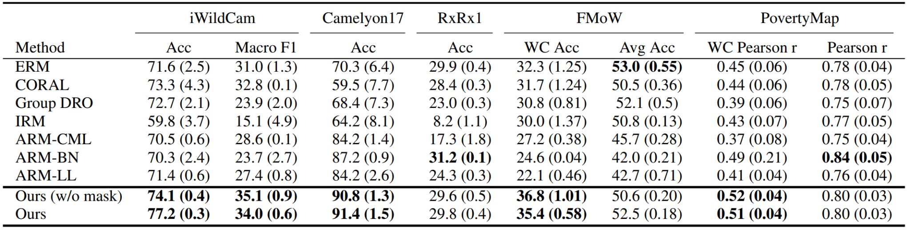
Main experiment results
Our method achieves the best performance on 4 out of 5 benchmark datasets
Notes:
To evaluate the effectiveness of our proposed framwork, we conduct several experiments on WILDS benchmark.
Our proposed method performs well across all datasets and increases both worst-case and average accuracy compared to other methods. Specifically, our method achieves the best performance on 4 out of 5 benchmark datasets.

Slide 21
Main experiment results
Our method outperforms ARM-CML, BN and LL by 9.5%, 9.8%, 8.1% for iWildCam, 8.5%, 4.8%, 8.5% for Camelyon17 and 14.8%, 25.0%, 22.9% for FMoW in terms of average accuracy
Zhang et al. Adaptive Risk Minimization: Learning to Adapt to Domain Shift. NeurIPS 2021
Notes:
The existing test-time adaptation method, ARM, also meta-learns the adaptation process but using a single model to represent the knowledge from multiple source domains. As a result, our method using Mixture of multiple expert models can outperforms ARM significantly

Slide 22
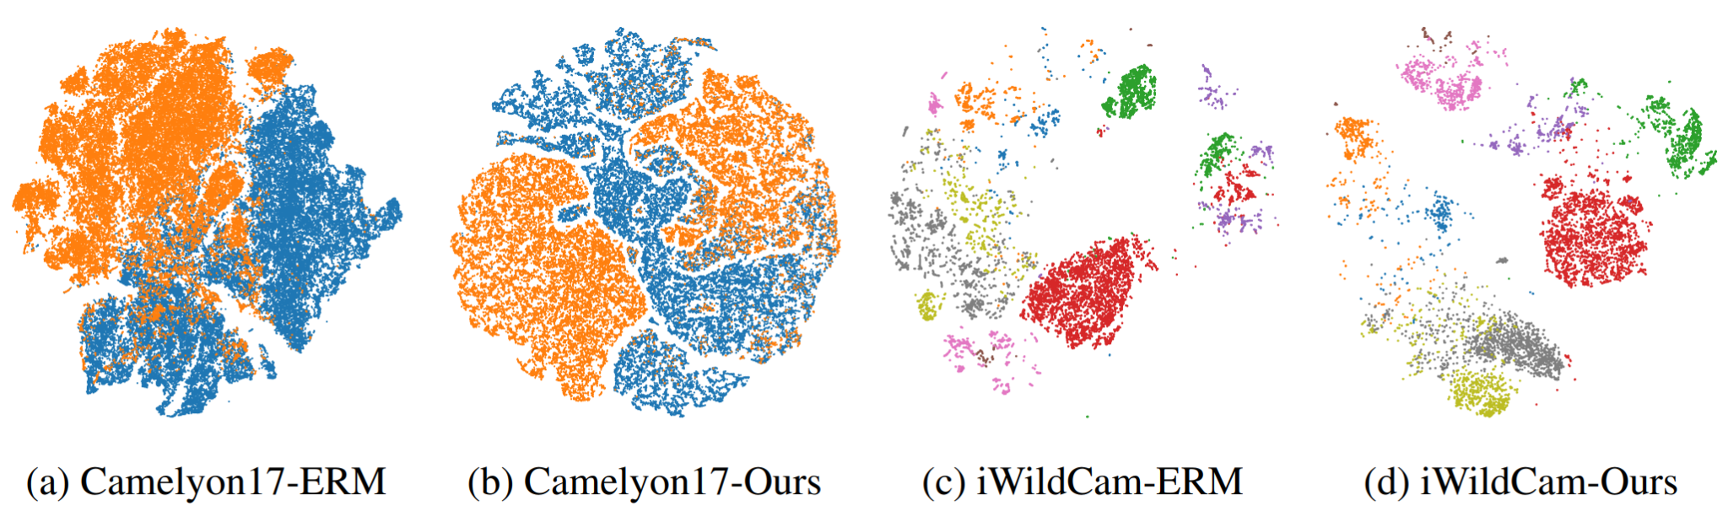
Main experiment results
Notes:
To evaluate the capability of adaptation through learning discriminative representations on unseen target domains, we compare the t-SNE [71] feature visualization using the same test domain sampled from two datasets in WILDS. In the picture, each color represents a class and each point represents a data sample. It is clear that our method can produce better clustered and more discriminative features.

Slide 23
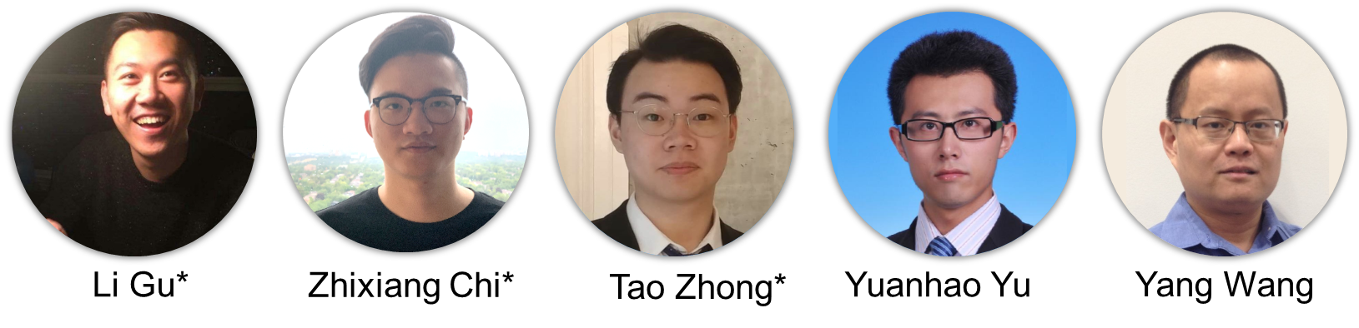
Conclusion
Propose a new framework for unsupervised test-time adaption towards domain shift
Formulate the adaptation process as knowledge distillation and meta-learn the scheme of knowledge aggregation from multiple source domains
Paper: https://arxiv.org/abs/2210.03885
Code: https://github.com/n3il666/Meta-DMoE

