Slide 1
Web GIS
Lecture

Slide 2
Web GIS in Web 2.0
No significant update of any technical specifications, but rather refers to cumulative changes in the ways software developers and end users use the Web
Web 1.0 – read only content and top down information flow
Web 2.0 – read write web, with user-generated content and a bottom up information flow

Slide 3
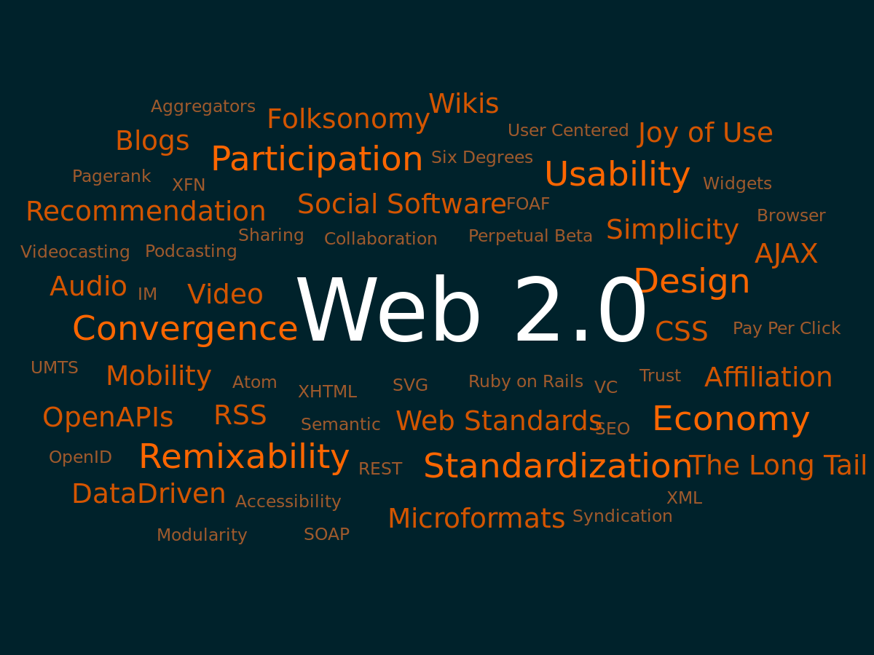

Slide 4
Web 2.0
The web as a platform for computing and software development
Light weight programming models
Data is the next “intel inside”
Software that reaches beyond a single device
Rich usability

Slide 5
Web 2.0
Web 2.0 = User-generated content + the web as a platform + a rich user experience

Slide 6
Web 2.0
Google maps
Google earth
Microsoft bing maps
Yahoo maps
Openstreet
MapQuest

Slide 7
Web 2.0
Professional companies have adopted Web 2.0 principles and design patterns in Web GIS product lines to facilitate the sharing, communication, interoperability, collaboration and integration of geospatial information on the web
Do a bit of research on GIS Design Patterns?

Slide 8
Web 2.0 Principles
Harnessing of collective intelligence and data as the next “Intel Inside”
Using web as a platform
Mash up programming style
Mobile solutions
A rich user experience

Slide 9
W3Schools.com
Good web resource

Slide 10
Web 2.0
What is Web 2.0………..
must read article
Will be uploaded to LMS
Read Page 1 to 12 of Chapter 1 of Web GIS, Principles and Applications by Pinde Fu & Jiulin Sun, 2011
Need a comparison…

