Slide 1
Real-Time Movie Ratings Processing and Aggregation
Dec - 2024

Slide 2
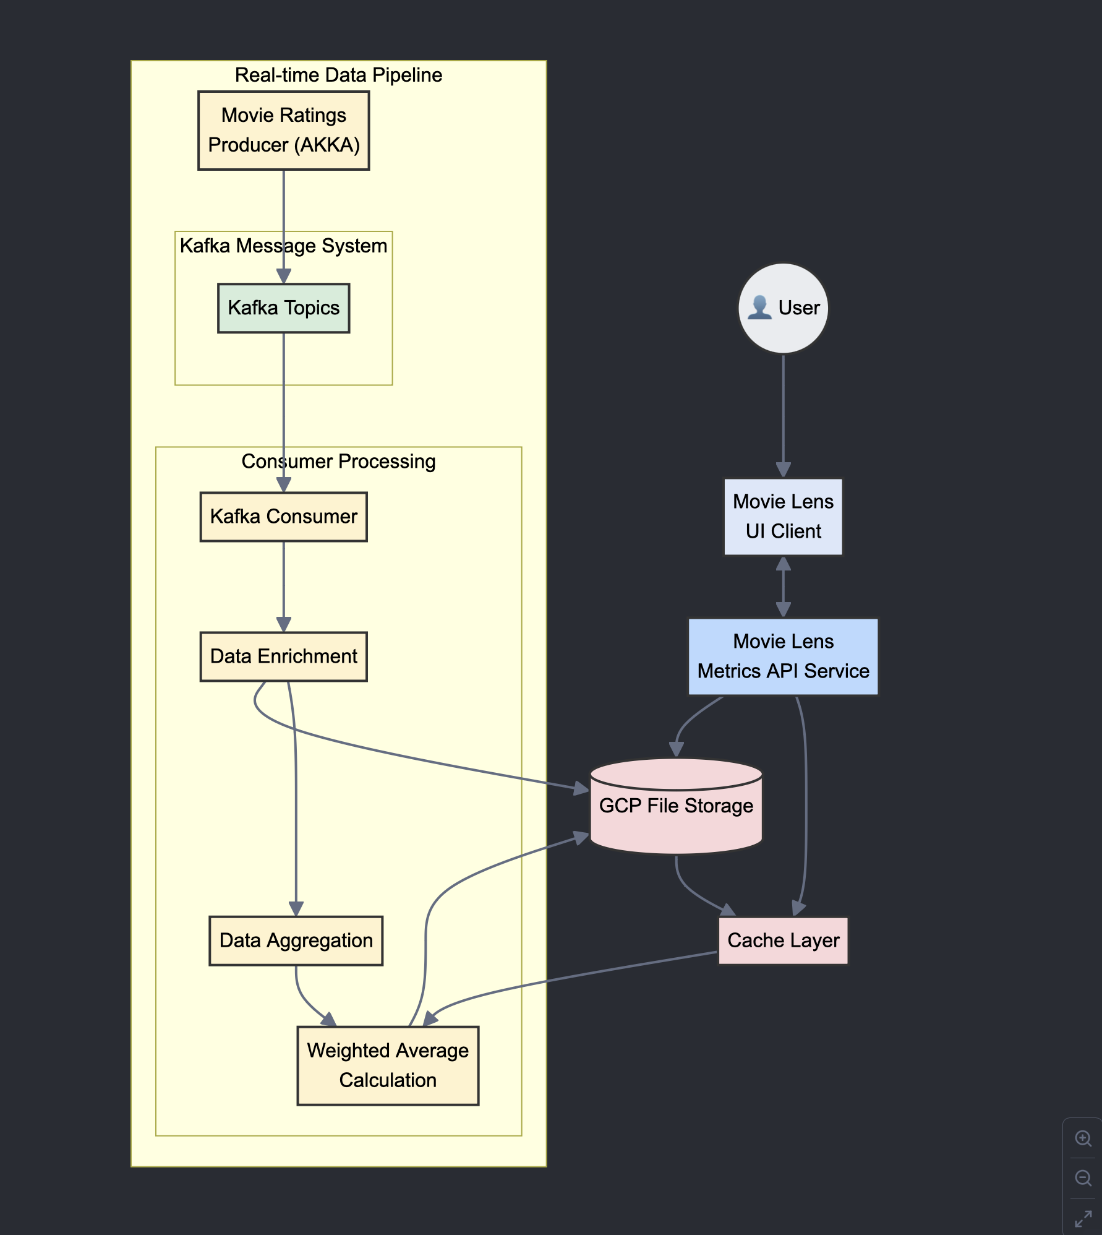
Real-Time Movie Metrics Processing Architecture
Combining Kafka, GCP, and Aggregation Pipelines

Slide 3
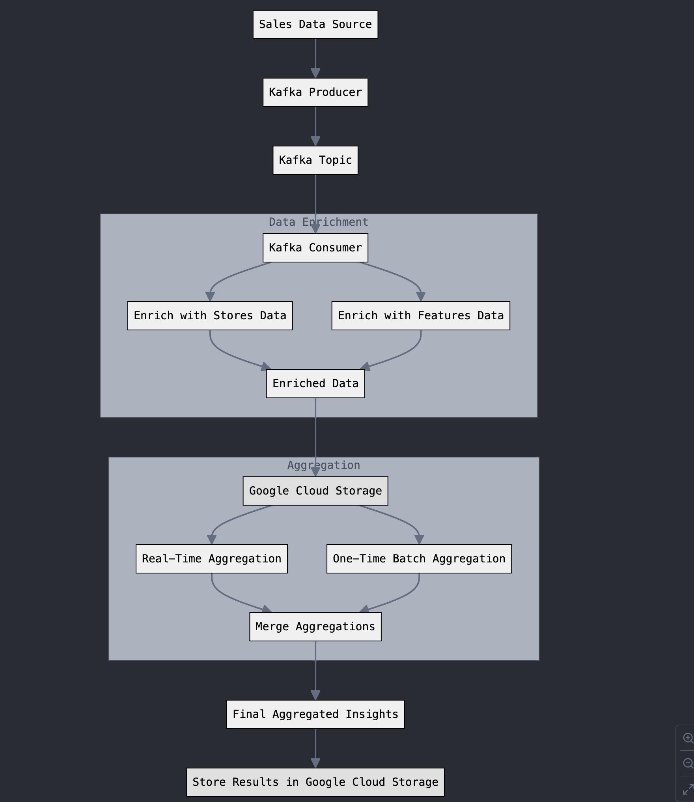
Real-Time Data Streaming

Slide 4
Data Processing
Fetch real-time data from Kafka.
Enrich data with metadata (movies, users).
Store enriched data in GCP.

Slide 5

Aggregation
Perform calculations on enriched data (averages, trends).
Fetch and cache historical data.
Merge historical and real-time data using weighted averages.

Slide 6
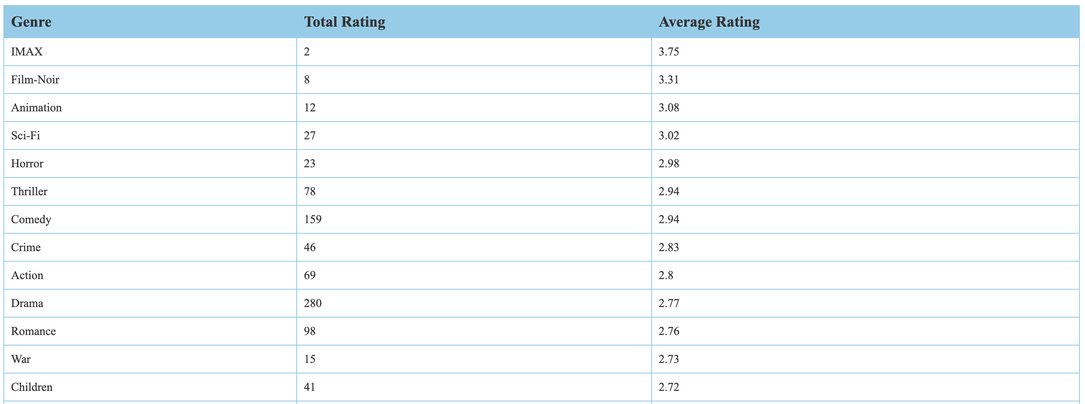
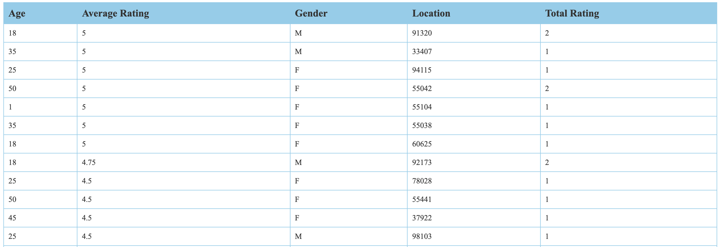
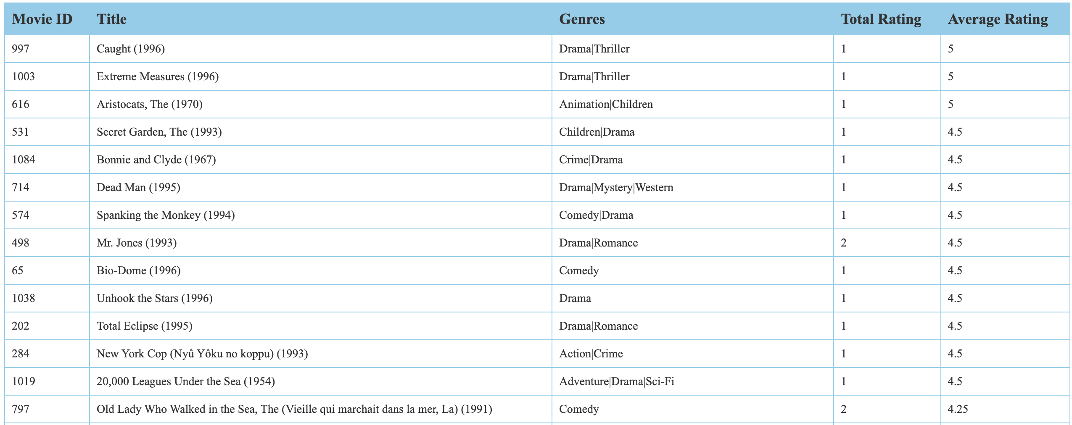
Serving Metrics
the aggregated metrics are stored back in GCP and served via the API service.

Slide 7

Optimizations
Scalable and modular architecture.
Combines real-time and historical data for actionable insights.
Reliable data storage and processing with GCP.
Low-latency streaming with Kafka.

Slide 8
Challenges and Solutions
Challenge - 1: Handling high-volume real-time data.
Solution: Kafka’s high-throughput messaging system.
Challenge - 2: Balancing real-time and historical data.
Solution: Weighted averaging.

Slide 9

THANK YOU

