Slide 1

Data processing Optimization
Priyanshi – Dec 2024

Slide 2
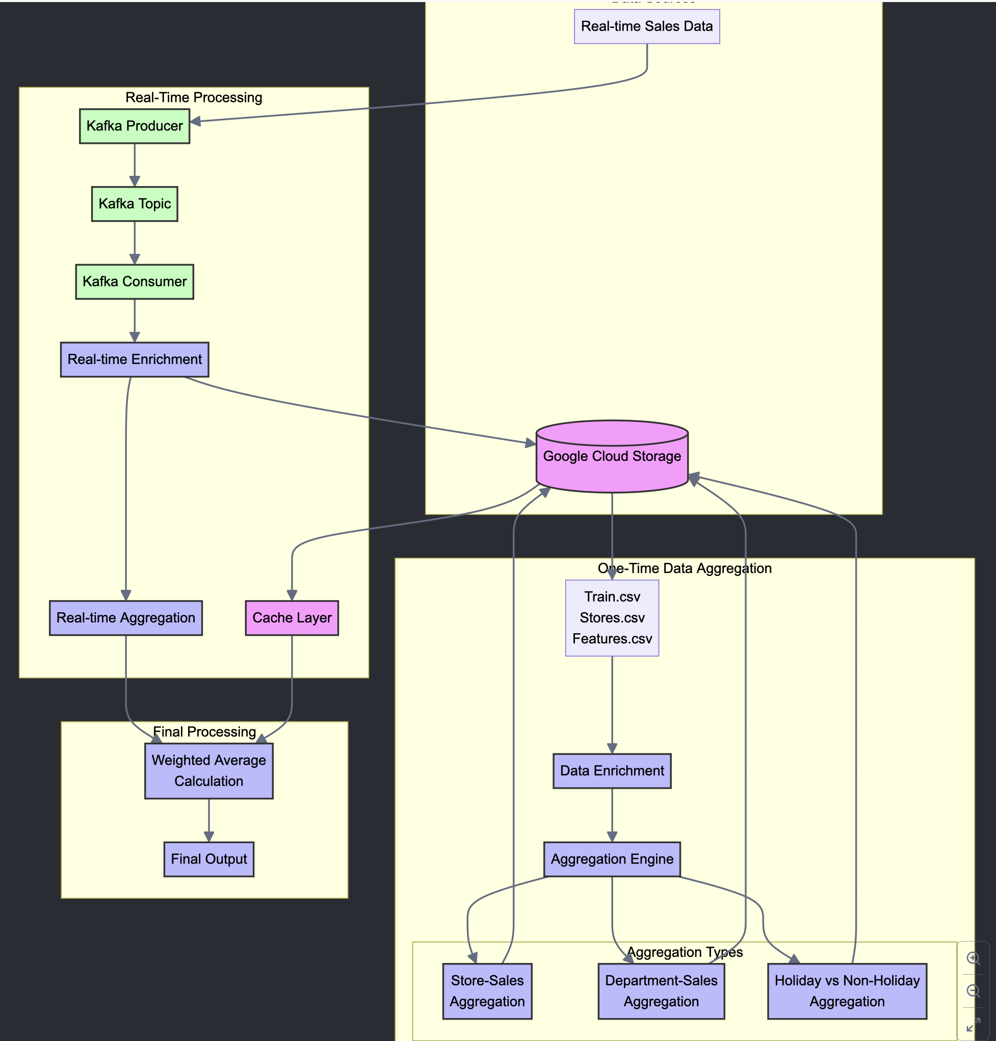
Architecture Diagram

Slide 3
Overview of the Architecture
- Two major components:
1. One-Time Data Aggregation
2. Real-Time Data Processing
- Core Technologies:
Kafka, Google Cloud Storage (GCS), Spark

Slide 4
One-Time Data Aggregation
- Reads historical data from GCS (Train.csv, Stores.csv, Features.csv)
- Joins and enriches sales data with store and feature details
- Computes various aggregations (Store-Sales, Department-Sales, Holiday-Sales)
- Stores aggregated data back to GCS

Slide 5
Real-Time Data Processing
- Kafka Producer sends real-time data to Kafka topics
- Consumer enriches real-time data with store and feature details
- Enriched data is stored in GCS
- Aggregation is performed on enriched real-time data

Slide 6
Integration of Historical and Real-Time Data
- Fetches historical data from GCS and caches it
- Merges historical and real-time data using weighted averages
- Ensures up-to-date aggregated metrics

Slide 7
Benefits of the Workflow
- Combines historical and real-time insights
- Scalable architecture with Kafka and GCS
- Flexible aggregation pipeline for various metrics
- Reduces latency with caching and efficient processing

Slide 8
Challenges and Solutions
- Challenge: Ensuring low latency for real-time processing
Solution: Use Kafka and optimized caching
- Challenge: Balancing historical and real-time data
Solution: Weighted averaging during aggregation

