Slide 1
Data Science Projects
Karina Rathore
0801CS183D08

Slide 2
Online Retail System
Project 1

Slide 3
Dataset Description
The dataset contain information about transaction history, it includes following fields:-
Fields | Description
InvoiceNo | Invoice number. Nominal, a 6-digit integral number uniquely assigned to each transaction.
StockCode | Product (item) code. Nominal, a 5-digit integral number uniquely assigned to each distinct product.
Description | Product (item) name. Nominal.
Quantity | The quantities of each product (item) per transaction. Numeric.
InvoiceDate | Invoice Date and time. Numeric, the day and time when each transaction was generated.
UnitPrice | Unit price. Numeric, Product price per unit in sterling.
CustomerID | CustomerID: Customer number. Nominal, a 5-digit integral number uniquely assigned to each customer.
Country | Country name. Nominal, the name of the country where each customer resides.

Slide 4
Objectives:- We are going to do Market Analysis on online retail dataset, it is technique used by retailers to uncover strength of association between pairs of products purchased together and identify patterns of co-occurrence.
Process:-
Import libraries, Read data, Check dataset info
Check value counts, Perform data visualization, Find missing values,Replace with mean,Feature selection, Perform Data exploration
Outcomes:- By doing this,it allows retailers to identify relationships between the items that people buy.

Slide 5
Texture feature extraction from image , twice wavelet transform
Project 2

Slide 6
Introduction of feature texture extraction from image -through wavelet
In this project we are going to extract the texture feature of the image using wavelet transform and gray level co-occurrence matrix.
Basically texture can be defined as a function of spatial variation of the brightness intensity of the pixels.
The texture represents the variations of each level, which measures characteristics such as smoothness, smoothness, coarseness and regularity of each surface in different order directions.
To describe the texture of the region three approaches are used in image processing; these are statistical, structural and spectral.
The common second order statistic is the gray level co- occurrence matrix.

Slide 7
Purpose
Texture analysis is used in a very broad range of fields and applications
From texture classification (e.g., for remote sensing) to segmentation (e.g., in biomedical imaging), passing through image synthesis or pattern recognition
(e.g., for image inpainting).
For each of these image processing procedures, first, it is necessary to extract—from raw images—meaningful features that describe the texture properties.

Slide 8
Example
import numpy as np
from skimage.feature import greycomatrix, greycoprops
from skimage import io,color, img_as_ubyte
def contrast_feature(x):
contrast=greycoprops(x,'contrast')
return "Contrast =",contrast
# Load image=
img=io.imread('C:/ProgramData/imgg.png')
gray = color.rgb2gray(img)
image = img_as_ubyte(gray)
max_value = img.max()
matrix_coocurrence = greycomatrix(image, [1], [0, np.pi/4, np.pi/2],
levels=max_value+1, normed=False, symmetric=False)
print(contrast_feature(matrix_coocurrence))

Slide 9
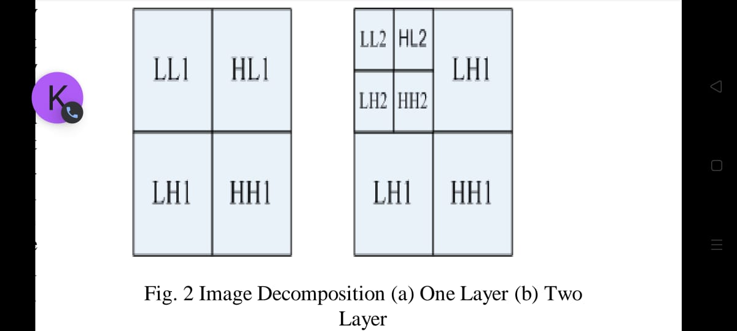
Introduction of twice wavelet transform
When we want to do analysis, de-noise, and compression of signals and images then wavelet transform become very popular for doing all this things.
In this the image is actually decomposed into four sub-bands and critically sub-sampled by applying DWT.

Slide 10
These sub-bands labeled LH1, HL1 and HH1 represent the finest scale wavelet coefficients i.e., detail images while the sub-bands LL1 corresponds to coarse level coefficients i.e., approximation image.
To obtain the next coarse level of wavelet coeﬃcients, the sub-band LL1 alone is further decomposed and critically sampled. This results in a two-level wavelet decomposition.
Similarly, to obtain further decomposition, LL2 will be used. This process continues until some ﬁnal scale is reached.

Slide 11
Purpose
Wavelets allow complex information such as music, speech, images and patterns to be decomposed into elementary forms at different positions and scales and subsequently reconstructed with high precision.
Wavelet transform allows the components of a stationary signal to be analyzed as well as non-stationary signals.
It can provide time and frequency information simultaneously and wavelets can be adjusted and adapted easily
Wavelet analysis is able to solve difficult problems in mathematics, physics, and engineering, with modern applications as diverse as wave propagation, data compression, signal processing, image processing, pattern recognition, computer graphics, the detection of aircraft and submarines and other medical image technology.

Slide 12
Example
import matplotlib.pyplot as plt
import pywt
import pywt.data
import matplotlib.image as mpimg
img=mpimg.imread('C:/ProgramData/imgg.jpeg')
titles = ['Approximation', ' Horizontal detail',
'Vertical detail', 'Diagonal detail']
coeffs2 = pywt.dwt2(img, 'bior1.3')
LL, (LH, HL, HH) = coeffs2
fig = plt.figure(figsize=(12, 3))
for i, a in enumerate([LL, LH, HL, HH]):
ax = fig.add_subplot(1, 4, i + 1)
ax.imshow(a, interpolation="nearest", cmap=plt.cm.gray)
ax.set_title(titles[i], fontsize=10)
ax.set_xticks([])
ax.set_yticks([])
fig.tight_layout()
plt.show()

Slide 13
Thank You
Thankyou

