Slide 1
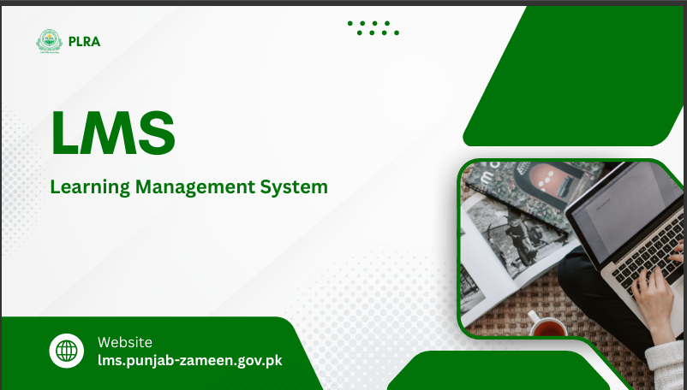
P
PLRA
LMS
Learning Management System
🌐 Website lms.punjab-zameen.gov.pk

Slide 2
P
PLRA - LMS
AGENDA
01 Project Background
02 Key Objectives
03 Purpose & Scope
04 Types of Users
05 Role Dashboards
06 Core Platform Capabilities
07 Learning & Assessment
08 Certification & Analytics
09 Application Workflows
10 Technology Stack
11 Operating Environment
12 Closing

Slide 3
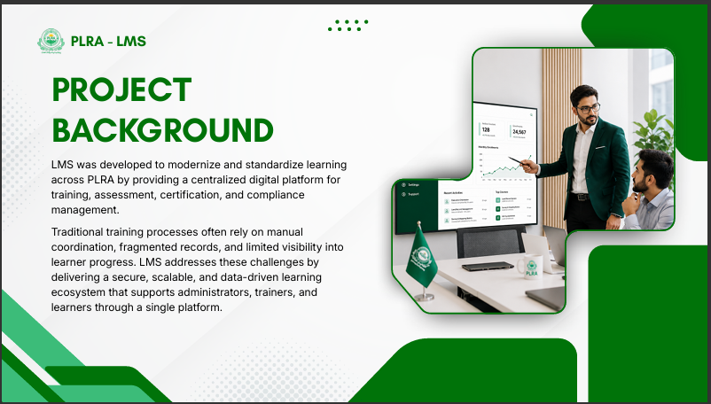
P
PLRA - LMS
PROJECT BACKGROUND
LMS was developed to modernize and standardize learning across PLRA by providing a centralized digital platform for training, assessment, certification, and compliance management.
Traditional training processes often rely on manual coordination, fragmented records, and limited visibility into learner progress. LMS addresses these challenges by delivering a secure, scalable, and data-driven learning ecosystem that supports administrators, trainers, and learners through a single platform.

Slide 4
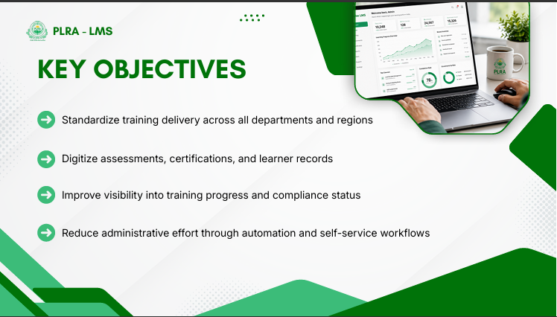
P
PLRA - LMS
KEY OBJECTIVES
›
Standardize training delivery across all departments and regions
›
Digitize assessments, certifications, and learner records
›
Improve visibility into training progress and compliance status
›
Reduce administrative effort through automation and self-service workflows

Slide 5
P
PLRA - LMS
PURPOSE & SCOPE
PURPOSE
PULSE LMS is a Laravel-based Learning Management System for PLRA that delivers CIMS authentication, role-based access, trainee onboarding, course delivery, quizzes, certificates, reports, notifications, support tickets, chat, forums, and protected media access — reflecting the software as implemented.
IN SCOPE
OUT OF SCOPE
• CIMS login, RBAC, onboarding & approvals
• Courses, modules, lessons, quizzes & media
• Progress, certificates, badges & reports
• Alerts, support tickets, chat & forums
• Authoring of legal training content itself
• Video / translation / trainer-guide production
• Content creation remains a project deliverable
• LMS stores and delivers materials once ready

Slide 6
P
PLRA - LMS
TYPES OF USERS
01
02
03
04
Super Admin
Admin
Trainer
Trainee
Platform governance & control
Learning operations & management
Course delivery & learner insights
Personalized learning journey

Slide 7
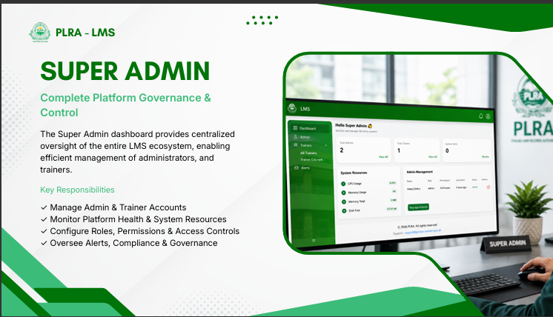
P
PLRA - LMS
SUPER ADMIN
Complete Platform Governance & Control
The Super Admin dashboard provides centralized oversight of the entire LMS ecosystem, enabling efficient management of administrators and trainers.
Key Responsibilities
✓
Manage Admin & Trainer Accounts
✓
Monitor Platform Health & System Resources
✓
Configure Roles, Permissions & Access Controls
✓
Oversee Alerts, Compliance & Governance

Slide 8
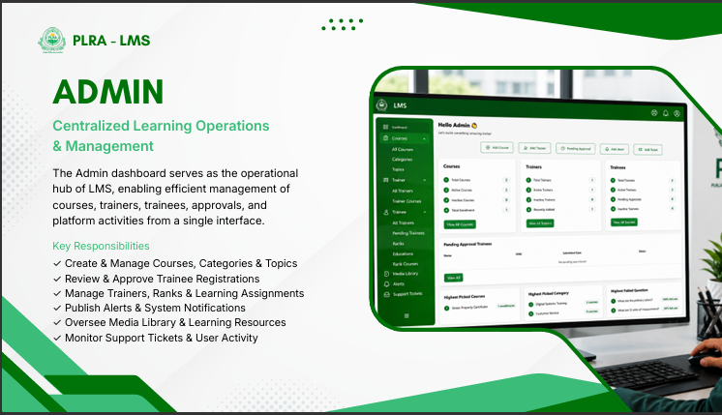
P
PLRA - LMS
ADMIN
Centralized Learning Operations & Management
The Admin dashboard serves as the operational hub of LMS, enabling efficient management of courses, trainers, trainees, approvals, and platform activities from a single interface.
Key Responsibilities
✓
Create & Manage Courses, Categories & Topics
✓
Review & Approve Trainee Registrations
✓
Manage Trainers, Ranks & Learning Assignments
✓
Publish Alerts & System Notifications
✓
Oversee Media Library & Learning Resources
✓
Monitor Support Tickets & User Activity

Slide 9
P
PLRA - LMS
TRAINER
Empowering Instructors Through Data & Insights
The Trainer dashboard provides a centralized workspace for managing assigned courses, monitoring learner progress, and tracking performance outcomes to ensure successful course delivery.
Key Responsibilities
✓
Manage Assigned Courses & Learning Activities
✓
Monitor Student Progress & Course Completion
✓
Analyze Learner Performance & Assessment Results
✓
Identify At-Risk Learners Through Analytics
✓
Respond to Course-Related Support Tickets
✓
Improve Learning Outcomes Through Data-Driven Insights

Slide 10
P
PLRA - LMS
TRAINEE
Your Learning. Your Progress. Your Growth.
The Trainee dashboard provides a personalized learning experience, enabling users to access courses, track progress, manage learning activities, and achieve certification goals through a single, intuitive platform.
Key Responsibilities
✓
Access Enrolled Courses & Learning Materials
✓
Track Lesson Progress & Course Completion
✓
Monitor Study Hours & Learning Performance
✓
Stay Updated with Alerts & Notifications
✓
Manage Calendar, Deadlines & Learning Tasks
✓
Create & Track Support Tickets
✓
Earn Certificates Upon Course Completion

Slide 11
P
PLRA - LMS
CORE CAPABILITIES — ACCESS & USERS
Authentication & Access
Dashboards
User & Master Data
• CIMS login with PKCE for trainees, admins & trainers
• Role mapping and server-side session context
• Auto-provision trainees; no auto-create for admins
• Pending approval, profile completion & logout
• Role-specific dashboards for every user type
• Admin: stats, enrollments & performance links
• Trainer: course and trainee metrics
• Trainee: active courses, hours, badges & calendar
• Search, filter, activate/deactivate trainees
• Approve/reject registrations & assign ranks
• Manage admins, trainers, education & ranks
• District / tehsil data and rank-course mapping

Slide 12
P
PLRA - LMS
LEARNING DELIVERY & ASSESSMENT
Course Management
Content & Media
Quizzes & Progress
• Create/edit bilingual courses, categories & topics
• Modules, lessons, quizzes, duration & outcomes
• Trainer & rank assignment; activate/deactivate
• Enrollment due dates and expired-course handling
• Videos, PDFs, documents, subtitles & resources
• Media library with folders and S3/MinIO storage
• Protected streaming for authorized learners only
• Block unauthorized direct media navigation
• MCQ / fill-in quizzes with CSV question upload
• Time limits, passing scores & auto-grading
• Lesson/course progress and study-hour tracking
• Completion when lessons done & quizzes passed

Slide 13
P
PLRA - LMS
CERTIFICATION, ANALYTICS & ENGAGEMENT
Certificates & Badges
Reports & Analytics
Alerts & Support
• Auto-issue certificates on eligibility
• Hash-based public certificate verification
• Template, signature & settings support
• Gamification badges for learning milestones
• Admin overview with charts & summaries
• Trainee/course progress with rich filters
• District, tehsil, rank & status dimensions
• CSV export for operational reporting
• Admin alerts and deadline notifications
• Notification history with read status
• Support tickets, chat & discussion forums
• System, certificate & profile settings

Slide 14
P
PLRA - LMS
APPLICATION WORKFLOWS — ACCESS & LEARNING
01
Login
02
Trainee Onboarding
• Select login mode and redirect to CIMS (PKCE)
• Exchange code, resolve user/role, store session
• Route to dashboard, profile, or pending approval
• Authenticate via CIMS and provision local user
• Complete profile fields and documents
• Admin approves; trainee gains course access
03
Course Creation
04
Trainee Learning
• Admin enters course structure and bilingual info
• Attach media, modules, lessons and quizzes
• Validate, save, assign and activate course
• Enroll / continue an active non-expired course
• Complete lessons; system tracks progress & time
• Pass quizzes; certificate issued on eligibility

Slide 15
P
PLRA - LMS
APPLICATION WORKFLOWS — ASSESSMENT & OPERATIONS
01
Course Expiry
02
Quiz Attempt
• Due date = enrollment date + duration (days)
• Overdue incomplete courses marked expired
• Removed from active lists; content access blocked
• Start attempt with selected questions
• Answer / skip / flag; finalize on submit or timeout
• Auto-grade; show results; allow retry where enabled
03
Certificate
04
Reports & Notifications
• Check lessons complete and quizzes passed
• Issue certificate with hash and mark course done
• Trainee views certificate; public verify by hash
• Admin filters reports and exports CSV
• Alerts and deadline notifications generated
• Users view, act, and mark notifications read

Slide 16
P
PLRA - LMS
SUPPORT & COMMUNICATION WORKFLOW
01
02
03
Raise
Track
Resolve
User creates a support ticket or starts chat / forum interaction.
System stores messages, participants, attachments, and ticket status.
Authorized users respond, update status, or moderate where permitted.

Slide 17
P
PLRA - LMS
TECHNOLOGY STACK & OPERATING ENVIRONMENT
LMS is a server-rendered Laravel web application organized by domains. It runs with PHP-FPM and Nginx, uses a relational database, integrates with CIMS for authentication, and stores media via S3-compatible storage (MinIO).
Application
Runtime
Data & Storage
Integrations
• Laravel (PHP 8.2+)
• Blade role-specific UI
• Composer dependencies
• Node / Vite frontend assets
• Docker containers
• Nginx reverse proxy
• PHP-FPM app runtime
• Queue & scheduler workers
• Relational database
• S3 / MinIO object storage
• Persistent volumes
• CSV reporting data
• CIMS auth (PKCE)
• SMTP / mail services
• HTTPS termination
• Modern browser clients

Slide 18
P
Thank You
PLRA LMS — Modernizing Learning Across Punjab Land Records Authority
lms.punjab-zameen.gov.pk | Punjab Land Records Authority (PLRA)

