Slide 1
Machine learning in Medical domain (deep learning in Pneumonia detection)

Slide 2
Pneumonia Detection by Transfer Learning
OBJECTIVE -
"Let our advance worrying become advance thinking and planning." ...

Slide 3
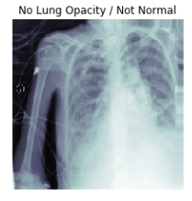
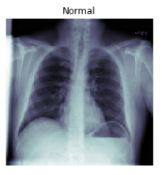
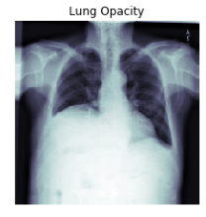
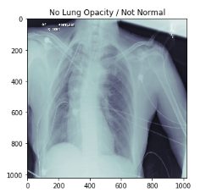
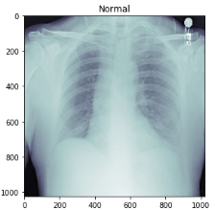
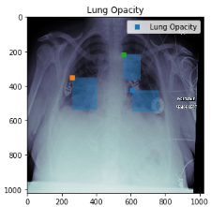
Pneumonia Detection
INPUT
Building an algorithm to showing a good confidence interval in detecting pneumonia. The algorithm automatically locate lung opacities on chest radiographs & medical images.
OUTPUT

Slide 4
METHODS -
TRANSFER LEARNING-
Transfer learning is a research problem in machine learning that focuses on storing knowledge gained while solving one problem and applying it to a different but related problem.
TensorFlow ( Version – 1.11.0 )
CNN Model ( DenseNet169)

Slide 5
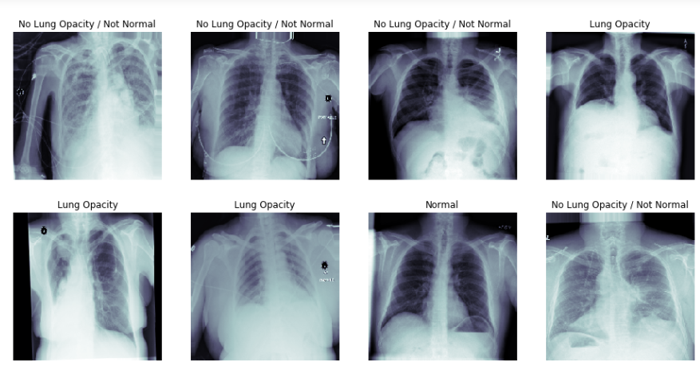
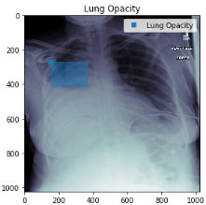
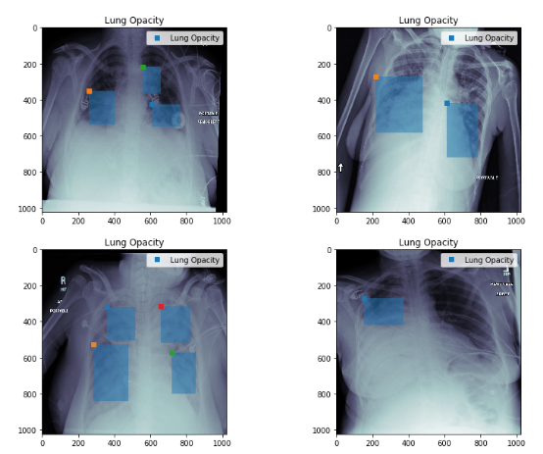
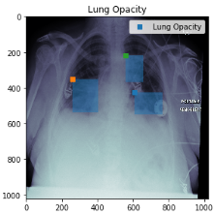
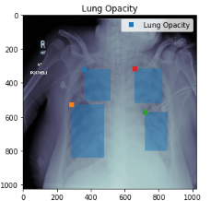
Data Flow-
Transferring parameters of a CNN
Source Task
Training Images
Source Task Labels
Normal
Lung Opacity
No-Lung Opacity
Convolutional Layers
Fully-connected Layers
C1-C2-C3-C4-C5
FC6
FC7
1: Feature Learning
2: Feature Transfer
3: Classifier Learning
Transfer Parameter
Normal Data
Lung Opacity
No-Lung Opacity
Target Task Labels
C1-C2-C3-C4-C5
FC6
FCa
FCb
Training Images
Target Task

Slide 6
DATASETS -
Train & validation datasets
https://drive.google.com/open?id=1anjwft3kynzobdrq3nzvptbftpxfos9q
Test datasets
https://drive.google.com/open?id=1nvgwdmalj5w_4ahivwx43tuqsonepj1n

Slide 7
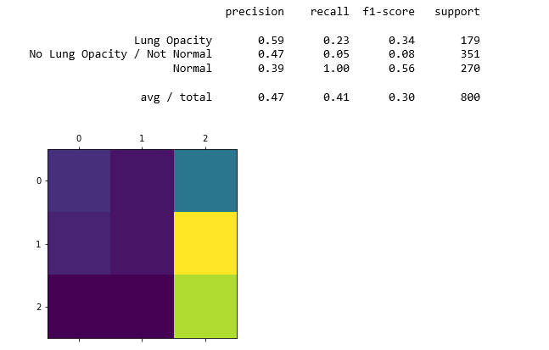
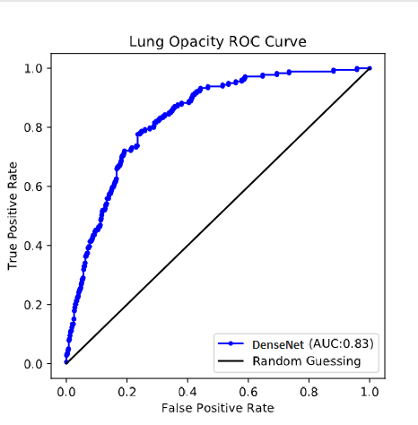
Result-
ROC CURVE

Slide 8
Thank you

