Slide 1
CCMS Data Analysis
Team Sudohack

Slide 2




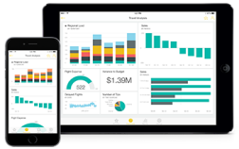


Architecture
Data Sources
Data Ingestion
Calculation Engine
Storage and Warehousing
Hub
Data Interfacing
Transformation
Push Real
Time Events
Processed
Stream
PWA
PWA
Raw
stream
Azure Databricks
Real Time
Notifications
Event Hub
Calculation of behavioural points
Receive High throughput Real-time Predictive Feed
Excel
MAT
SQL Data Warehouse
Power BI Dashboards
Batch
Source
Azure Data Factory
Azure Machine Learning Services

Slide 3
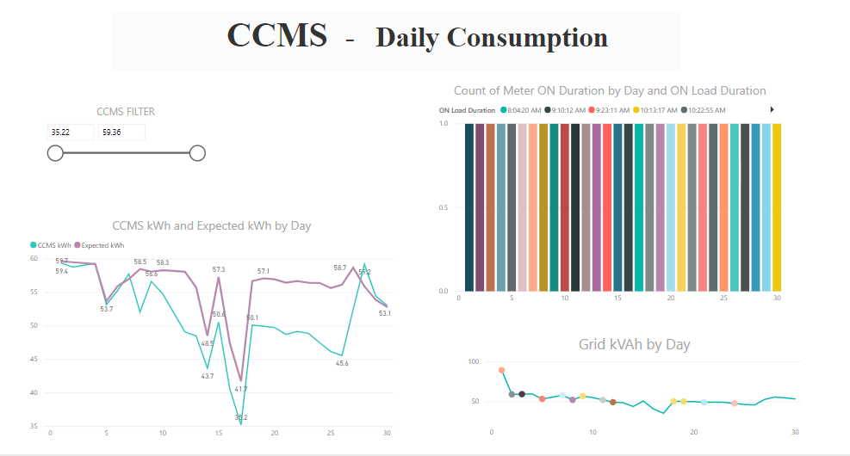

Slide 4
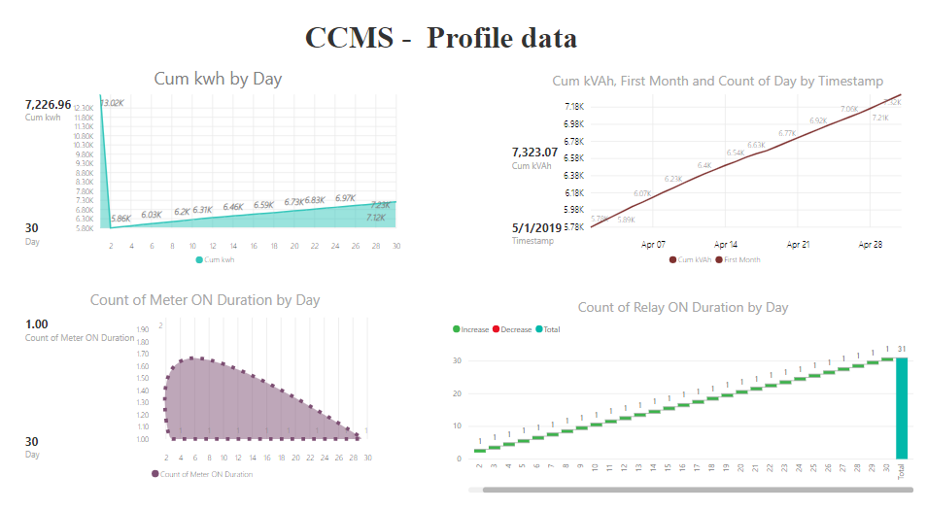

Slide 5
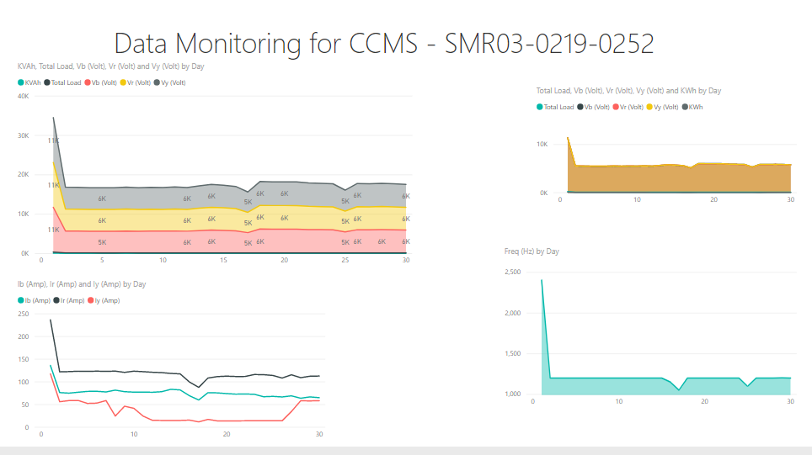

Slide 6
Business Model
Cost | Benefits
ccms
ccms networked

Slide 7
Thanks !
Team SudoHack
- Gulshan Sharma
- Bharat Singh
- Ravi Choudhary
- Digvijay Kumar

