Slide 1

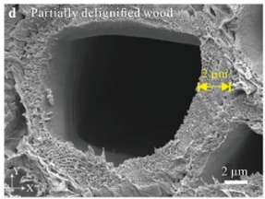
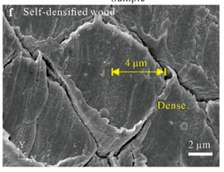
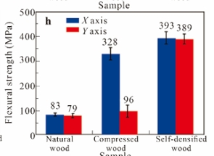
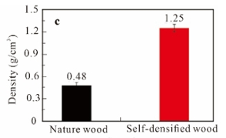
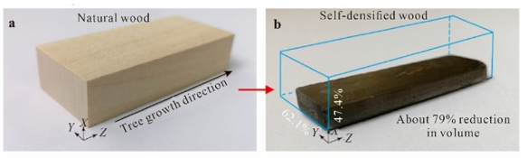
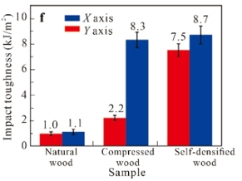
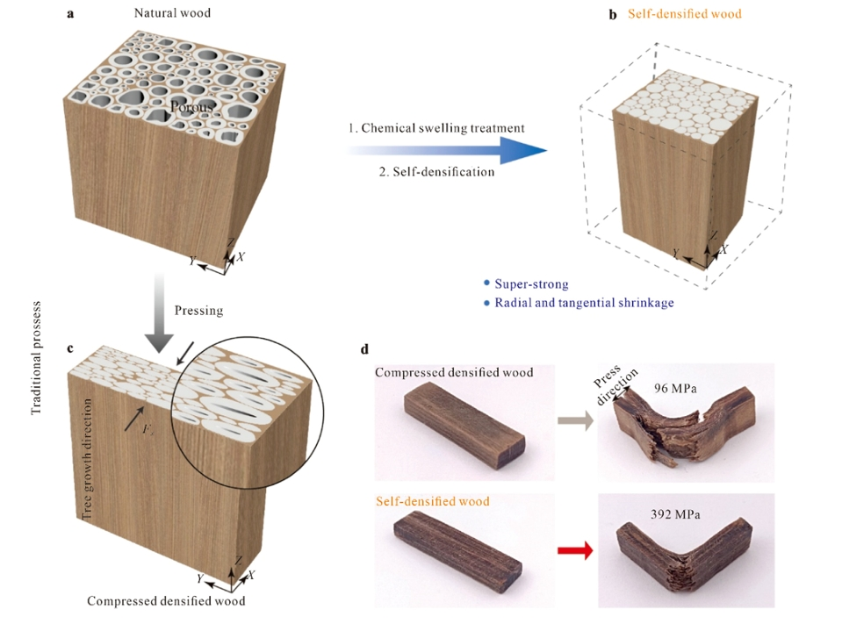
Self-Densified Super-Strong Wood
Evan Huling; Dr. Joshua Klaassen
Boil wood samples in a lignin removal solution composed of Na₂SO₃ and KOH for 10 hours
Submerge wood samples in boiling DI water several times to remove residual chemicals
Preserve wood samples in N,N-dimethylacetamide to remove water
Boil wood samples in an N,N-dimethylacetamide and LiCl solution for 1 hour at 160 ℃
Let wood samples air dry at room temperature
The densification of wood can also be achieved through a hot compressing procedure.
Significant improvement in strength, with the tensile strength of the self-densified wood being 496.1 MPa (normal wood was around 50 MPa.)
Stronger than compressed wood, especially against the grain.
Problems:
The process I am studying requires the chemical N,N-dimethylacetamide.
The process revolving around hot compressing is a very expensive and requires a lot of energy.
Goals:
Find a more environmentally friendly method.
Find new uses for the self-densified wood.
Modify the procedure to expand the capabilities of the self-densified wood.
Huang, D., Li, J., Li, S., Cao, Z., Guo, Y., Ding, Y., Zhu, M., & Chen, Y. (2025). Self-densified super-strong wood. Journal of Bioresources and Bioproducts, 10(2), 199-208. Self-densified super-strong wood – ScienceDirect
Khakalo, A., Tanaka, A., Korpela, A., & Orelma, H. (2020). Delignification and ionic liquid treatment of wood toward multifunctional high-performance structural materials. ACS Applied Materials & Interfaces, 12(20), 23532-23542, https://pubs.acs.org/doi/10.1021/acsami.0c02221

