Slide 1
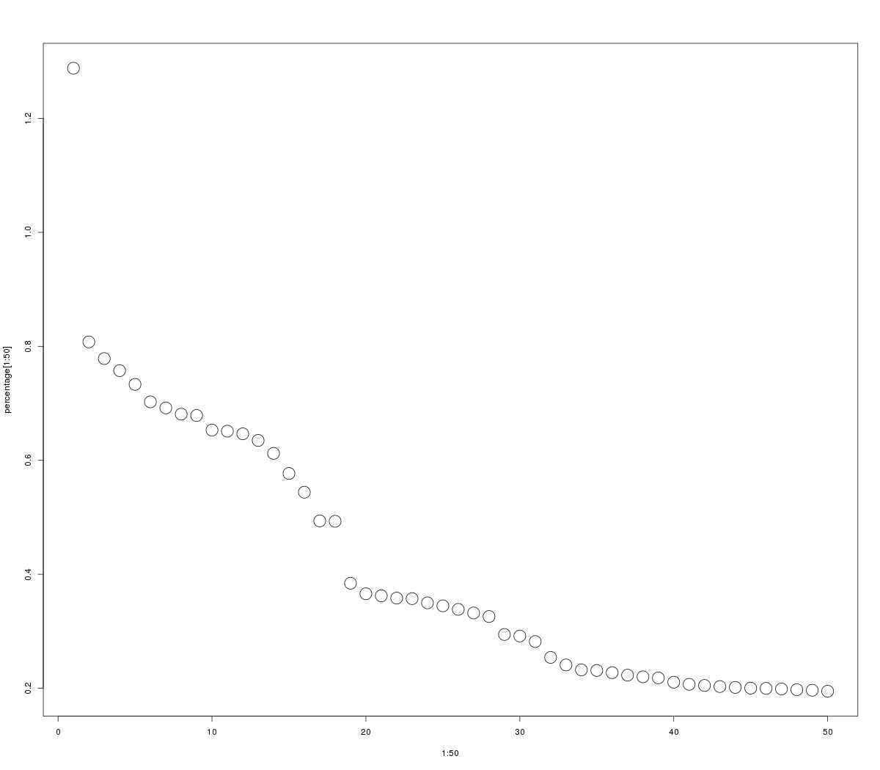
Relative Percent Variance
0.2 0.4 0.6 0.8 1.0 1.2
0 10 20 30 40 50
Components

