Slide 1

Ingenious approach for attendance using LBPH algorithm -Guide : G . Neelima Asst . prof
GOKARAJU RANGARAJU INSTITUTE OF ENGINEERING AND TECHNOLOGY
Department of Computer Science and Engineering
MINI Project Review-2
Team members :
A . Shashivadan (21245A0502)
A . Shivakumar (21245A0503)
B . Sudheer (21245A0504)
D . Abhinay (21245A0506)

Slide 2
Existing : Proposed :
GOKARAJU RANGARAJU INSTITUTE OF ENGINEERING AND TECHNOLOGY
Department of Computer Science and Engineering
MINI Project Review-2
The manual attendance system is prone to error, time-consuming ,and can be easily manipulated, leading to inaccurate attendance records .
The existing project focuses on face detection through three different CNN’s. They are AlexNet, GoogleNet, SqueezeNet. Which takes input as RGB image and the CNN’s are trained on the data.
This system proposes facial recognition using local binary pattern histogram(LBPH).
The images are captured then converted to greyscale and this dataset is trained.
Student management system is also provided for admin to manage the student details.
The LBPH algorithm is applied on dataset and this method increases the accuracy.

Slide 3
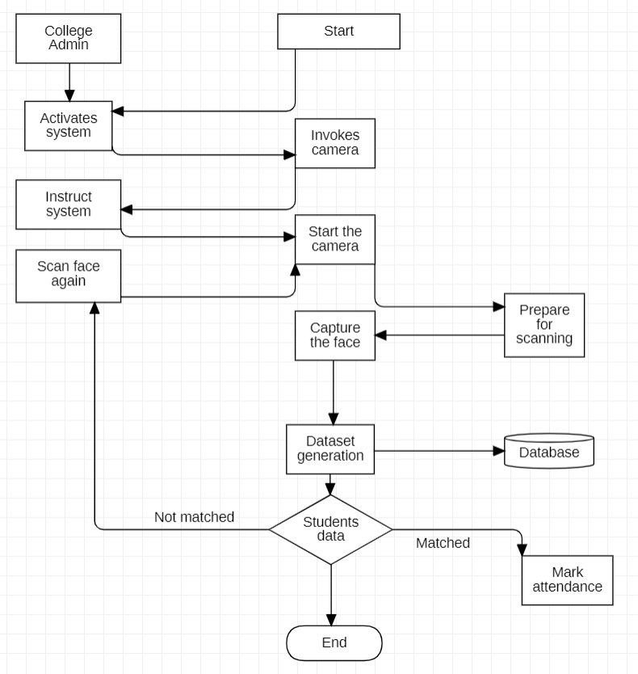
GOKARAJU RANGARAJU INSTITUTE OF ENGINEERING AND TECHNOLOGY
Department of Computer Science and Engineering
MINI Project Review-2
Architecture diagram:

Slide 4
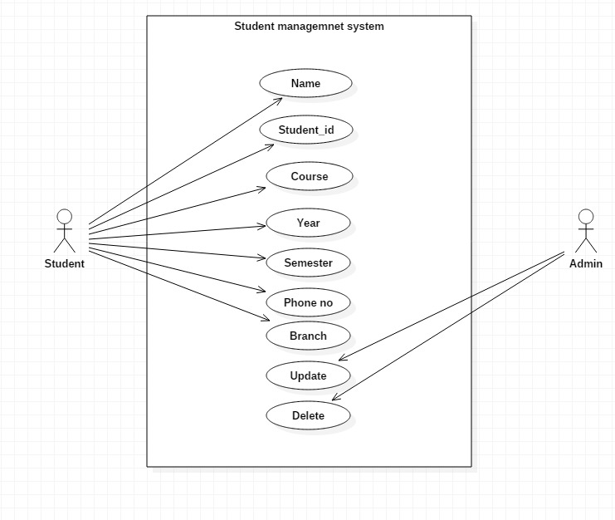
Student management module:
GOKARAJU RANGARAJU INSTITUTE OF ENGINEERING AND TECHNOLOGY
Department of Computer Science and Engineering
MINI Project Review-2
In this module the details provided by the student will be entered into the database and detials are saved.
Admin has full control on management system.
Admin can update the detials and also can delete the records of specific student.

Slide 5
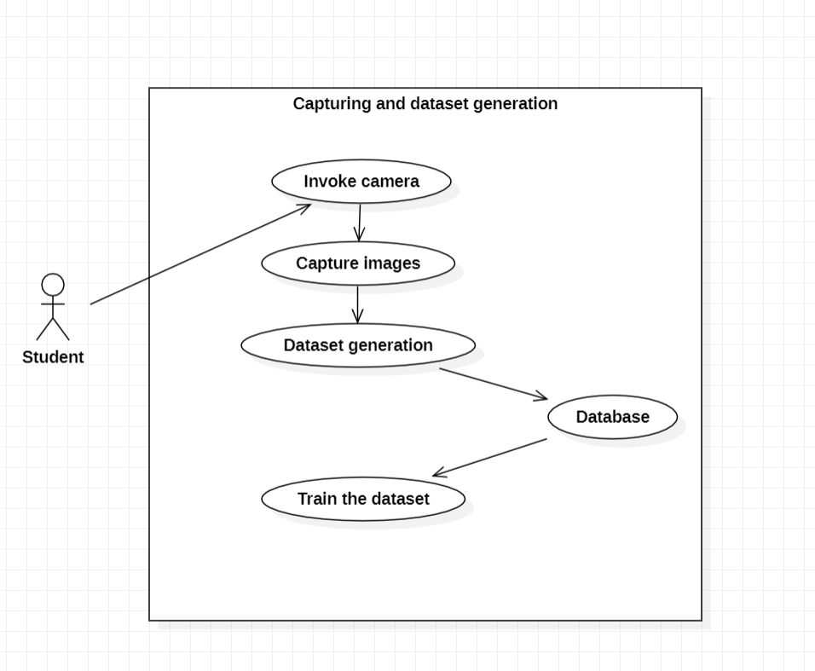
Scanning and dataset generation module:
GOKARAJU RANGARAJU INSTITUTE OF ENGINEERING AND TECHNOLOGY
Department of Computer Science and Engineering
MINI Project Review-2
In this module the camera is invoked and student images are captured using camera.
The dataset is generated by capturing images and they are stored in database using MySql.
The generated dataset is trained by algorithm.

Slide 6
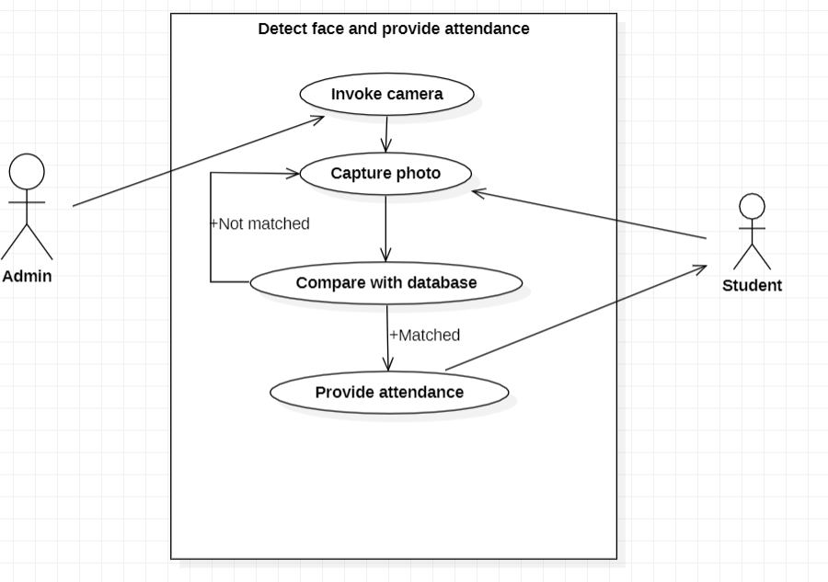
Detect face and provide attendance:
GOKARAJU RANGARAJU INSTITUTE OF ENGINEERING AND TECHNOLOGY
Department of Computer Science and Engineering
MINI Project Review-2

Slide 7
GOKARAJU RANGARAJU INSTITUTE OF ENGINEERING AND TECHNOLOGY
Department of Computer Science and Engineering
MINI Project Review-2
Algorithms:
In proposed system we are using Haar cascade frontal face algorithm and Local binary pattern histogram (LBPH).
The haar cascade frontal face algorithm is used to detect faces based upon its features.
The RGB images are converted to greyscale for efficient processing.
Now the algorithm locates the exact features of faces.
The algorithm return 4 values of the detected face and based on that the data set is generated

Slide 8
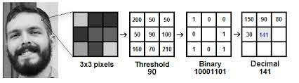
GOKARAJU RANGARAJU INSTITUTE OF ENGINEERING AND TECHNOLOGY
Department of Computer Science and Engineering
MINI Project Review-2
Algorithms:
The Local binary pattern histogram (LBPH) is used for face recognition.
The greyscale images are represented as matrix. In the matrix the threshold values are converted to binary values.
By concatenating binary values in clockwise direction it forms a new binary value.
The new binary value is further converted to decimal value and placed in the matrix as central value.
After images are generated the histogram is formed based on the images.
To find the image that matches input image we just need to compare two histograms.

Slide 9
THANK YOU & QUERY
GOKARAJU RANGARAJU INSTITUTE OF ENGINEERING AND TECHNOLOGY
Department of Computer Science and Engineering
MINI Project Review-2

