Slide 1
Photograph stitching for the creation of panoramas
2812ICT
Sebastian Perry
S5132483

Slide 2
Problem Description
Panorama images require the user to be in the location, unharried by chaotic outside influences, with a steady hand that can slowly pan across the environment; if these requirements are not met the results can be horrific
Therefore the goal of this project is:
the creation of a body of code which can stitch multiple images into a somewhat finished panorama

Slide 3
Technical Approach
Image management
SIFT key point identification
KNN feature matching and ratio testing
RANSAC outlier removal through subset selection
Homograph estimation and perspective translation
Image stitching
Black border removal

Slide 4
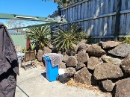
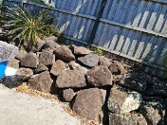
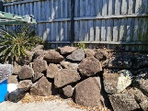
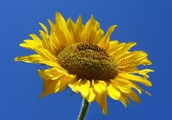
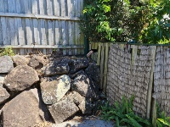
1) Image management
For this explanation the program will be processing the input of experiment 4

Slide 5
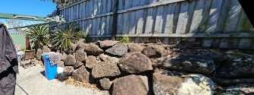
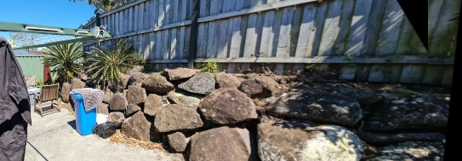
For the following steps 2 to 5 will be demonstrated using the stitching of the 1st and 2nd image, as this stitch crates very minimal black background the stitching of the next image will also be shown for steps 6 and 7
1
2
12
+
=
3
123
12
+
=

Slide 6
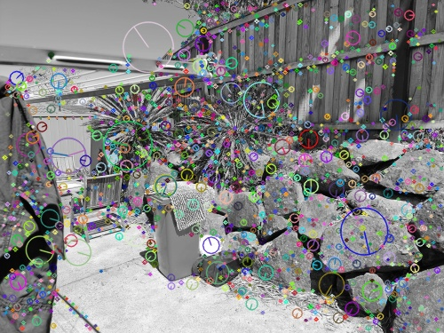
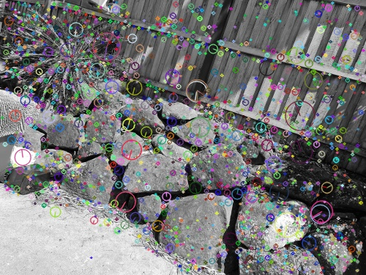
2) SIFT key point identification
Here SIFT is selecting key points with the two images

Slide 7
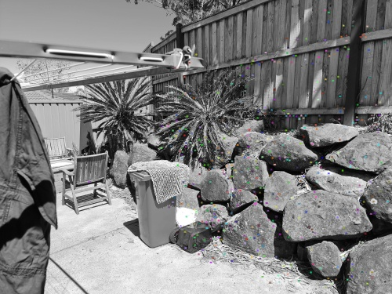
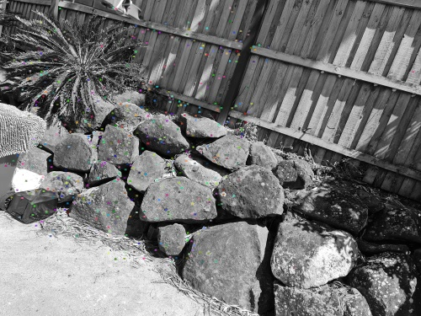
3) KNN feature matching and ratio testing
Here the KNN feature matching and ratio testing is used to make a new subset of points that only show up in both images

Slide 8
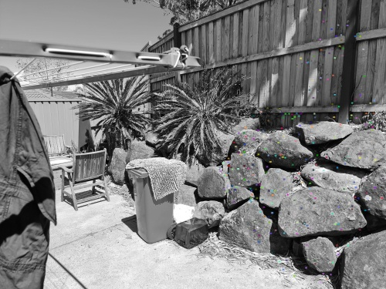
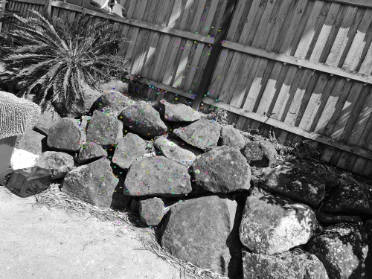
4) RANSAC outlier removal through subset selection
Here RANSAC is shown selecting an even small subset of the more densely packed points from the previous matches allowing to remove outlier points from the set

Slide 9
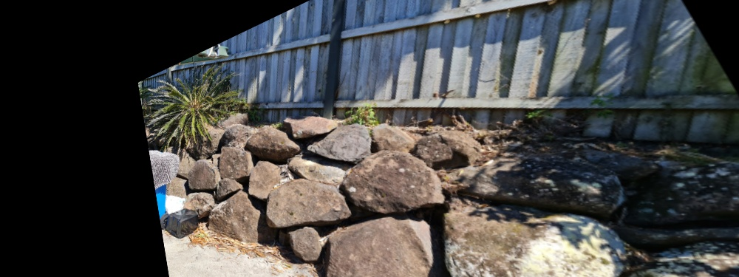
5) Homograph estimation and perspective translation
Here the homograph has been estimated and applied to the right hand image to make it match the perspective of the left image
->

Slide 10
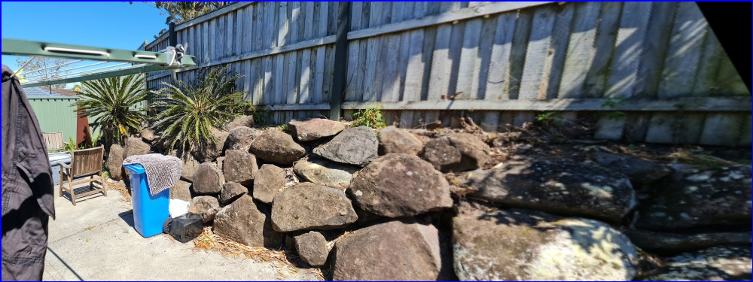
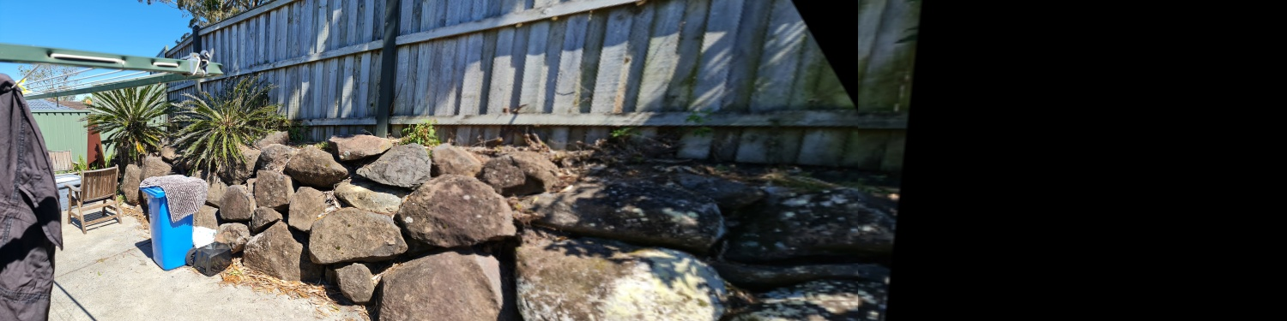
6) Image stitching
Here the left hand image is stitched to the translated right image
12
123

Slide 11
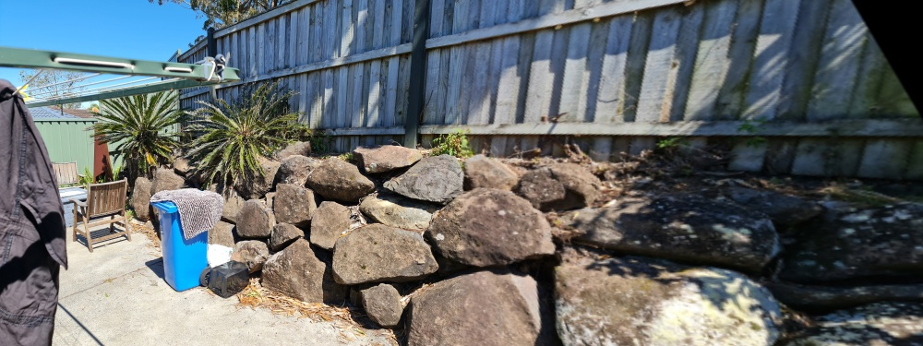

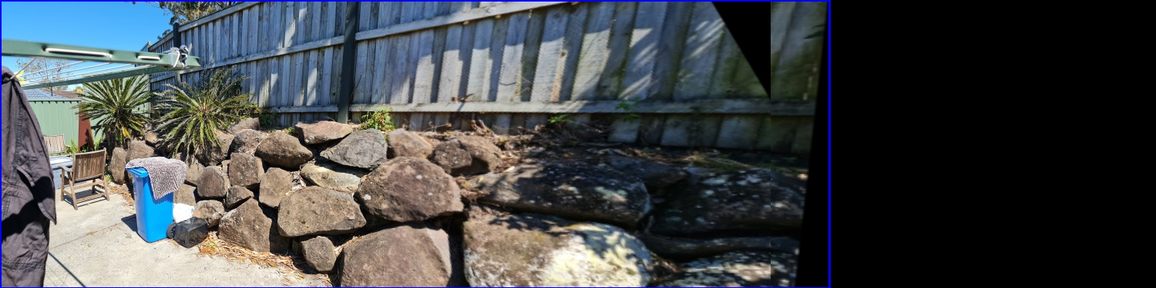
7) Black border removal
12
12
->
123
123
->

Slide 12
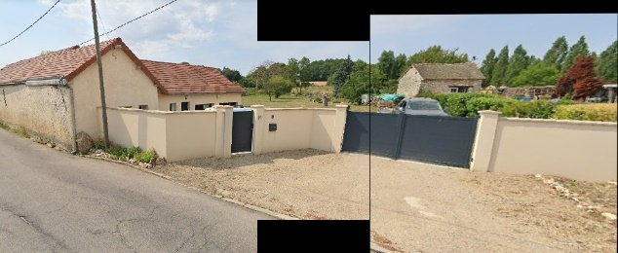
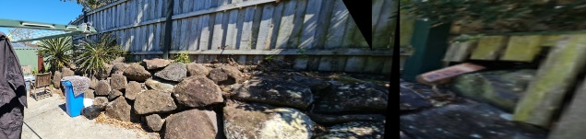

Experiments
Experiment 1
Experiment 2
Experiment 3
Experiment 4
Experiment 5

Slide 13
Experiment 1
Input:
Output:
Description:
This is a test consisting of 2 images sourced from S.Perry’s backyard
Result:
The successful result shows that the program is able to make a panorama using 2 images

Slide 14
Experiment 2
Input:
Output:
Description:
This is a test consisting of 3 images sourced from S.Perry’s backyard
Result:
The successful result shows that the program is able to make a panorama using 2 or more images

Slide 15
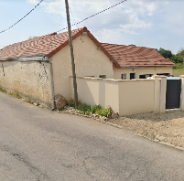
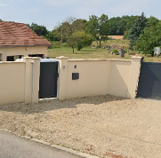
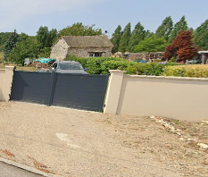
Experiment 3
Input:
Output:
Description:
This is a test consisting of 3 images sources online from a random location in France
Result:
The successful result shows that the program will allow people to create panoramas of locations they haven’t even visted

Slide 16
Experiment 4
Input:
Output:
Description:
This is a test consisting of 4 images sourced from S.Perry’s backyard and one random image sourced from the internet
Result:
The successful result shows that the program is able to make a panorama of several images, while also being able to check and discard images that are detected to not match the others

Slide 17
Experiment 5
Input:
Output:
Description:
This is a test consisting of the same images from experiment 4 expect they are in a different order with the last image going first
Result:
This unsuccessful result shows that the program is sensitive to the order in which it is fed the images, it must be fed images from left to right in order to function

Slide 18
Code demo
I will now perform a demonstration of the code running experiment 4

