Slide 1
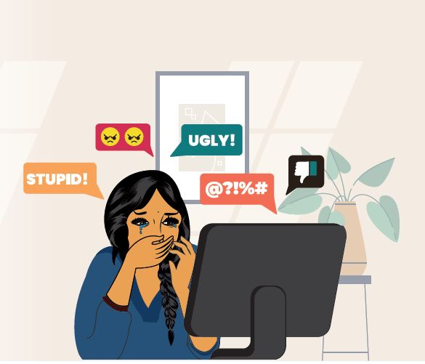
Cyberbullying Detection Using Machine Learning and Deep Learning
Team members
B. Nithin Reddy 2103A52046
A. Druva Kumar 2103A52121
G. Sri Harshini 2103A52137
K. Ajay Rao 2103A52147
CH. Rohith 2103A52128

Slide 2
Introduction
Cyberbullying is a pervasive issue in today's digital era, particularly on social media platforms. This project aims to develop a model to detect cyberbullying based on comments extracted[Web Scraping] from social media platform fromYouTube.
To accomplish this, text cleaning methods will be applied to remove noise from the data, including special characters, emojis, and URLs, followed by tokenization to break down the comments into analyzable components.
The processed dataset will then be used to train a machine learning model, experimenting with algorithms like Logistic Regression, Support Vector Machines (SVM), and Decision Trees and neural networks to identify the most effective approach for detecting offensive and harmful content accurately.

Slide 3
Existing Solution
Rule-Based Approaches – Using predefined keyword lists and regular expressions to detect offensive words.
Dictionary-Based Methods – Matching words against databases of toxic or harmful terms.
Lexicon-Based Sentiment Analysis – Analyzing the tone of text using sentiment scores.
Basic Machine Learning Models – Early models like Naïve Bayes, Decision Trees, and SVM, trained on small datasets without deep learning.
Manual Moderation – Relying on human moderators to filter out harmful content, which was slow and inconsistent.

Slide 4
Proposed System
Deep learning Models like LSTM,RNN
Enhance Data Augmentation to increase dataset diversity for better generalization.
Real-Time Prediction: The final model is implemented in a real-time system that can process new comments and classify them immediately, making it applicable for automated moderation and content filtering.
Deployment and Integration: The implemented cyberbully detection system is hosted on an easy-to-use platform, enabling effortless integration with social media monitoring tools and online moderation systems.

Slide 5
Data Collection and Data Preprocessing
We collected data by web scraping comments from YouTube and Reddit. We used the YouTube Data API to extract comments. The collected data was stored as CSV files for further processing.
After collecting the data, we performed several text cleaning operations to remove unwanted characters, URLs, emojis, and punctuation. We also removed extra whitespaces to prepare the text for further analysis.
Tokenization is the process of splitting text into smaller units, like words or phrases, to make it analyzable for machine learning models. It helps convert raw text into structured data that models can interpret effectively.
Removing stopwords involves eliminating common words like "and," "the," and "is" that don't add significant meaning to text analysis. This process helps improve model efficiency by focusing on more relevant words in the data.

Slide 6
Data Labeling
After cleaning the data, we labelled the comments as 'cyberbullying' or 'non-cyberbullying'. This labeling process was crucial in providing labeled training data for the machine learning model.
In labeling,
1 for Cyberbullying
0 for Non-Cyberbullying
Automatic labeling
To automate labeling, we used the "unitary/toxic-bert" model to classify comments as "cyberbullying" or "non-cyberbullying" based on toxicity scores. Comments with scores above a set threshold are labeled as "cyberbullying”.
Modules Used - Auto Tokenizer, AutoModelForSequenceClassification

Slide 7
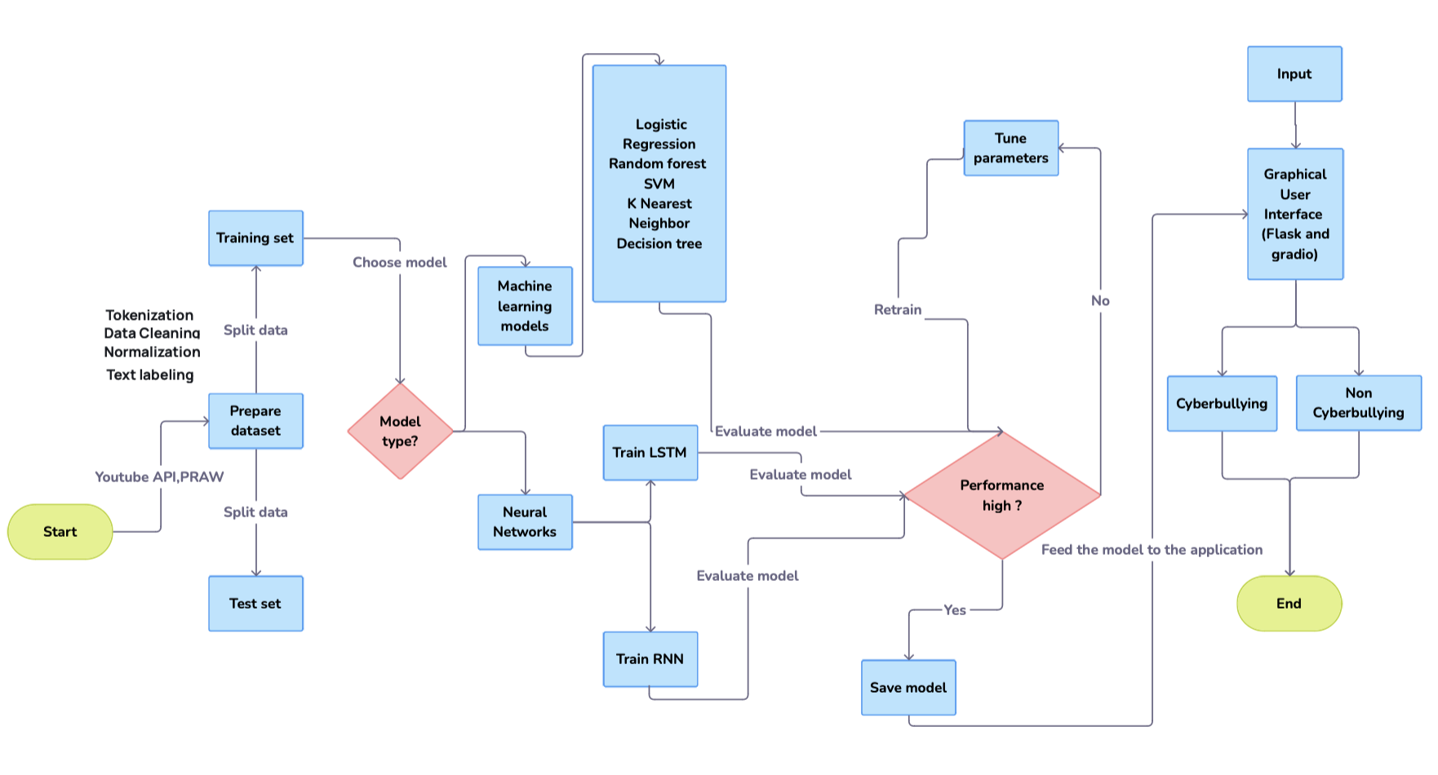
Workflow of the process

Slide 8
Phase 1: Web Scraping & Data Preprocessing
Retrieved data using the YouTube Data API v3 to gather video comments.
Processed and cleaned the data by removing unwanted elements, normalizing text, and breaking down sentences into tokens.
Performed initial data analysis to understand the comment patterns and potential challenges.
Phase 2: Data Splitting & Model Training
Classified the data into two groups: Cyberbullying and Non-Cyberbullying.
Used several classifiers, including Logistic Regression, SVM, and Random Forest, to train the model and assess performance.
Phase 3: Model Training using Neural Network
Trained the LSTM and RNN models on the updated dataset to improve the accuracy of cyberbullying detection.
Incorporated additional data to refine the model's ability to classify comments effectively.
Evaluated model performance and accuracy to assess detection improvements.
Phase 4: GUI Development with Stream lit
Built a user interface with stream lit for interaction and model evaluation.
Integrated the trained model within the web interface and performed tests with new data.

Slide 9
Model Training
Feature Extraction and Model Selection
The preprocessed text data was converted into numerical format using TF-IDF Vectorization. Multiple models, including Logistic Regression, Random Forest, and LSTM, were trained to identify the most effective approach.
Evaluation and Integration
The best-performing model, LSTM, was selected based on metrics like accuracy and F1-score.
Modules Used for Model Training
Scikit-learn: For traditional machine learning models like Logistic Regression and Random Forest, and evaluation metrics.
TensorFlow/Keras: For building and training deep learning models such as LSTM.
Pandas: For data manipulation and preparation.
NumPy: For numerical computations and matrix operations.

Slide 10
Advanced models using RNN-LSTM
RNN is a type of neural network designed to process sequential data, such as time series, text, or audio.
LSTM is a special type of RNN designed to overcome the limitations of standard RNNs.
WHY RNN-LSTM
They are excellent at analyzing and predicting patterns in data.
LSTM is particularly effective in text-based tasks, as it can capture the context and relationships between words over long sentences.
LSTM captures subtle details in comments or messages by analyzing context, tone, and word sequence, thereby enhancing detection accuracy,

Slide 11
Statistical Analysis of Model training data
Model | Test Size (20%) | Test Size (25%) | Test Size (30%)
Logistic Regression | 78.17 | 78.16 | 78.05
Random Forest Classifier | 76.21 | 75.70 | 75.58
Support Vector Machine(SVM) | 78.68 | 78.61 | 78.57
Decision Tree Classifier | 74.88 | 75.33 | 74.45
K-Nearest Neighbours (K-NN) | 65.29 | 59.11 | 64.74
Long Short-Term Memory(LSTM) | 81.56 | 79.84 | 78.81
Recurrent Neural Network(RNN) | 68.57 | 73.59 | 73.42
Label | Data_Count | Percentage
Non cyberbullying | 9095 | 54.71%
Cyberbullying | 7530 | 45.29%

Slide 12
GUI development with Stream lit
Stream lit: The front-end of the Cyberbullying Detection System is developed with Stream lit, providing an interactive and aesthetically pleasing user interface
Seamless Model Integration: Stream litcan easily integrate the trained machine learning model for smooth interaction and testing.

Slide 13
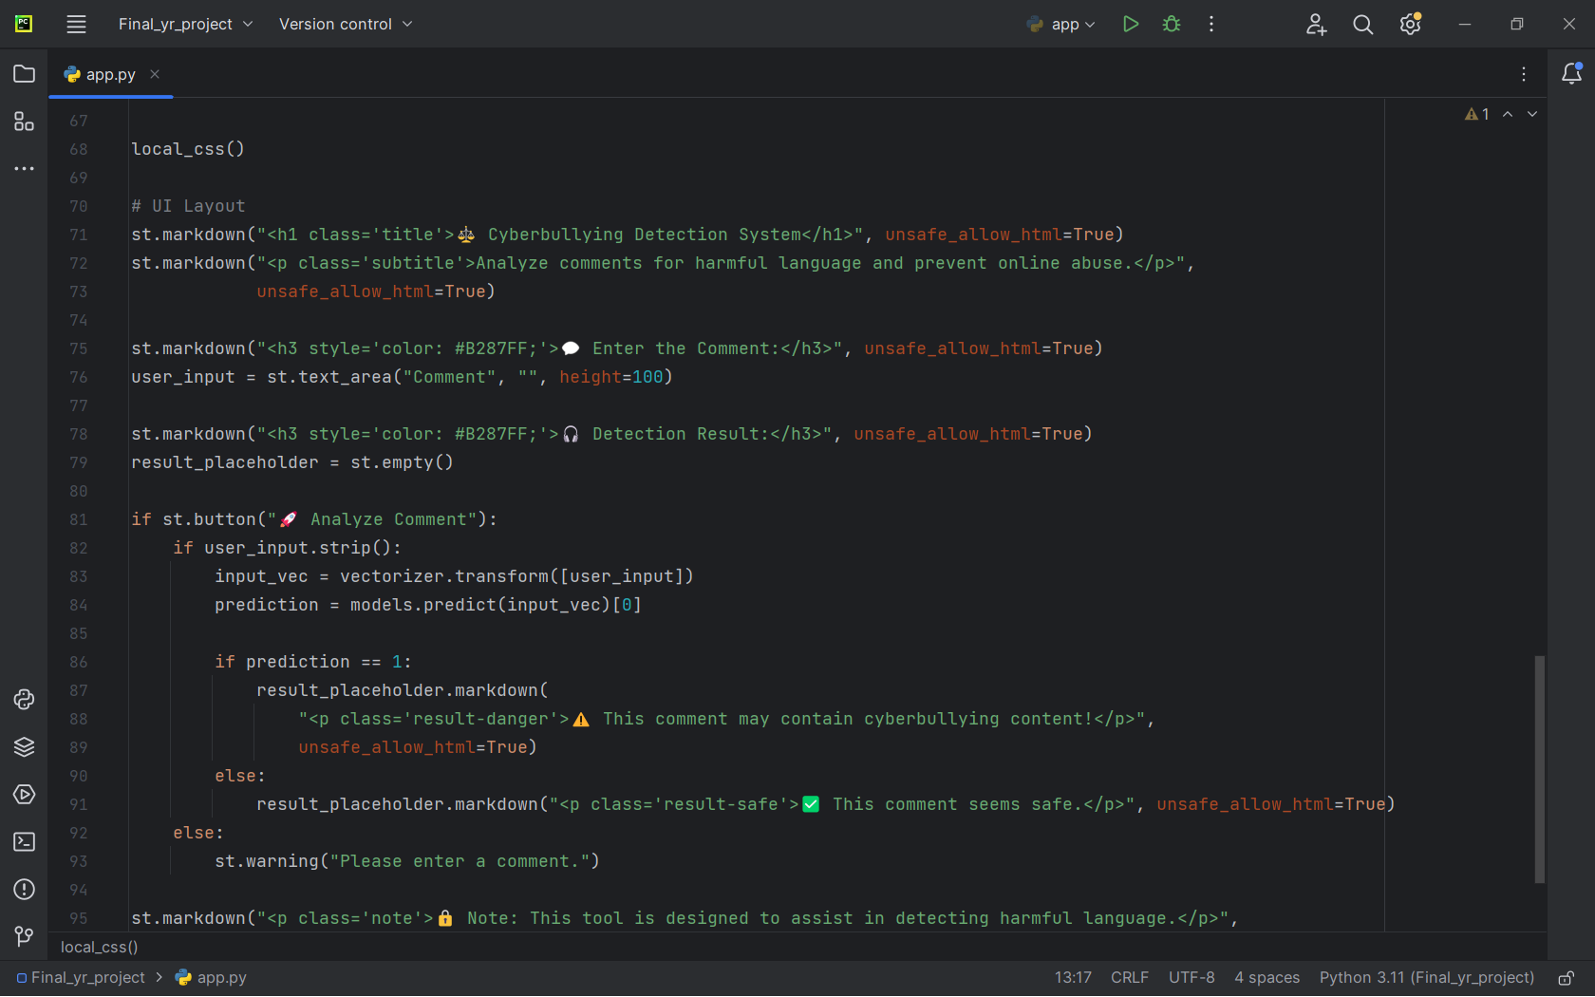
Working of the frontend

Slide 14
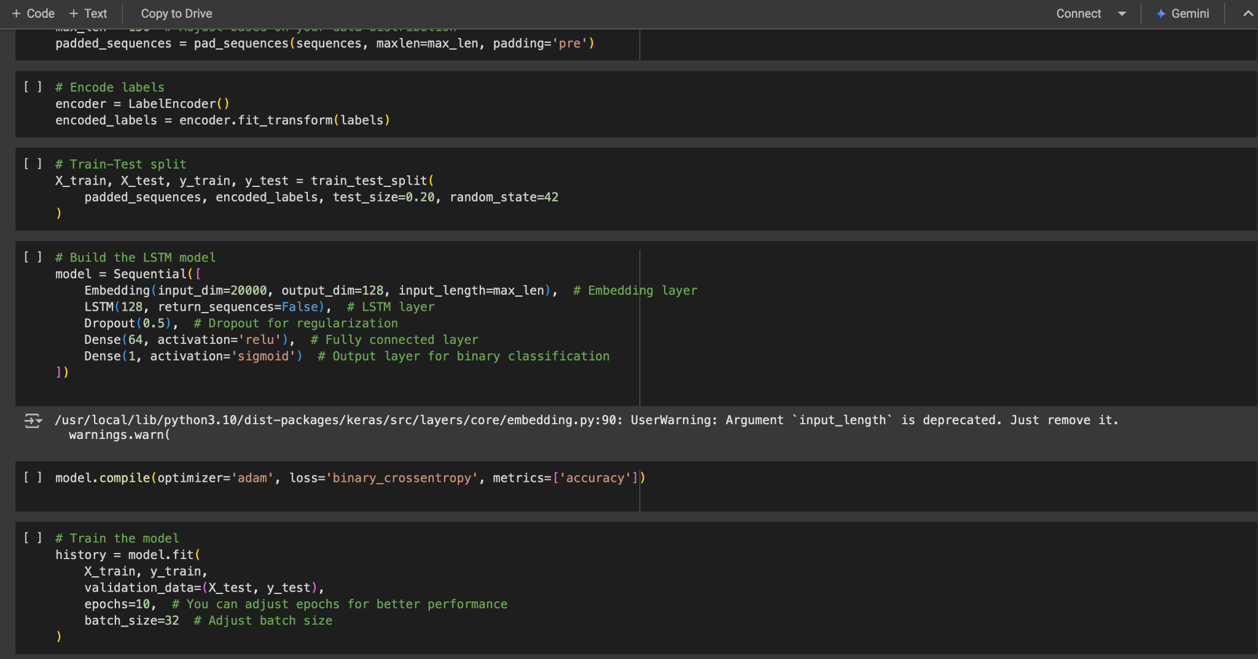
Working of the backend

Slide 15
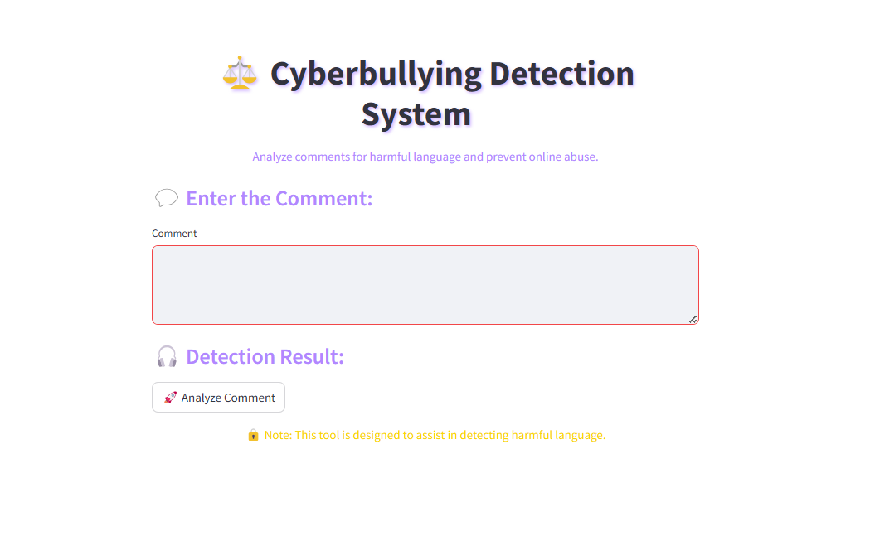
Final User Interface

Slide 16
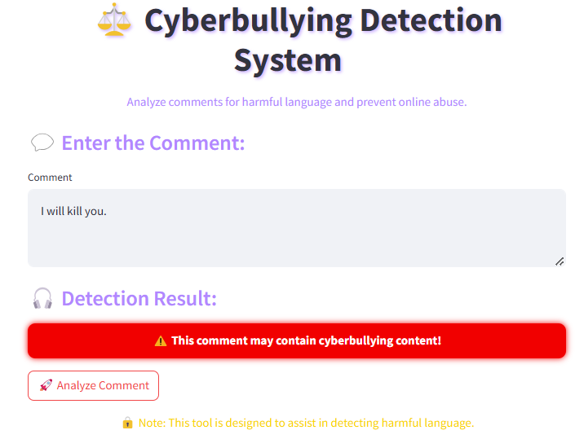
Cyberbullying detected

Slide 17
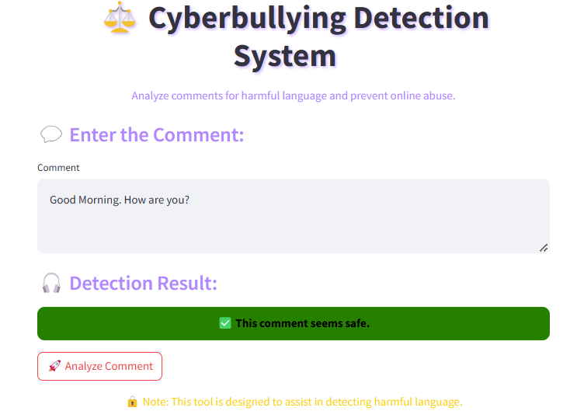
No Cyberbullying detected

Slide 18
Conclusion
Our study employed a number of algorithms for classification, including Logistic Regression, Support Vector Machine (SVM), Random Forest, Decision Tree, K-Nearest Neighbors (KNN), Long Short-Term Memory (LSTM), and Recurrent Neural Network (RNN). The experimental results proved that LSTM performed better than all the conventional machine learning algorithms with the highest accuracy of 81.56%, because it can learn sequential relationships in text data. SVM and Logistic Regression also performed well, so they are good alternatives for use in applications that need computational efficiency.
Finally, this work contributes to the development of automated cyberbullying detection with a scalable solution that can assist social media platforms, educators, and policymakers in creating a safer online community

