Slide 1
LANGUAGE TRANSLATION
A
G. Sri Harshini – 2103A52137
A. Druva Kumar – 2103A52121
M. Dheeraj – 2103A52055
Ch. Rohith – 2103A52128
K. Ajay Rao – 2103A52147

Slide 2
Abstract
Technology has the potential to connect people worldwide, but communication barriers often hinder meaningful interactions, especially among travelers, disabled individuals, social media friends, and international business partners. A device that bridges these gaps through translation can foster understanding, reduce miscommunication, and promote cultural exchange. Translation not only transfers words but also conveys cultural equivalence, enabling better comprehension across languages. It plays a vital role in spreading knowledge, ideas, and information globally, fostering effective communication and impacting historical change.

Slide 3

Introduction
Translation is essential for the dissemination of new information, knowledge, and ideas across the globe. In a world where diverse languages and cultures coexist, it serves as a crucial tool for ensuring effective communication and mutual understanding. Without translation, groundbreaking discoveries, scientific advancements, and cultural contributions could remain confined to their native contexts, limiting their global impact. By bridging linguistic gaps, translation helps spread innovation, fosters collaboration, and enriches cross-cultural exchanges. Moreover, in the process of sharing new ideas, translation has the potential to shape societies, influence global decisions, and even change the course of history, as it allows important messages to reach and resonate with a broader audience.

Slide 4
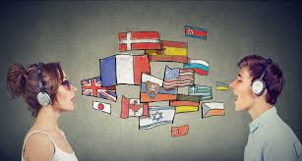
Problem Statement
The structure of sentences in English and other languages may be different. This is considered to be one of the main structural problems in translation. Limit your Expertise: Gain expertise only in a couple of languages that you are already well-versed with. The translator has to know the exact structure in each language, and use the appropriate structure, and they have to ensure that the translation is performed without changing the meaning as well.

Slide 5
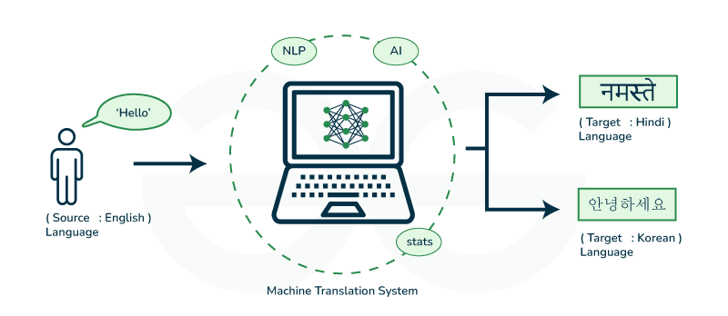
Proposed System
The aim of the proposed system is to develop a system that has capability to perform Translation, Converting text to speech, Speech Recognition. The system proposed here will be developed for a small domain of English words. A translator is a programming language processor that modifies a computer program from one language to another.

Slide 6
Literature Survey
s.no | Authors and Year | Models used | Parameters | Merits | Limitations and drawback
1 | Dhairya Suman, Atanu Mandal, Santanu Pal, Sudip Kumar Naskar (2023) | Indic BART, mbart-large-50, Indic Trans | BLEU, ChrF, RIBES, TER, COMET | High performance for low-resource languages, Effective translation for Assamese-English and Manipuri-English, Supports multiple Indian languages | Morphological complexity, Noise in output (e.g., random Chinese characters, emoticons), Errors in transliteration, Poorer performance when translating into Indic languages
2 | Santosh Kesiraju, Karel Benes, Maksim Tikhonov(2023) | Big Transformer Models Ensemble Models, Back-Translation Models, Ensemble Models Codebook Discretization Models | Batch Size, Dropout Rate, Epochs, Attention Heads. | Codebook Discretization Models, Back-Translation Models, Ensemble Models | Computationally expensive. Risk of index collapse and underutilization of codebook entries, Higher training time and resource requirements, May introduce noise into the dataset

Slide 7
Literature Survey
3 | Zifan Jiang, Amit Moryossef [2023] | Text-to-Gloss Translation, Gloss-to-Pose Conversion, Pose-to-Video Generation | Preprocessed using Sentence piece segmentation, trained on public DGS Corpus | Open-source and reproducible, Multilingual Support, Pipeline Flexibility, Real-time Operation | Gloss Representation Issues, Accuracy, Pose Inconsistencies, Handling Unknown Glosses, Pose-to-Video Quality
4 | Csaba Oravecz, KatinaBontchev David Kolovratník, Bhavani Bhaskar,(2021) | Ensemble Models, Back-Translation Models, Big Transformer Models, BaseTransformer Models | Ensemble Models, Batch Size, Embedding Dimension, Attention Heads | Ensemble Models, Base and Big Transformer Models: | Complex Data Preprocessing, Computational Costs, Training Complexity
5 | Meijuan Chen[2023] | Double-RNN | Parallel Corpus Real-Time Processing Machine Translation Systems | Real-Time Evaluation ImprovedQuality Estimation EfficientFeature Extraction | Complexity Lack of Robustness to All Languages Dependency on High-Quality Corpus
6 | Bılge Kağan Yazar Durmuş Özkan Şahın Erdal Kiliç[2023] | Deep Learning Methods low-resource neural machine translation (NMT). | BLEU Score Corpora Bilingual Corpora | Comprehensive Review Future Directions Focus on Recent Techniques | Narrow Focus on Metrics Dataset and Tool Specificity Lack of Detailed Methodologies

Slide 8
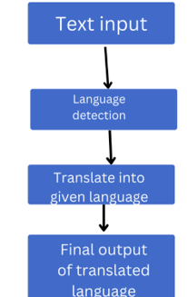
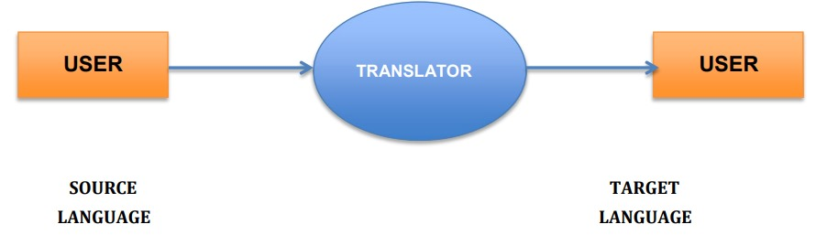
ARCHITECTURE​

Slide 9
METHODOLOGY
Sequence-to-Sequence model
A sequence-to-sequence (Seq2Seq) model is a type of neural network architecture for transforming sequences in one domain to another. The types of applications for a sequence-to sequence model are: text-to-text transformations, like machine translation between languages, or 14 the generation of text summaries or image captions
NLLB model
The NLLB (No Language Left Behind) LLM is a multilingual language model developed by Meta AI to facilitate high-quality translation across a vast range of languages, including many underrepresented ones. It is part of Meta's initiative to enhance global communication by leveraging machine learning to support over 200 languages.

Slide 10
T5 model
The T5 (Text-to-Text Transfer Transformer) model, developed by Google Research, is a state-of-the-art language model, designed to approach all NLP tasks as a text-to-text problem. The unified framework is such that tasks like translation, summarization, classification, and question answering can be addressed with the model in the sense of converting inputs and outputs into text strings, hence versatile and task-agnostic. T
Helsinki-NLP OPUS-MT Models
Model Type: MarianMT (Marian Machine Translation).
Target: Pretrained on specific language pairs, in this case, English-to-Hindi (en-hi). It serves as a basic model for fine-tuning or for direct use.
Architecture: The transformer encoder-decoder model. It applies attention mechanisms for the context understanding of input and output sequences.

Slide 11
Results
Results from the language translation project, particularly when translating from English to Hindi and Telugu, were promising as they produced coherent yet contextually appropriate translations. Using the sequence-to-sequence model driven by LSTMs, the system was capable of learning linguistic patterns and nuances of the word-to-word and phrase-to-phrase translations as practiced between English and the target languages. Model testing indicated high accuracy for frequent phrases and sentences used, and the BLEU scores demonstrate close proximity to human translators. However, difficulties were encountered in handling complex sentences and rare words and idiomatic expressions where the predictions sometimes were different from what was expected. Though it poses quite some challenges, this experiment demonstrated pretty well how deep learning may bridge the linguistic barrier. It laid a good robust foundation for further optimization and deploying real-world applications such as multilingual chatbots and educational tools.

Slide 12
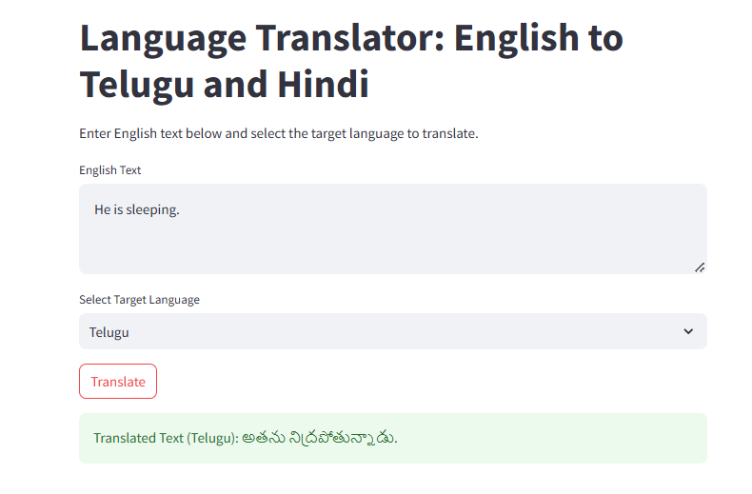
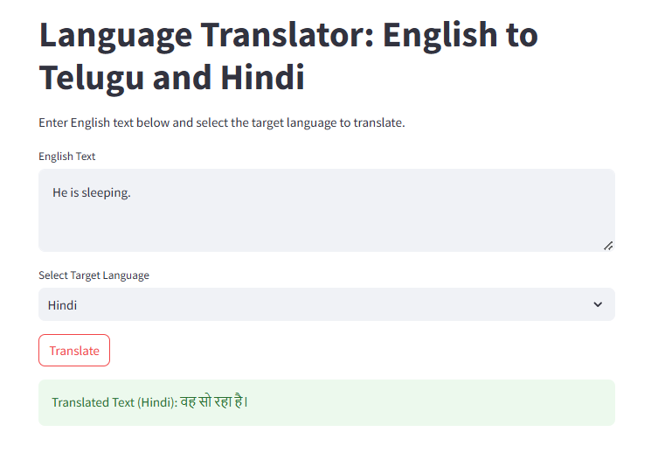
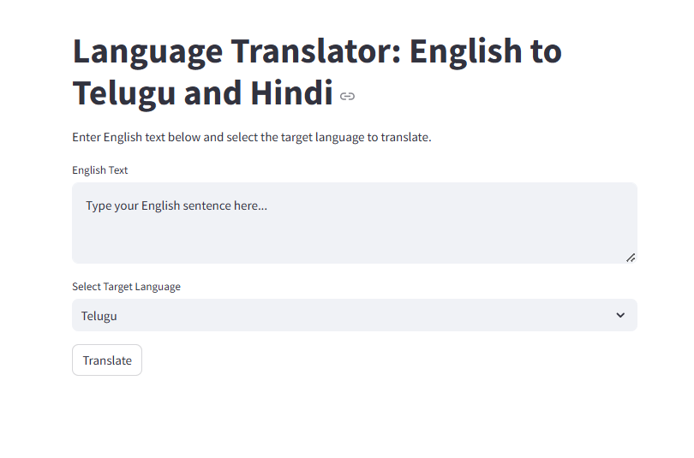
Telugu Translating
Hindi Translating
Front-End

Slide 13
Conclusion
In this proposed system, we implemented the system for user who phasing problems of language barrier. So, it automatically reduces the user task for understanding the languages for communication. Translation is not merely changing words but also transferring of cultural equivalence with culture of original language and recipient of that language as well as possible. So, it should be accepted that the better translation, both in logic and by fact, must be accepted by all people; hence, the message contained within the source language (SL) can satisfy the reader within the target language (TL) with the information within. The importance of translation for everyone will make you consider it as a necessary and worthy investment.

Slide 14
FUTURE SCOPE
However to make this system more precise and useful for a wide range of target audience, it demands some further improvements. Further we are aiming at following improvements: To take input text from an image of printed English text by implementing character recognition. Presently we are only able to take manual input through virtual keyboard. The system can be further extended to include more languages and possibly dialects.

Slide 15
THANK
YOU

