Slide 1

immuneRegulation:
An ImmuneSpace module for identifying human immune regulatory elements
Presenter: Selim Kalayci, PhD
PI: Zeynep H. Gümüş, PhD
Icahn Institute for Genomics and Multiscale Biology &
Department of Genetics and Genomic Sciences

Slide 2
Overview
immuneRegulation is a web-based tool to interact with massive gene regulation datasets.
Goals:
identify genetic variants or transcription factors that regulate changes in gene expression to vaccines, pathogens, therapies (“stimuli”).
interactively explore HIPC-specific and other publicly available immune-related gene expression regulation data via a user-friendly interface.

Slide 3
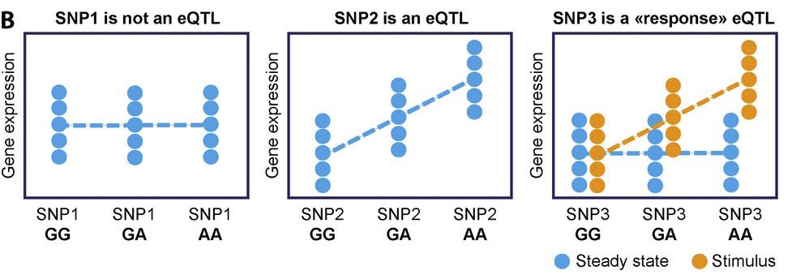
Regulators of gene expression: eQTLs
expression quantitative trait loci (eQTLs): DNA variants that alter gene expression
We can understand why some individuals respond differently to stimuli
*Fig: Quach, Hélène, and Lluis Quintana-Murci. "Living in an adaptive world: Genomic dissection of the genus Homo and its immune response." Journal of Experimental Medicine 214.4 (2017): 877-894.

Slide 4
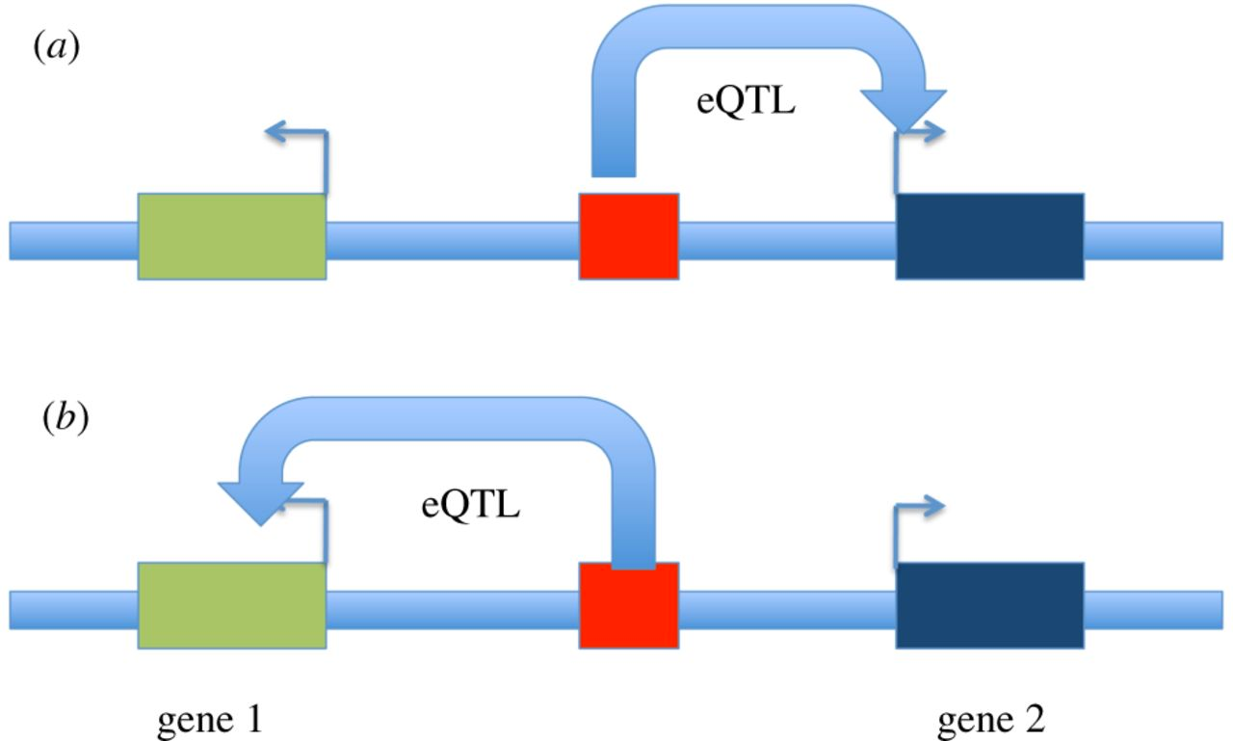
eQTL analysis
eQTL analysis: identify variants that regulate the expression of a gene.
eQTL effects are tissue- and cell-type specific.
cis-eQTL: variant located near affected gene (e.g. ~ 1 megabase)
trans-eQTL: : variant located further away from affected gene (e.g. > 5 megabases away, or on another chromosome)
*Fig: Nica, AC, and Dermitzakis ET. Phil. Trans. R. Soc. B 368.1620 (2013): 20120362

Slide 5
immuneRegulation – Data Sources
We developed immuneRegulation as a central repository of gene regulation datasets.
Public datasets:
Multiple studies on Whole blood, B-cells, monocytes, CD4+ T-cells, CD16+ neutrophils, toxin exposure, Lymphoblastoid cell lines, and methylation.
Total # of datasets: 27 37
cis-eQTL datasets: 17 24
trans-eQTL datasets: 10 13
Total # of genotyped individuals: 12,423 23,040
Total # of gene expression data: 14,007 30,562
Total # of eQTLs: around 200 million.

Slide 6
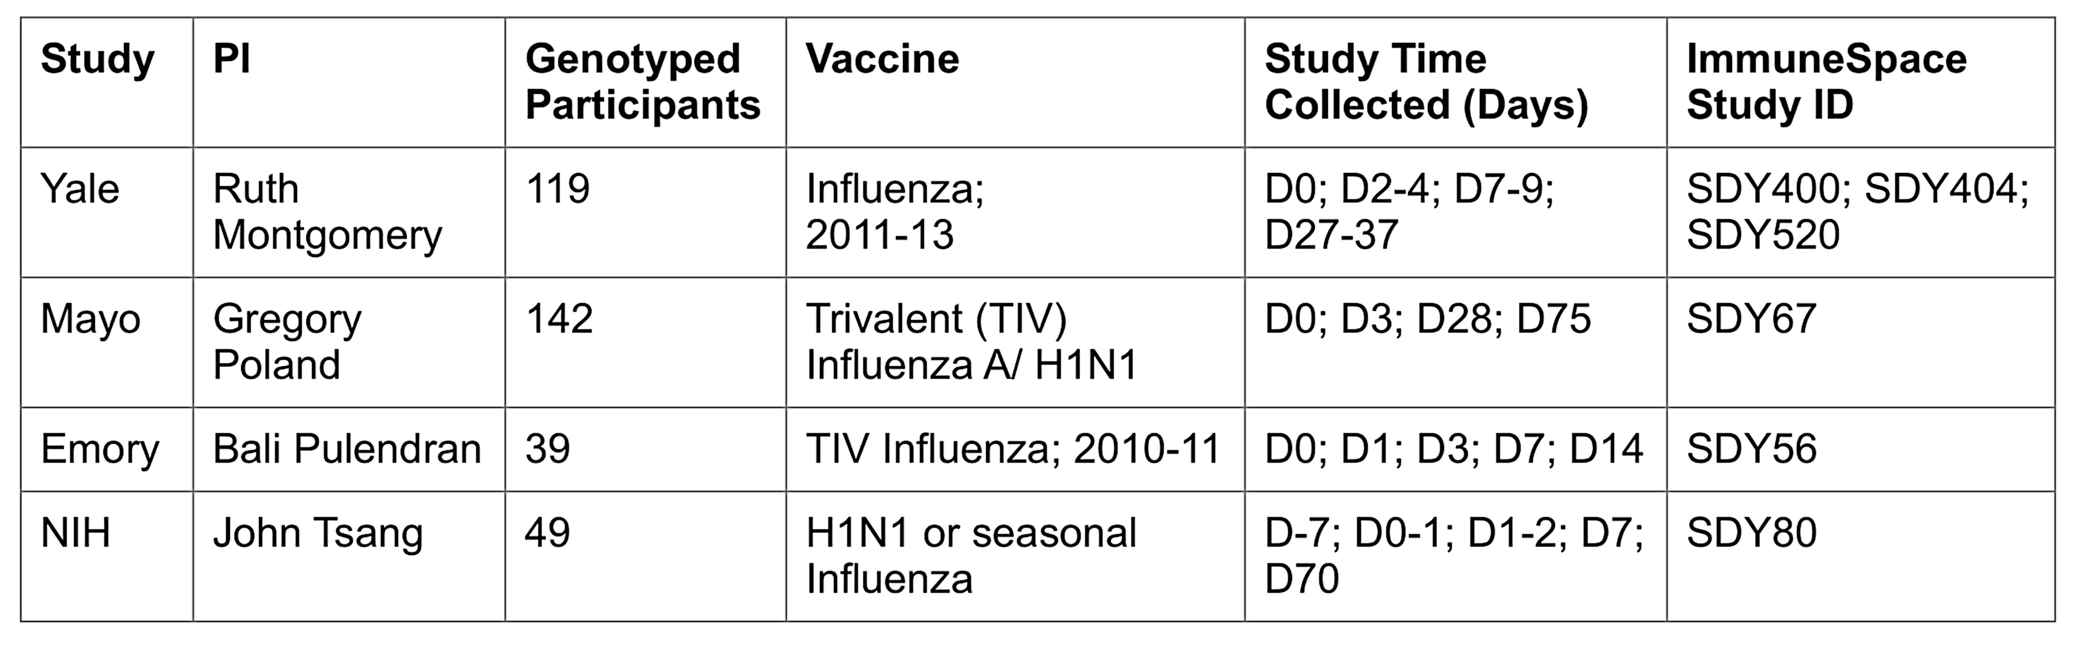
immuneRegulation – Data Sources
HIPC datasets:
We developed analysis pipelines to identify eQTLs.
This year we added HIPC studies to immuneRegulation interface.

Slide 7
immuneRegulation interface
integrates multiple regulation datasets (for different cell-types) in a single interface
enables interactive query and visualization of regulatory information
simple and intuitive browser interface to easily
explore, filter datasets;
submit and modify queries
enables users to upload private datasets and explore them within the same interface

Slide 8
DEMO

Slide 9
New Features in immuneRegulation
Manhattan Plot visualization of trans-eQTLs.
Completely new query interface
simple, intuitive
comprehensive/informative to guide users
Ability to add and visualize private datasets
completely local (NO data upload to a server!)
fully integrated with the interface
eQTL analysis pipeline for HIPC datasets, where input data is:
microarray + genotype; or
RNASeq
New datasets: HIPC datasets, public datasets

Slide 10
Ongoing Work
Integration with immune datasets in GWAS catalog (www.ebi.ac.uk/gwas)
associate and visualize disease/trait information with immuneRegulation datasets
Analysis and integration of additional immune studies with proper RNASeq (or genotype+microarray) data, such as:
HIPC/ImmuneSpace: SDY888 (Dengue), SDY301 (Influenza)
ImmPort: SDY997 (Lupus), SDY998 -SDY999 (Rheumatoid Arthritis)
Other upcoming studies
Finalizing the interface for Transcription Factor regulators from ENCODE lymphoblastoid cell line GM12878 ChIP-seq data
User response/feedback studies: message board, FAQ, use-case materials

Slide 11
Conclusions
immuneRegulation enables immune researchers to interactively and visually explore regulators of gene expression and create hypotheses for experimental validation.
Largest database of immune regulation data
Researchers can
upload and explore their own regulatory datasets
identify eQTLs and transcription factors that can explain phenotypic differences within their cohorts

Slide 12


Conclusions
immuneRegulation is live and available at:
https://kalays01.u.hpc.mssm.edu/hipc/
Manuscript in preparation
We
zeynep.gumus@mssm.edu
selim.kalayci@mssm.edu

Slide 13
Acknowledgements
MSSM:
Zeynep H. Gümüş, PhD
Ana Fernandez-Sesma, PhD
Irene Ramos-Lopez, PhD
Robert J. Klein, PhD
Andrew Kasarskis, PhD
Ted Pak, PhD
Jun Zhu, PhD
Tarrell Malloy
Yale:
Steven Kleinstein, PhD
Ruth Montgomery, PhD
Chris Cotsapas, PhD
Noah Connally, PhD
UCSF:
Jeffrey Johnson, PhD
Mayo:
Greg Poland, MD
Emory:
Bali Pulendran, PhD
Northwestern:
Eun-Young Kim, PhD
NIH:
John Tsang, PhD
Fred Hutchinson:
Raphael Gottardo, PhD
+ All DHIPC members
NIAID IOF

