Slide 1

Project Title & Group Members
EventNest
One campus.
Every opportunity.
Events · competitions · clubs · student stories
Aashriya Chauhan · Daksh Arora · Nishit Gupta · Vedant Choudhary
PRN 23030124113 · 23030124097 · 23030124086 · 23030124114
Web UI & Content Management · Semester VII · Division B
01 / 12
Notes:
Group names and their PRNs are taken from the supplied v3a presentation. The logo mark is the EventNest website mark.

Slide 2
Problem Statement
Campus event information is often spread across multiple channels, making it difficult for students and staff to discover activities, register, and track proposals. Organizers also need a consistent way to manage clubs, competitions, event registrations, and approvals. EventNest provides one role-based portal for these activities.
5
Notice boards
Posters
WhatsApp groups
Email
Paper forms
places students
look for updates
01
FRAGMENTED
Students miss event details and deadlines across bulletin boards, chats, email and social channels.
02
MANUAL
Organizers coordinate publishing, registration lists and approvals by hand.
03
HARD TO TRACK
Review status, attendance and participation are difficult to follow consistently.
EventNest brings discovery, registration and approvals into one role-aware campus portal.
02 / 12
Notes:
Problem statement uses the revised v3a content, with the existing visual breakdown retained.

Slide 3
Objectives
Five connected goals define what EventNest helps campus communities do.
01
02
03
04
05
UNIFIED PLATFORM
BROWSE + REGISTER
PROPOSAL REVIEW
ROLE-BASED ACCESS
ORGANIZED DATA
Bring campus events, competitions, clubs, and student stories into one portal.
Let users browse activities and manage registrations.
Support event proposals, review decisions, and requested revisions.
Give administrators and authorized staff tools suited to their roles.
Keep event and account data organized in WordPress and custom database tables.
THE OUTCOME
One route for participation, proposal review and role-based campus operations.
Profiles · registrations · revisions · organized records
03 / 12
Notes:
Objectives reflect all five goals from the supplied v3a presentation.

Slide 4
Technology Used
WordPress, PHP, MariaDB and the EventNest theme and plugin form the local stack.
INTERFACE
HTML5 · CSS · JavaScript
CUSTOM WORKFLOW DATA
Responsive pages and interactions
Registrations
↓
wp_en_registrations · wp_en_teams
THEME
EventNest theme 1.2.15
Templates · navigation · visual system
Proposal history
↓
wp_en_approvals · wp_en_proposal_revisions
APPLICATION
EventNest Core 0.9.2
Roles · forms · dashboards · approvals
Membership + audit
↓
wp_en_club_memberships · wp_en_audit_log
PLATFORM
WordPress 7.1.3 · PHP 8.2.12
Content management and server-side logic
DUPLICATE RSVP GUARD
↓
Unique event + user registration pair
DATABASE + LOCAL SERVER
MariaDB 10.4.32 · XAMPP / Apache
Blocks a second active registration.
Application data and local development
ACCESS + INPUT SAFEGUARDS
Role checks · staff approval · hashed passwords
Nonces · sanitization · prepared queries · rate limits
04 / 12
Notes:
Stack and versions are from the supplied report. WordPress standard tables store content and profile metadata; EventNest custom tables support registrations, teams, approvals, revisions, memberships and audit records.

Slide 5
Main Features
Eight connected features support students, organizers and reviewers.
08
01
CAMPUS PAGES
02
SEARCH + FILTERS
Events, competitions, clubs and student stories.
Find activities by keyword and relevant details.
KEY
03
PROFILES + ACCESS
04
REGISTRATIONS
FEATURES
User profiles, role-based accounts and staff approval.
Register for events, clubs and competitions.
From discovery
to administration
05
PROPOSAL LIFECYCLE
06
CLUB LEADERSHIP
Submit, review, request revisions and resubmit.
Manage membership and club leadership.
One role-aware
campus platform.
07
ROLE-AWARE EVENTS
08
CALENDAR + ADMIN
Faculty-only events and dashboards by role.
Calendar and registration management for Admin, Director and Deputy Director.
05 / 12
Notes:
All eight feature statements are taken from v3a and refined for concise presentation.

Slide 6
System/Workflow
Seven steps connect account access, campus participation, proposals and administration.
01
ACCOUNT + PROFILE
Users create an account, sign in, and complete their profile.
02
STAFF APPROVAL
Staff access is enabled after administrator approval.
03
DISCOVER + REGISTER
Users browse events or competitions and register when eligible.
04
SUBMIT + TRACK
Students submit event proposals and can view review feedback.
05
REVISE + RESUBMIT
If changes are requested, the student updates and resubmits the proposal.
06
APPROVE + PREPARE
After approval, the event is prepared for publication by an administrator.
07
ADMINISTER
Administrators manage users, content, registrations, and review tasks.
Step 5 applies only when reviewers request changes; resubmission returns the proposal to review.
06 / 12
Notes:
Workflow text follows the seven steps supplied by the user. The note clarifies the conditional revision loop.

Slide 7
User Workflows — Participation
Student, club member, club head and faculty · role workflows 1 of 2.
01
STUDENT
Create profile
Sign in
Find + filter
Register / cancel / track
02
CLUB MEMBER
Apply to join club
Club Head reviews
Approved member
See club notices
03
CLUB HEAD
Admin approves account
Create club activities
Manage members
View participants
04
FACULTY
Request faculty access
Admin verifies + assigns
Create department event
Manage registrations
Member is approved student status. Students can track stories / proposals; requested changes return for edits.
07 / 12
Notes:
The four flows cover student, club member, club head and faculty journeys. Students can also submit stories and proposals; club membership is recorded as approved status on a student account.

Slide 8
User Workflows — Review & Administration
Faculty Head, Admin and institute reviewers · role workflows 2 of 2.
05
FACULTY HEAD
Assigned department queue
Review proposal
Approve / changes / reject
Route to Admin
06
ADMIN
Staff + proposal queue
Verify route + scope
Approve / changes / reject
Send to final reviewer
07
DEPUTY DIRECTOR
Assigned final queue
Review proposal
Approve / changes / reject
Admin prepares event
08
DIRECTOR
Institute proposal queue
Final review
Approve / changes / reject
Admin prepares event
Requested changes return to the student; rejection closes the request. Final review is assigned to the Director or Deputy Director.
08 / 12
Notes:
Reviewer role paths use the same row-based style as the Participation slide. Cultural and Technical club-linked proposals may require both the assigned Faculty Head and Club Head approvals before Admin review.

Slide 9
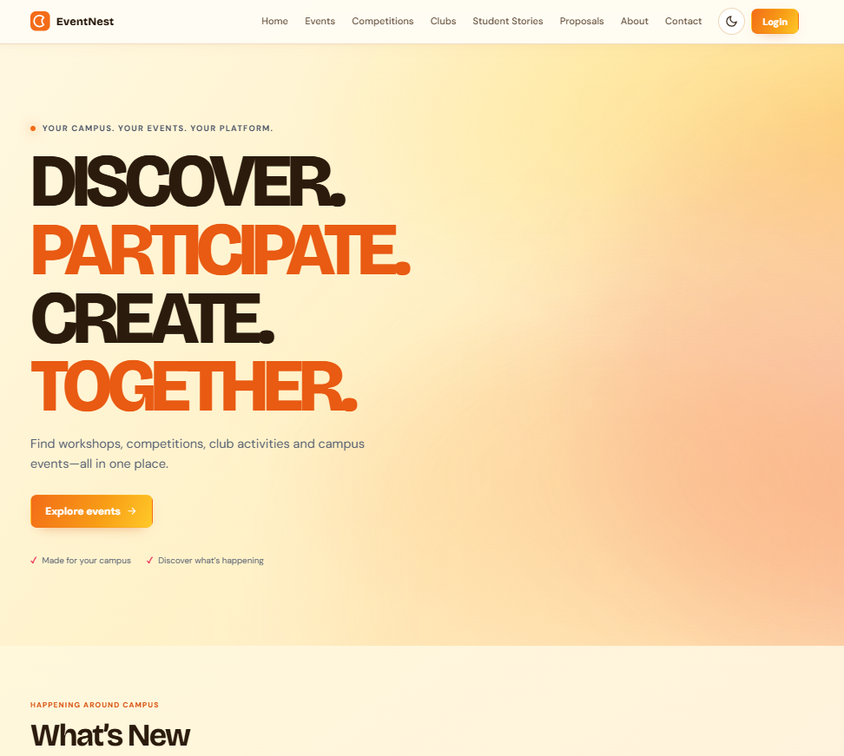
Screenshots
HOME PAGE:
09 / 12
Notes:
The interface screenshots come from the original team presentation. The demo path is based on the supplied implementation description.

Slide 10
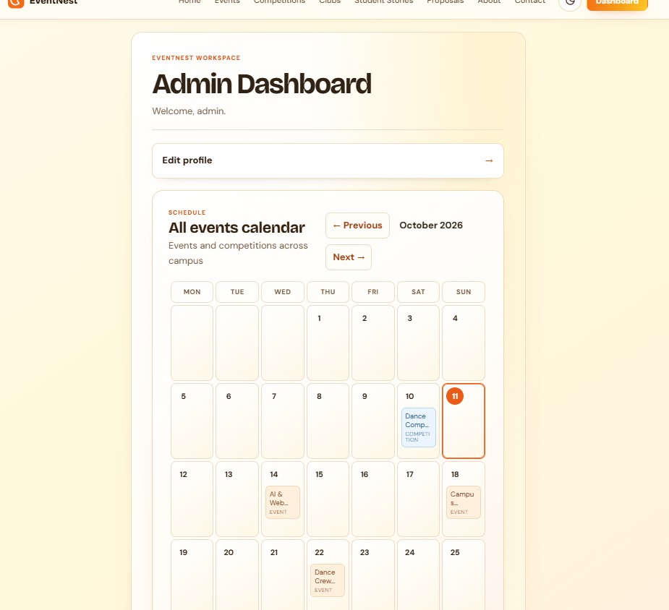
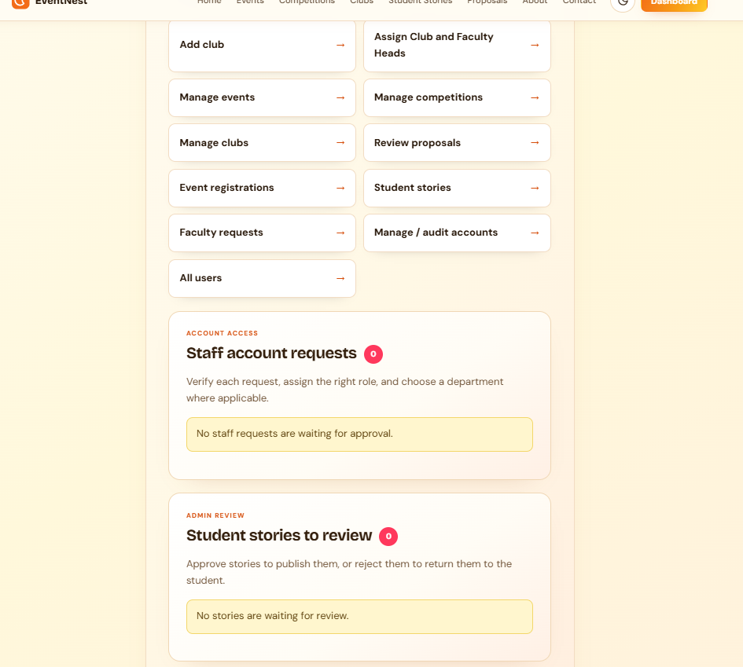
Screenshots
ADMIN DASHBOARD:
09 / 12
Notes:
The interface screenshots come from the original team presentation. The demo path is based on the supplied implementation description.

Slide 11
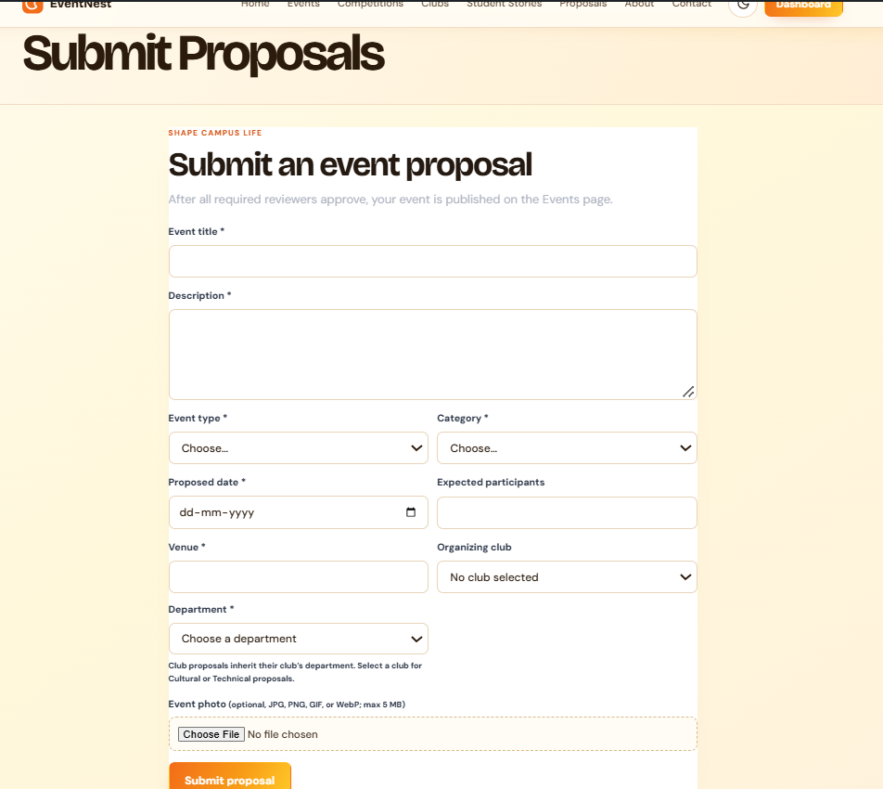
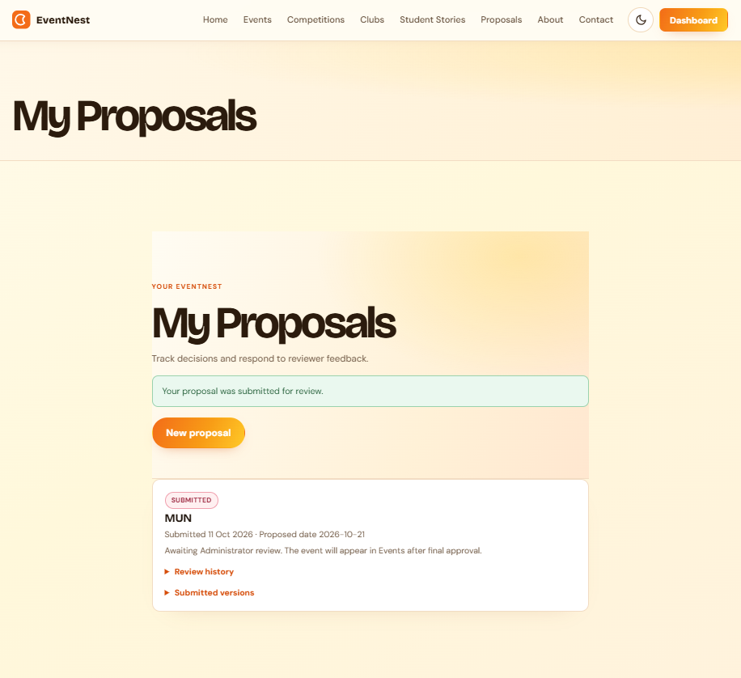
Screenshots
PROPOSALS:
09 / 12
Notes:
The interface screenshots come from the original team presentation. The demo path is based on the supplied implementation description.

Slide 12
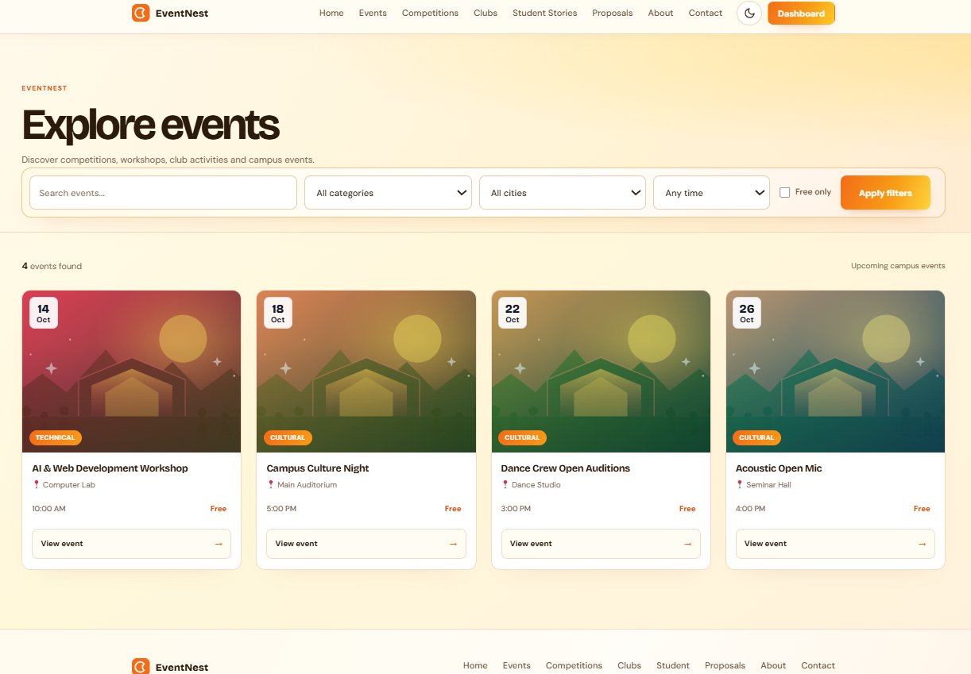
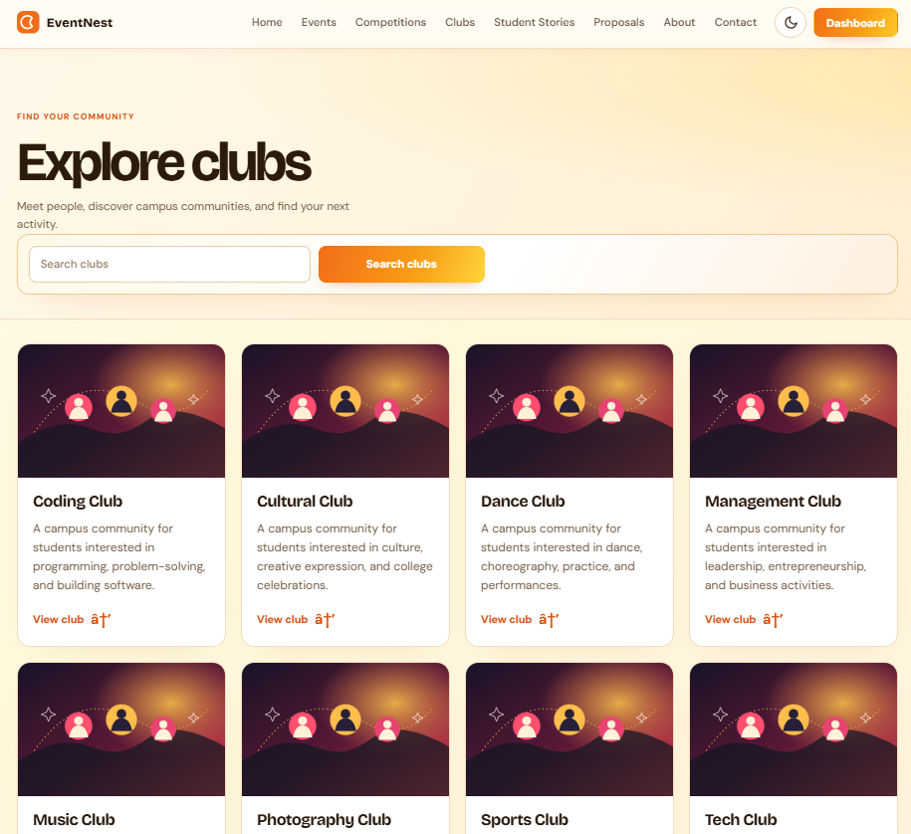
Screenshots
EVENTS AND CLUB PAGES:
09 / 12
Notes:
The interface screenshots come from the original team presentation. The demo path is based on the supplied implementation description.

Slide 13
Implementation
Run the platform locally, then follow one student request through its review path.
LOCAL SETUP
LIVE DEMO
01
Start XAMPP
One end-to-end example
Run Apache and MariaDB.
01
STUDENT
Browse an event, register, then submit a proposal.
02
Open WordPress
Load the local EventNest site in a browser.
02
REVIEWER
Open the assigned queue and request a revision.
03
Check components
Confirm EventNest theme and EventNest Core are active.
03
STUDENT
Edit the proposal and resubmit it.
04
Sign in by role
04
ADMIN
Use student and authorized reviewer accounts.
After final approval, publish the event and confirm its public listing.
Use test accounts and non-production data for the classroom demo.
10 / 12
Notes:
Implementation steps and demonstration sequence are based on the supplied report. The example shows a proposal revision and approval; role assignments determine which reviewer sees each request.

Slide 14
Conclusion
EventNest makes campus activity easier to find and easier to run.
FOR STUDENTS
FOR ORGANIZERS
FOR THE INSTITUTION
One reliable place
Structured operations
Connected campus
Discover workshops, competitions and campus activities; manage a profile and registrations.
Coordinate proposals, events, club activity, registrations and review decisions.
Give campus activity visibility and make approval history easier to follow.
DISCOVER
PARTICIPATE
CREATE
REVIEW
One connected experience from first search through final approval.
11 / 12
Notes:
Value statements condense the report’s student, organizer and institution benefits without adding unsupported impact metrics.

Slide 15
Future Scope
Potential extensions beyond the current implementation.
01
COMMUNICATION
02 · INSIGHT
Email or in-app updates for registrations and review decisions.
Reports and analytics for organizers to understand activity and participation.
03 · CALENDAR
04 · ACCESS
05 · PAYMENTS
Calendar export and event reminders.
A stronger mobile experience and improved accessibility.
Online payment support for paid events.
12 / 12
Notes:
Future-scope items are from the supplied project summary and are not represented as implemented.

