Slide 1

Detecting Fraudulent Customer’s Transactions using Paysim Dataset
A dissertation submitted in partial fulfilment of the requirements for the degree of
MSc Human and Social Data Science
by
Student Name- Gunveer Singh Sanjeev Thapar
Candidate no- 269020
Under the guidance of
Dr. Hsi Ming-Ho
Dissertation Supervisor
Department of Mathematics and Physical Science
University of Sussex
Sussex House, Falmer, Brighton BN1 9RH
September 2023

Slide 2
Table of contents
01
Introduction
Detecting Fraudulent Customer’s Transactions using Paysim Dataset
Detecting Fraudulent Customer’s Transactions using Paysim Dataset
02
03
Aims and Objectives
Dataset
Description of basic information of the project
Description of what the project will cover and aim
Description of the selected dataset and its characteristics
04
05
06
Methodology
Results
Conclusion & Future Work
Description of the criteria to be used for completion of the project
Results based on selected machine learning algorithms
Final remarks based on objectives and future recommendations

Slide 3
Introduction
Detecting Fraudulent Customer’s Transactions using Paysim Dataset
With a rise in online transactions, electronic payments, and mobile banking, the global financial environment has been digitalized recently.
Despite its convenience and efficiency, it has also led to an increase in financial fraud i.e. Identity theft, credit card fraud and money laundering.
Machine learning can be used to stream data in real-time, uncover hidden patterns in user conduct, and estimate the likelihood of fraudulent behaviour.

Slide 4
Aims & Objectives
Detecting Fraudulent Customer’s Transactions Paysim Dataset
Aim
To create precise machine learning models that can identify and prevent fraudulent transactions
Objectives
Objective 1
Objective 2
Objective 3
Objective 4
Obtain a financial dataset.
Eliminate unnecessary data fields from the dataset.
Locate appropriate metrics to assess the model's performance.
Select the tested models that have performed the best and strengthen the weaker ones.

Slide 5
Dataset
Detecting Fraudulent Customer’s Transactions using Paysim Dataset
NAME
Paysim Dataset
Sources of Data: PaySim develops its dataset by taking cues from unpublished datasets and actual bank records. These private datasets are likely to have transaction records that have been aggregated, anonymized, or otherwise cleaned up to remove any personally identifying information (PII).
Mobile Transactions in Africa: PaySim's dataset is largely concerned with replicating mobile transactions, a critical component of financial services in many locations, particularly in Africa. These transactions are a sample of actual financial transactions made through mobile money services over a given month.
Multinational Corporation Data: PaySim used financial records from a multinational company that offers mobile banking services in more than 14 different nations to produce the dataset. These logs probably contain a wide variety of transaction patterns and behaviours from different geographical areas.
Background

Slide 6
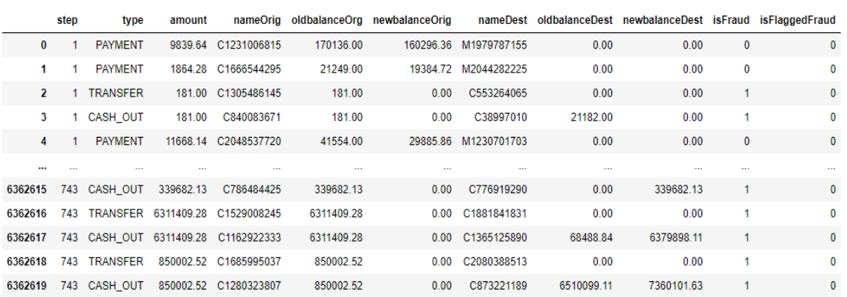
Detecting Fraudulent Customer’s Transactions Paysim Dataset
Dataset
Has 6,362,620 rows (individual data points or transactions) and 11 columns (attributes or characteristics)
Some Key Attributes include:
step- Time of the transaction.
Type- type of the transfer.
Amount- Money in Dollars.
nameOrig- Sender’s name.
oldbalanceOrg- Sender’s old balance.
newbalanceOrig,- - New balance of sender.
nameDest- Receiver’s name.
oldbalanceDest- Receiver’s old balance.
newbalanceDest,- Receiver’s new balance.
isFraud- Fraud indication(0 or 1).
isFlaggedFraud- A binary indicator that acts as a flag to identify possibly fraudulent transactions.
Characteristics

Slide 7
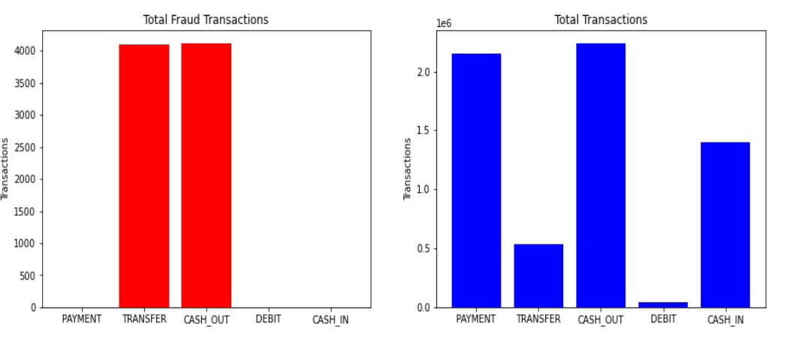
Which type of transactions are fraudulent?
Detecting Fraudulent Customer’s Transactions
There is only 0.3% fraud in total transactions.
Only transactions with the TRANSACTION type of either TRANSFER or CASH_OUT are fraudulent.
We can observe from the second graph that TRANSFERS occur 4 times less frequently than CASH_OUTS. Because they do not exhibit fraudulent activity, the transaction types PAYMENT, DEBIT, and CASH_IN are eliminated as they are redundant.

Slide 8
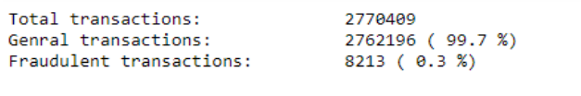
Total Number of Transactions
Detecting Fraudulent Customer’s Transactions using Paysim Dataset
Total Transactions (2,770,409): This represents the overall number of transactions that occurred within a specific period or context. It includes all types of transactions, both legitimate and potentially fraudulent.
General Transactions (2,762,196): These are transactions that are considered to be normal or legitimate. General transactions typically include everyday financial activities, such as purchases, withdrawals, deposits, or transfers, that do not raise any suspicions of fraudulent activity.
Fraudulent Transactions (8,213): These are transactions that are categorized as fraudulent. Fraudulent transactions involve deceptive or illegal activities aimed at gaining financial benefits dishonestly. They can include activities like unauthorized credit card charges, identity theft, or other forms of financial fraud.

Slide 9

Imbalance Dataset
Detecting Fraudulent Customer’s Transactions using Paysim Dataset
When one class considerably outnumbers the other, the dataset is unbalanced
In terms of fraud detection, this indicates that the great majority of transactions are honest (majority class) and the minority class (extremely tiny number) of transactions are dishonest.
Machine learning models are significantly hampered by unbalanced data
One of the main problems is that models can forecast the majority class (legal transactions) and yet score highly on popular measures like accuracy.
Biased Models: models that primarily predict the majority class that may appear to be accurate. But because the minority class (fraudulent transactions) is entirely ignored, there is a serious under-detection of fraud

Slide 10
Approaches to overcome imbalance in Datasets
Detecting Fraudulent Customer’s Transactions using Paysim Dataset
Resampling: - Oversampling the minority class entails adding more examples of the minority class to balance the distribution of the classes.
Alternative measures:- F1-score, precision-recall curves, and area under the precision-recall curve (AUC-PR) offer a more precise evaluation of a model's performance.
Putting the Minority Class in Focus: Specialised methods are employed to make sure that the minority class is given enough consideration and is not ignored because of the imbalance in class.

Slide 11
Key Definitions
Detecting Fraudulent Customer’s Transactions using Paysim Dataset
SMOTE stands for Synthetic Minority Over-sampling Technique.
It is a popular technique for addressing the class imbalance problem in machine learning.
SMOTE works by generating synthetic samples in the feature space.
The primary goal is to balance the class distribution by increasing the size of the minority class, thereby improving the performance of machine learning models.
Class weights are used to modify the loss function, making the model pay more attention to under-represented classes.
During the training process, the loss for each sample is weighted by the class weight of its true label.
This encourages the model to correct its mistakes on the minority class, thereby improving its performance on imbalanced datasets.

Slide 12
Methodology
Detecting Fraudulent Customer’s Transactions using Paysim Dataset
Methodoloy
Accuracy
Data Cleansing
Data encoding
Data Visualization
Confusion Matric based on True Positive(TP), False Positive(FP), False Negative(FN) and True Negative(TN).
Calculated % of fraud missed and % of fraud detected by the model.
Class Weights and SMOTE to solve class inequality(fraudlent and legal transactions).
Data Cleaning unnecessary attributes esp. nameOrig, nameDest
Feature engineering: Transforming data into features that define its structure.
The fields must be integers in order to apply various machine learning algorithms to the data. CASH_OUTs are represented by 1, and TRANSFERs by 0.
Visualization of legitimate and fraudulent transactions to produce accurate predictions.
Preffered Chart: histogram

Slide 13
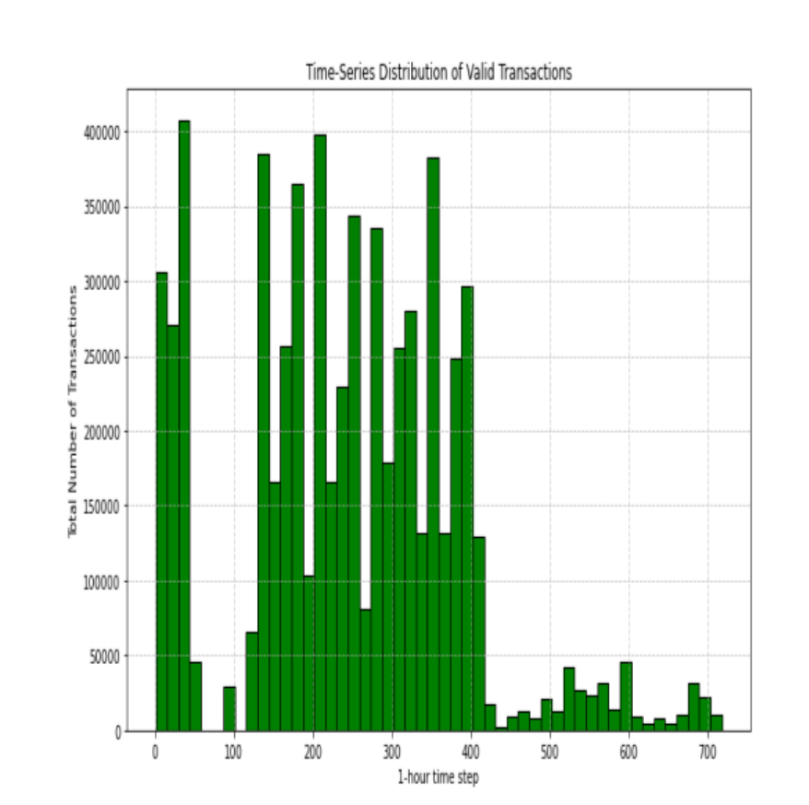
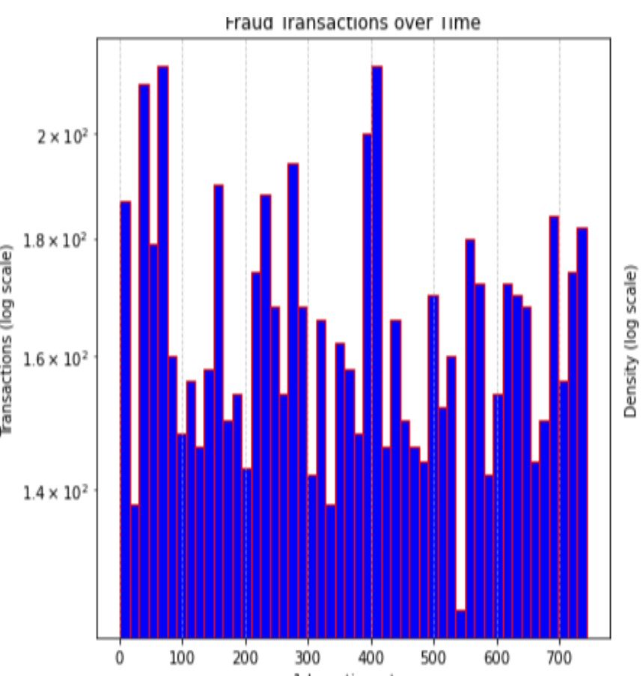
Data Visualization using histogram
Detecting Fraudulent Customer’s Transactions
Most legitimate transactions take place between time steps 0 and 60 and 110 and 410. For each time step of the month, the visualisations show the number of transactions. The frequency of fraudulent transactions does not significantly alter over time.
Day 0 in the histograms, however, does not always denote Monday or Sunday. The later histograms do not provide adequate proof that fraudulent transactions happen on a specific day of the week. So, it doesn't matter what day of the week is displayed.

Slide 14
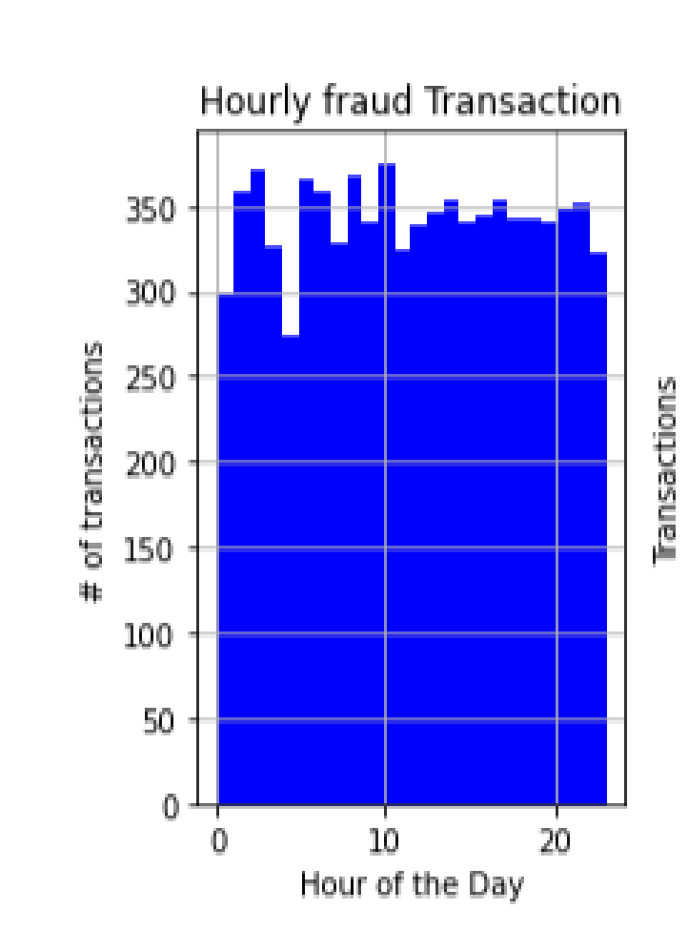
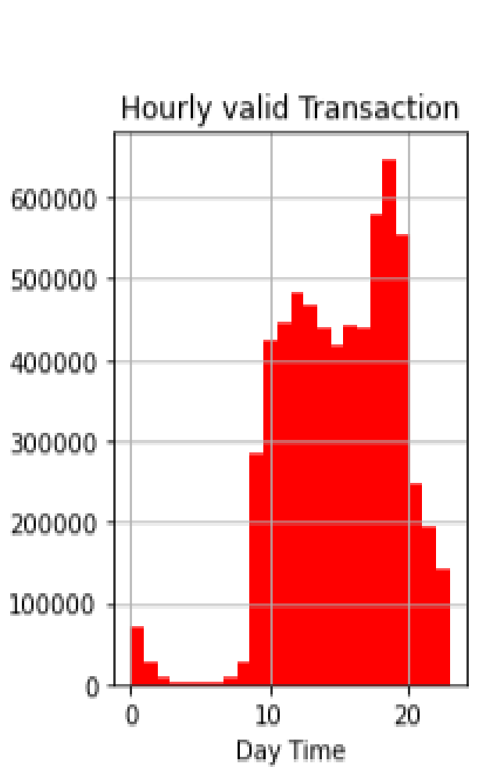
Detecting Fraudulent Customer’s Transactions using Paysim Dataset
However, when transactions are analysed based on the time of day, fraud can occur at any moment of the day, whereas real transactions often take place between hours 10 to 20.

Slide 15
RESULTS BASED ON SELECTED ALGORITHMS
Detecting Fraudulent Customer’s Transactions using Paysim Dataset
Random Forest Classifier
Logistic regression
K Nearest Neighbours
XGBOOST
Naïve Bayes

Slide 16
Random Forest Classfier
Detecting Fraudulent Customer’s Transactions
A Random Forest Classifier is an ensemble learning method that combines multiple decision trees to make more accurate and robust predictions in classification tasks. Each decision tree in the forest is created using a random subset of the training data (bootstrapping) and a random subset of the features (feature bagging). The final prediction is typically made by aggregating the predictions of all the individual trees.
Definition
The time complexity of Random Forests is O(t*u*n*log(n)), where:
• t is the number of trees
• u - total characteristics considered while splitting
Time Complexity

Slide 17
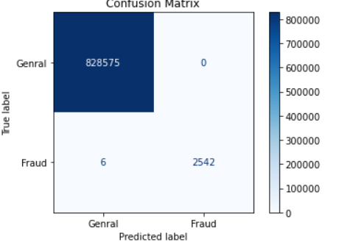
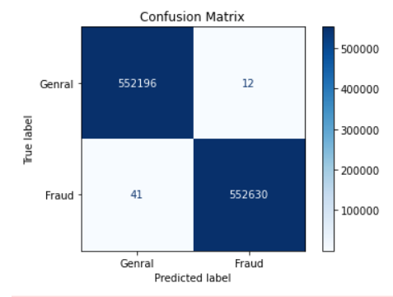
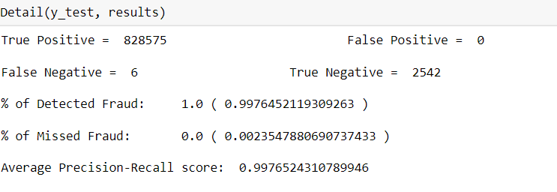
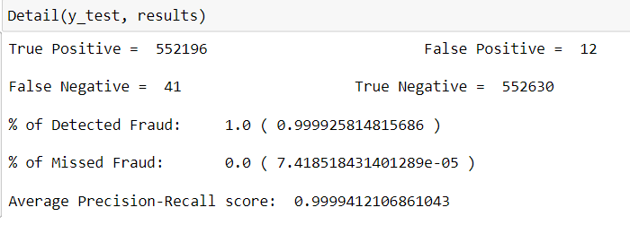
Random Forest Classifier
Detecting Fraudulent Customer’s Transactions
RANDOM FOREST USING CLASS WEIGHTS
RANDOM FOREST WITH SMOTE
RESULTS
RESULTS
Random Forest is an exact algorithm that produces outcomes that are comparable to those of the SMOTE method and class weights.

Slide 18
Detecting Fraudulent Customer’s Transactions using Paysim Dataset
PERFROMANCE METRICS DISCUSSION
USING CLASS WEIGHTS
USING SMOTE
TRUE POSITIVE
828,575 instances of fraudulent transactions were successfully recognised.
552,196 instances as fraudulent transactions.
FALSE POSITIVE
0 instances as fraudulent when they were genuine transactions.
12 instances in which the model mistakenly detected legitimate transaction.
FALSE NEGATIVE
6 instances of actual fraudulent transactions and classified them as genuine.
41 real instances of fraudulent transactions and incorrectly identified them as legitimate..
TRUE NEGATIVE
2,542 instances as genuine transactions..
5,52,630 cases were accurately classified as actual transactions.
% OF DETECTED FRAUD
It's 0.9976%, signifying that the model successfully identified all instances of fraud.
is 0.999%,model was effective in spotting every incident of fraud.
% OF MISSED FRAUD
low at 0.00002354.%, suggesting that the model missed only a very small fraction of fraudulent transactions.
0.00007418.%, missed only a very small fraction of fraudulent transactions.
AVERAGE PRECISION-RECALL SCORE
0.9976%, model excels in both precision (minimizing false positives) and recall (minimizing false negatives),
0.9999%, highly accurate and reliable.

Slide 19
XGBoost is a supervised machine learning algorithm that combines the predictions of multiple decision trees to create a robust and highly accurate model. It extends the gradient boosting framework by incorporating a number of enhancements, including a regularization term and the ability to handle missing values, which makes it less prone to overfitting and more robust to noisy data. XGBoost is widely used in various machine learning competitions and real-world applications due to its speed and effectiveness.
Detecting Fraudulent Customer’s Transactions
XGBOOST
Definition
Time Complexity: The time complexity of XGBoost primarily depends on the number of trees (iterations) in the ensemble and the complexity of each tree. Generally, the time complexity is approximately O(T * n * d * log(n)), where:
T is the number of trees in the ensemble.
n is the number of data points (training examples).
d is the average depth of each tree.
Time Complexity

Slide 20
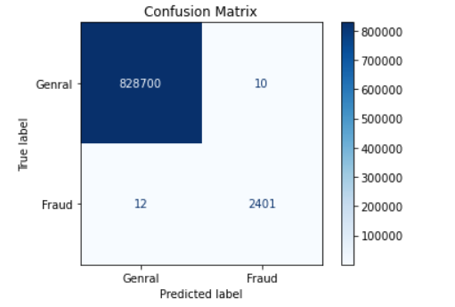
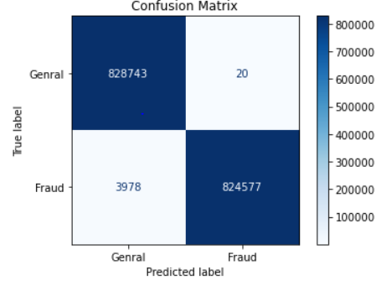
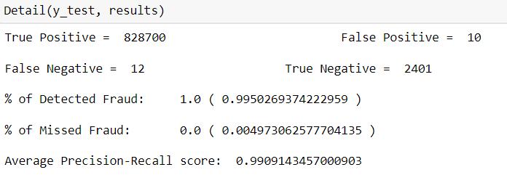
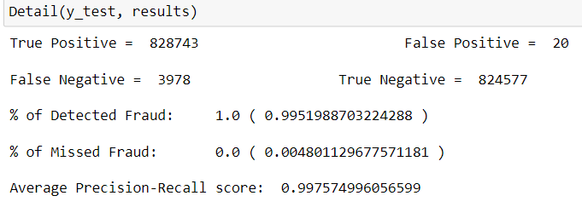
XGBOOST
Detecting Fraudulent Customer’s Transactions using Paysim Dataset
XGBOOST USING CLASS WEIGHTS
XGBOOST WITH SMOTE
RESULTS
RESULTS
It successfully detected virtually all fraud cases while minimising false positives. This suggests a very efficient fraud detection model with a great precision/recall ratio.

Slide 21
Detecting Fraudulent Customer’s Transactions using Paysim Dataset
PERFROMANCE METRICS DISCUSSION
USING CLASS WEIGHTS
USING SMOTE
TRUE POSITIVE
828,700 instances of fraudulent transactions were successfully recognised
828,743 true positives are present
FALSE POSITIVE
10 instances in which the model mistakenly detected
20 false positives
FALSE NEGATIVE
12 real instances of fraudulent transactions incorrectly identified
3,978 false negatives were found
TRUE NEGATIVE
2,401 cases were accurately classified as actual transactions
824,577 real negatives
% OF DETECTED FRAUD
0.9950% , model was effective in spotting every incident of fraud
0.995% of the fraudulent transactions detected.
% OF MISSED FRAUD
At 0.0049%, missed a very small proportion of fraudulent transactions
missed 0.004% of the fraudulent transactions
AVERAGE PRECISION-RECALL SCORE
0.9909, demonstrated high precision and recall
0.9975, performs very well in distinguishing between fraudulent and genuine transactions.

Slide 22
Logistic Regression is a statistical model used for binary classification, where the goal is to predict the probability of an input data point belonging to one of two classes (typically labeled as 0 and 1). It models the relationship between the independent variables (features) and the probability of belonging to the positive class using the logistic function (sigmoid function). The output of the logistic regression model is a probability score that can be converted into a binary decision by applying a threshold (e.g., 0.5).
Detecting Fraudulent Customer’s Transactions using Paysim Dataset
Logistic Regression Classifier
Definition
Time Complexity
Time Complexity: The time complexity of training and prediction in logistic regression is relatively low compared to more complex algorithms. The key factors affecting time complexity are:
Training Time: The time complexity of training a logistic regression model is typically O(m * n), where:
m is the number of training examples (data points).
n is the number of features (dimensionality of the feature space).
The training phase involves finding the coefficients (weights) that optimize the logistic regression model to fit the training data. This optimization is usually performed using iterative optimization algorithms like gradient descent.
Prediction Time: The time complexity of making predictions with a trained logistic regression model is O(n), where:
n is the number of features.
To make a prediction, the model computes a weighted sum of the input features and applies the logistic (sigmoid) function to obtain the probability score.

Slide 23
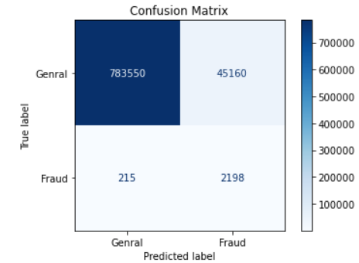
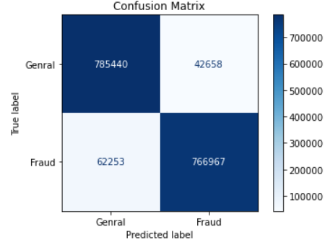
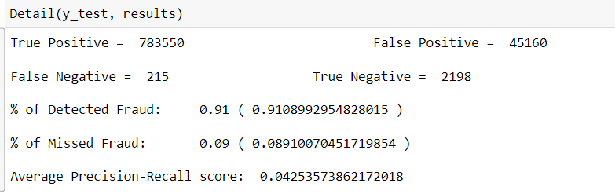
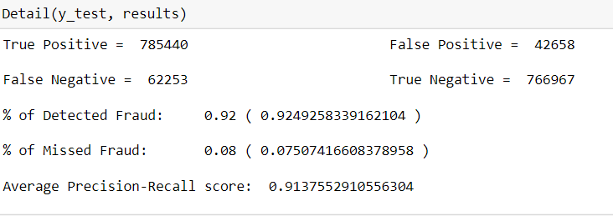
Detecting Fraudulent Customer’s Transactions using Paysim Dataset
LOGISTIC REGRESSION USING CLASS WEIGHTS
LOGISTIC REGRESSION WITH SMOTE
RESULTS
RESULTS
Overall, the XGBoost and Random Forest algorithms outperform Logistic Regression with Class Weights and the SMOTE method.

Slide 24
Detecting Fraudulent Customer’s Transactions using Paysim Dataset
PERFROMANCE METRICS DISCUSSION
USING CLASS WEIGHTS
USING SMOTE
TRUE POSITIVE
identified 783,550 cases as fraudulent transactions.
identified 785,440 cases as fraudulent transactions.
FALSE POSITIVE
45,160 instances, legitimate transactions were mistakenly classified.
42,658 instances, legitimate transactions were incorrectly classified.
FALSE NEGATIVE
215 actual instances of fraudulent transactions, incorrectly identifying them as legitimate.
missed 62,253 actual fraudulent transactions, incorrectly.
TRUE NEGATIVE
2,198 cases were accurately classified as legitimate transactions.
766,967 instances were accurately classified as legitimate transactions.
% OF DETECTED FRAUD
91%, the model successfully identified around 91% of the instances of fraud.
92.49% of the fraud cases were successfully detected by the algorithm.
% OF MISSED FRAUD
over 99.1% of the actual fraudulent transactions were not missed by the model.
7.51% of the actual fraudulent transactions were not recognized.
AVERAGE PRECISION-RECALL SCORE
0.0425, model struggles to balance accurate detection of fraudulent transactions and minimizing false positives.
0.9138, both high precision and recall from the model.

Slide 25
Naive Bayes is a supervised learning algorithm that uses Bayes' theorem to make predictions based on probabilistic principles. It assumes that the features used to describe data points are conditionally independent, given the class label. This is a "naive" assumption and simplification, which is where the algorithm gets its name. In classification tasks, Naive Bayes calculates the probability of a data point belonging to each class and assigns it to the class with the highest probability.
Detecting Fraudulent Customer’s Transactions using Paysim Dataset
Naive Bayes Classification
Definition
𝑃 (𝐴) =𝑃(𝐴 ∩ 𝐵)
𝑃(𝐵)
Where:
𝑃 (𝐴) = The probability of A occurring
𝑃 (𝐵) = The probability of B occurring
𝑃 (𝐴|𝐵) = The probability of A given B
𝑃 (𝐵|𝐴) = The probability of B given A
𝑃 (𝐴 ∩ 𝐵 ) = The probability of both A and B occurring
= 𝑃(𝐴) ∗ 𝑃(𝐵 | 𝐴)
P(B)
Time Complexity: The time complexity of Naive Bayes is generally quite efficient and depends on the following factors:
Training Time: The training phase of Naive Bayes is usually very fast because it involves calculating the prior probabilities of each class and the conditional probabilities of features given each class. The complexity of the training phase is often considered to be O(N * M), where:
N is the number of data points in the training dataset.
M is the number of features.
Prediction Time: The prediction phase in Naive Bayes is also typically fast. For each data point to be classified, the algorithm computes the conditional probabilities for each class and multiplies them with the prior probabilities. The final prediction is assigned to the class with the highest probability. The prediction phase's complexity is often considered to be O(K * M), where:
K is the number of classes.
M is the number of features.
Time Complexity

Slide 26
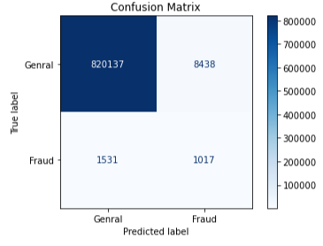
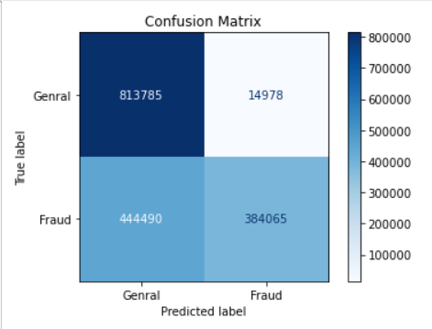
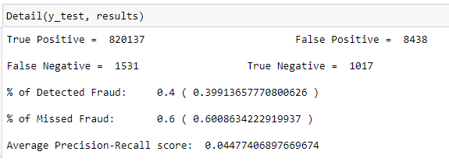
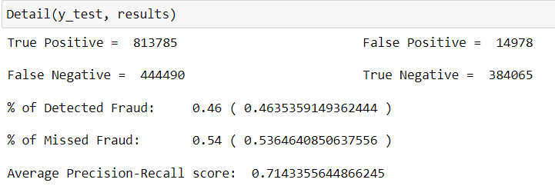
Detecting Fraudulent Customer’s Transactions using Paysim Dataset
NAÏVE BAYES USING CLASS WEIGHTS
NAÏVE BAYES WITH SMOTE
RESULTS
RESULTS
In general, Gaussian Naive Bayes performs worse than Logistic Regression and does not produce reliable results.

Slide 27
Detecting Fraudulent Customer’s Transactions using Paysim Dataset
PERFROMANCE METRICS DISCUSSION
USING CLASS WEIGHTS
USING SMOTE
TRUE POSITIVE
820,137 cases as fraudulent transactions
813,785 instances of transactions were accurately classified as fraudulent
FALSE POSITIVE
8,438 instances, legitimate transactions were incorrectly classified
14,978 cases were legitimate transactions, the model mistakenly classified
FALSE NEGATIVE
1,531 actual fraudulent transactions, erroneously identifying
misidentified as real 444,490 instances of actual fraudulent transactions.
TRUE NEGATIVE
1,017 instances were correctly identified as legitimate transactions
384,065 examples were accurately classified as actual transactions
% OF DETECTED FRAUD
0.4%, percentage of actual fraudulent transactions that the model correctly recognized
46% of the instances of fraud were successfully detected by the algorithm.
% OF MISSED FRAUD
0.6% indicates the percentage of actual fraudulent transactions that the model failed to identify.
model potentially missed about 54% of the fraudulent transactions
AVERAGE PRECISION-RECALL SCORE
0.0448, struggles to strike a balance between precision and recall (minimizing missed positive instances).
a high score of 0.7143, the model demonstrates commendable effectiveness.

Slide 28
K-NEAREST NEIGHBOUR
Detecting Fraudulent Customer’s Transactions using Paysim Dataset
Definition: K-Nearest Neighbors (KNN) is a non-parametric algorithm that makes predictions by finding the k data points (neighbors) in a training dataset that are closest in feature space to the input data point being classified or predicted. In classification tasks, KNN assigns the most common class label among the k-nearest neighbors to the input data point. In regression tasks, it calculates the average or weighted average of the target values of the k-nearest neighbors to predict a continuous value. K is a user-defined parameter that determines the number of neighbors to consider.
Definition
Definition
Time Complexity
Time Complexity: The time complexity of the KNN algorithm depends on several factors, including the size of the training dataset (n), the dimensionality of the feature space (d), and the value of k.
Training Time: KNN has virtually no training time because it simply memorizes the training data.
Prediction Time: The prediction time in KNN can be significant, especially when dealing with large datasets. The key factor affecting prediction time is the need to calculate distances between the input data point and all data points in the training dataset. The typical time complexity for prediction in KNN is O(n * d), where:
n is the number of data points in the training dataset.
d is the dimensionality of the feature space.

Slide 29
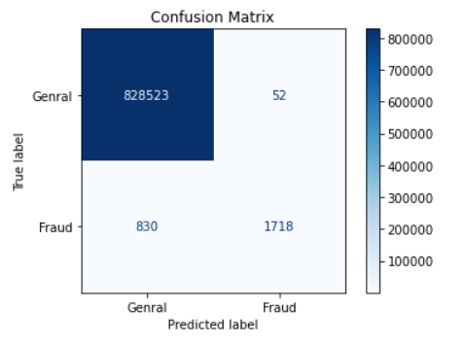
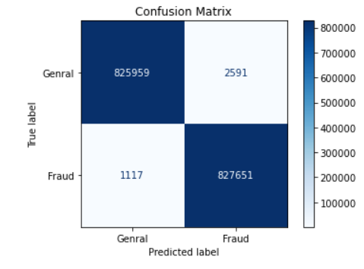
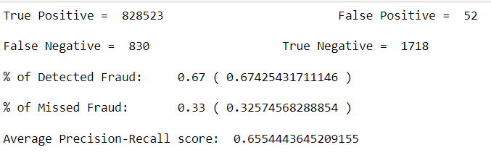
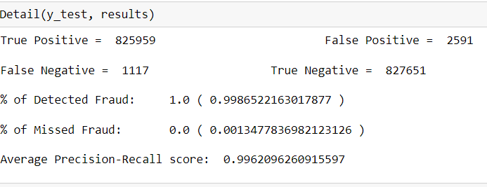
Detecting Fraudulent Customer’s Transactions using Paysim Dataset
K-NEAREST NEIGHBOURS USING CLASS WEIGHTS
K-NEAREST NEIGHBOURS WITH SMOTE
RESULTS
RESULTS
The model performs exceptionally well. It successfully detected virtually all fraud cases while minimising false positives. This suggests a very efficient fraud detection model with a great precision/recall ratio.

Slide 30
Detecting Fraudulent Customer’s Transactions using Paysim Dataset
PERFROMANCE METRICS DISCUSSION
USING CLASS WEIGHTS
USING SMOTE
TRUE POSITIVE
identified 828,523 cases as fraudulent transactions.
identified 825,959 cases as fraudulent transactions.
FALSE POSITIVE
52 instances, legitimate transactions were mistakenly classified.
2,591 instances, legitimate transactions were mistakenly classified.
FALSE NEGATIVE
missed 830 actual fraudulent transactions, incorrectly.
1,117 actual fraudulent transactions, identifying them as legitimate.
TRUE NEGATIVE
1,718 instances were correctly identified as legitimate transactions.
827,651 instances were correctly identified as legitimate transactions.
% OF DETECTED FRAUD
model identified about 67.43% of the actual fraudulent cases.
it's 99.86%, showcasing the model's ability to identify most fraudulent cases.
% OF MISSED FRAUD
0.33% suggests the model's inability to identify a portion of fraudulent transactions.
low value of 0.13% suggests the model's slight underestimation of fraudulent transactions.
AVERAGE PRECISION-RECALL SCORE
0.6554, strong overall performance.
0.9962 signifies the model's strong overall performance.

Slide 31
Conclusion & Future Work
Detecting Fraudulent Customer’s Transactions using Paysim Dataset
Ensemble techniques like Random Forest, XGBoost, and K-Nearest Neighbours outperform Gaussian Naive Bayes and Logistic Regression.
The use of SMOTE and class weights can significantly impact the performance of the algorithms.
Overall, Random Forest with class weights and Smote performed really well but it will be grateful to calculate Loss function(Gini impurity)
For Traditional Machine Learning, further work may be done by developing a unique loss function that figures out how much money is lost as a result of False Negative transactions when a model misclassifies a transaction.
Finally, the K-Nearest Neighbours algorithm can be tried with more than 5 neighbours. The more neighbours the algorithm takes into consideration, the slower the algorithm is.

Slide 32
THANK YOU!!
Detecting Fraudulent Customer’s Transactions using Paysim Dataset

