Slide 1

E-COMMERCE APPLICATION
PRESENTED BY
GUNA (1931009)
SUJITH(1931045)
VISHNU(1931053)

Slide 2
PROJECT ABSTRACTION:
1) Our project provides a platform for distributors and retailers to sell and buy their products online(Application).
2) It is implemented using Java Swing for GUI design and Oracle my SQL Plus for database
3) It helps us to reduce time consumed for this process and is also cost efficient.

Slide 3
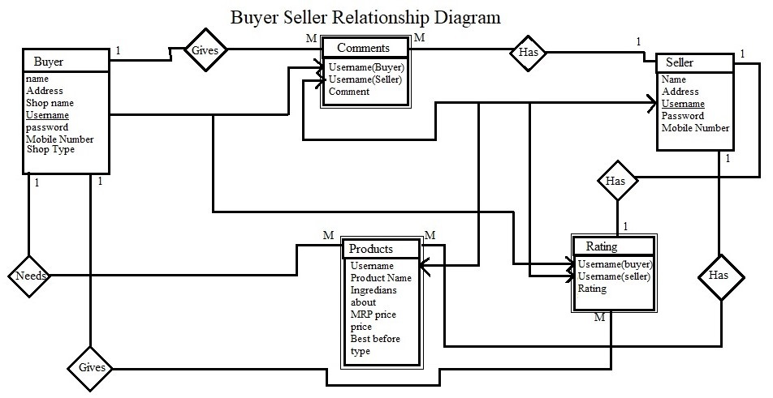
ER DIAGRAM:

Slide 4
TOOLS USED:
We used JAVA swing for GUI interface
For Database we used oracle database.
We used Netbeans for a convenient java platform.
We used JDBC for Database connectivity.

Slide 5
FRONT-END TECHNOLOGY:
Java swing for application creation and development.
Java for form validation .

Slide 6
BACK-END TECHNOLOGY:
We used Oracle My SQL Plus for manipulation of data.
We used JDBC for back end database connectivity.

Slide 7
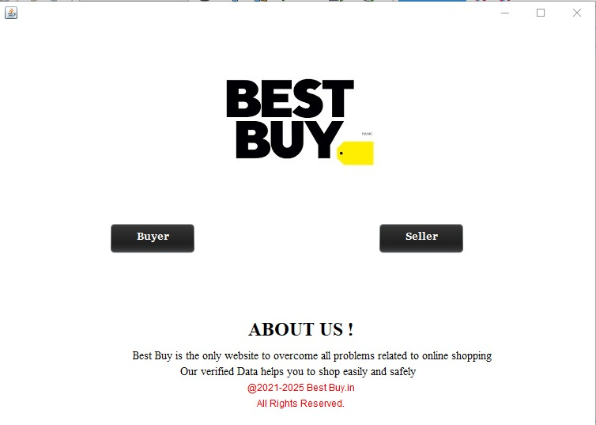
APPLICATION HOME PAGE:

Slide 8
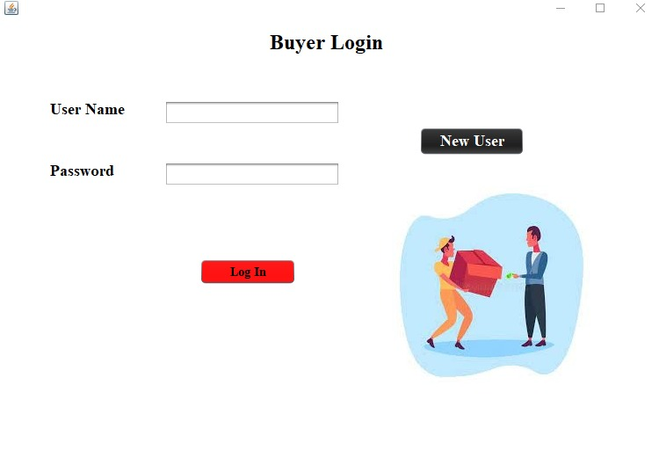
LOG IN PAGE:

Slide 9
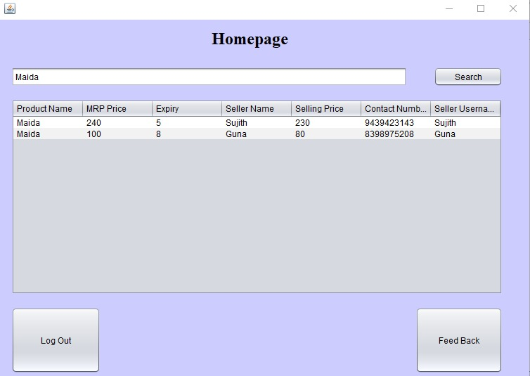
BUYER HOME PAGE:

Slide 10
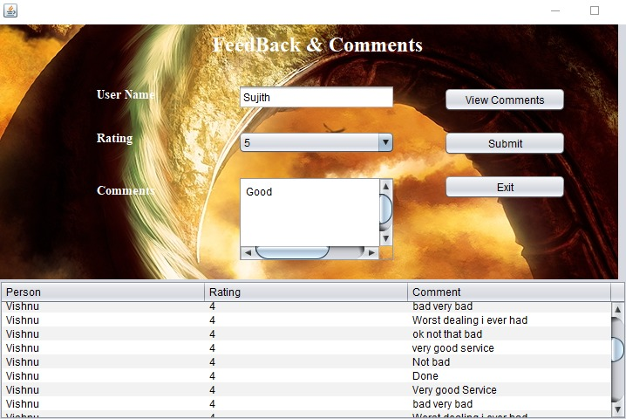
FEEDBACK FORM:

Slide 11
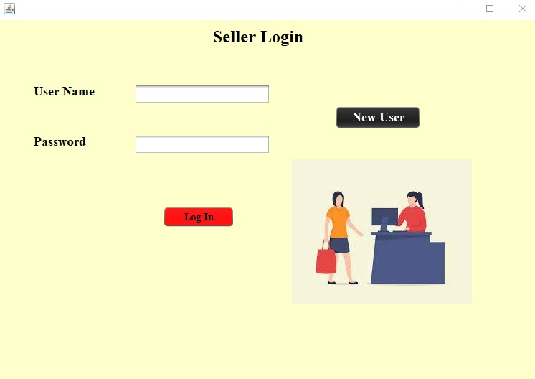
SELLER LOGIN:

Slide 12
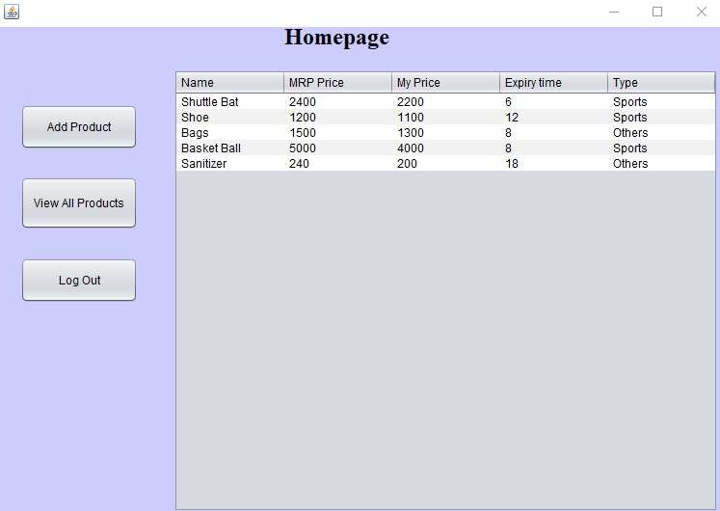
SELLER HOME PAGE:

Slide 13
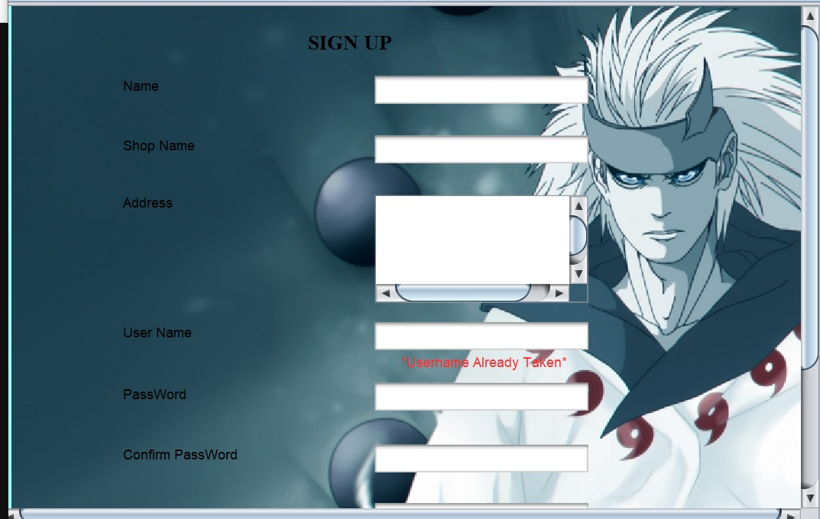
SIGN IN PAGE:

Slide 14
THANK YOU!

