Slide 1
EPPURA rESTAURANT
Name : Gunasekaran.m
Project : food SALES DISCOUNTS

Slide 2
Delivery Detalis
Food menu
Delivery men
Food Delivery

Slide 3
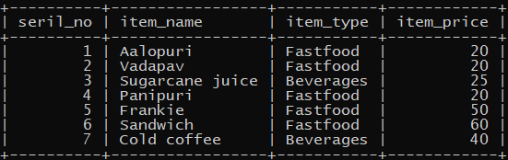
Food Menu table
select * from foodmenu;

Slide 4
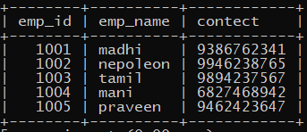
Deliverymen
select * from deliverymen;

Slide 5
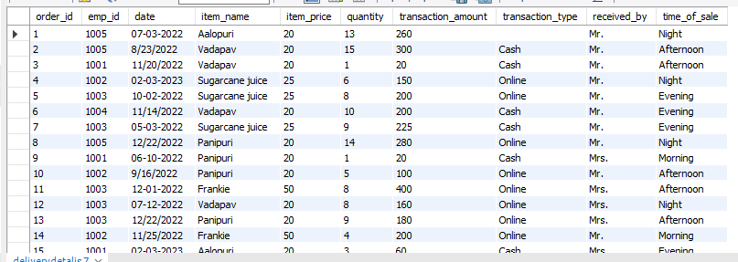
Delivery Detalis
select * from deliverydetalis;

Slide 6
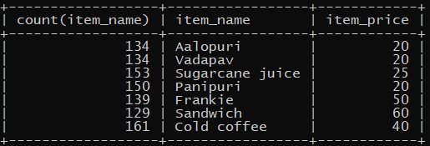
Maximum of Item Sales
select count(item_name),item_name,item_price from deliverydetalis group by item_name,item_price;

Slide 7
SUM OF TOTAL AMOUNT
select sum(transaction_amount) as total,item_name from deliverydetalis group by item_name having sum(transaction_amount);
select sum(transaction_amount) from deliverydetalis;
+-------+-----------------------+
| total | item_name |
+-------+-----------------------+
| 20880 | Aalopuri |
| 54440 | Cold coffee |
| 57500 | Frankie |
| 24520 | Panipuri |
| 65820 | Sandwich |
| 31950 | Sugarcane juice |
| 20120 | Vadapav |
+-------+------------------------+
+-----------------------------------+
| sum(transaction_amount) |
+-----------------------------------+
| 275230 |
+------------------------------------+

Slide 8
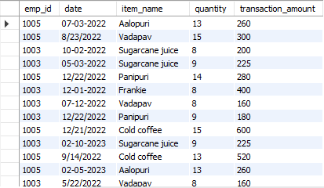
LIST OPERATOR
select emp_id,date,item_name,quantity,transaction_amount from deliverydetalis where emp_id in (1003,1005);

Slide 9
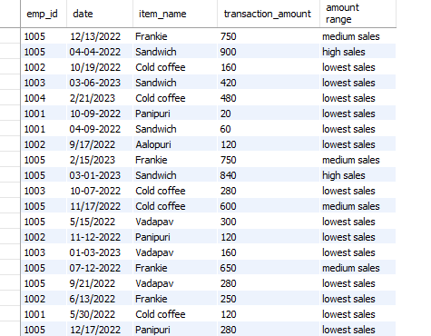
SALES RANGE
select emp_id,date,item_name,transaction_amount,case when transaction_amount>=800 then 'high sales' when transaction_amount<=800 and transaction_amount >=500 then 'medium sales' else 'lowest sales' end as 'amount range' from deliverydetalis;

Slide 10
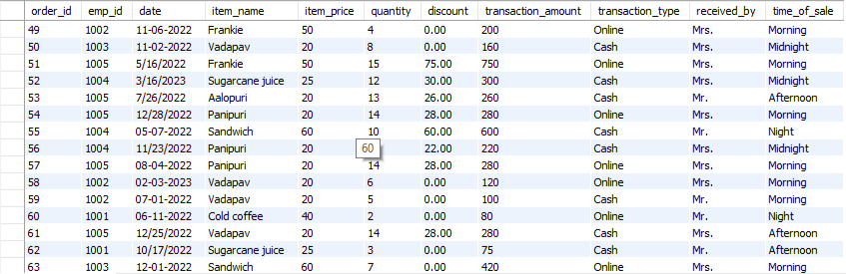
ADD DISCOUNT 10%
UPDATE deliverydetalis SET discount = CASE WHEN quantity >= 10 THEN transaction_amount * 0.1 ELSE 0 END;

Slide 11
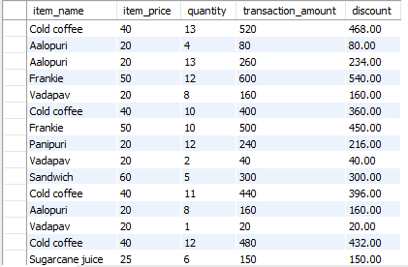
DISCOUNT AMOUNT
select item_name,item_price,quantity,transaction_amount,transaction_amount - discount as discount from deliverydetalis;

Slide 12
Conclusion
Drive the Sale
[ThankYou]

