Slide 1
The Financial Health
Done by : Gunasheela. R

Slide 2
Executive Summary
A large majority of American households live in a state of financial vulnerability. Across a range of incomes, people struggle to build savings, pay down debt, and manage irregular cash flows. Even modest savings cushions could help households take care of unexpected expenses or disruptions in income without relying on costly credit. But in practice, setting aside savings can be difficult. Making a single deposit or transfer actually involves multiple steps such as reviewing balances across accounts, planning for upcoming payments, and making a business-hours trip to the bank or navigating online banking portals.
Adding to the challenge, work, school, childcare, and other more urgent needs command much of our active attention. Taking care of these competing priorities can leave little bandwidth for close tracking of personal finances. As a result, funds that might have gone to savings may be spent elsewhere and bill payments can be overlooked.
For low- and middle-income families, these limits on attention and bandwidth can be especially unforgiving. Without resources to course correct, even one financial misstep can lead to a series of short and long term consequences. At the same time, managing a precarious financial situation can demand a single-minded focus that sharply reduces the capacity to tend to other responsibilities.

Slide 3
Research from the field of behavioral science shows that light-touch interventions can help address these barriers. For example, changing default settings or bringing financial management to the forefront of everyday life have had powerful effects on savings activity. The Financial Health Check (FHC) draws on such insights to offer a new model of scalable support for achieving financial goals. During a one-time, 30-60 minute phone appointment, specially trained consultants work one-on-one with participants to review monthly budgets and create financial goals. Consultants then help people set up recurring transfers in support of those goals so that funds automatically flow to designated savings or debt accounts without further action.
1. Create a moment that fits into people’s lives :
As a scheduled appointment, the FHC imposes a concrete timeline for working on financial goals.
The one-time, phone-based format minimizes the burden of participation.
2. Facilitate follow-through in real time :
FHC sessions support real-time decision making and action rather than information sharing.
Easy-to-follow guidance breaks the decision-making process into concrete steps (e.g., budget template to identify cash available, detailed visualization of goals to help prioritize them).
3. Make it automatic :
A system of automated transfers establishes a new status quo in which funds are diverted to goals on a recurring schedule.
Designated savings accounts with vivid labels separate goal funds from daily spending and make future benefits stand out.
Email or text alerts capture attention when adjustments may be necessary.

Slide 4
In a rigorous evaluation of the Financial Health Check, we found that participants who had access to the service posted net savings transactions 34% higher than a control group of peers who did not have access to appointments. These results, tracked during the 12-month period following contact, demonstrate the promise of services like the FHC to help families achieve financial resilience. To build on the outcomes of the BECU Financial Health Check pilot, we offer the following lessons learned.
1. Expand the reach :
Explore multiple delivery channels, including in-person and digital platforms, to serve a wider range of preferences regarding how to connect.
Consider offering FHC program elements alongside other customer touchpoints such as opening new accounts.
Market the service through multiple channels to capture the attention of busy families who may be interested.
2. Customize the experience :
Create customized tracks for different financial situations such as organizing surplus funds, managing irregular income streams, or prioritizing debt payments.
Match complementary interventions such as commitment devices and prize-linked savings programs to custom tracks.
3. Increase scalability :
Use digital modules to create a cost-efficient blend of online and offline components, reserving consultant time for the most critical moments within the FHC.
4. Test new approaches :
Rigorously measure the impact of innovations to identify best practices and target investments wisely

Slide 5
Barriers To Financial Health
Financial Vulnerability in America :
Everyday household financial management is a challenge for many families. According to a national survey fielded by The Center for Financial Services Innovation, as many as 138 million Americans are struggling financially. 71% of working adults say it would be somewhat or very difficult to pay bills if paychecks were delayed by one week and household debt balances have increased to aggregate levels higher than those seen during the Great Recession. Long term financial security is just as tenuous. Almost a third of adults report having no retirement savings at all. These numbers suggest that families across a range of incomes struggle with core aspects of financial resilience, from savings to debt reduction and cash flow management.
A close look at the context of household finances reveals why financial insecurity is so prevalent. Unemployment rates in the U.S. have recovered after the Great Recession and are now at a level below the pre-crisis period. But income streams are often irregular and unpredictable, in part because more employers leverage dynamic staffing models and workers engage in the so-called gig economy. Spending varies widely as well. Utility and phone bills depend on usage, costs such as tuition or travel change by season, and unpredictable shocks cause spikes throughout the year. This volatility in income and expenses makes it more difficult to manage household finances or meet unexpected needs in the near term, even if annual income can cover expenses in the aggregate.

Slide 6
Behavioural Challenges :
For many households, a savings cushion (even a small one) can help prevent disruption from economic shocks and ongoing volatility in incomes and expenses. Studies show that the likelihood of experiencing a hardship such as eviction, missed housing or utility payments, or reliance on public benefits begins to fall at savings levels of just $250-749. In fact, research suggests that engaging in savings behavior can boost financial resilience even while holding income constant.
Even though savings are an important component of financial heath, behavioral challenges can prevent households from taking appropriate action. When people are asked directly to reflect on their financial security, many acknowledge they are “unprepared for the unexpected” and report worrying about their lack of savings. But most of the time, managing one’s finances is not top of mind. Work, school, childcare, and other more urgent needs monopolize attention in the day-to-day. Meanwhile, there is no clear deadline for saving for the future. Unpredictable cash f lows can complicate decisions of how much and when to save. And seemingly small hassles like getting to the bank to make a deposit – after work, before the branch closes, and perhaps with young children in tow – can prove difficult to overcome. As a result, people can struggle to set aside much-needed savings. Likewise, making on-time payments can turn out to be surprisingly challenging, with due dates completely slipping by even when funds are readily available.

Slide 7
When finances are not closely managed, households may lose money to unnecessary trans action costs. For example, without savings on hand, people may need to rely on credit cards for unexpected expenses, incurring high interest payments that further crowd out savings. Poorly timed payments can result in costly overdrafts or late fees.
Research shows that light-touch interventions using reminders and default settings can power fully influence savings behavior. Simple text messages can help keep financial management on the radar, encouraging people to stick to savings goals and make on-time payments. When employers change default settings to automatically enroll people into retirement plans (with clear paths to opt out if desired), they leverage a common bias toward inaction and plan participation jumps significantly. Behavioral insights such as these can help practitioners design financial services that are cost-effective, reach a wide range of families, and lead to meaningful gains in financial resilience.

Slide 8
The Financial Health Check
Existing solutions in the field of financial counseling and advisory services typically cater to either the most affluent or the most financially vulnerable, leaving a gap for the vast majority of American households. High-touch investment advisors and money managers navigate complex decision-making on behalf of the wealthy. For low- and moderate-income Americans, financial counseling services are often focused on dealing with financial crises or debt consolidation. In recent years, financial counseling programs have expanded their reach and often make use of action-oriented approaches such as goal setting or plan making. While these developments move in the right direction, the structure of many programs leaves clients to take care of critical steps on their own. With significant time and resources already dedicated to attending coaching sessions, the additional follow-up of opening accounts, executing transfers each month, and monitoring cash flows remain behavioral barriers to action.
Drawing upon behavioral science insights, the Financial Health Check (FHC) offers a new model of one-on-one, scalable support for the many American households who face barriers to taking action on their financial lives. During a one-time, 30-60 minute session, specially trained consultants help participants make concrete decisions related to increasing savings and reducing debt. Together, they review monthly budgets and future needs, specifying how much cash can be set aside for different financial goals. They then set up automatic, recurring transfers that regularly move money to designated savings or debt accounts. Email and text alerts prompt people to adjust spending and saving levels if necessary.

Slide 9
Financial Health Check Participants Outpace Peers in Savings Behaviors :
BECU members who were invited to participate in the FHC engaged in more savings activity in the 12 months following contact than a control group of peers who were not offered appointments.
33.9% Net savings transactions (deposits minus withdrawals)
4.7% Number of savings deposits
11.5% Dollars deposited.
Although we do not see robust effects on month-end balances, engaging in savings activity is likely a critical first step to building financial resilience over time. Analysis from the U.S. Financial Diaries suggests that balances do not capture important behavior related to short term savings and usage. Many families who set aside funds expect to draw from savings within six months or a year. While balances may be slow to grow, saving for the short term can nonetheless help households manage volatile cash flows and reduce reliance on debt.
By helping members take action to improve their financial situations, BECU is fulfilling a mission of building member financial health and, by extension, the financial health of the credit union. Operationally, measuring the impact of this new approach to financial counseling equips BECU to decide how best to deploy credit union resources in service of member needs.

Slide 10
Personalized Support for a Range of Needs :
As FHC consultants spoke one-on-one with members, they had the opportunity to engage in candid, personal conversations about members’ lives and the challenges of prioritizing financial goals. Some people were in transition and going back to school, starting a business, or separating from a marriage. Others admitted that working on their finances had been haunting to-do lists for months with little progress. A consistent theme was that the need to juggle multiple responsibilities often limited household financial management to only the most short-term or urgent matters (today’s bills).
These constraints on attention and bandwidth can be especially difficult for families who don’t have the resources to course correct after financial missteps. Even minor events can have serious repercussions. For example, running just a couple days late on a payment can trigger fees that then need to be covered with interest-bearing credit. Managing financial situations with such little room for error can demand a single-minded focus that sharply reduces the capacity to tend to other responsibilities.
To support families struggling with these constraints, BECU targeted part of its outreach for Financial Health Checks to low- and middle-income (LMI) households. During FHC appointments, consultants helped members clarify – given each household’s particular circumstances – how much to put aside for financial goals. Setting up automated transfers during the session itself then eliminated many ongoing tasks for managing to save. Even at modest levels, this approach to building savings could help families avoid disruption after financial shocks while also reducing the stress of managing complex financial situations.
In some instances, consultants surfaced unmet needs for specialized help such as debt consolidation or credit counseling. Notably, a number of these conversations involved higher income households whose account history showed no clear signs of financial vulnerability. The Financial Health Check gave BECU team members the opportunity to direct families to trusted affiliates for in-depth support. In internal surveys, consultants emphasized the value of these connections, saying they gave BECU “the ability to really advocate for our members on a deeper level.

Slide 11
Design Principles
The BECU Financial Health Check was offered – free of charge – to a randomly selected group of credit union members. Interested members opted into participation. The session format included the following elements:
One-time, 30-60 minute session.
Confidential, one-on-one conversation.
Delivered over the phone by specially-trained BECU employees.
Focused on building liquid savings and reducing high-interest credit card debt.
The session was designed with three main principles in mind:
1. Create a moment that fits into people’s lives.
2. Facilitate follow-through in real time.
3. Make it automatic.

Slide 12
Create a moment that fits into people’s lives:
Household financial management often consists of handling today’s bills and priorities while juggling multiple other responsibilities at home and work. If asked, most people would acknowledge they ought to be saving more or paying closer attention to expenses, and many genuinely want to follow through on these practices. However, there is usually no urgent trigger – and sometimes very little bandwidth – to act on overarching financial goals. People can easily overlook important financial tasks or postpone them as they run into complex decisions and burdensome actions.
FHC User Flows:
The FHC user flow began with email outreach and included touch points to support preparation and attendance. Process steps include:
BECU Emails Randomly Selected Members about the FHC Pilot.
Member Responds to Invitation.
BECU Sends Appointment Confirmation and Budget Worksheet.
Member Completes Budget Worksheet.
BECU Sends Personalized Reminders 3 days Before Appointment and Day Before Appointment.
At Scheduled Time, BECU Consultant Calls Member and Conducts FHC.

Slide 13
To address these challenges, the FHC creates a specific moment for members to work toward financial goals while minimizing the burden of participation. The structure of a dedicated appointment imposes a deadline and the one-time, phone-based format reduces the time and effort required. Most sessions take less than an hour to complete. Personalized appointment reminders are sent by phone or email, depending on member preferences. When members are unable to connect at scheduled times, consultants reach out to set up new appointments.
During the pilot, we continued to adjust the FHC to fit into people’s lives. For example, 12% of members who tried to set up an FHC could not schedule an appointment during the workweek. In response, BECU extended service hours to offer evening and weekend sessions. By contrast, multi-session engagements may require people to travel to counseling centers, miss work, or f ind extra childcare. Faced with these challenges, even highly motivated people may still need to skip sessions and miss key content.
Facilitate follow-through in real time:
The Financial Health Check focuses on supporting real-time decisions and actions rather than conveying information, assigning “homework,” or merely discussing financial situations. For example, many people have high-level goals such as “saving more,” but uncertainty around how much to save, when to time transactions, and which accounts to use can derail next steps. Consultants help members step through these granular and practical decisions so they can take action right away and begin working toward financial goals before the call ends. Meanwhile, informational topics are covered only briefly. Rather than walking members through their credit reports, for example, consultants share a one-pager on reading credit reports with interested members after the call.

Slide 14
Before the live portion of the FHC, we ask members to complete a specially designed budget worksheet that clarifies what actions they can take toward financial goals. For loans in repayment, the worksheet prompts members to gather information on interest rates and balances as well as current monthly payments. Space for variable and “one-off” expenses like gifts, repairs, and annual travel helps people more accurately consider categories they may otherwise underestimate because each individual charge feels like an isolated, low-frequency event. As members complete their budgets, the worksheet automatically calculates a running total of cash available for goals. To make the exercise feel as manageable as possible, we flag that completing the worksheet will take about 15 minutes, ask that members to simply “do as much as you can,” and remind them that one-on-one help will be available during the FHC call. Completing even a portion of this work in advance reduces the time spent on the phone and may help boost follow-through since people who take a small first step toward financial goals are more likely to take additional steps in the same direction.
During FHC calls, goal-setting activities move the member towards actionable steps. Consultants work with members to confirm the “cash available” figure from the budget worksheet, double-checking and refining it as necessary. Consultants then help members allocate these funds to different goals and choose appropriate products for each one. For example, to address high-interest credit card debt, consultants and members jointly review payments and terms across several credit cards at once, identifying opportunities for higher monthly payments and faster pay-offs. Pre-approved members have the option to complete balance transfers on the spot if more favorable BECU loan products are available.
On the savings side, consultants help members set goals by specifying needs and timelines. Clearly articulating goals such as “$700 for plane tickets to visit relatives at Thanksgiving” or “$5,000 for a down payment on a car next year” helps members visualize tradeoffs and clarify dollar targets. This vivid expression also makes savings goals personal and tangible, boosting the likelihood of achievement.

Slide 15
Staffing the FHC:
BECU recruited FHC consultants internally, drawing mainly from call center staff members who were already equipped to help members navigate BECU accounts. Because sessions focused on facilitating decisions and actions related to building liquid savings, consultants did not need specialized training on topics such as debt consolidation or retirement planning. Instead, consultants went through training on common behavioral barriers to acting on financial goals and tactics for overcoming them with design features of the FHC.
If members raised topics outside the scope of the FHC, consultants addressed immediate questions and referred members to more appropriate BECU product teams or resources after the session. While these leads generated some revenue for BECU, the primary goal was always to connect members with the products and services they needed at that moment in time to improve their financial situations.

Slide 16
Designing for Behavioral Barriers to Financial Resilience
Barriers What we end up doing – despite best intentions | Contextual Features Why we do it – usually a trigger in our physical or mental environment | Design Features How to overcome it – applying behavioral principles to work in our favor
We don’t prioritize the time to set aside savings or work on financial goals. | We selectively focus on the most prominent aspects of our environment while ignoring or unintentionally missing others. While our attention is regularly captured by work, school, childcare, and other urgent needs, finances are usually not top of mind. | Inviting members to participate in the FHC brings finances to the forefront.
We forget to pay bills or make deposits. | Often, we can’t take action in the moment we remember to do something (e.g., in the middle of the night or while driving through traffic). Later, our attention is diverted as we focus on what’s in front of us, rather than what’s most important. | Savings transfers and debt payments are automated, creating a system that helps us work toward goals by default, and extra effort is required if we choose to deviate from plans. Email or text alerts capture attention when action is required.

Slide 17
Barriers What we end up doing – despite best intentions | Contextual Features Why we do it – usually a trigger in our physical or mental environment | Design Features How to overcome it – applying behavioral principles to work in our favor
We put off complex decisions and unpleasant actions. | Even significant benefits like having an emergency fund feel distant and abstract, while the burden of setting financial goals, creating budgets, and working through administrative hurdles feels immediate. These actions can be time consuming, cognitively taxing, and intimidating. A protective reflex leads us to avoid or ignore negative information and ambiguity. If we’re juggling many accounts, dealing with unstable cash flows, or facing low balances, we may want to shy away from dealing with finances at all. | Scheduling an FHC imposes a concrete timeline for working on financial goals. Easy-to-follow guidance breaks the decision-making process into concrete steps (e.g., budget template). Specially trained consultants provide real-time help in a confidential, one-on-one setting.

Slide 18
Barriers What we end up doing – despite best intentions | Contextual Features Features Why we do it – usually a trigger in our physical or mental environment | Design Features How to overcome it – applying behavioral principles to work in our favor
We start working on our financial goals but never complete key steps. | Small hurdles like tracking down passwords or setting up online accounts make it difficult to move forward. When confronted with these upfront demands on our time and attention, we often put off next steps or get completely derailed. The consequence of postponing financial decisions/ actions feels unclear and distant. For example, emergencies may or may not come up soon. | Action items are completed with live support and accountability.

Slide 19
Barriers What we end up doing – despite best intentions | Contextual Features Why we do it – usually a trigger in our physical or mental environment | Design Features How to overcome it – applying behavioral principles to work in our favor
We underestimate irregular expenses. | We think of each irregular expense as a special, one-off purchase. For example, our best friend only gets married once in a lifetime. As a result, we underestimate the frequency of all irregular purchases and are willing to splurge on each. In reality, the chances of incurring any given “special” expense are quite high. As one member put it, “It’s always somebody’s birthday, or someone is getting married or having a baby”. | Specific prompts in the budget worksheet encourage members to consider several types of irregular expenses across monthly, quarterly, and annual timeframes. Consultants probe for underestimated budget areas when projected cash flows seem too high to members. Email/text alerts about large expenses help keep special cases top of mind so that members can make adjustments.

Slide 20
Barriers What we end up doing – despite best intentions | Contextual Features Why we do it – usually a trigger in our physical or mental environment | Design Features How to overcome it – applying behavioral principles to work in our favor
We spend our goal money elsewhere. | We have limited attention to devote to tracking cash f lows over time, so we may not realize we are off-track on financial goals. We change our minds last minute, often prioritizing current benefits over future benefits. We forget about our goals from time to time. | Designated savings accounts separate goal funds from daily spending. Savings accounts have vivid labels to make future benefits more salient. A system of automated transfers eliminates the need to remember, while alerts signal when action is needed.

Slide 21
Results
Even with minimal advertising and modest take-up rates, the FHC increases savings activity. Results of a randomized controlled trial show that, in the 12-month period after contact, BECU members who were invited to schedule financial health checks made 4.7% more savings deposits than peers who were also interested in working on financial goals but not given access to appointments. This group deposited 11.5% more money into BECU savings accounts and, with no measurable change in withdrawals, ended up with 33.9% higher net savings transactions (deposits minus withdrawals) over the course of one year. At the 12-month mark, data also show a 14.8% boost in month-end savings balances, but the quarterly trend for this outcome was not steady and this measure is less reliable.
Savings activity was even more pronounced for the subgroup of members who not only had access to appointments but actually completed a session. During the 12 months following contact, members who attended FHC sessions made an average of 37.7 deposits into BECU savings accounts. The average sum of deposits over this time was $2,440. Taking withdrawals into account, net deposits totaled $2,632 on average.

Slide 22
Because session attendees may represent the most motivated or well positioned of those who were offered appointments, we cannot directly compare their results to the savings behavior of members who did not have access to financial health checks or those who did not take advantage of them (see “Measuring Impact through a Randomized Controlled Trial” below). For this reason, the charts below do not show separate outcomes for this subgroup. Instead, changes in financial health for session attendees have been averaged with results for all members who had access to FHC sessions, and benchmarked against financial health metrics of members who did not receive program access. Despite limitations for impact measurement, tracking the financial outcomes of session attendees can provide a sense of “best case” targets, driving improvements in content and delivery.
For BECU, these results indicate a promising increase in member financial health and demonstrate the potential of financial service providers to help families make positive changes in financial behavior. BECU has established a dedicated team of Financial Health Check specialists to make FHC sessions available to its full member base. The team will serve an additional 1,400 members by the end of 2017. Through this rollout and related initiatives, BECU is building on lessons from the FHC pilot to improve the effectiveness of behavioral levers and find new paths to scale.

Slide 23
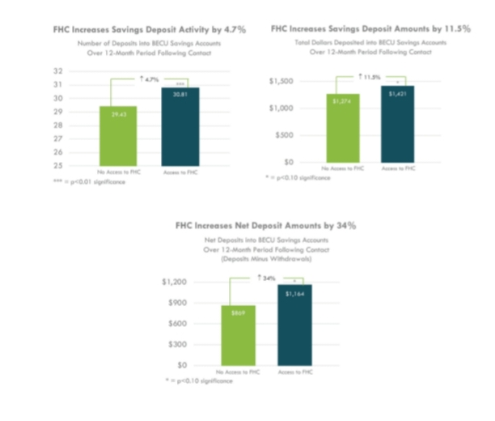

Slide 24
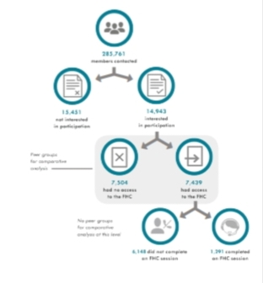

Slide 25
In order to measure the impact of the FHC on member financial resilience, we deployed this pilot through a randomized controlled trial (RCT). Members who demonstrated interest in the FHC were randomly divided into treatment and control groups with only the treatment group receiving access to the service. Comparing these two groups allows us to evaluate the impact of the FHC, rather than simply measure the financial outcomes of motivated members who volunteer for support. Highlights of the RCT set-up are below, with details available in the technical appendix.
We reached out to BECU members by email to let them know that BECU was considering a new service offering and asking if they would be interested in one-on-one help for financial goals.
We focused on the members who responded with positive interest in the new service. Of this group, half were randomly invited to participate in the pilot phase of the FHC, and half were simply invited to stay tuned for a potential rollout of the service.
We conducted sessions from August 2015 - May 2016 and tracked financial outcomes monthly from July 2015 to June 2017.

Slide 26
Technical Appendix
Intervention Details:
The FHC is a modified financial coaching session delivered over the phone by a trained BECU employee (“FHC Consultant”). The one-time, 30-60 minute appointment focuses on helping members of the credit union build liquid savings and reduce high-interest credit card debt.
Participants were randomized into treatment and control groups after expressing interest in one-on-one support for achieving financial goals. Only those in the treatment group had access to the FHC service. Members who signed up for an appointment received a budget worksheet to complete in advance of the call (see below). The budget worksheet helps members estimate monthly income, expenses, and savings and auto-calculates totals. It prompts members to consider regular, variable, and “one-off” expenses like gifts, repairs, and annual travel as well as monthly loan repayments and total debt amounts.
At the scheduled appointment time, an FHC consultant called the member, verified his/her identity, and conducted the FHC using an Excel-based tool called the FHC Navigator to capture data. The Navigator includes talking points and key questions to guide the conversation. During sessions, FHC Consultants also had access to systems that allowed them to view member accounts and mirror online banking sessions. Main sections of the FHC include:

Slide 27
Financial goals.
High interest and/or priority debts.
Savings habits and balances.
Budgets, using numbers prepared in advance by members.
Setting up automatic debt payments and / or savings transfers.
Setting up tailored alerts.
Planning for next steps, if needed.
Technical support specialists were available to join the call if needed, and referrals to other departments such as mortgage and investment services were made upon request. Consultants would either transfer members to other departments at the end of the call, or file requests for staff in other departments to reach out to members directly.
Members received follow-up emails thanking them for their participation and reviewing call topics at a high level. If applicable, notes on next steps were also shared.

Slide 28
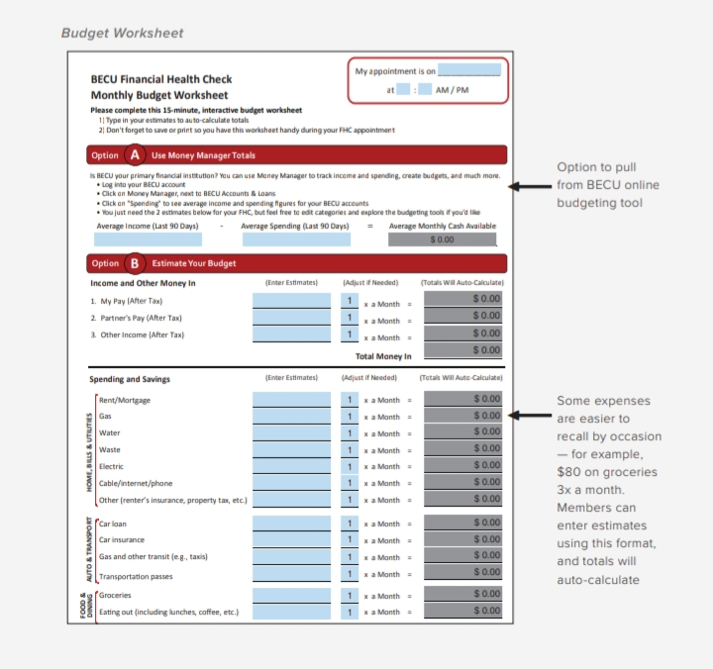

Slide 29
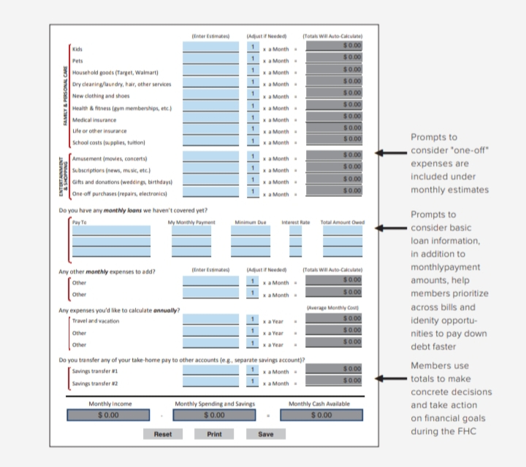

Slide 30
Eligibility:
BECU compiled a list of 560,161 members, excluding those with any of the following statuses as of May 26, 2015.
Business account holders, or members who hold small business/commercial accounts but not their own individual BECU accounts.
Secondary account holders, or members who are listed on a joint account but do not hold their own BECU accounts.
Members who hold only an auto-loan generated through a dealership partner.
Account holders under 18 years of age.
Ward of the State.
Power of Attorney on file.
Deceased accounts.
Accounts flagged for ID theft.
Members who have opted out of email communications (our primary recruitment channel).
Members (including all household members) who participated in our May and June user-testing sessions.
Members (including all household members) with locked or suspended accounts.
Members (including all household members) with delinquent accounts.
Members (including all household members) involved in bankruptcy proceedings.

Slide 31
We then analyzed income data and FICO scores for the remaining members and excluded the additional groups listed below. These exclusions target highly affluent individuals and individuals in financial distress, as we believe these members are the least likely to benefit from a Financial Health Check.
Members of households whose total deposits summed by household were less than $0 (3,077 members excluded).
Members of households whose maximum household FICO score was less than 300 (3,899 members excluded).
Members of households in the top decile of total deposits summed by household (more than $47,410 in total deposits) AND in the top four deciles of maximum household FICO (scores greater than 778) (45,192 members excluded).
Randomization, Recruitment and Communications:
Recruitment efforts started on July 31, 2015. We reached out to eligible participants by email, asking them to indicate interest in an FHC session. Because of technical constraints, we were unable to randomize respondents into treatment and control groups at the point they revealed their interest in the FHC. We therefore randomly pre-assigned all eligible members to either the treatment or control condition.

Slide 32
Assigning treatment and control eligibility:
We randomized our sample at the household level, and stratified on the following dimensions:
Income (mean of all incomes in household).
FICO score (highest score among household members).
We then performed balance checks to confirm that the two groups were balanced on these characteristics (see Table 1 in the “Data Collection and Analysis” section below).
Assigning batches and sub-batches:
Because of constraints on consultant capacity, we needed to divide eligible participants into “batches” and recruit participants in waves. This was accomplished by randomly assigning participants to one of ten batches, again stratifying by mean household income and maximum household FICO score. We performed balance checks to confirm that the batches were balanced. Finally, because call center capacity was lower than originally anticipated, each batch was broken down further into four sub batches, which were randomly assigned.
Changes to contact order:
By early December, we had contacted and served members from the first four batches. In early December, we adjusted our batch ordering to prioritize low and middle income families for participation in the FHC. Instead of emailing each batch according to the original sort order, we selected households making less than $50,800 a year1 within the current batch (batch 5) and the three following batches (batches 6-8) and pulled them to the “front of the line” for receiving recruitment emails. When the LMI populations in batches 5-8 had been contacted, we repeated the LMI prioritization process for batches 9 and 10. An illustration of this process change is included below. Once we had contacted all individuals with incomes below $50,800, we then went back and emailed all those with incomes between $50,800 and $80,000.

Slide 33
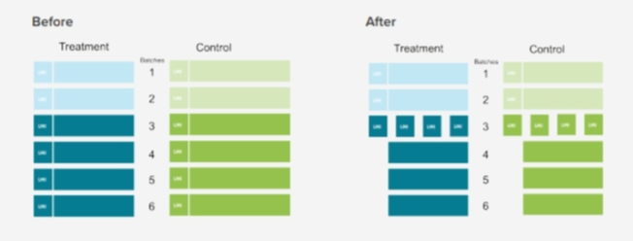

Slide 34
Recruitment email content:
Treatment- and control-eligible individuals received an identical recruitment email letting them know that BECU was considering a new service which would provide members with one-on-one help for financial goals. The email asked members to indicate interest in such a service (see below).
Members who clicked “Yes, I’m interested in this service” were directed either to:
Control-eligible: a web page soliciting additional preferences for this hypothetical service. We had no further contact with the control group after completion of this survey.
Treatment-eligible: a web page describing the opportunity to participate in a limited pilot offering of this service. Those who opted into the FHC at this point received the intervention detailed above.
Members who responded “No, I’m not interested in this service” were directed to a “Thank You” page. We had no further contact with this group.
Those members who did not click either “Yes” or “No” received one follow-up email with identical content about the FHC, but with a different subject line (“Want to know if you’re financially healthy?”).
After both initial and follow-up emails were sent out, we divided individuals into treatment and control groups for data collection. Individuals were assigned to the treatment group if they were treatment eligible and clicked “yes, interested” in the original or follow-up recruitment email. Individuals were assigned to the control group if they were control-eligible and clicked “yes, interested.”

Slide 35
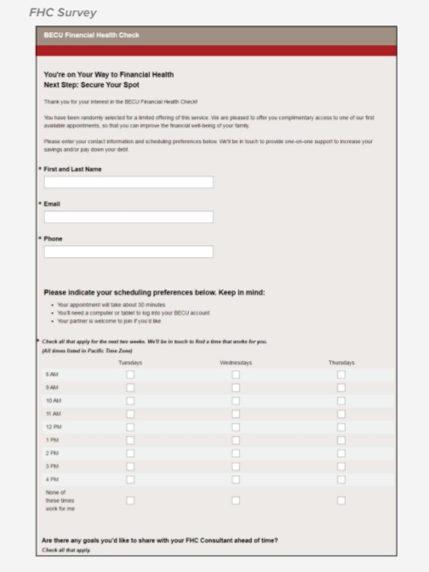

Slide 36
Changes to emails and additional outreach:
One month into the pilot roll-out, we changed the subject line of the initial email to increase open rates. The original subject line, “Your financial goals: Get one-on-one help from BECU,” was changed to “Please help us decide an important matter.”
About two months into the roll-out, we added a third choice option (“Yes, but at a later time”) to both the initial email and the follow-up email (see email below as an example). Both “Yes, definitely” and “Yes, at a later time” directed participants to a web page offering access to the FHC service.

Slide 37
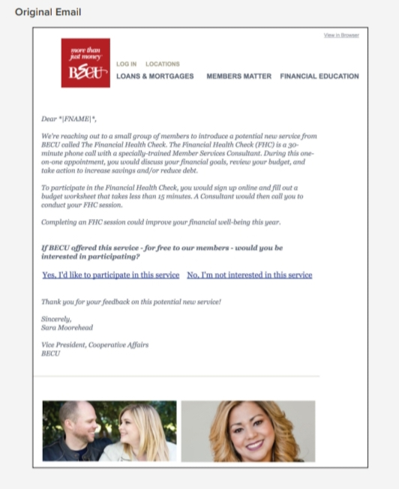

Slide 38
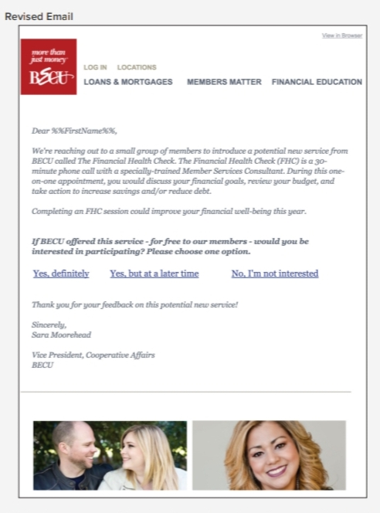
In addition to sending recruitment emails, we began following up via phone in January with those members who had indicated interest (i.e., clicked on “Yes, definitely” or “Yes, at a later time”) but had not followed through on taking up the service.

Slide 39
Scheduling Appointments:
Because we launched the FHC as a pilot, we scheduled calls manually instead of creating a dedicated platform. Treatment-eligible members who were interested in the FHC were directed to a web page inviting them to participate in a limited pilot offering. On this page, members were asked to indicate their scheduling preferences (see below). 3,559 members completed this step. A BECU employee then matched members to available appointments according to their preferences and sent personalized emails with confirmed appointment times. Members had the option of replying to messages by phone or email to request changes. If members did not reply, consultants assumed they would attend their sessions as assigned.
About 12% of surveys were returned with the response, “None of these times work for me.” To serve this group, BECU extended call hours to 7:00 am – 8:00 pm and offered a limited number of Saturday morning appointments. However, these members sometimes had to wait 3-5 weeks for an evening or weekend appointment.
By the end of the experimental period (May 2016), we conducted 1,291 Financial Health Check sessions, with a no-show rate of 64%. See figure below for more information on the number of individuals contacted and scheduled for FHC sessions.

Slide 40
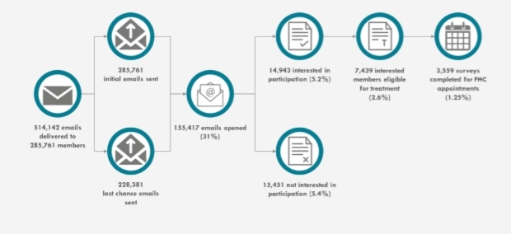

Slide 41
Data collection and analysis:
We collected monthly data for treatment and control groups, starting the month they indicated interest in participation.
Our primary outcomes are:
Changes in month-end savings balances.
Credit score.
Our secondary outcomes are:
Changes in savings account transaction frequency.
Changes in the size of savings account transactions.
Changes in month-end debt balances.
Changes in debt account transaction frequency.
Changes in the size of debt account transactions.

Slide 42
Methodology:
We used ordinary least squares regression in Stata to estimate the effects of the Financial Health Check on each of the outcome variables. Regressions were run to test effects at 3, 6, 9, and 12 months after being contacted via email about interest in the FHC, as the closest possible proxy for “months after treatment.” Treatment participants who ended up completing a session did so on average 1.02 months after contact, with 93% of completers doing so within the two months after contact. If a participant was missing data for a specific month-since-contacted, data from the adjacent month was included in order to minimize attrition due to missing data. Control variables included baseline estimated income and baseline FICO (both used for stratification) as well as the baseline of the outcome variables.
The following tables include:
Balance table showing baseline values for treatment and control groups.
Selection effects table showing differences in baseline values for groups assigned to treatment, receiving treatment, and electing to set up automatic savings transaction.
Descriptive statistics of all outcome variables after 12 months since contact.
Intention-to-treat results for all outcome variables at 3, 6, 9, and 12 months after contact.
Treatment-on-the-treated results that estimate effects on the full treatment group if all had received treatment, using assignment to treatment as the instrument in an instrumental variables regression.

Slide 43
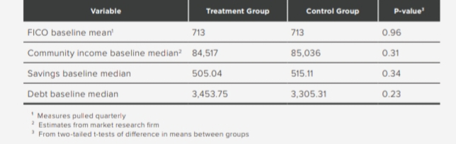
Measures pulled quarterly.
Estimates from market research firm.
From two-tailed t-tests of difference in means between groups.

Slide 44
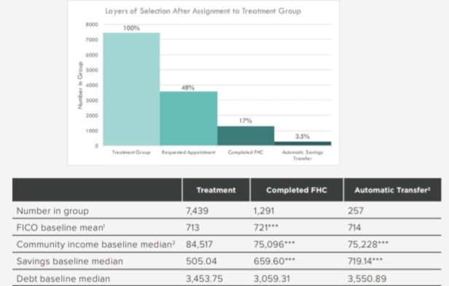
Statistically significantly different from rest of treatment group at p<0.01 threshold, based on two-sample t-test.
Measures pulled quarterly.
Estimates from market research him.
This group is not statistically significantly different from rest of FHC-completers on any of the listed baseline measures.

Slide 45
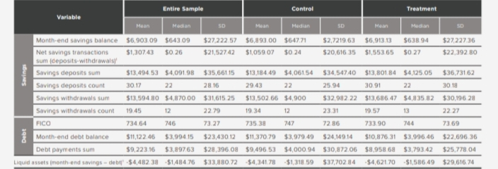
Extreme values (top and bottom 1% of observations) win sorized (censored to the 1st and 99th percentile values) due to high variance.

Slide 46
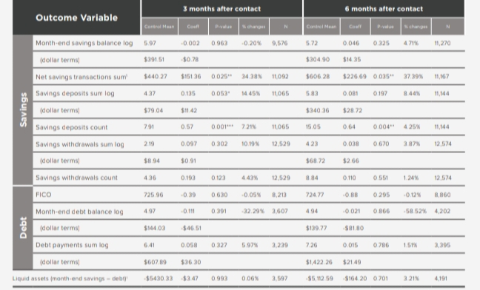
* = p<0.10 significance; ** = p<0.05 significance; *** = p<0.01 significance.
Extreme values (top and bottom 1% of observations)win sorized (censored to the 1st and 99th percentile values) due to high variance.

Slide 47
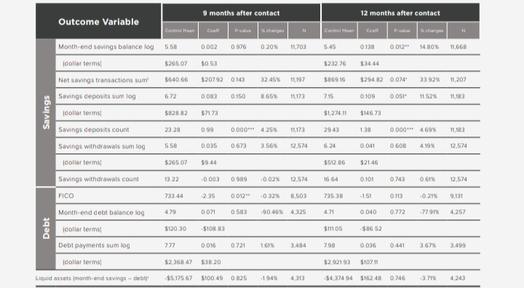
* = p<0.10 significance; ** = p<0.05 significance; *** = p<0.01 significance.
Extreme values (top and bottom 1% of observations) win sorized (censored to the 1st and 99th percentile values) due to high variance.

Slide 48
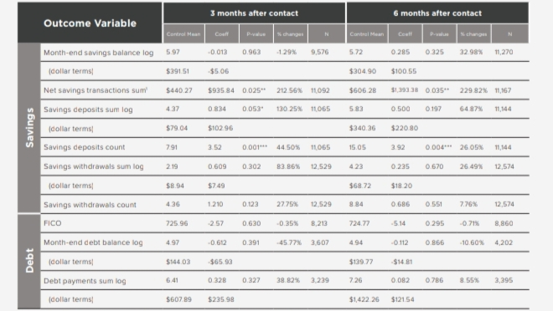
* = p<0.10 significance; ** =p<0.05 significance; *** = p<0.01 significance.
Extreme values (top and bottom 1% of observations) win sorized (censored to the 1st and 99th percentile values) due to variance.

Slide 49
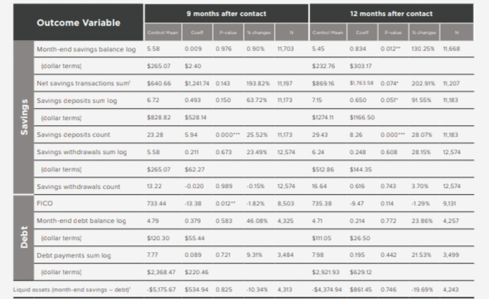
* = p<0.10 significance; ** = p<0.05 significance; *** = p<0.01 significance.
Extreme values (top and bottom 1% of observations) win sorized (censored to the 1st and 99th percentile values) die to variance.

Slide 50


